Slide 1
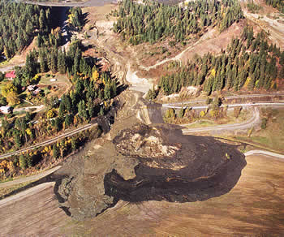
30 Years of Challenging
Highway Construction in
North Idaho
Wm. Capaul, P.G
Senior Geologist
American Geotechnics (ITD Retired)

Slide 2
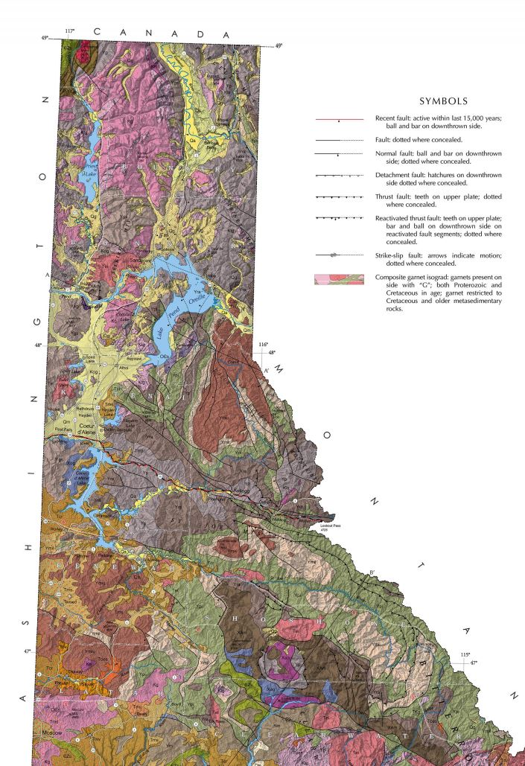

Slide 3
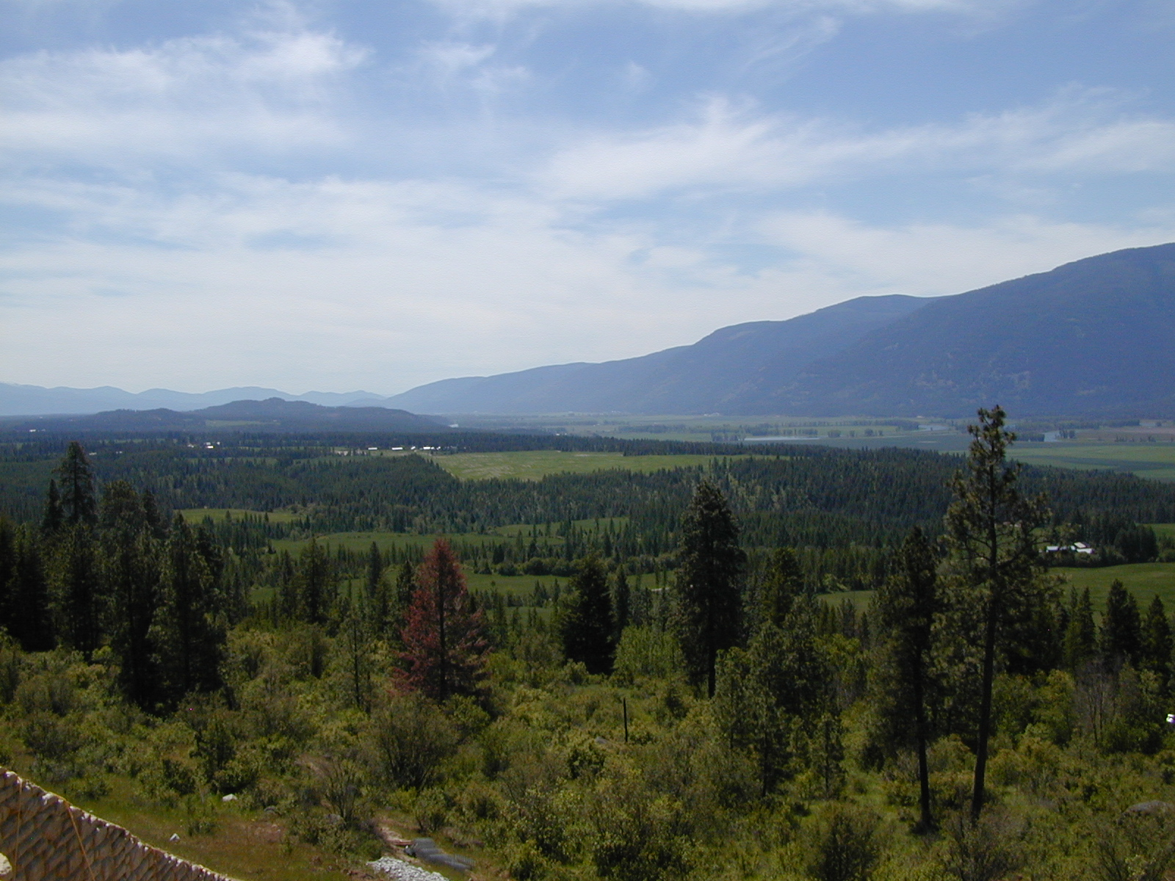
MOUNTAINOUS TERRANE WITH DEEP VALLEY FILLS

Slide 4
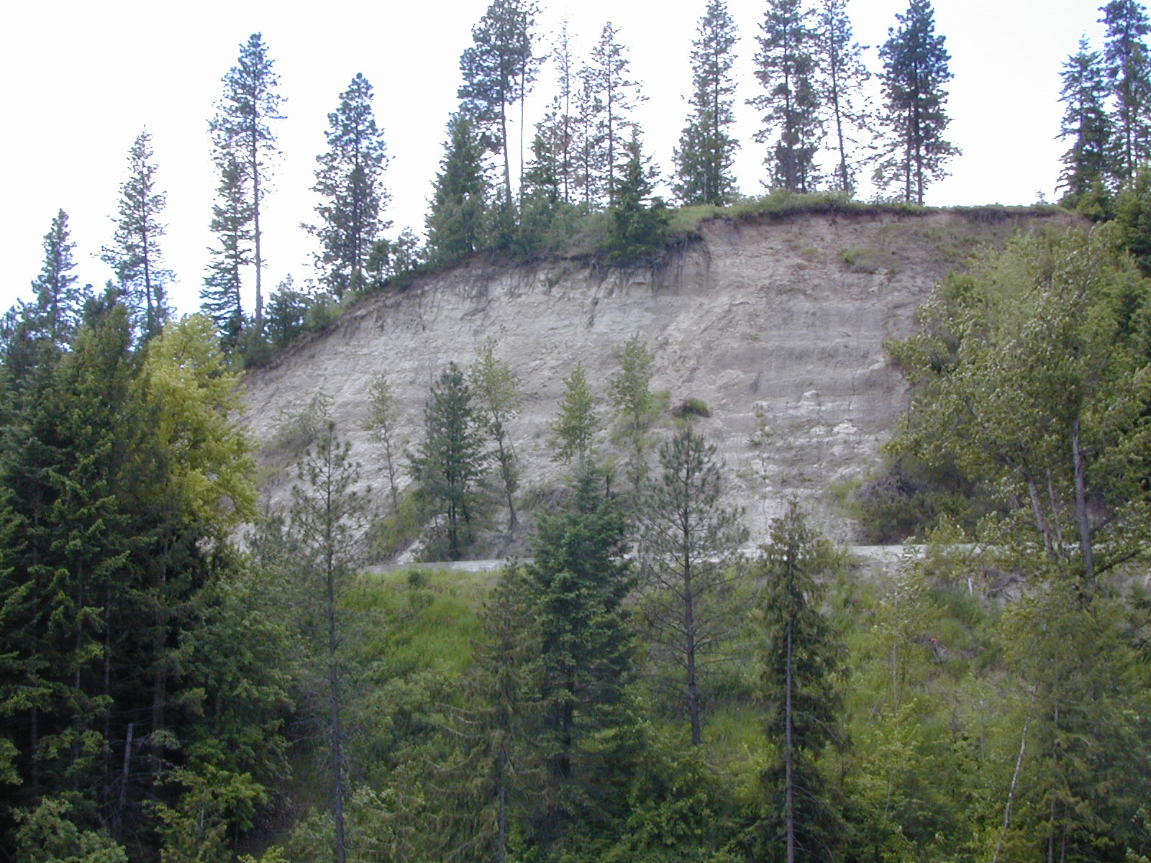
THICK GLACIAL LACUSTRINE DEPOSITS

Slide 5
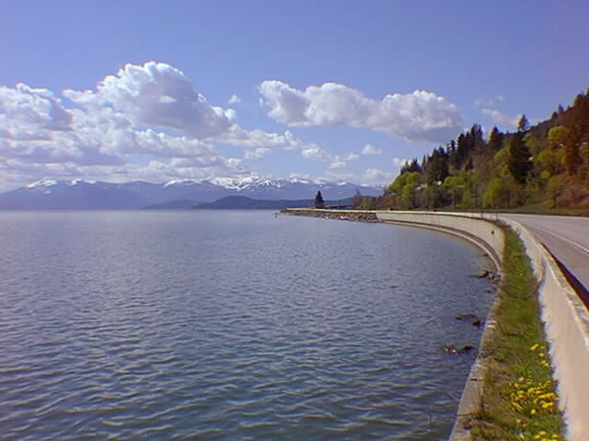
LOTS OF LAKES

Slide 6
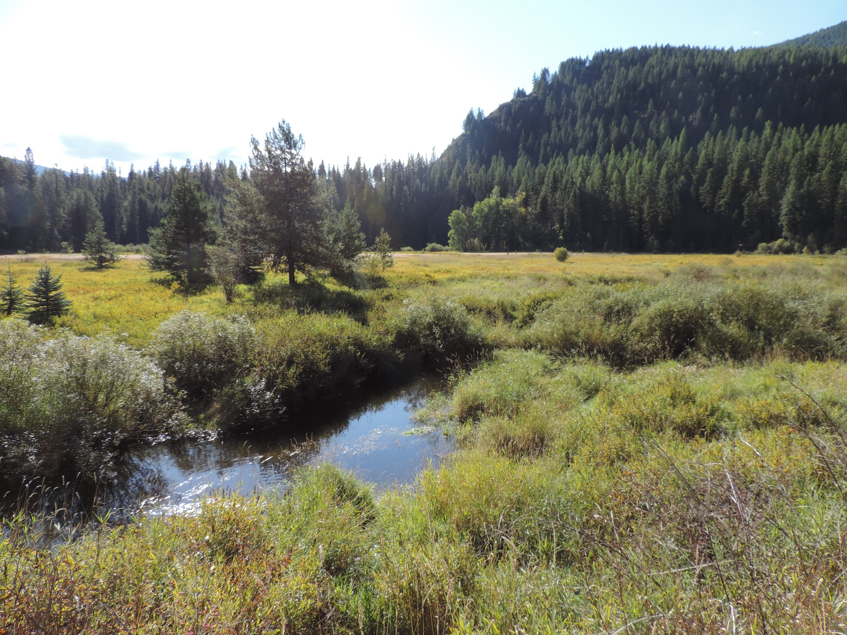
THICK ORGANIC DEPOSITS

Slide 7
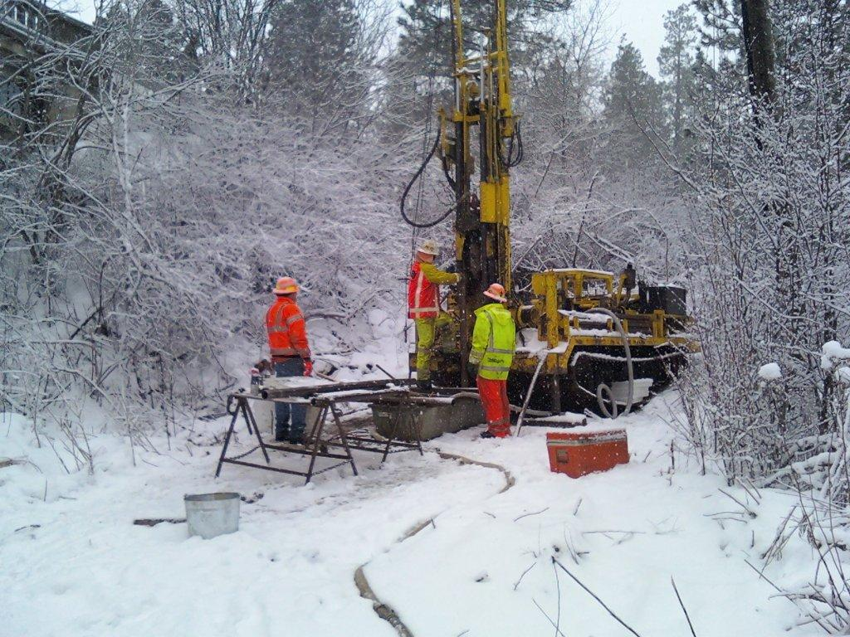
CHALLENGING DRILLING CONDITIONS

Slide 8
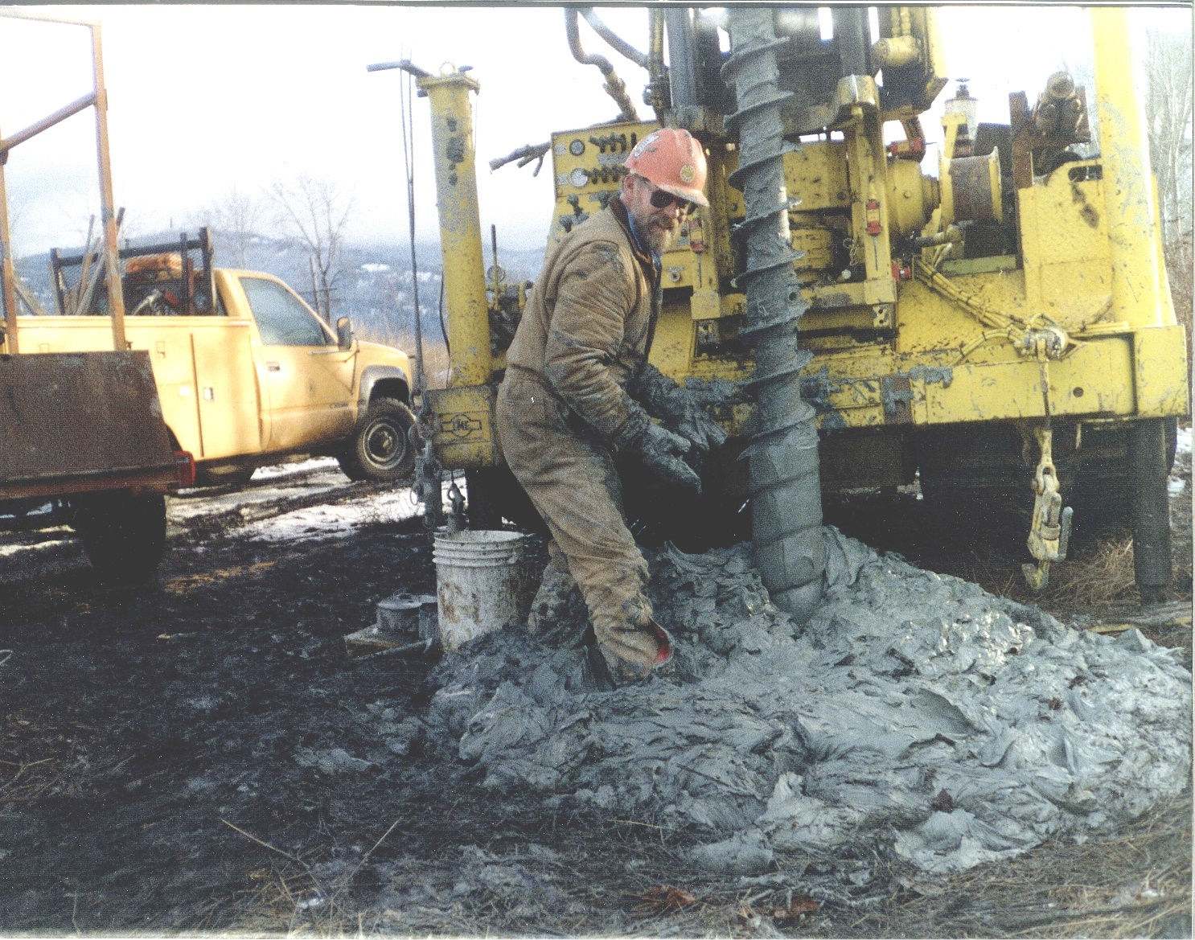
Bottomless Lakebed Deposits

Slide 9
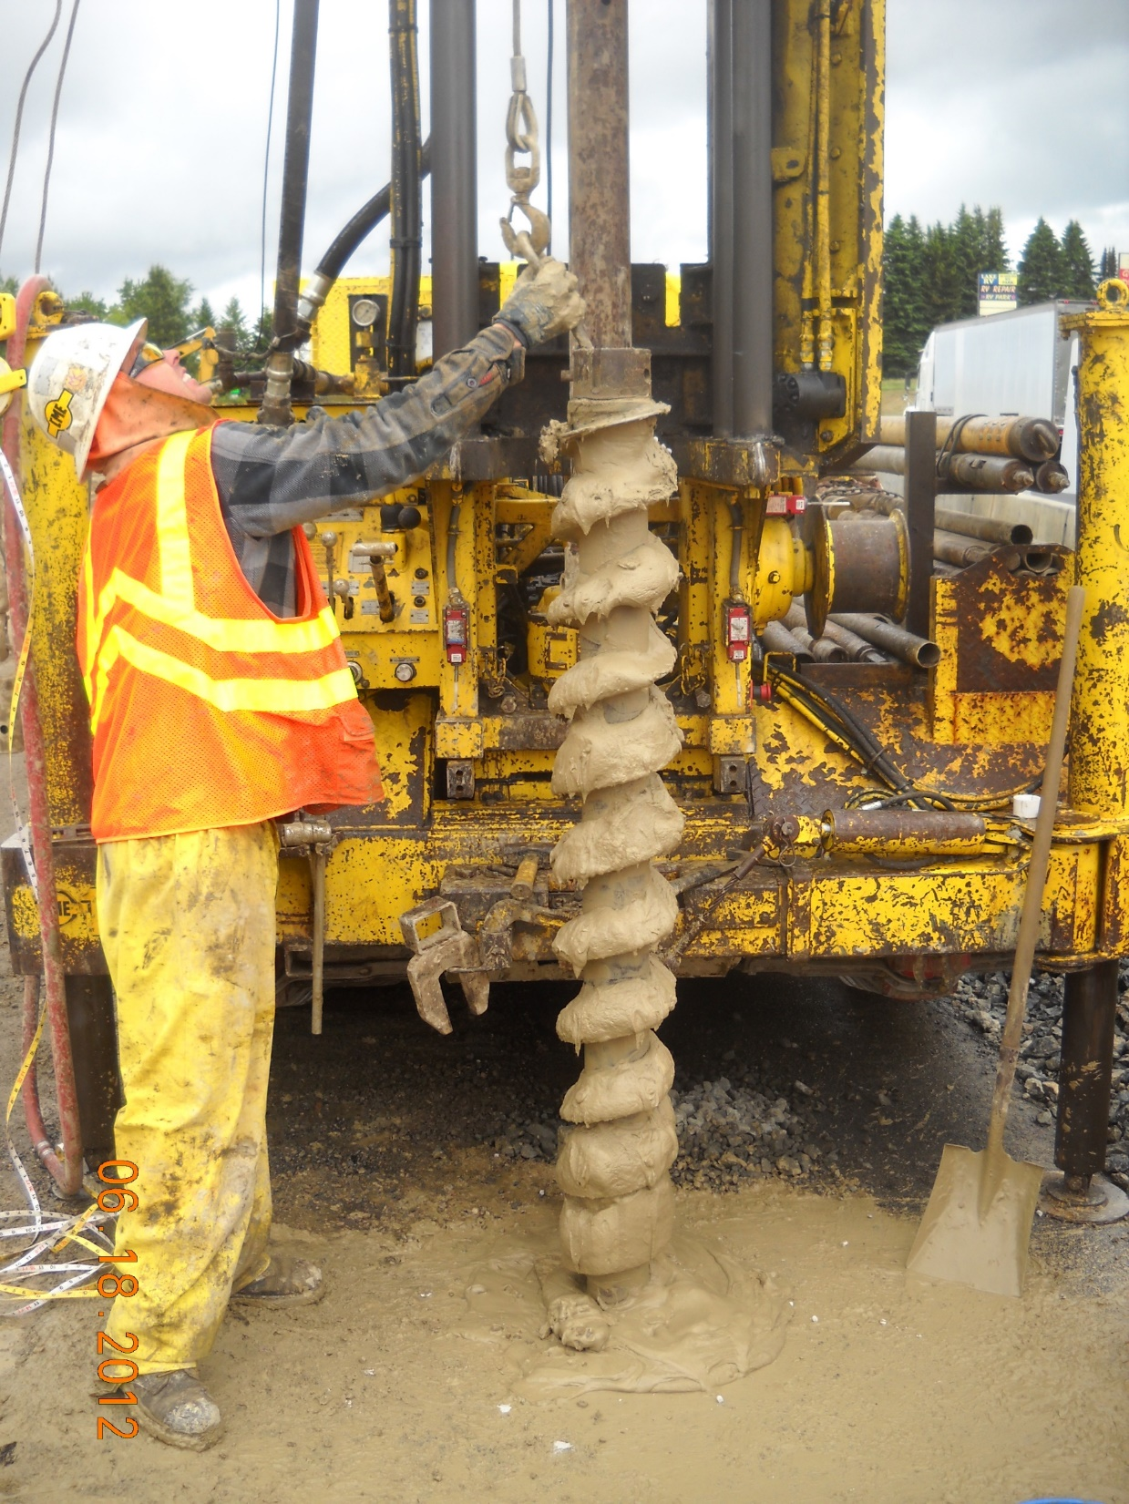
SLIGHTLY OVER OPTIMUM SOILS

Slide 10
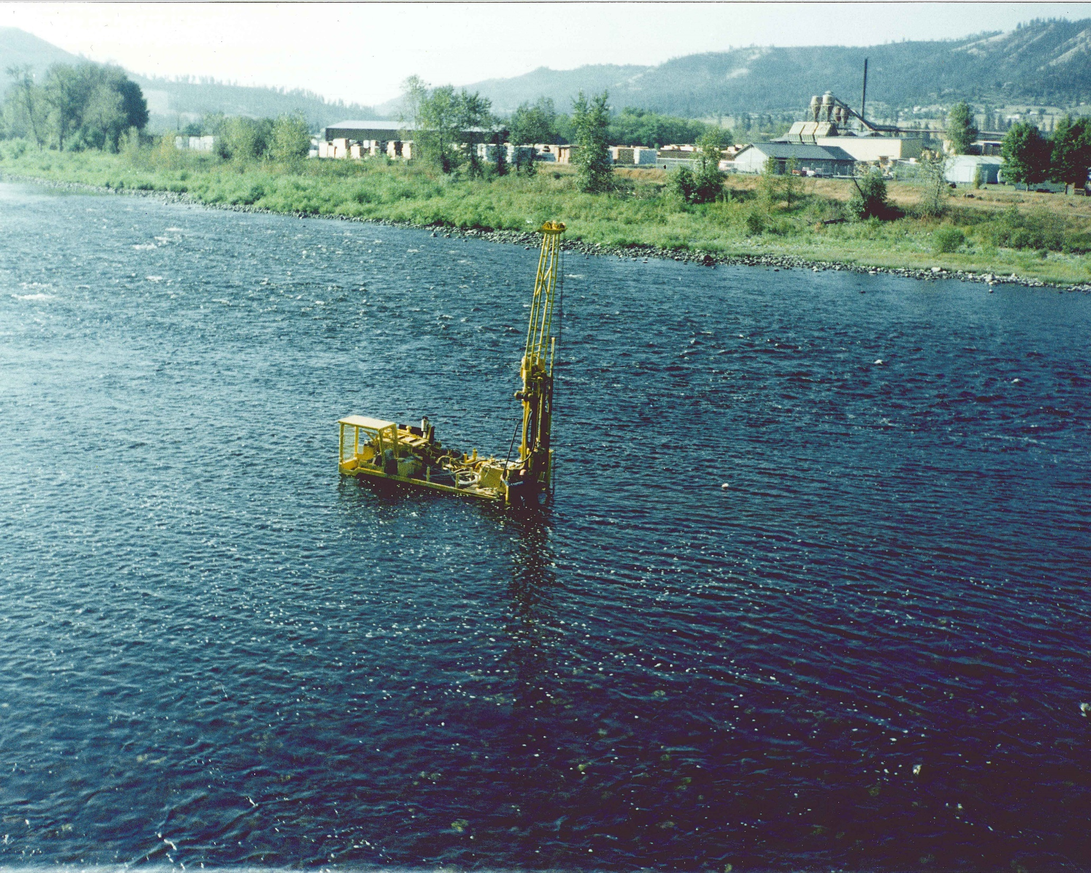
CLEARWATER RIVER – KAMIAH BRIDGE

Slide 11
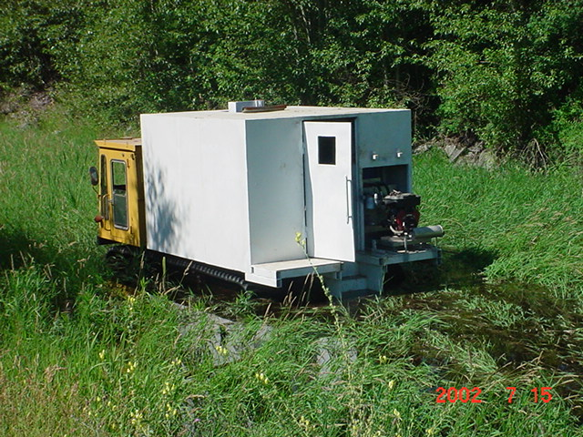
ELECTRONIC CONE PENETROMETER

Slide 12
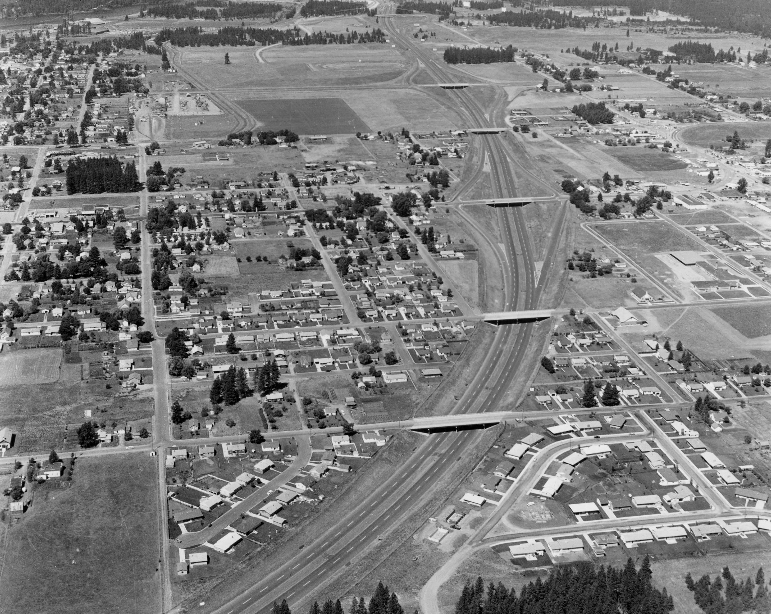
I-90 thru Cd’A – Early 1960’s

Slide 13
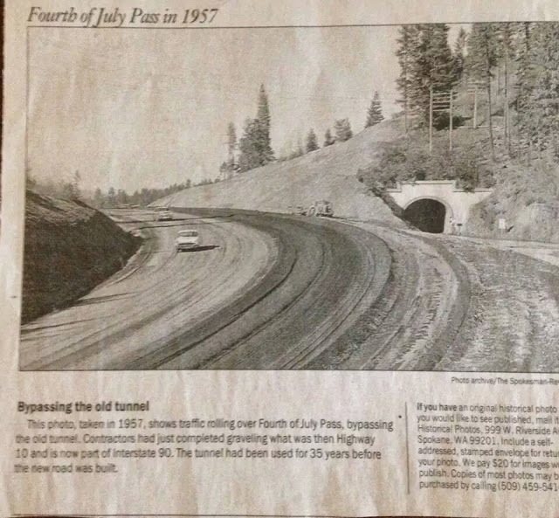

Slide 14
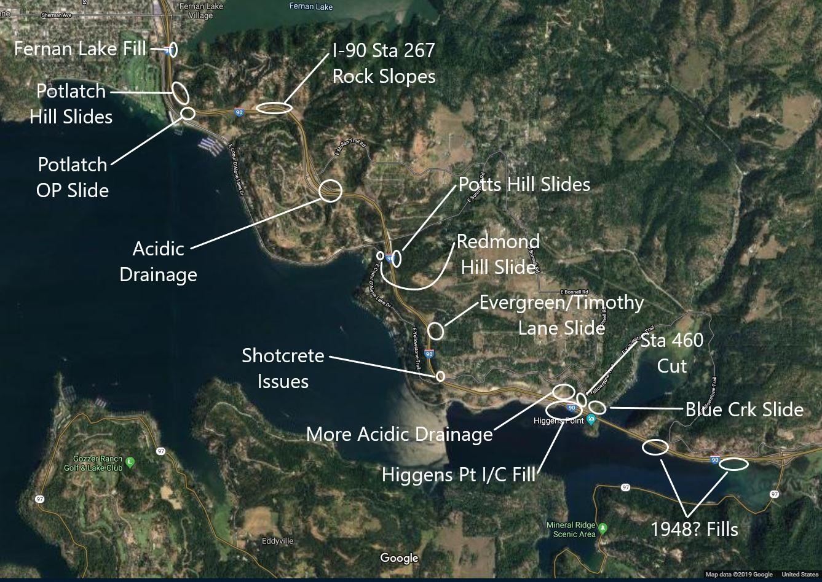

Slide 15
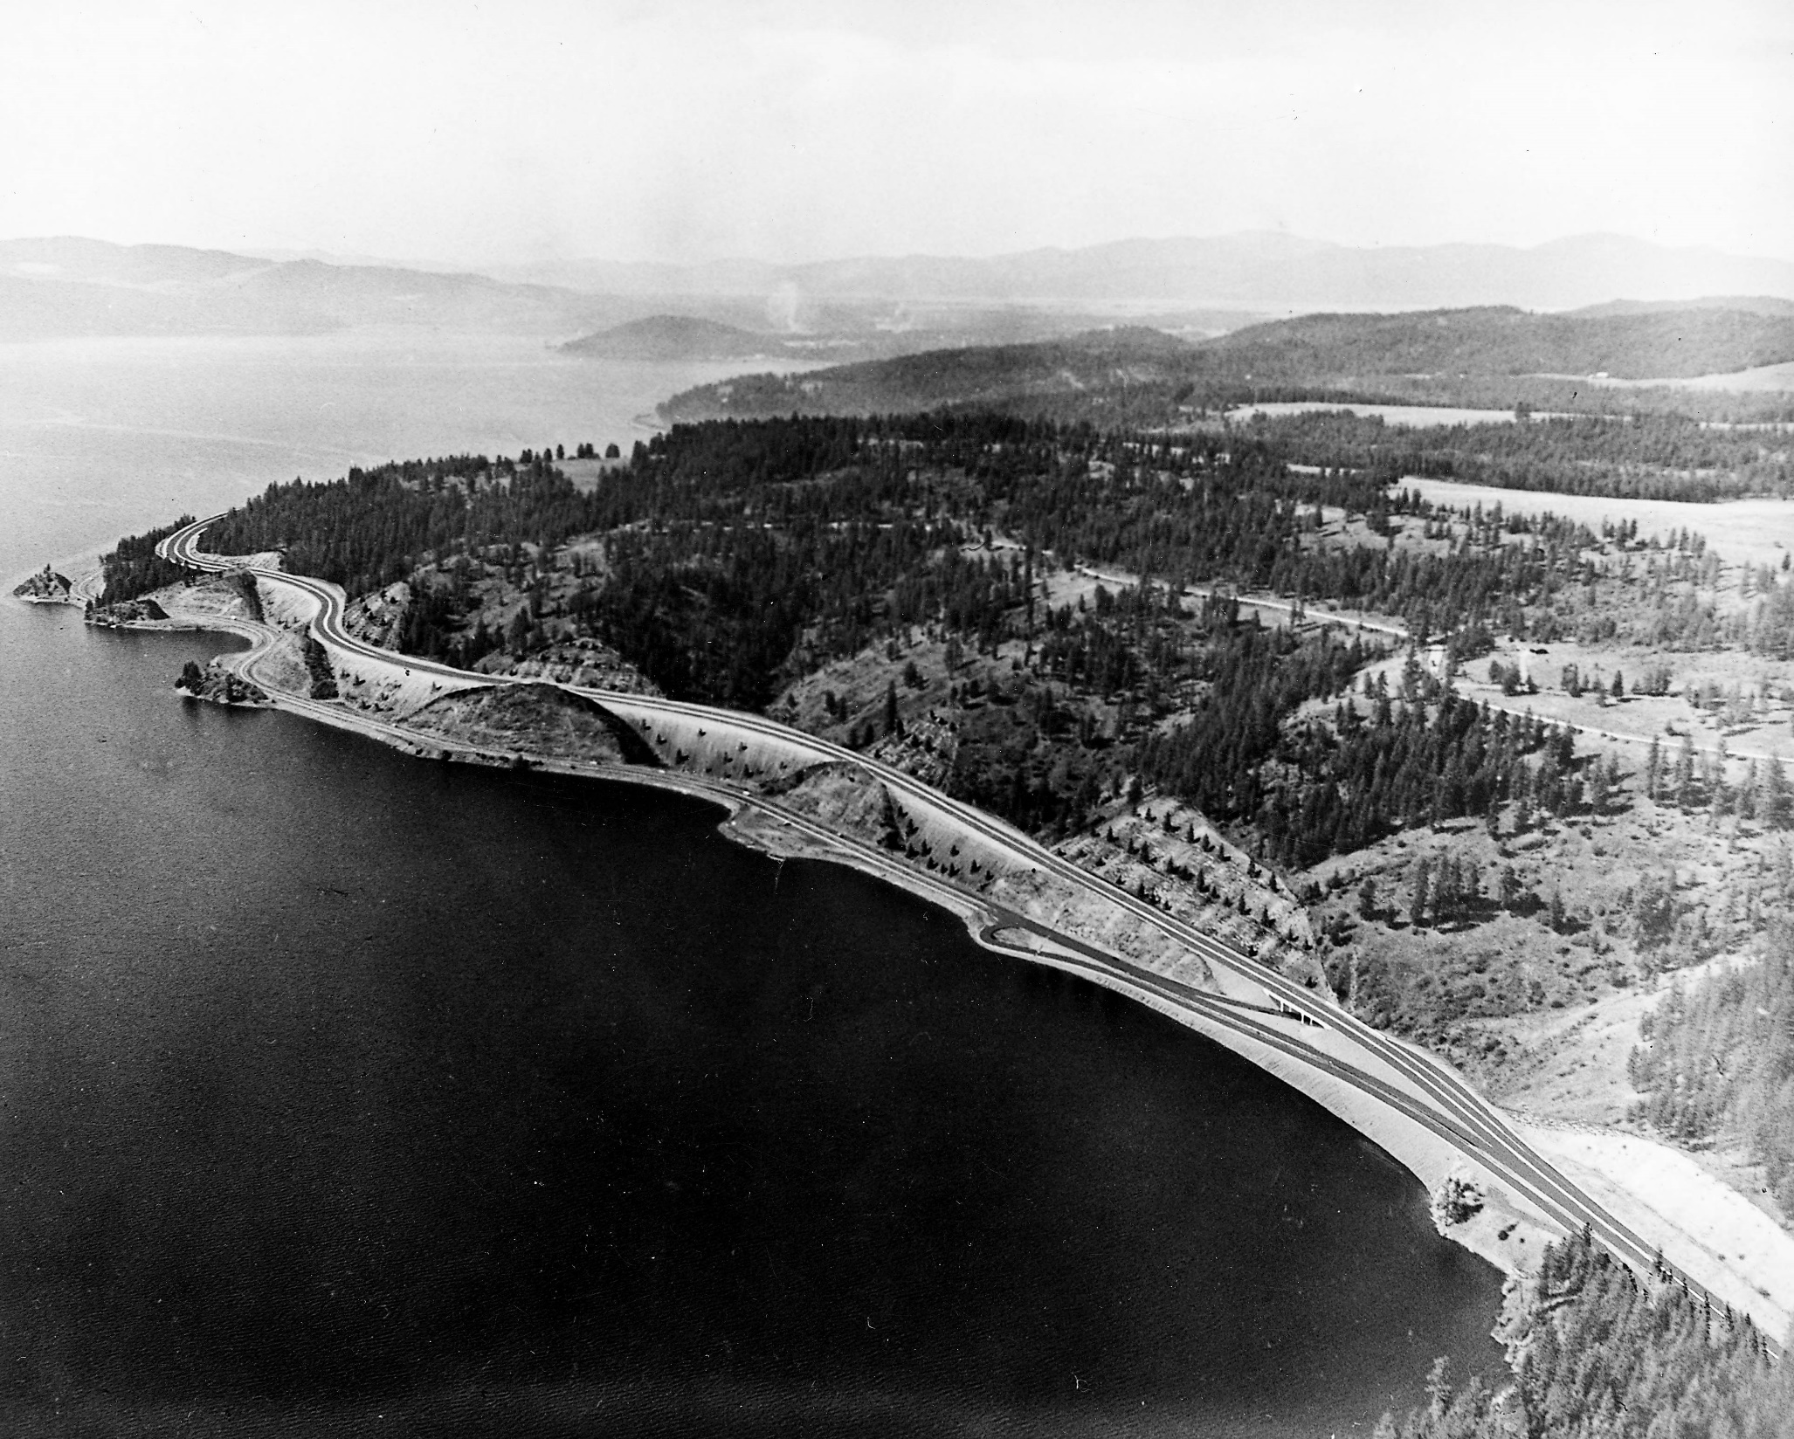

Slide 16
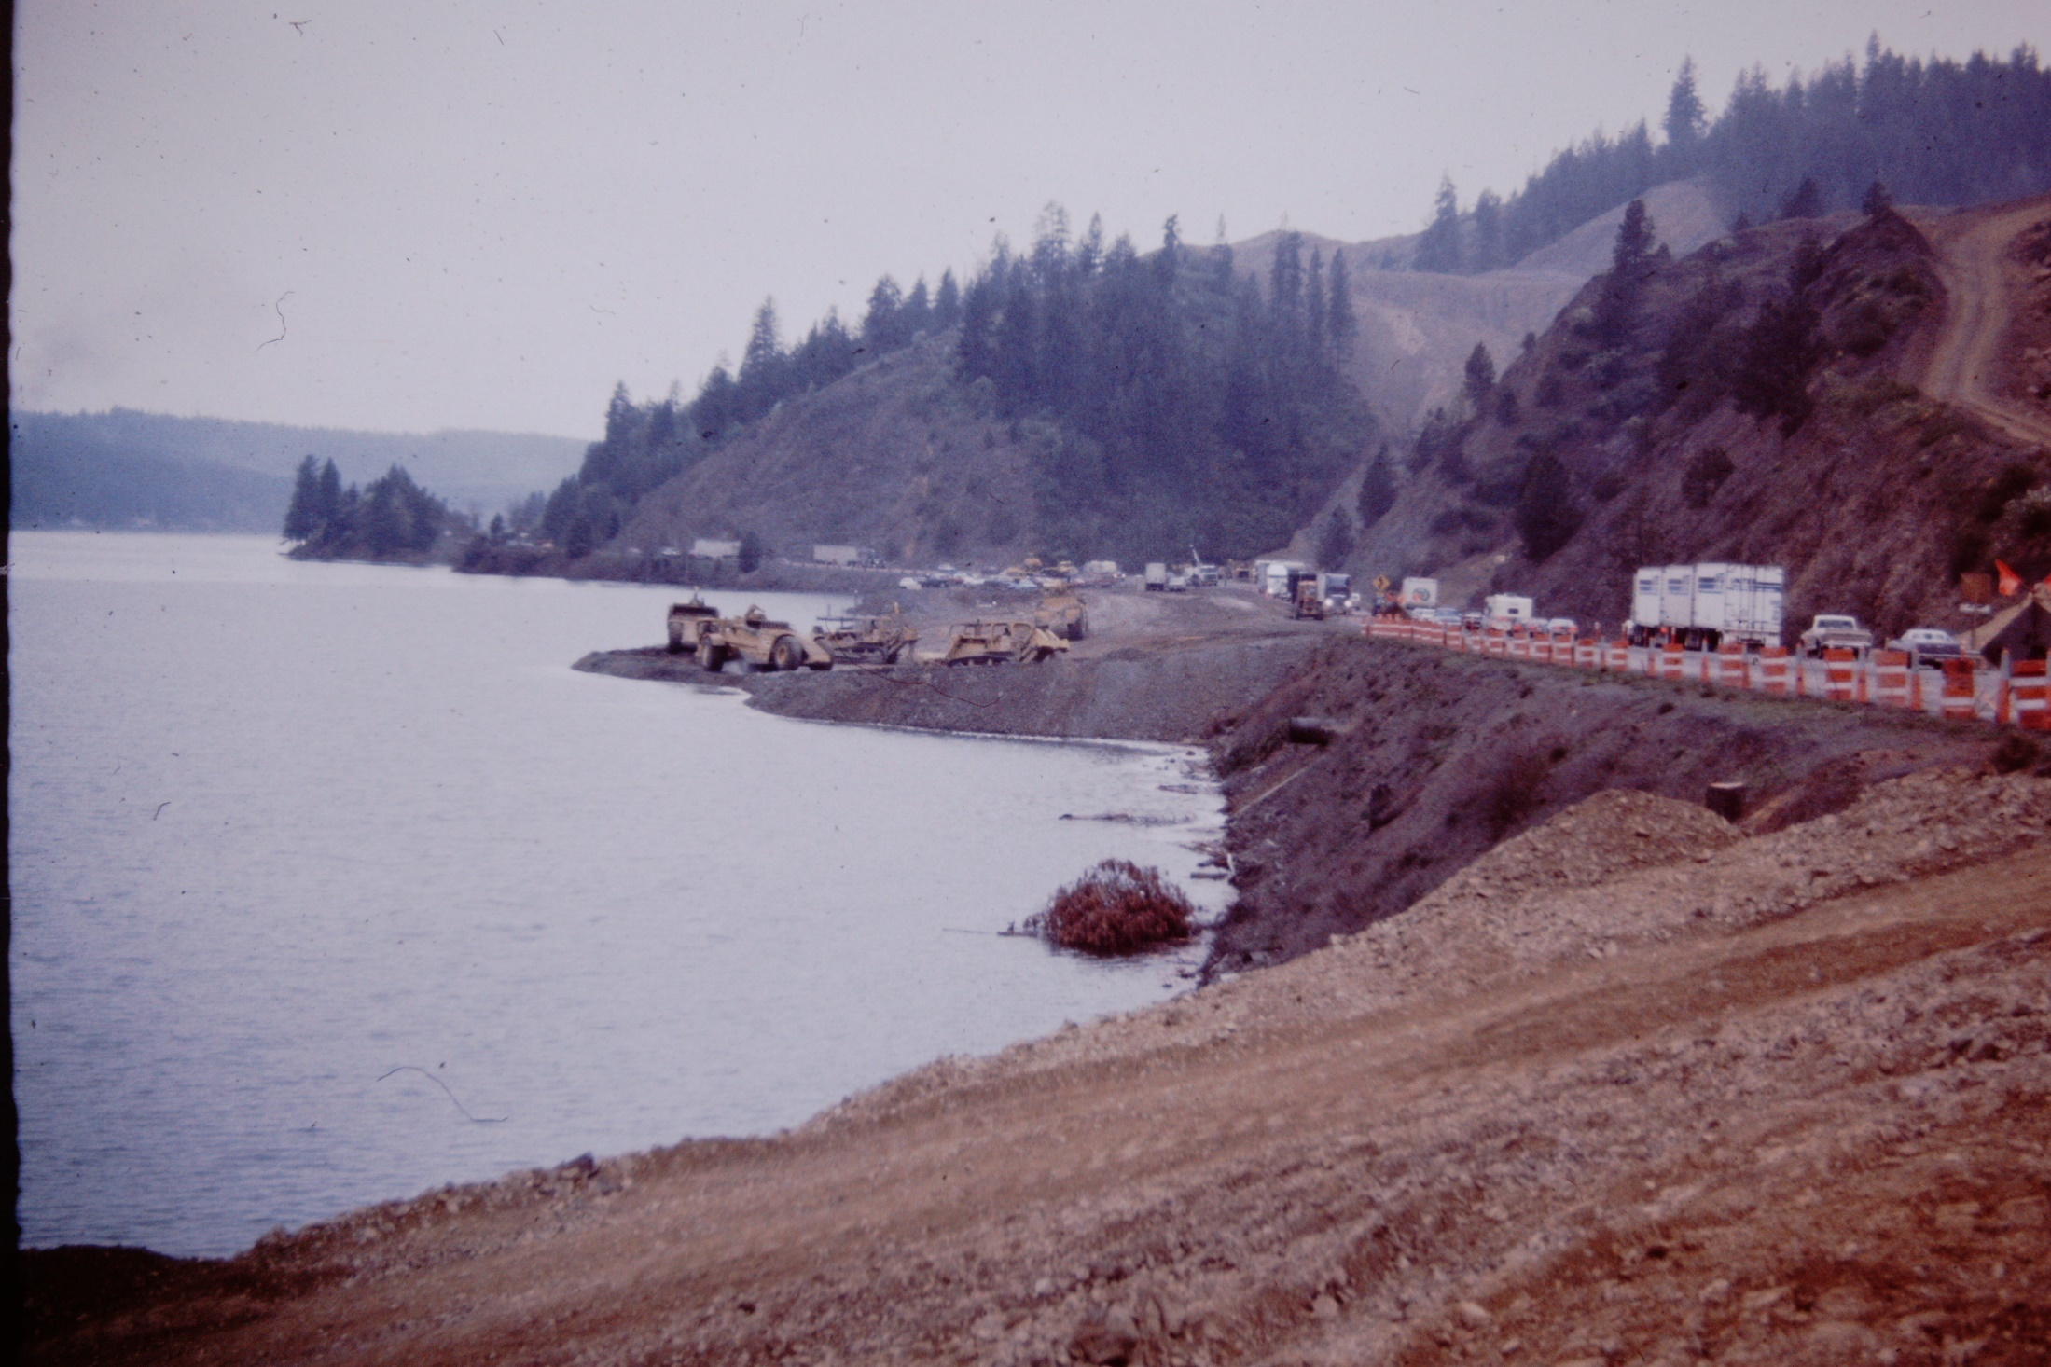
HIGGENS POINT I/C CONSTRUCTION

Slide 17
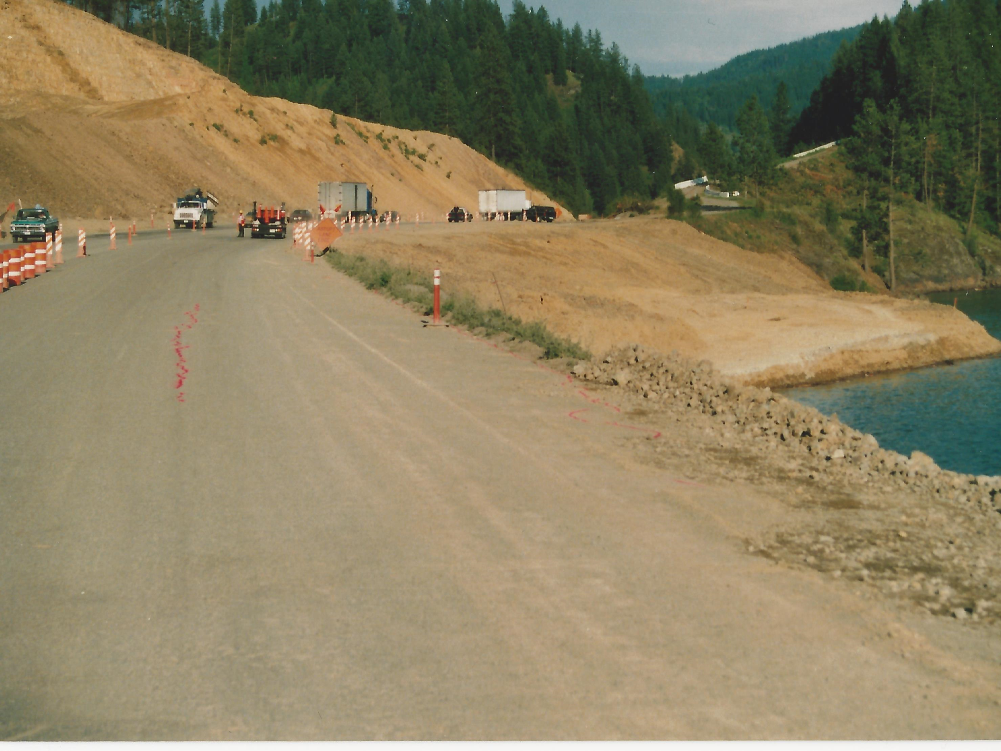
CRACKING – A WARNING OF THINGS TO COME

Slide 18
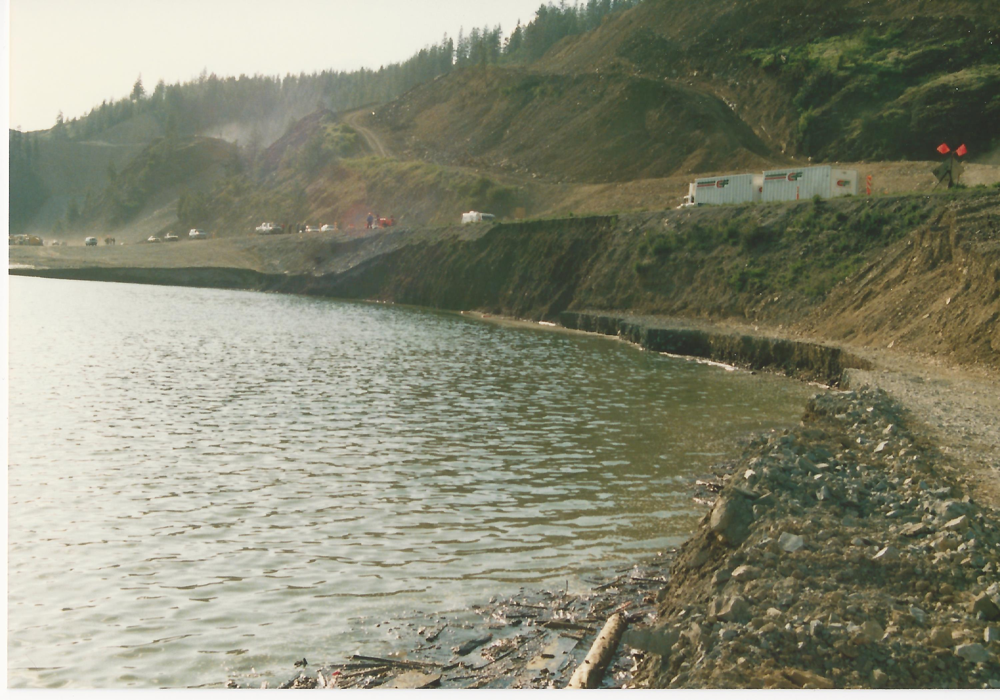
FIRST FOUNDATION FAILURE

Slide 19
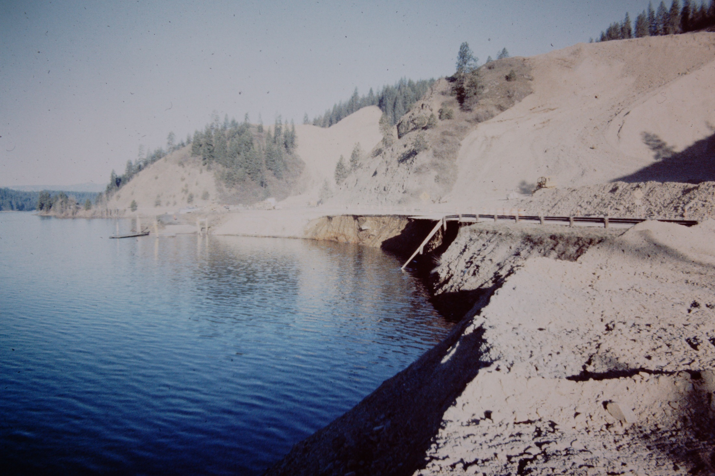
SECOND FAILURE

Slide 20
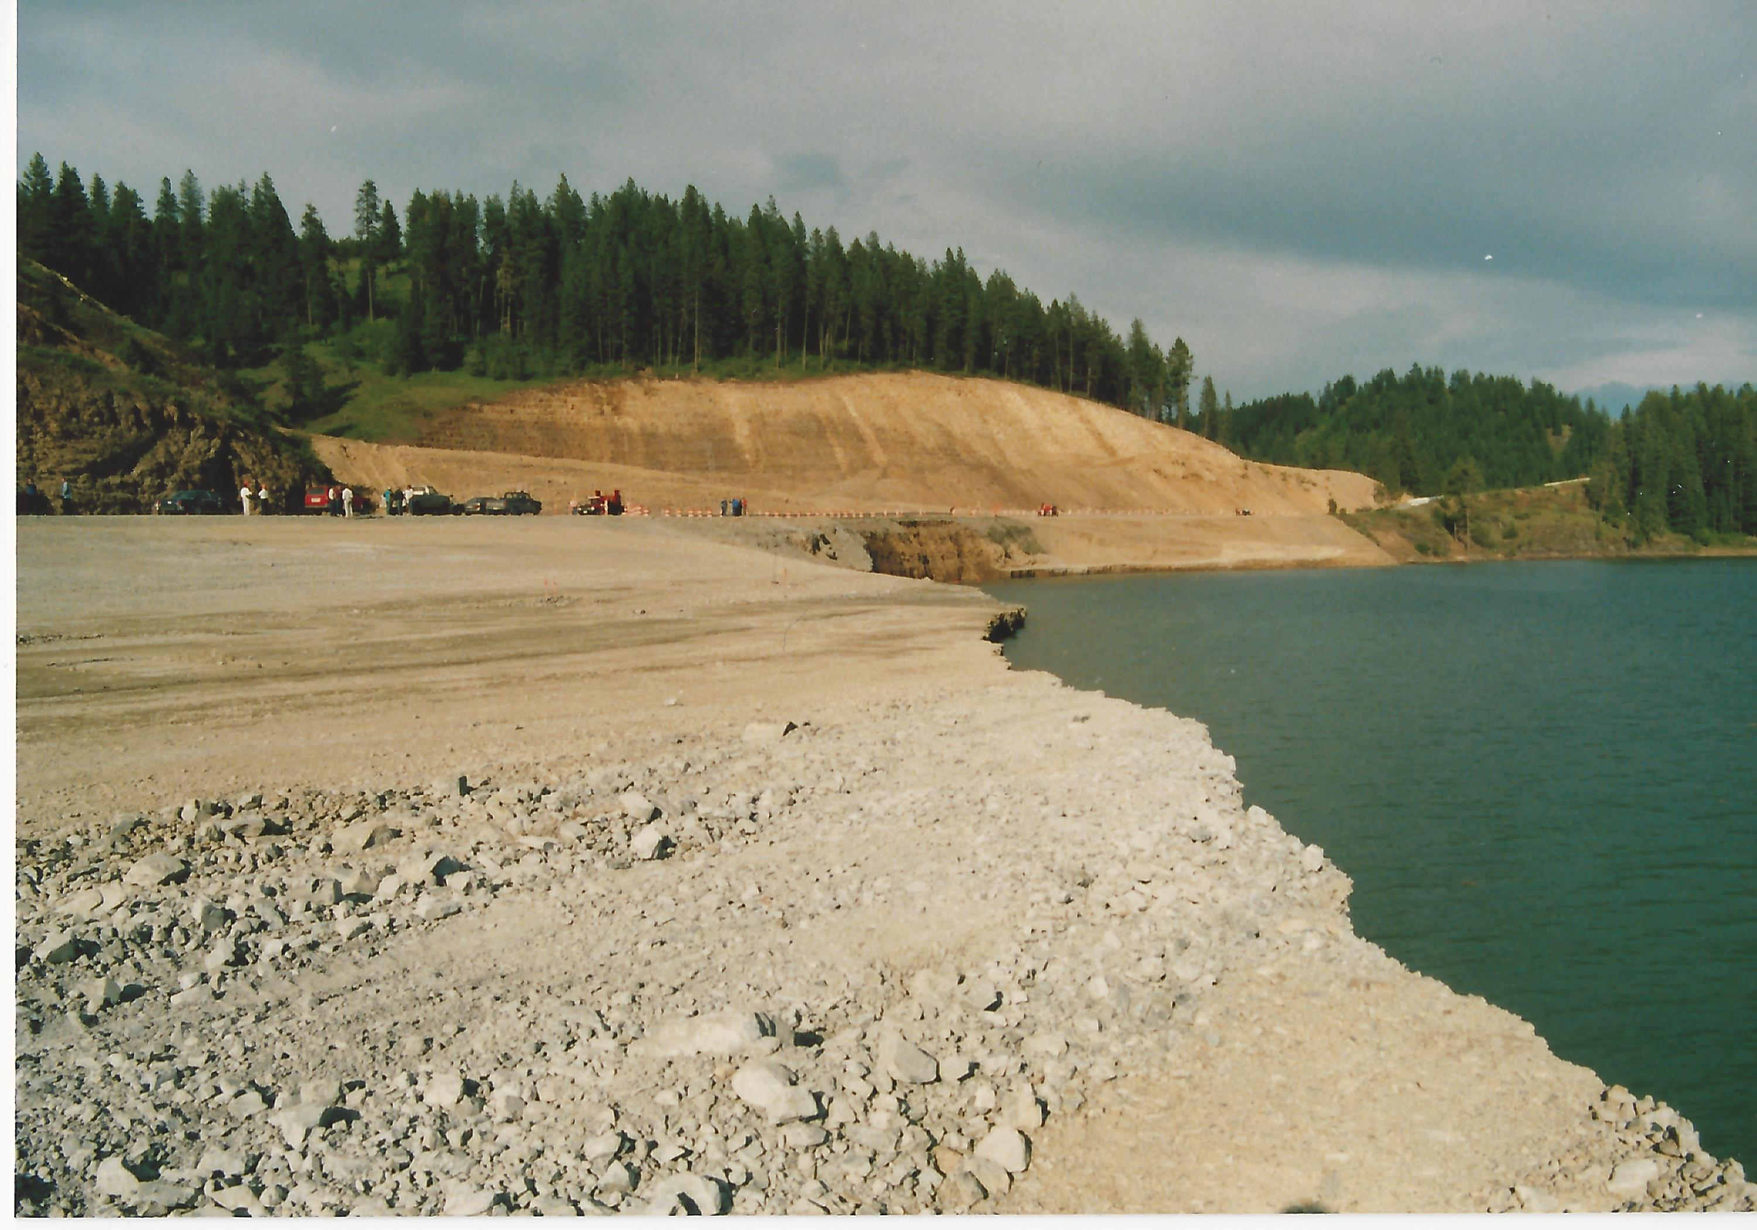

Slide 21
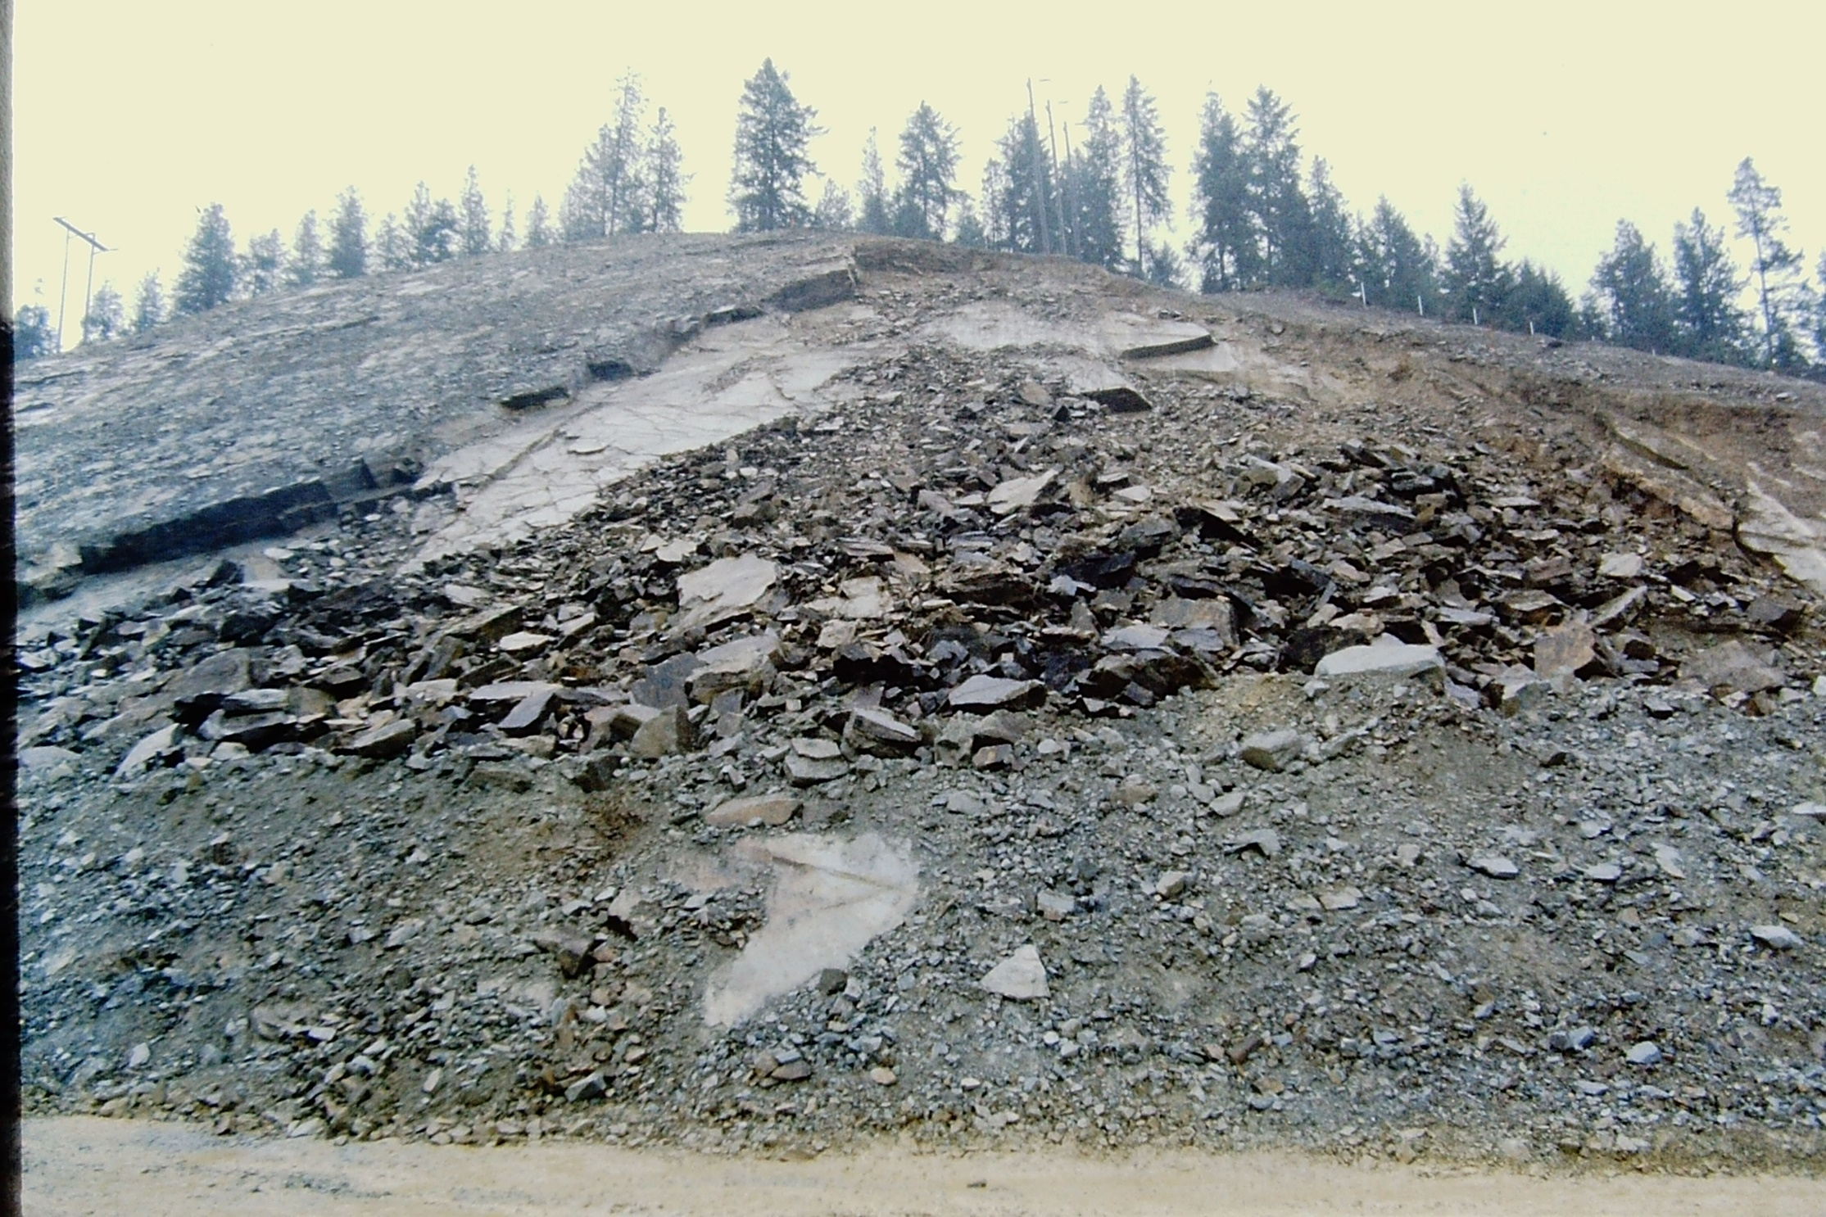
I-90 Station 267 Slide

Slide 22
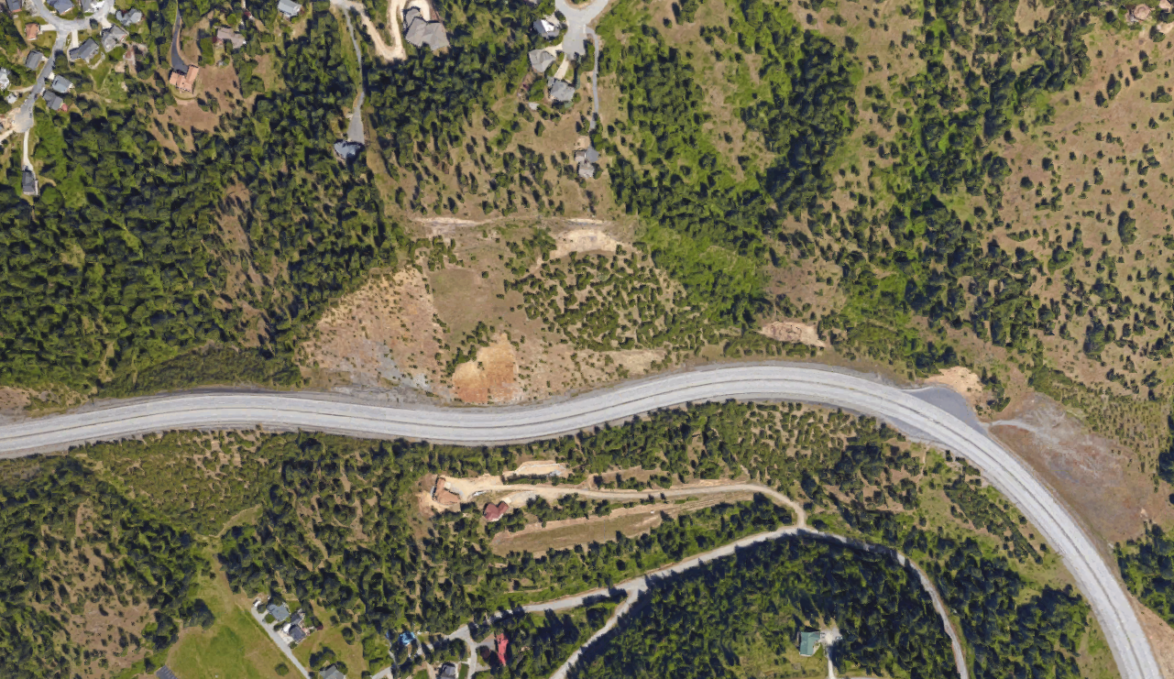

Slide 23
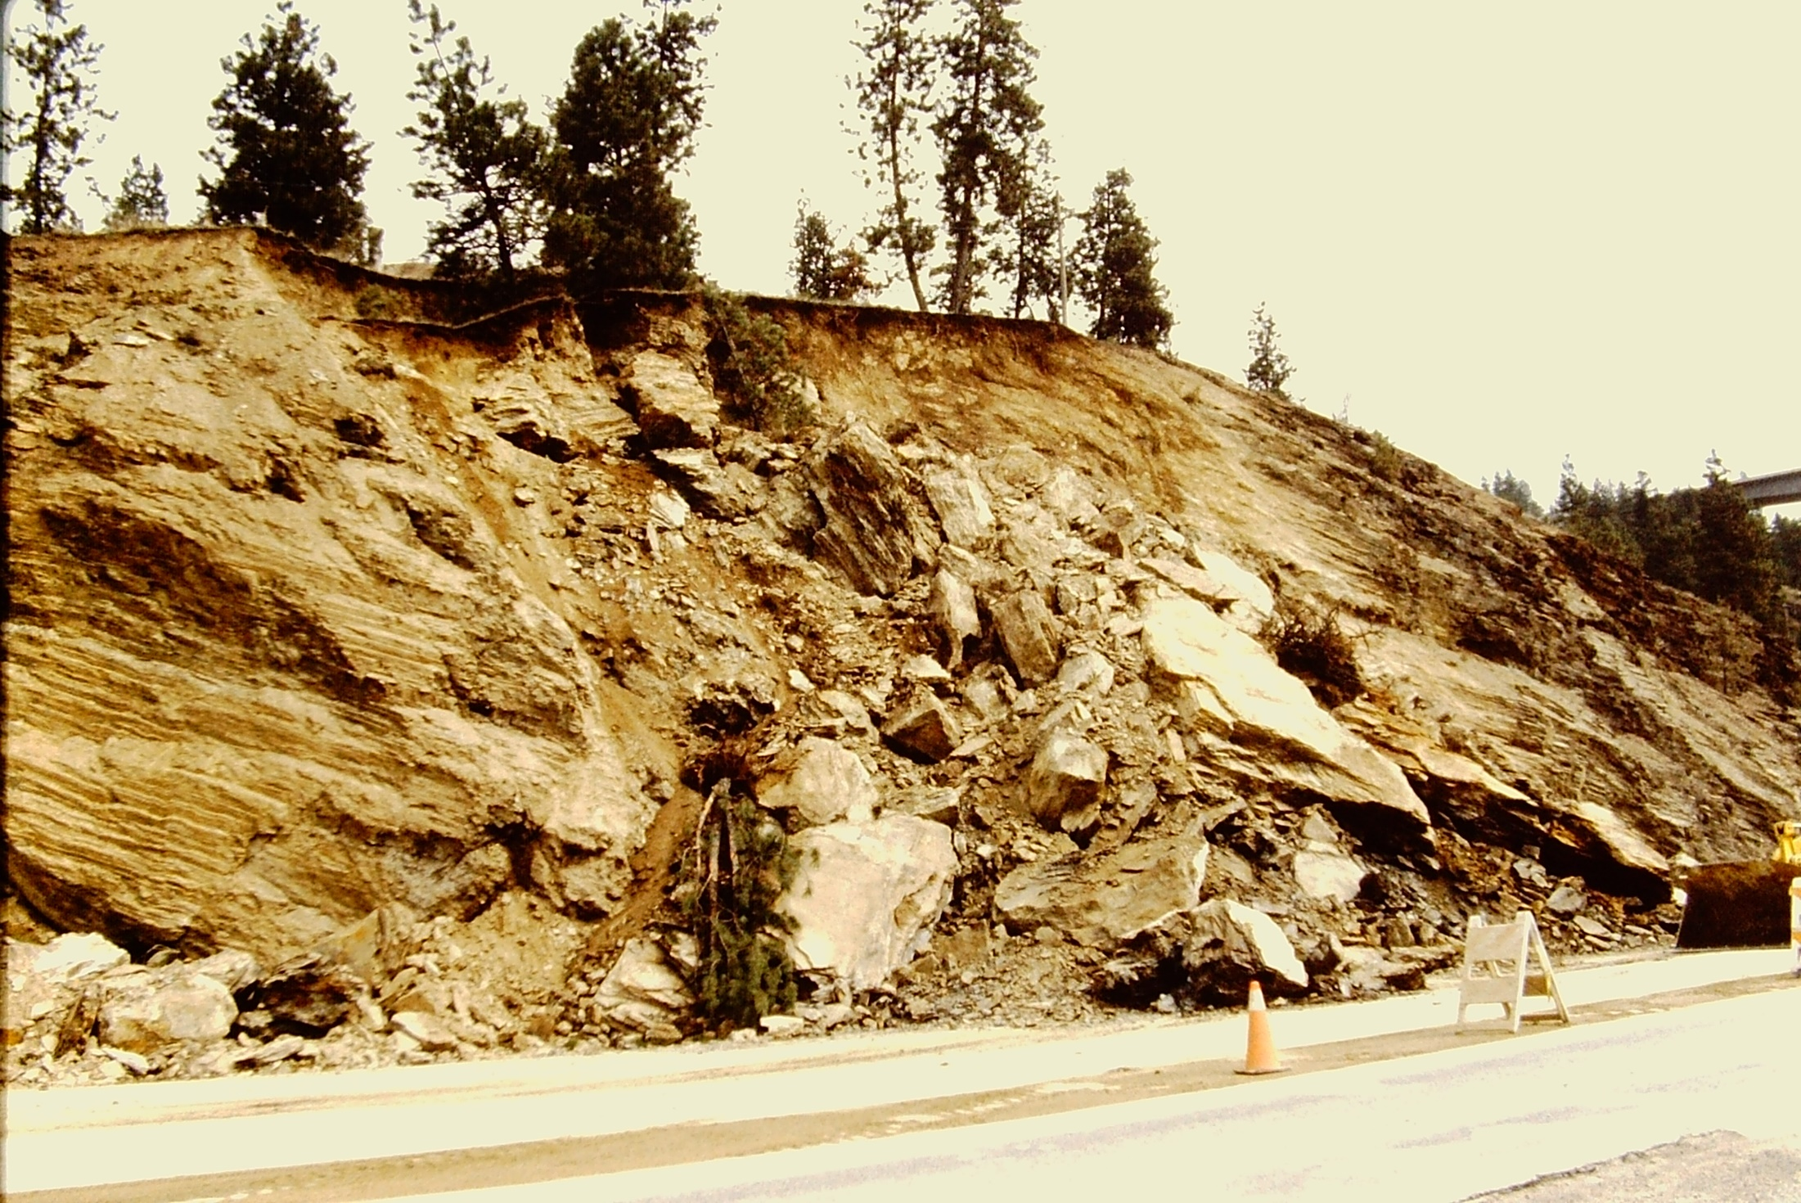
I-90 Slide NEAR TONY’S

Slide 24
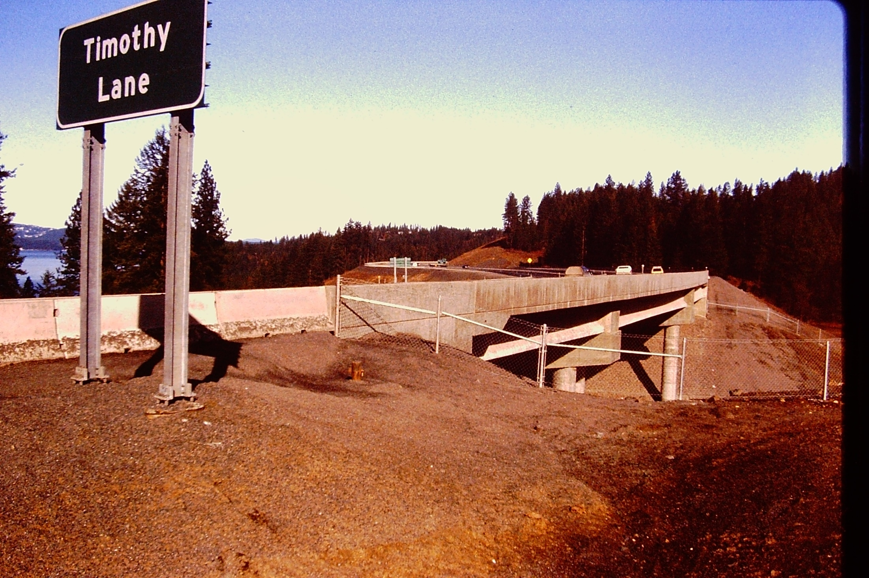
“Evergreen Slide”

Slide 25
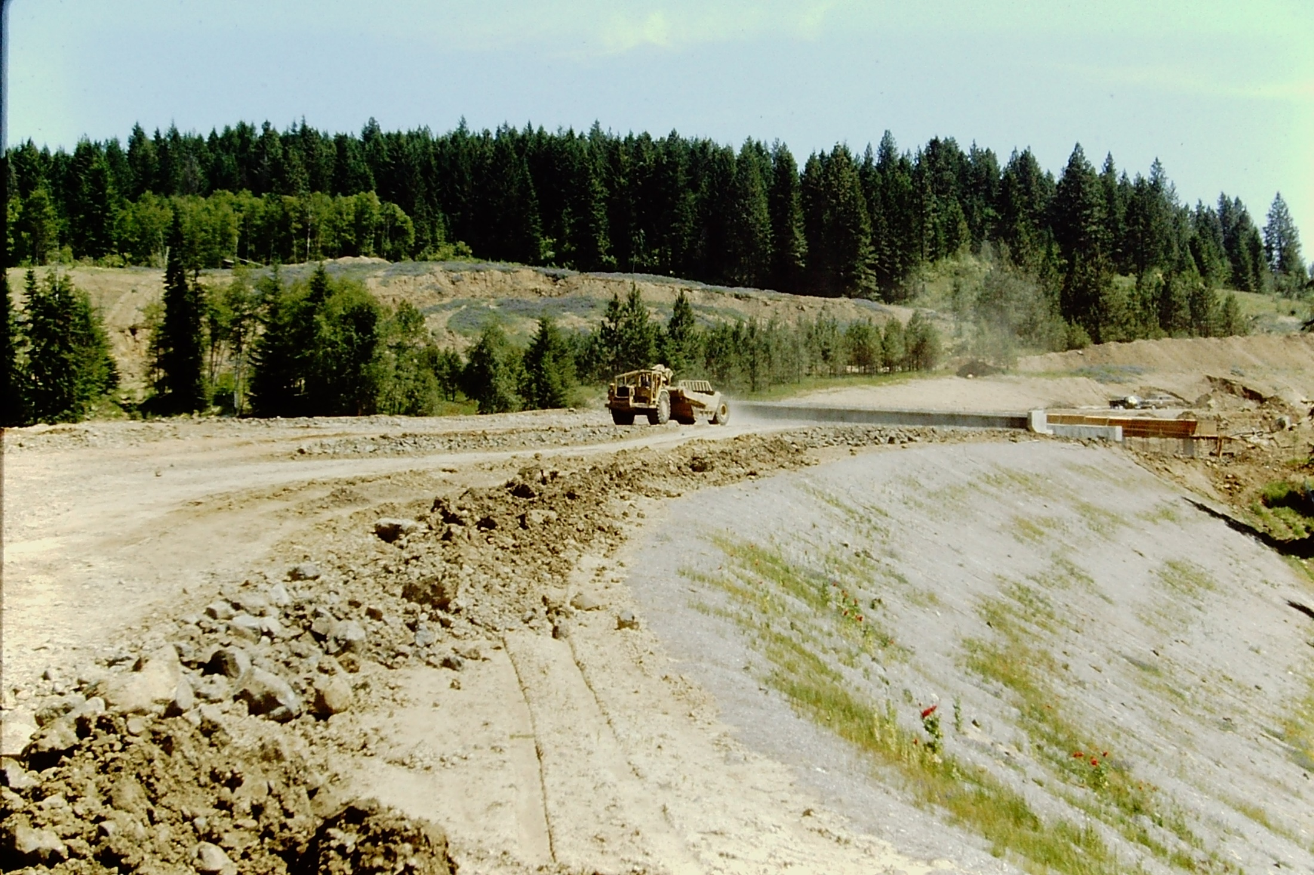

Slide 26
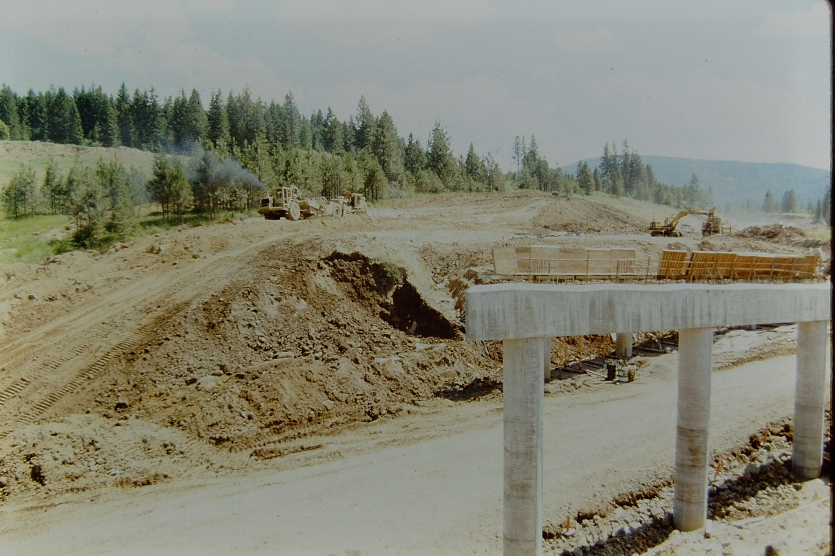

Slide 27
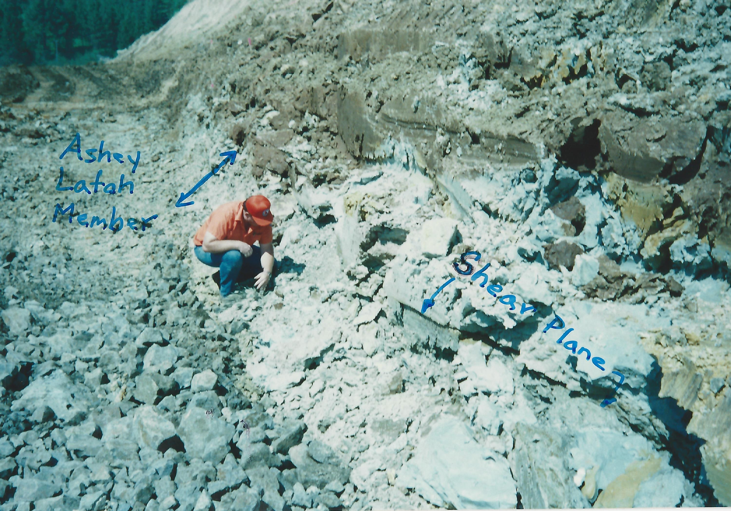

Slide 28
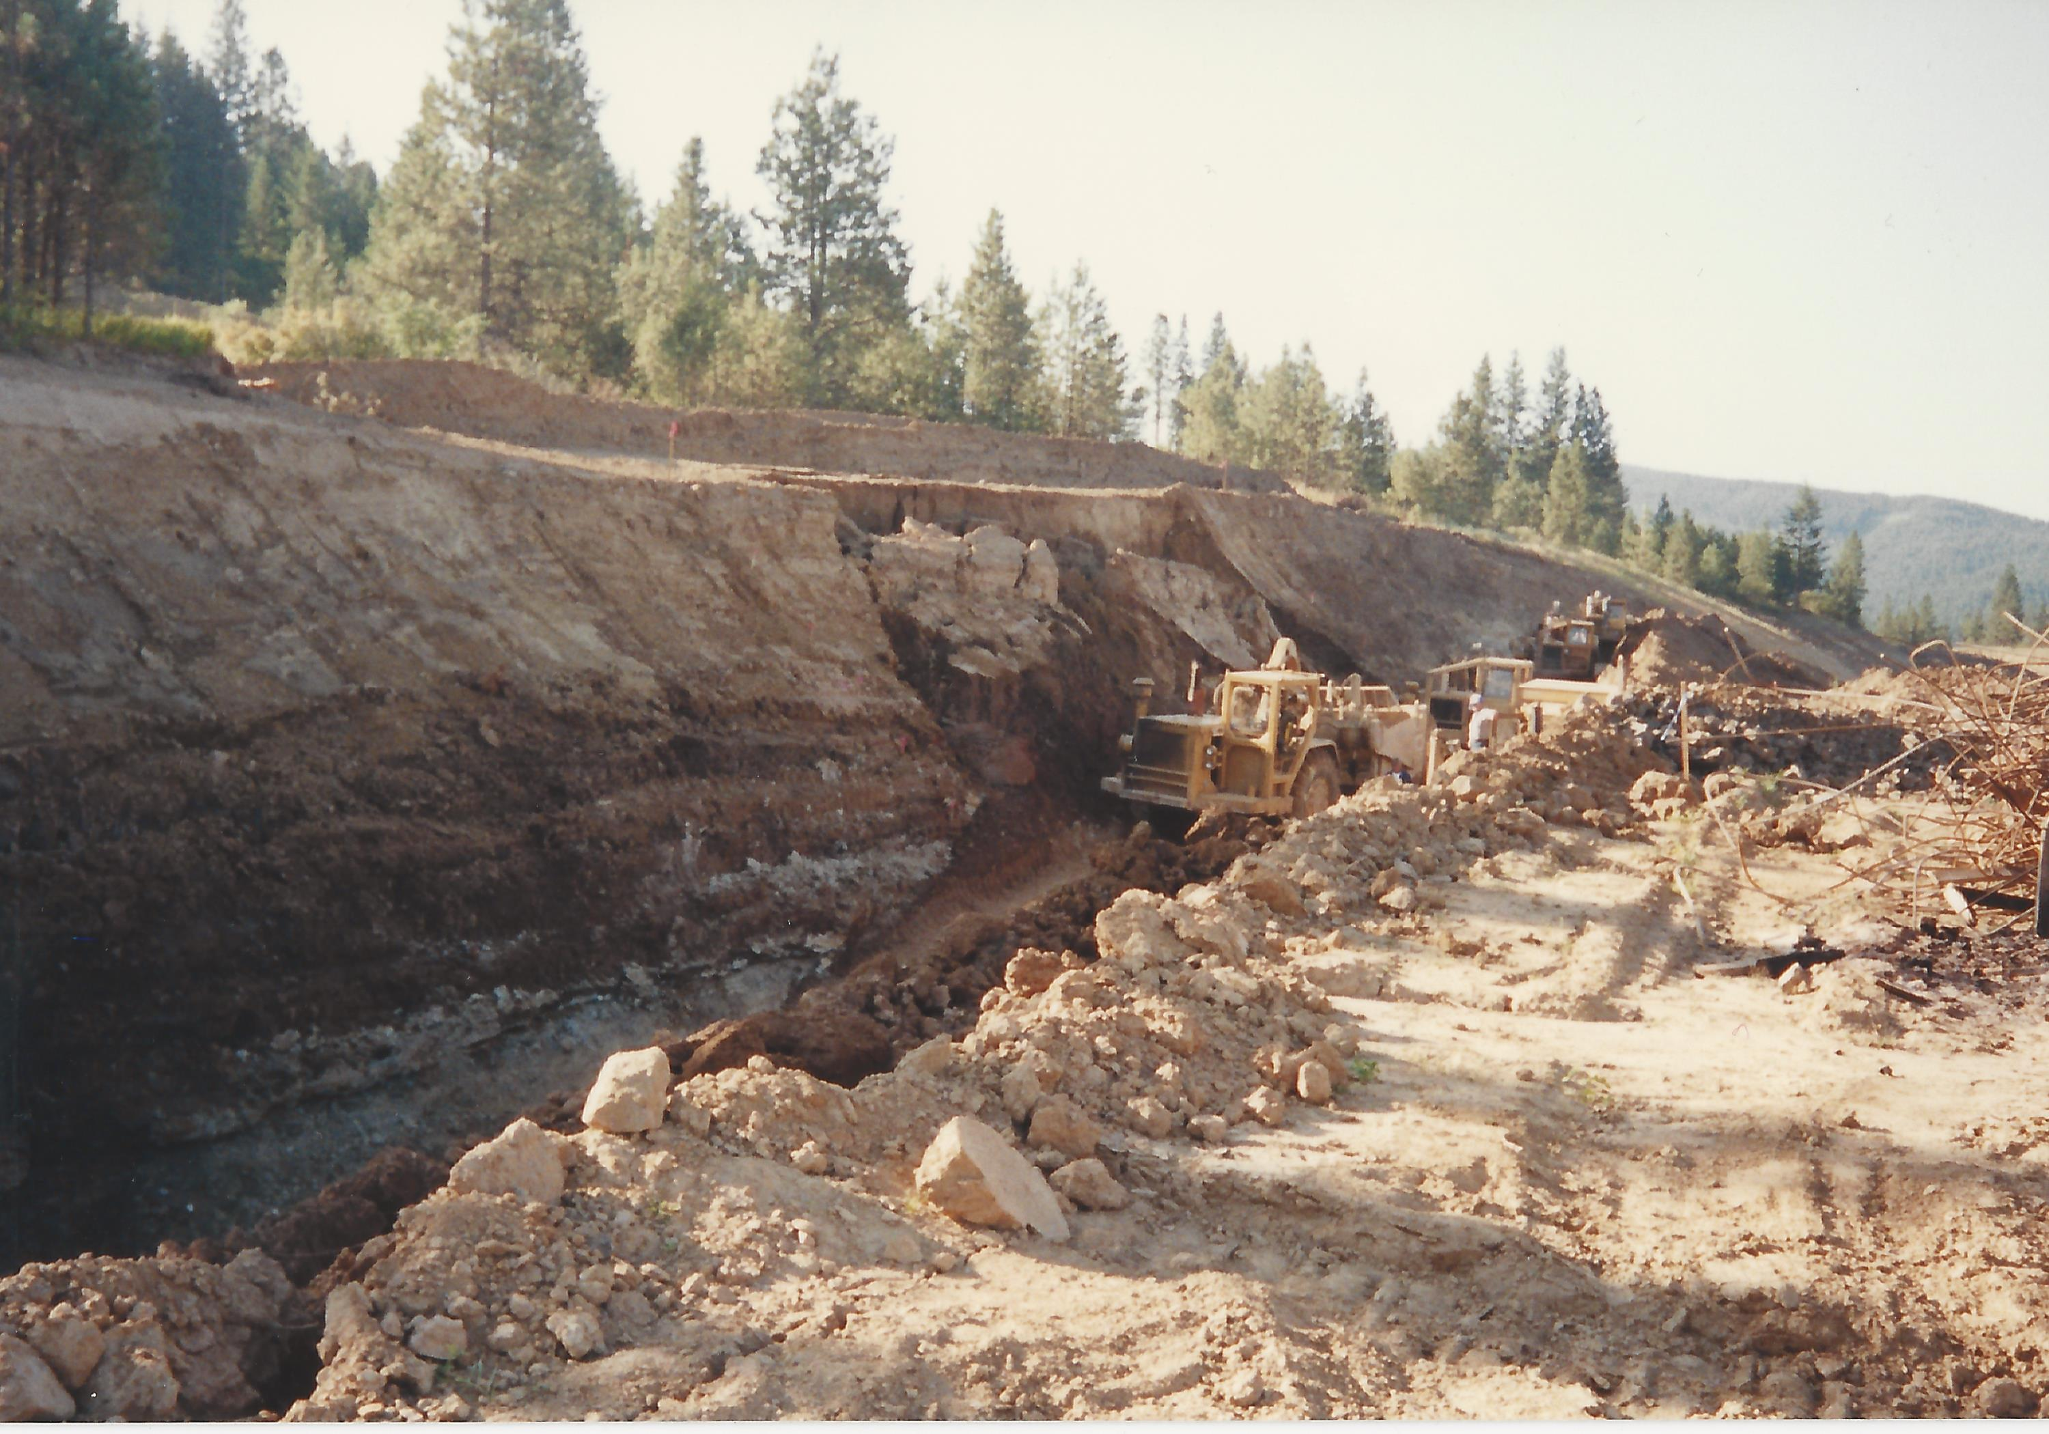
SHEAR KEY CONSTRUCTION

Slide 29
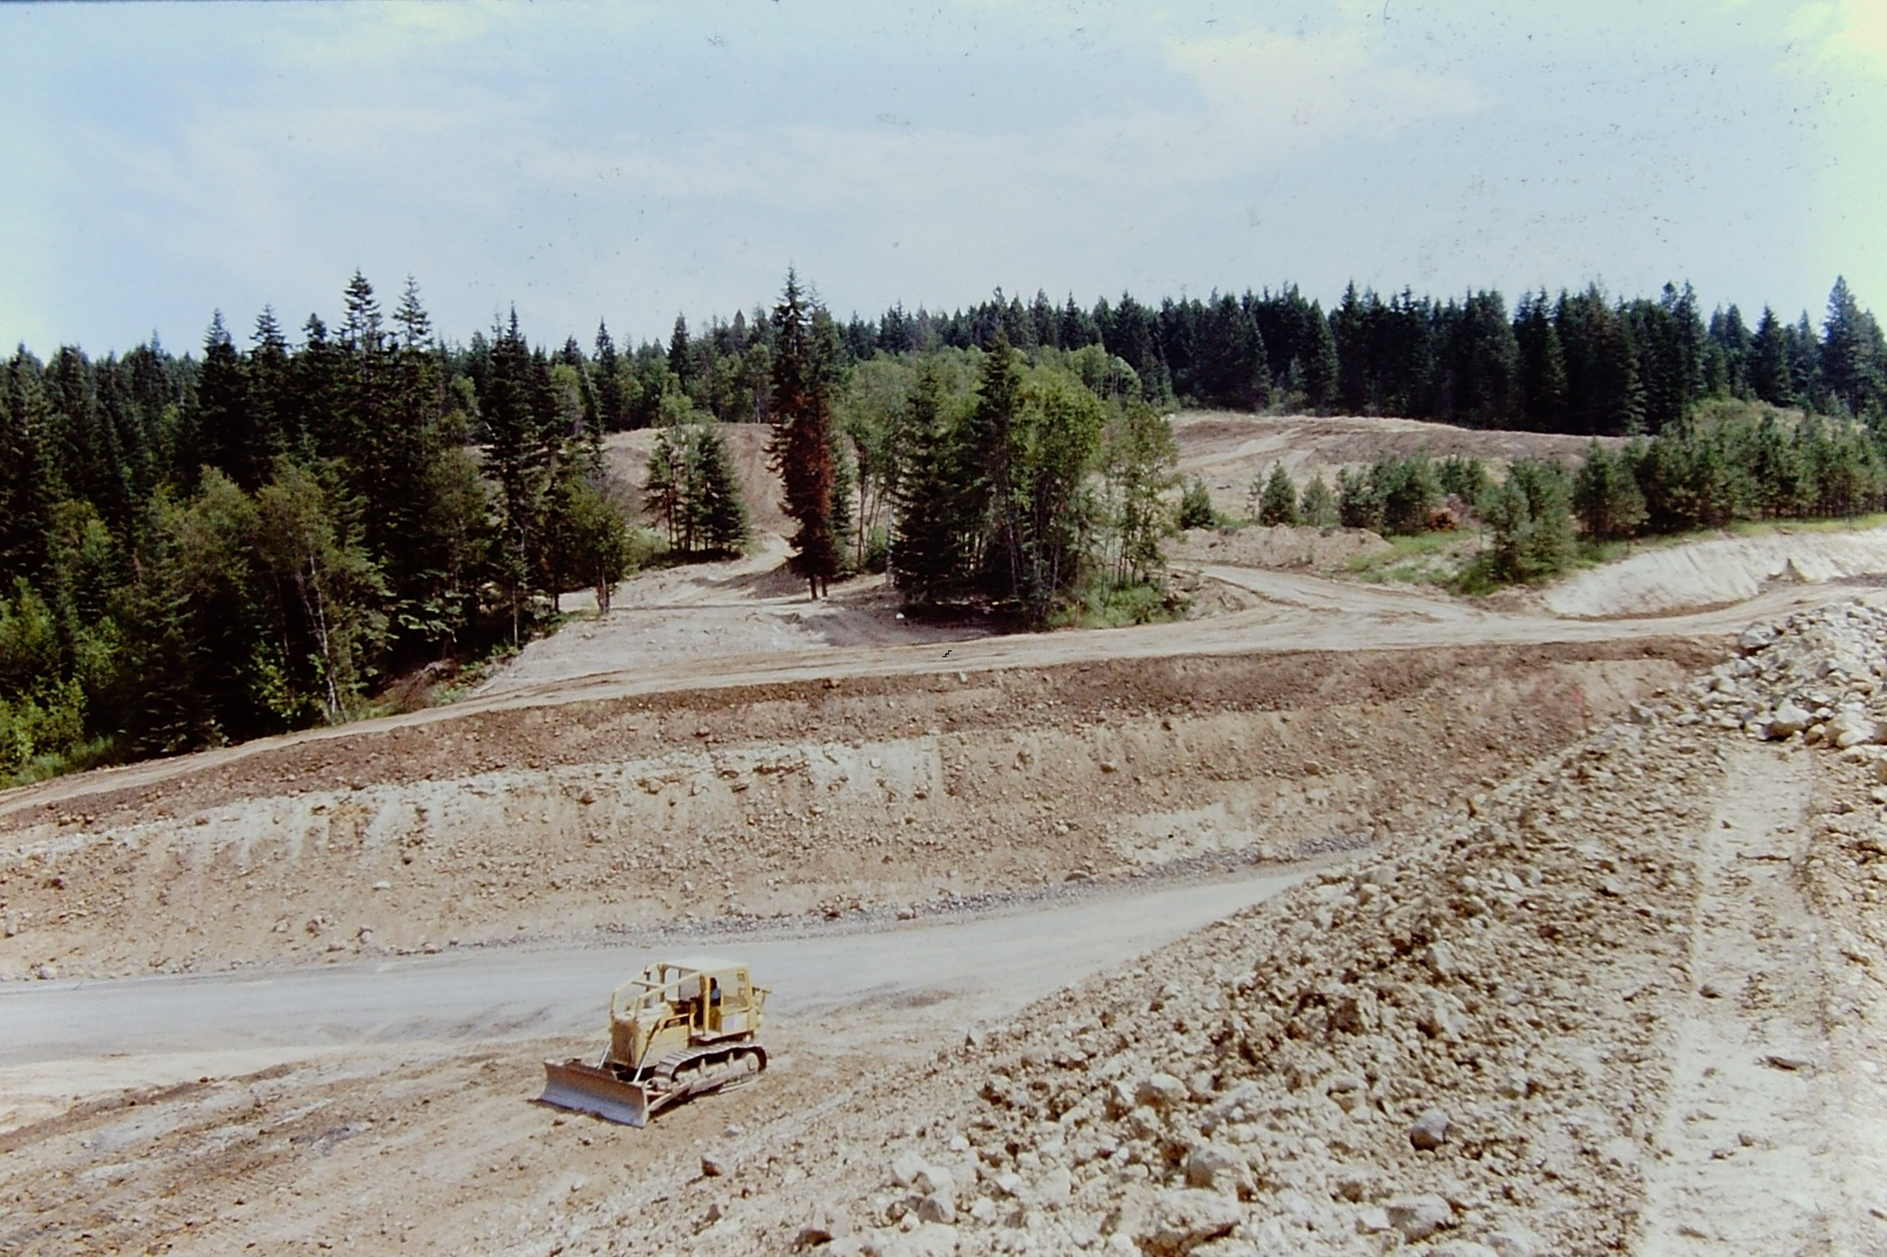
TOE BUTTRESS CONSTRUCTION

Slide 30
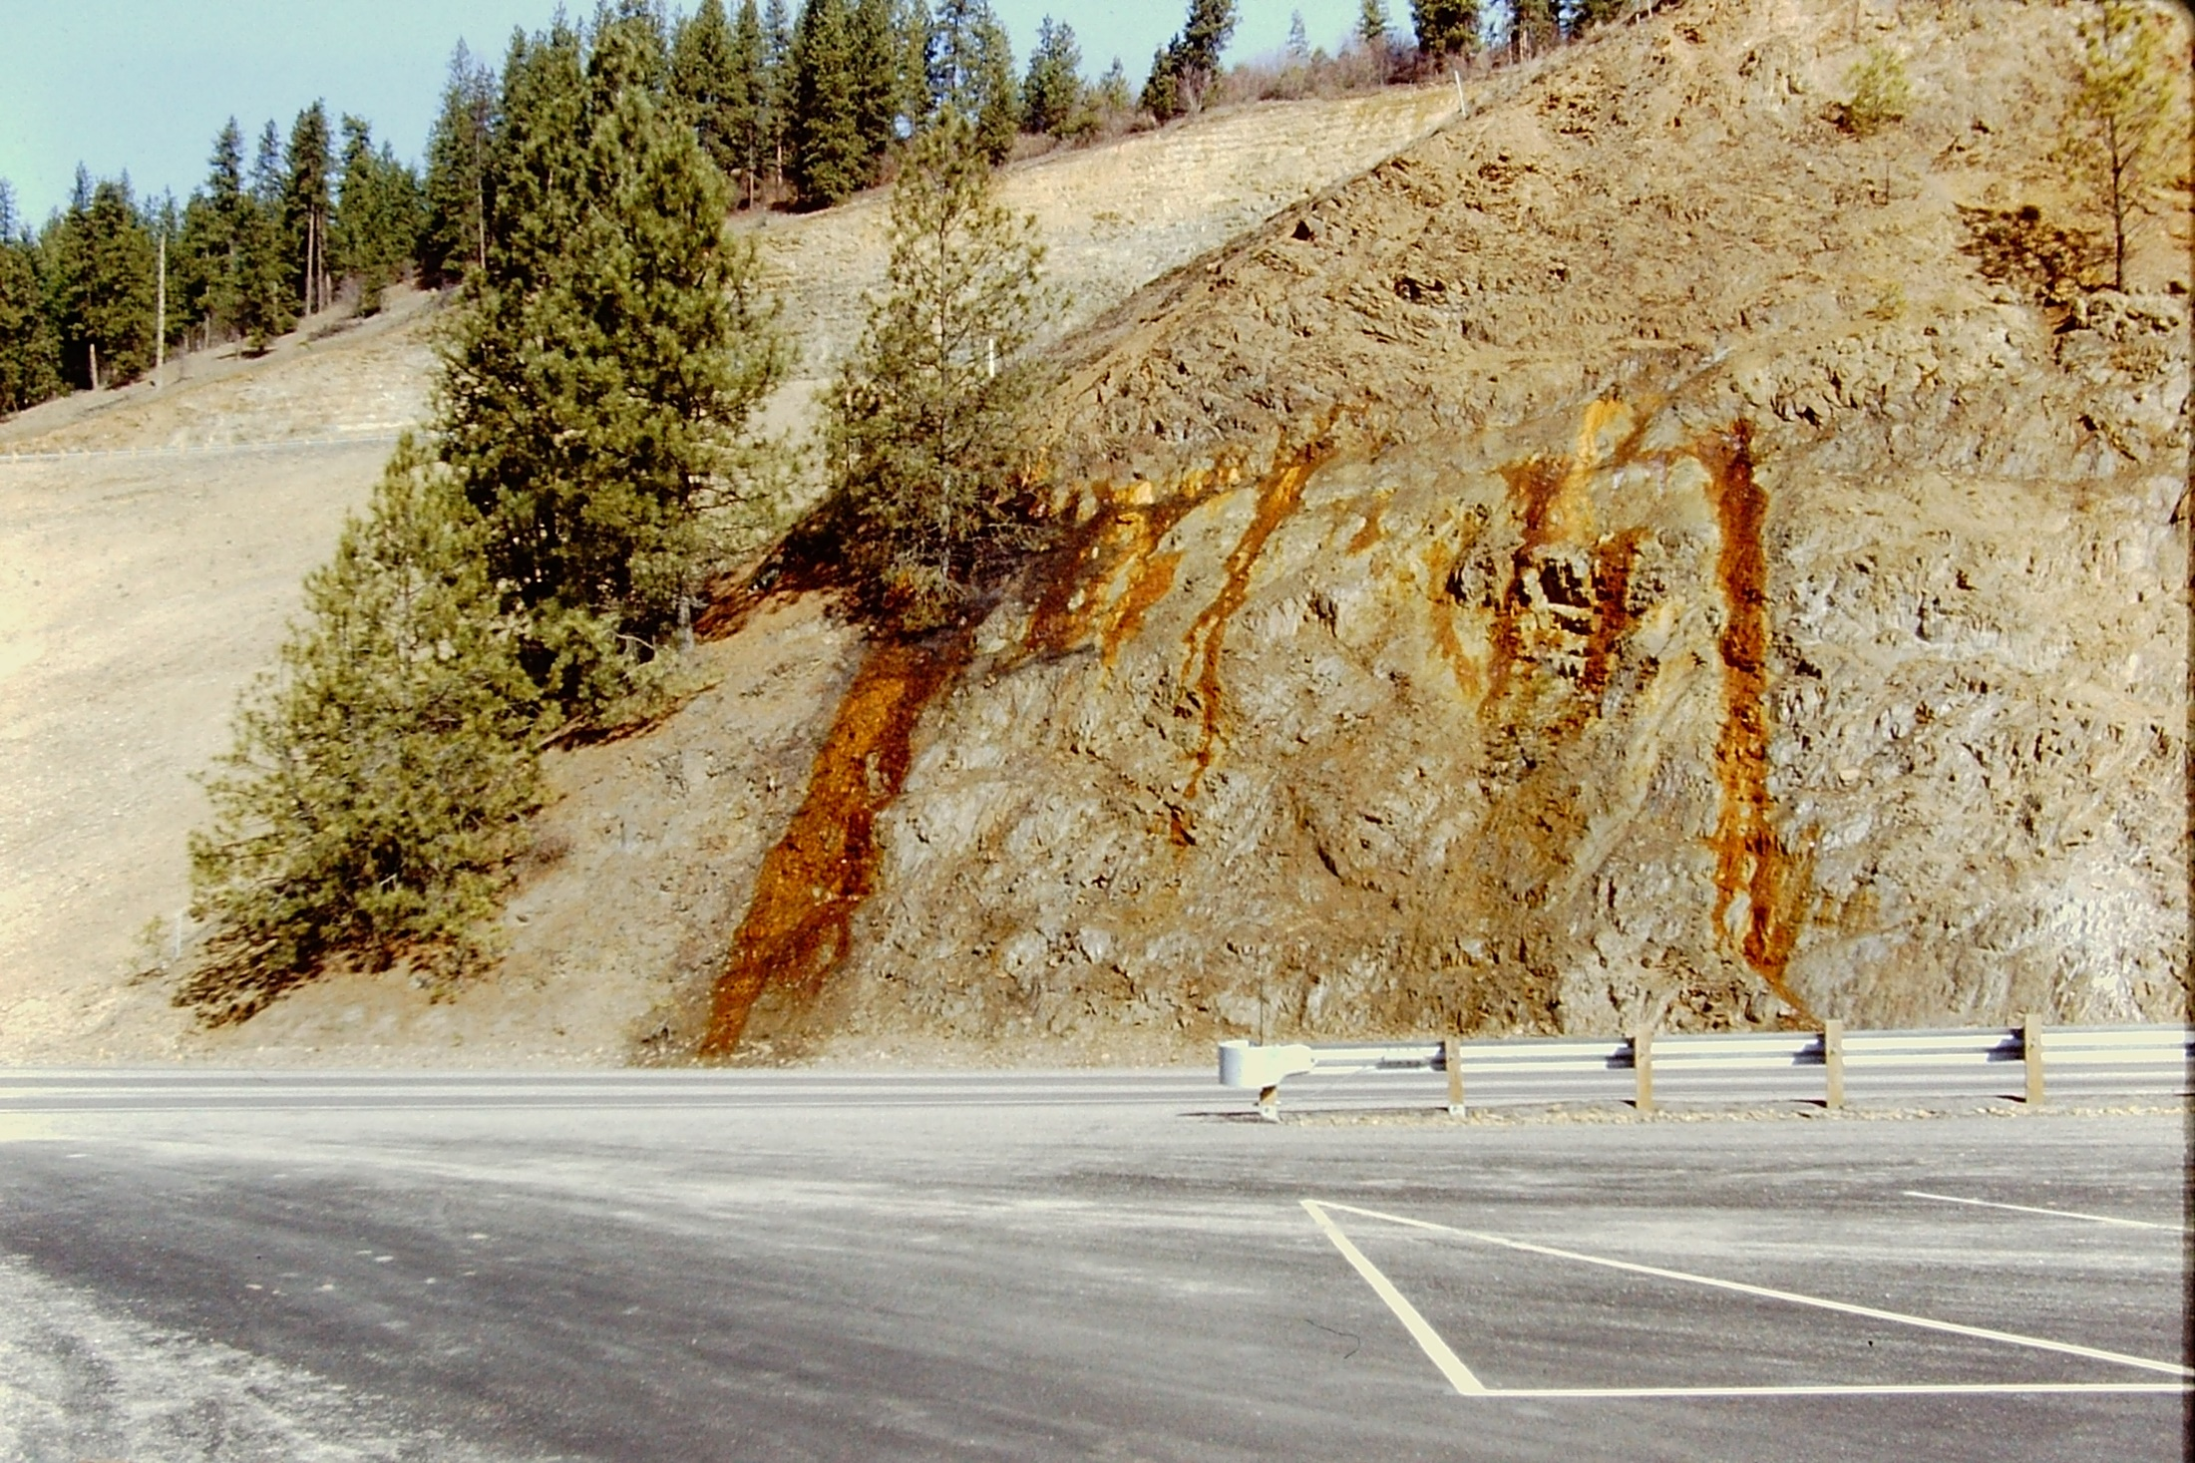
ACIDIC DRAINAGE

Slide 31
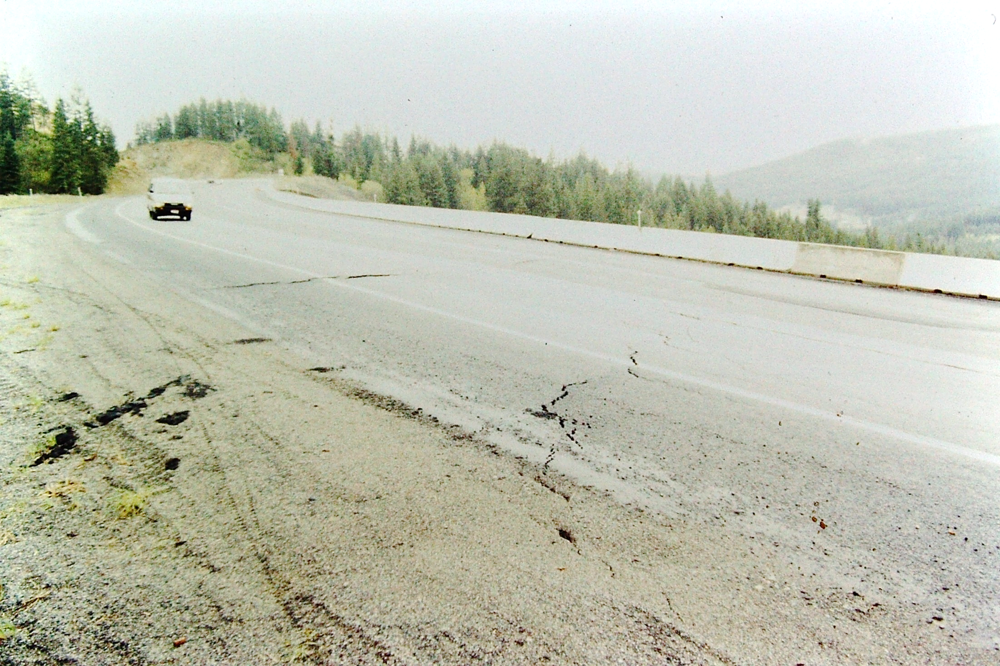
US-95 MP 425 NORTH MICA GRADE

Slide 32
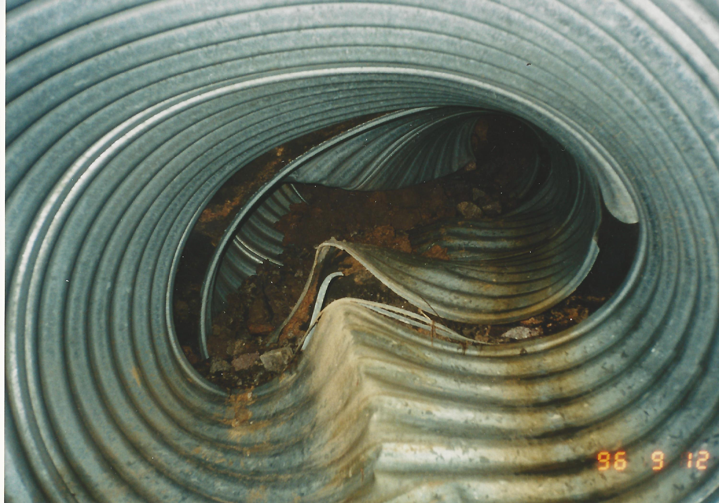

Slide 33
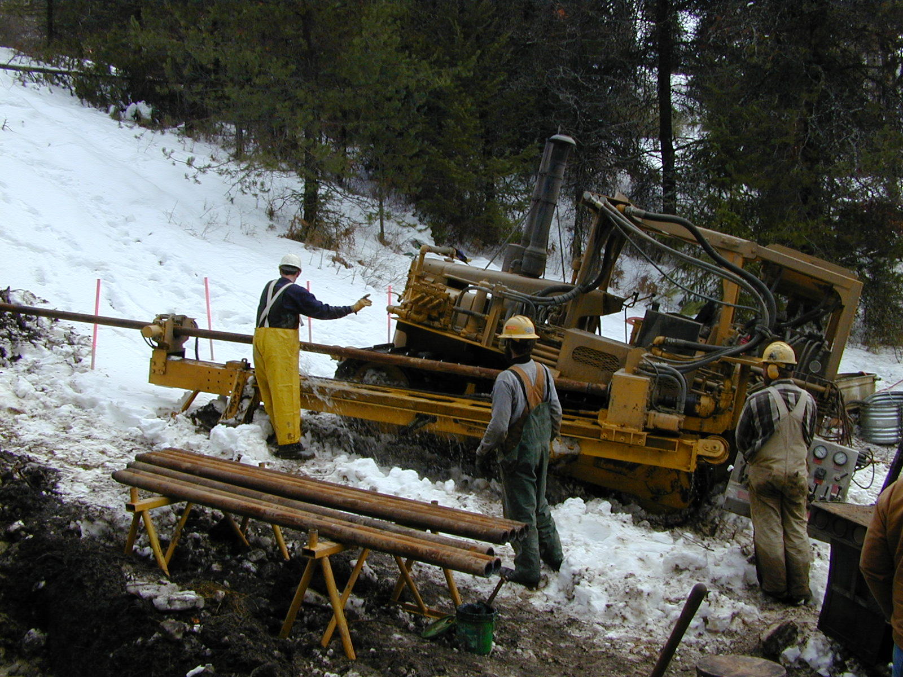
HORIZONTAL DRAIN CONSTRUCTION

Slide 34
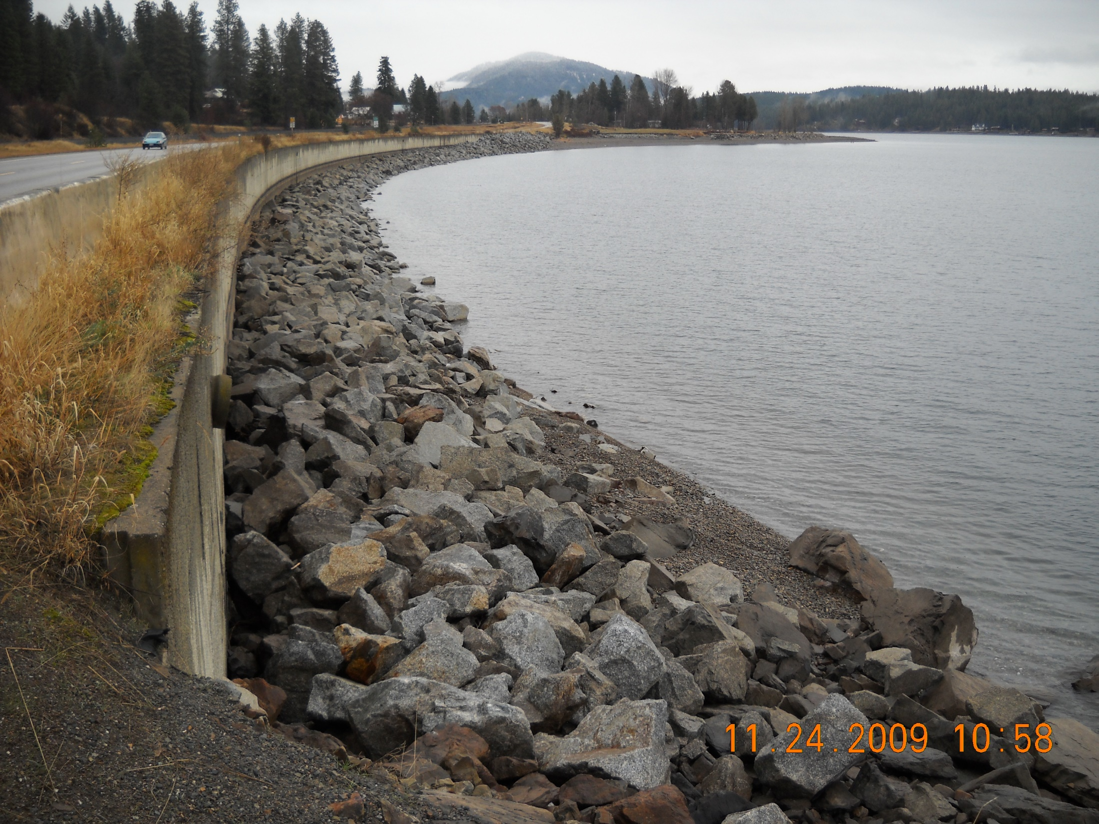
SH-200 HOPE RETAINING WALL

Slide 35
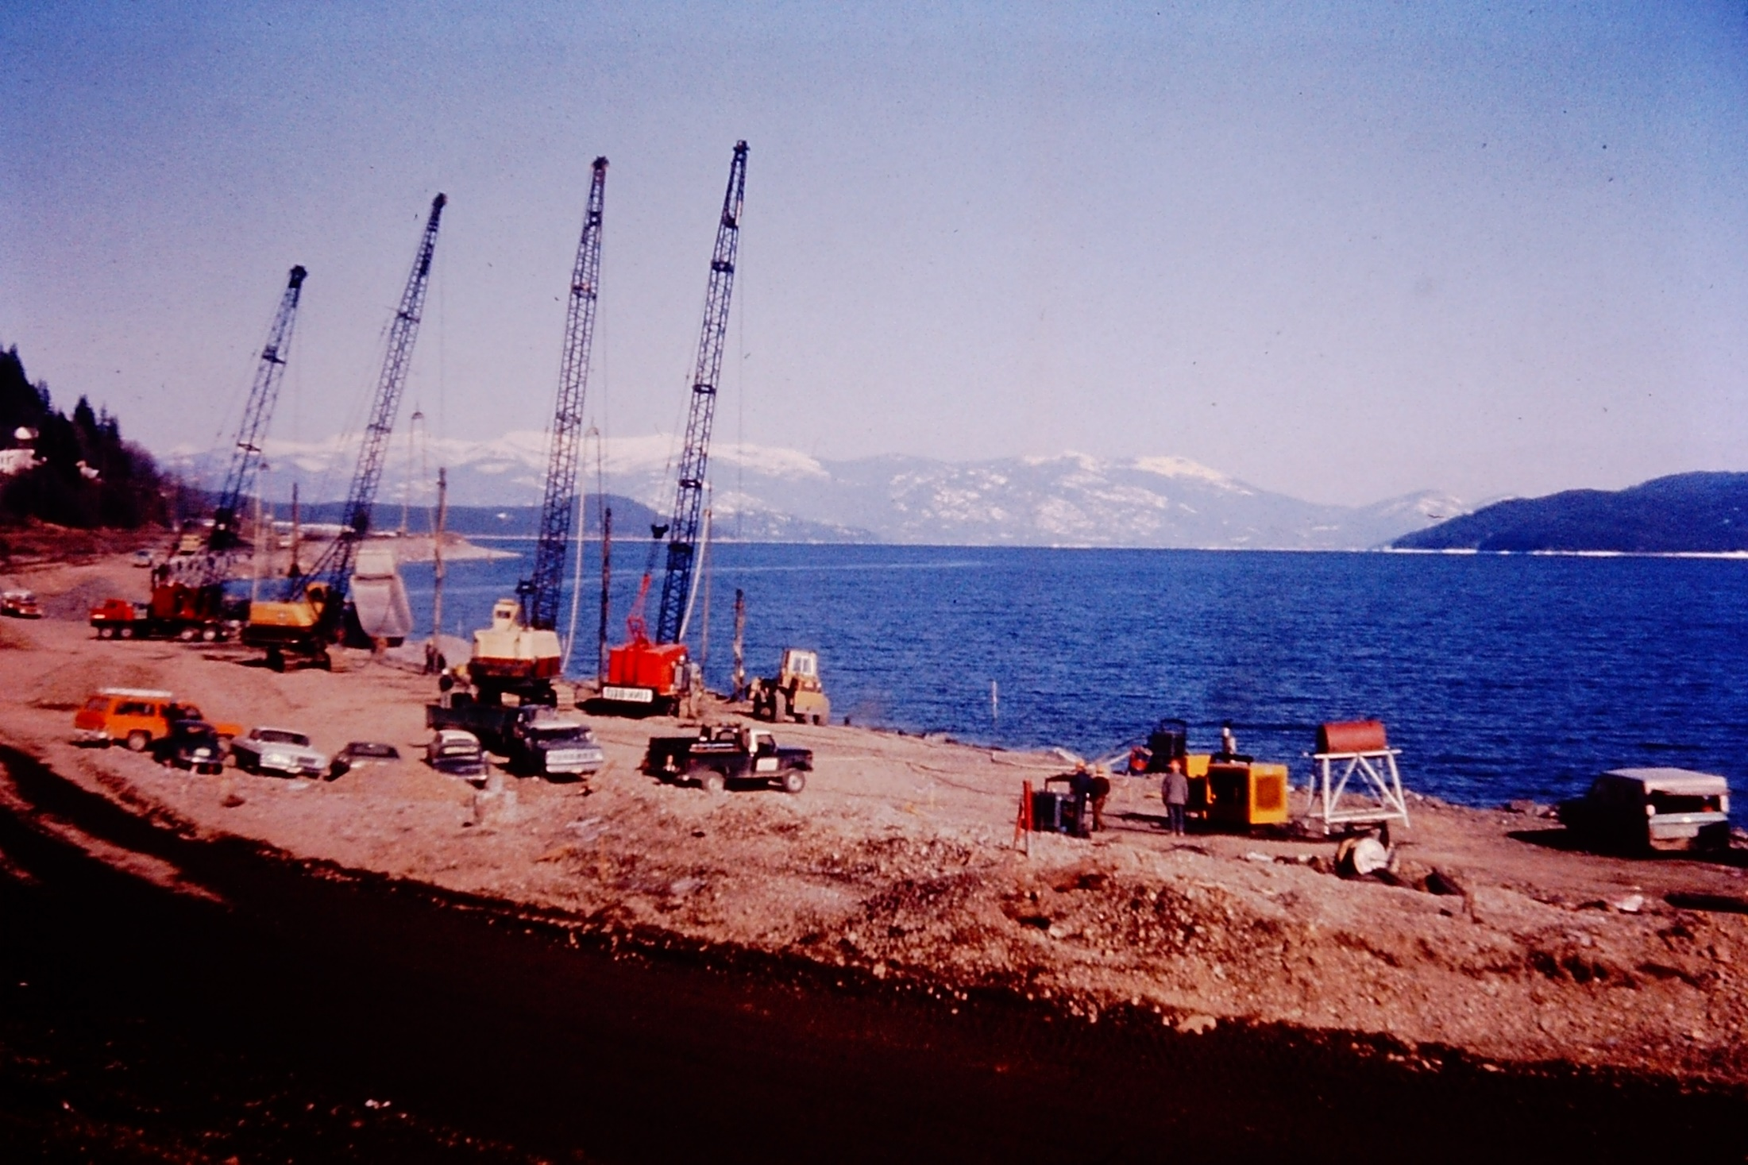

Slide 36
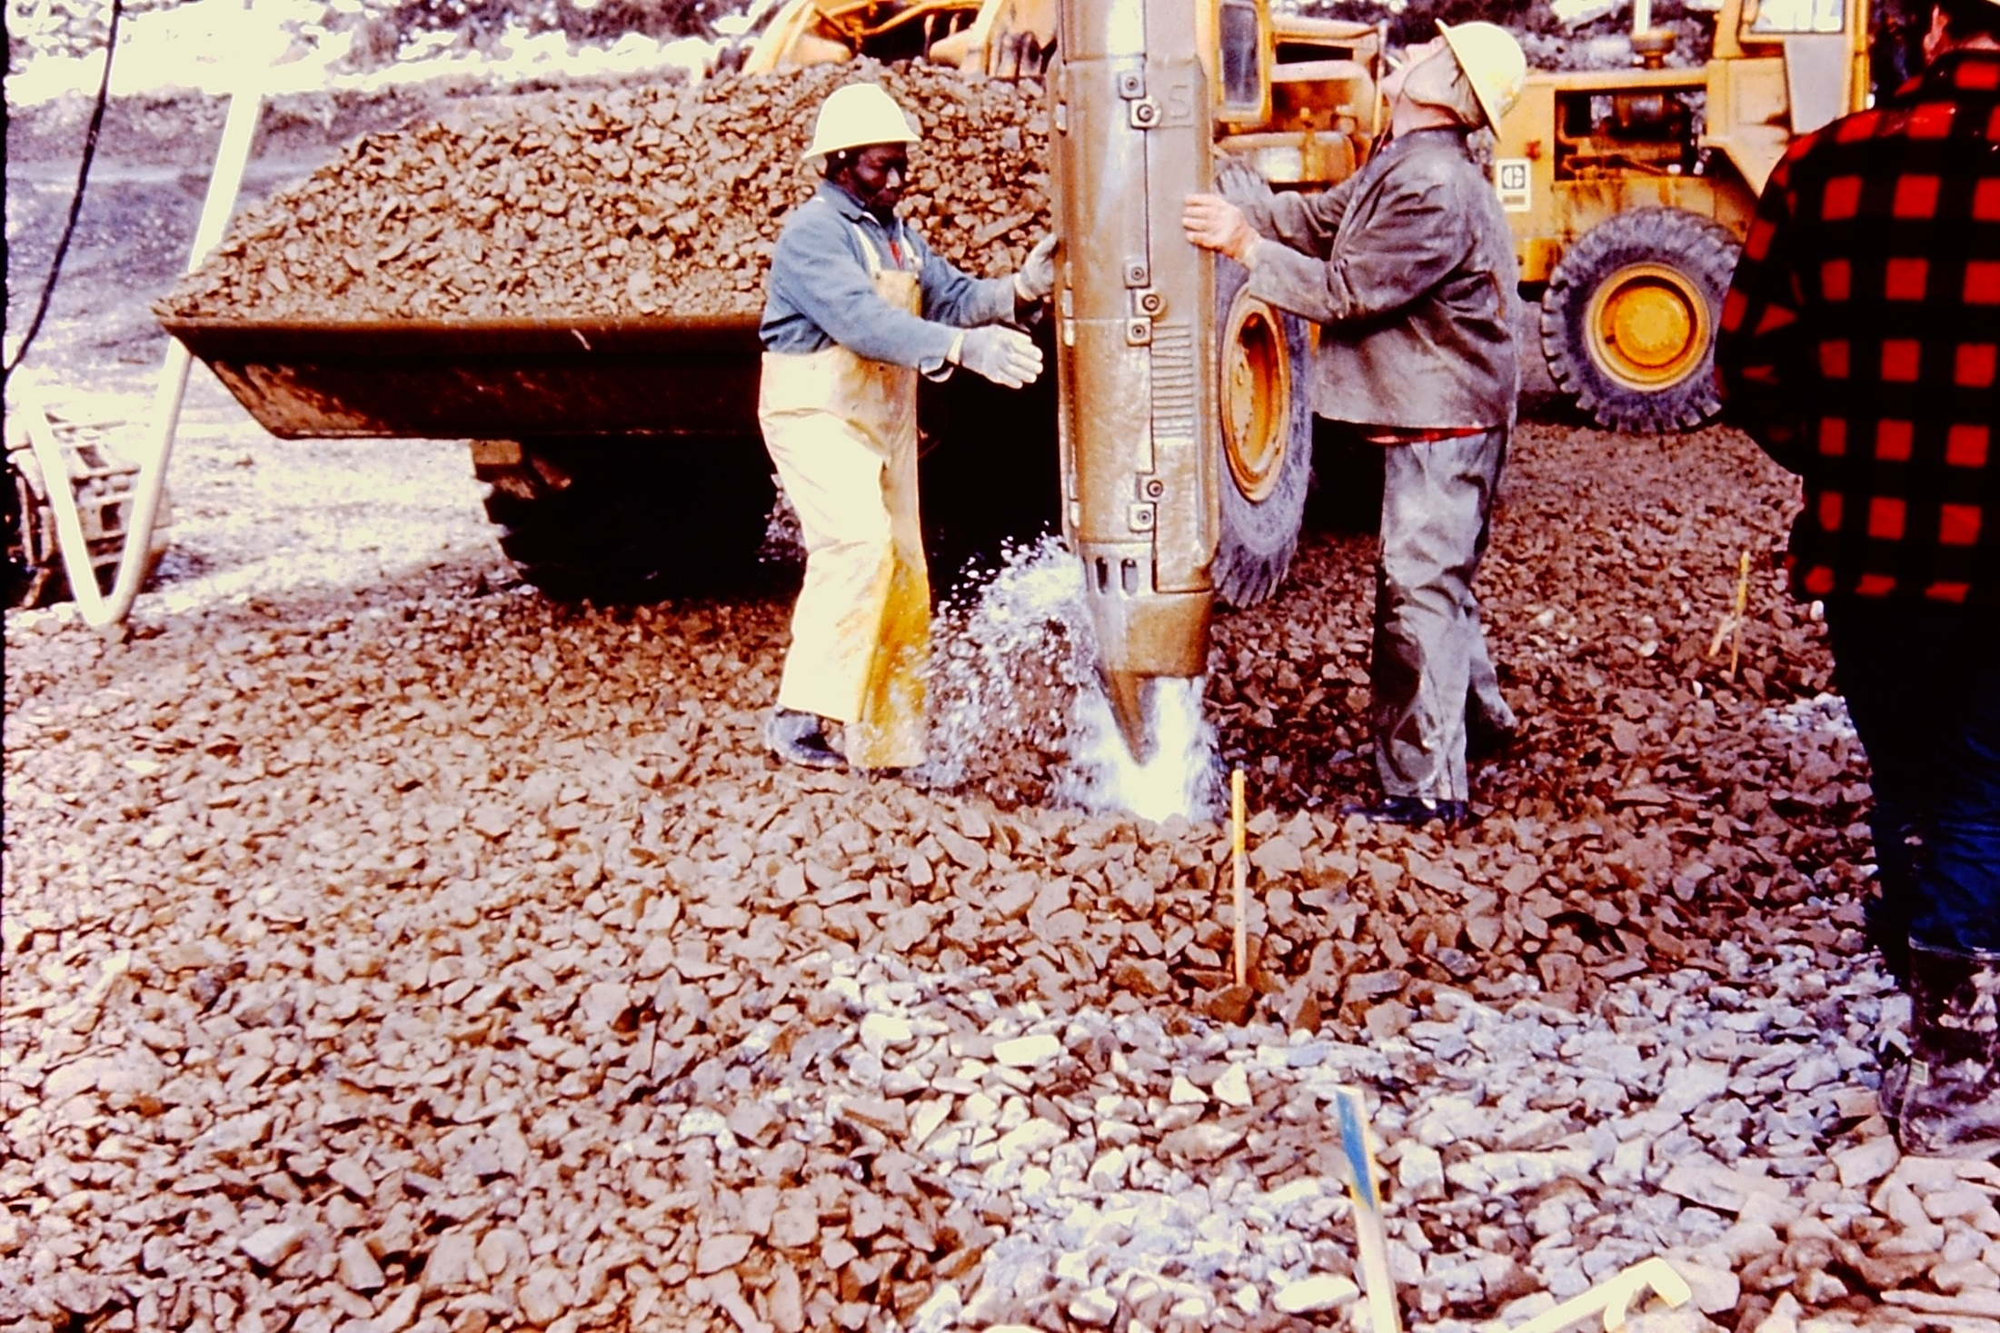
VIBRO-DENSIFICATION/STONE COLUMNS

Slide 37
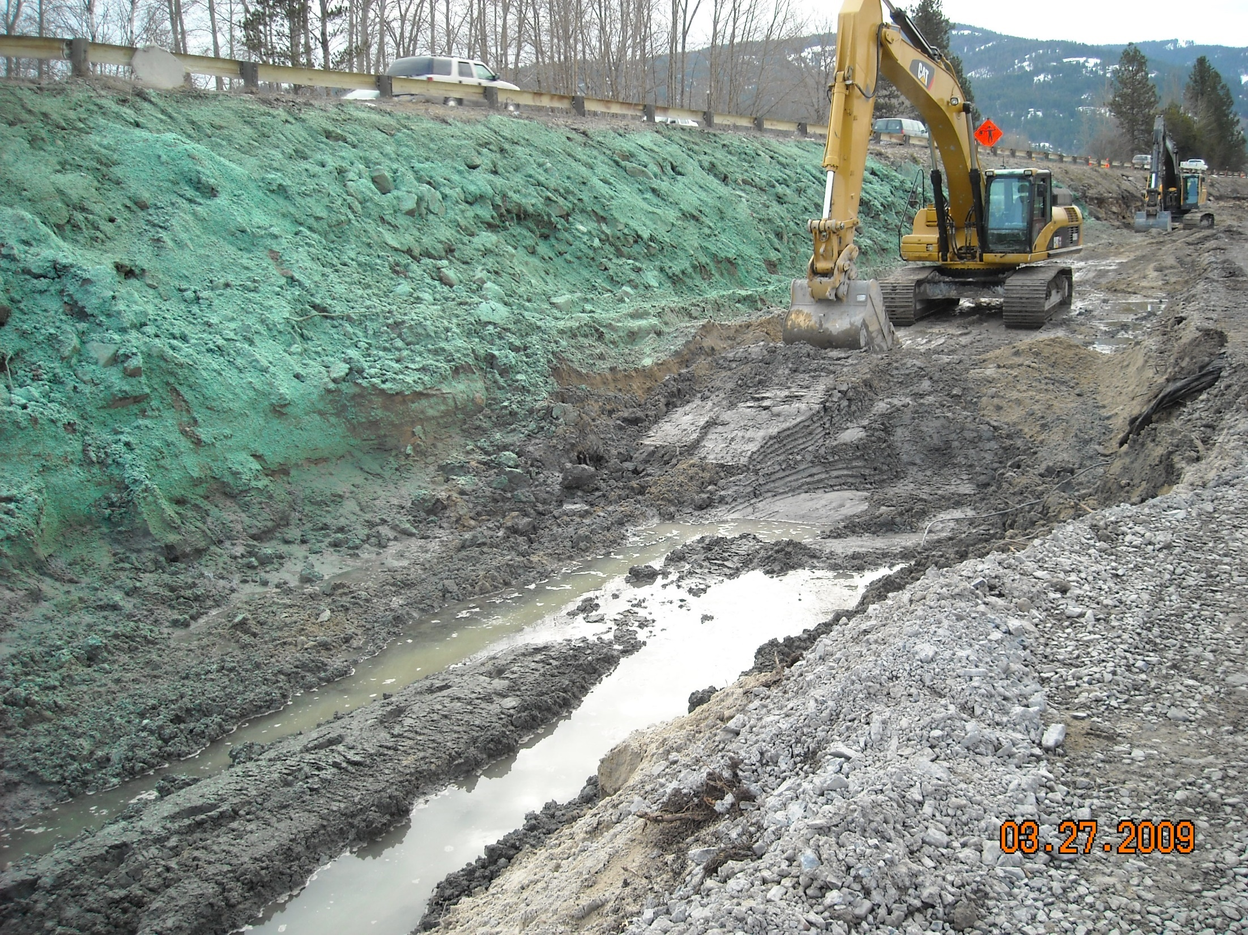
MSE WALL FOUNDATION PREPARATION

Slide 38
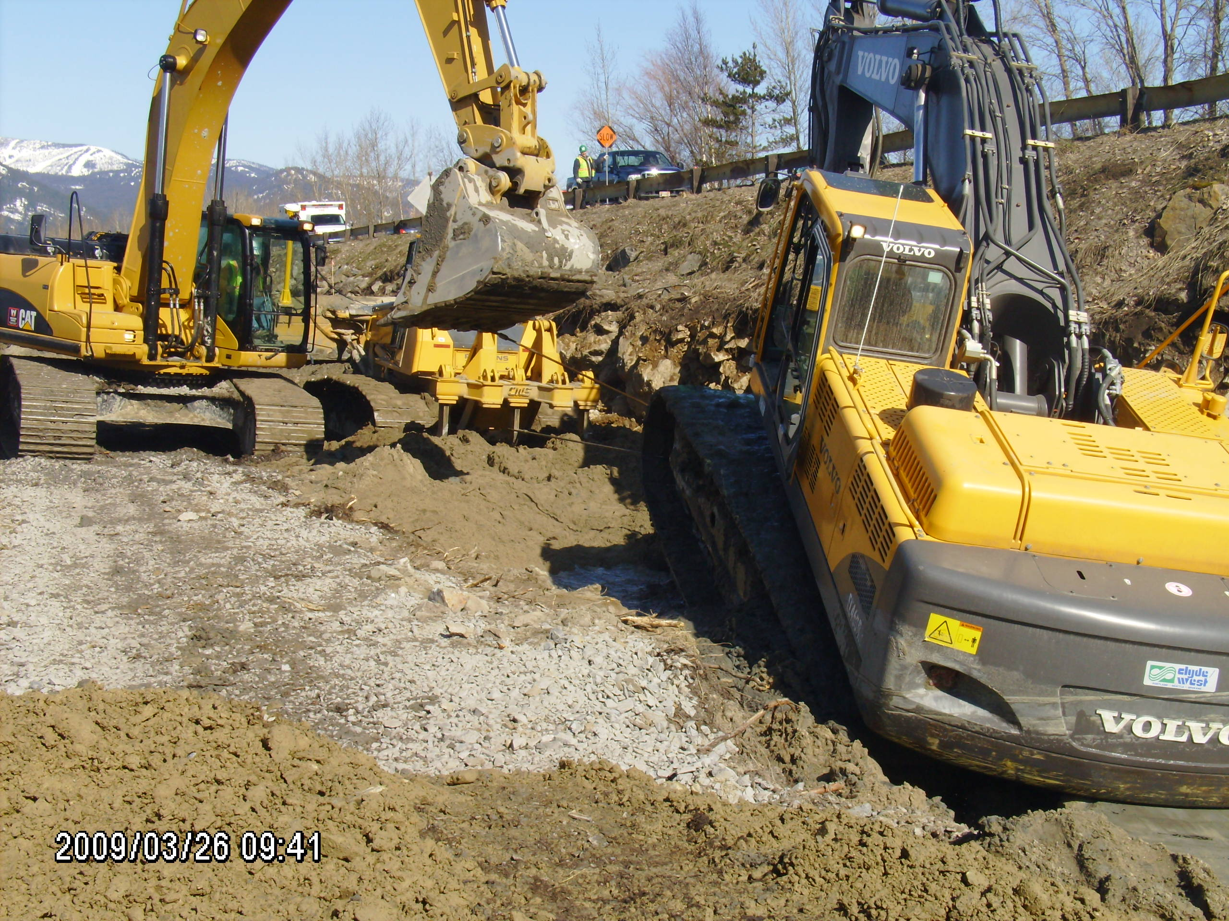

Slide 39
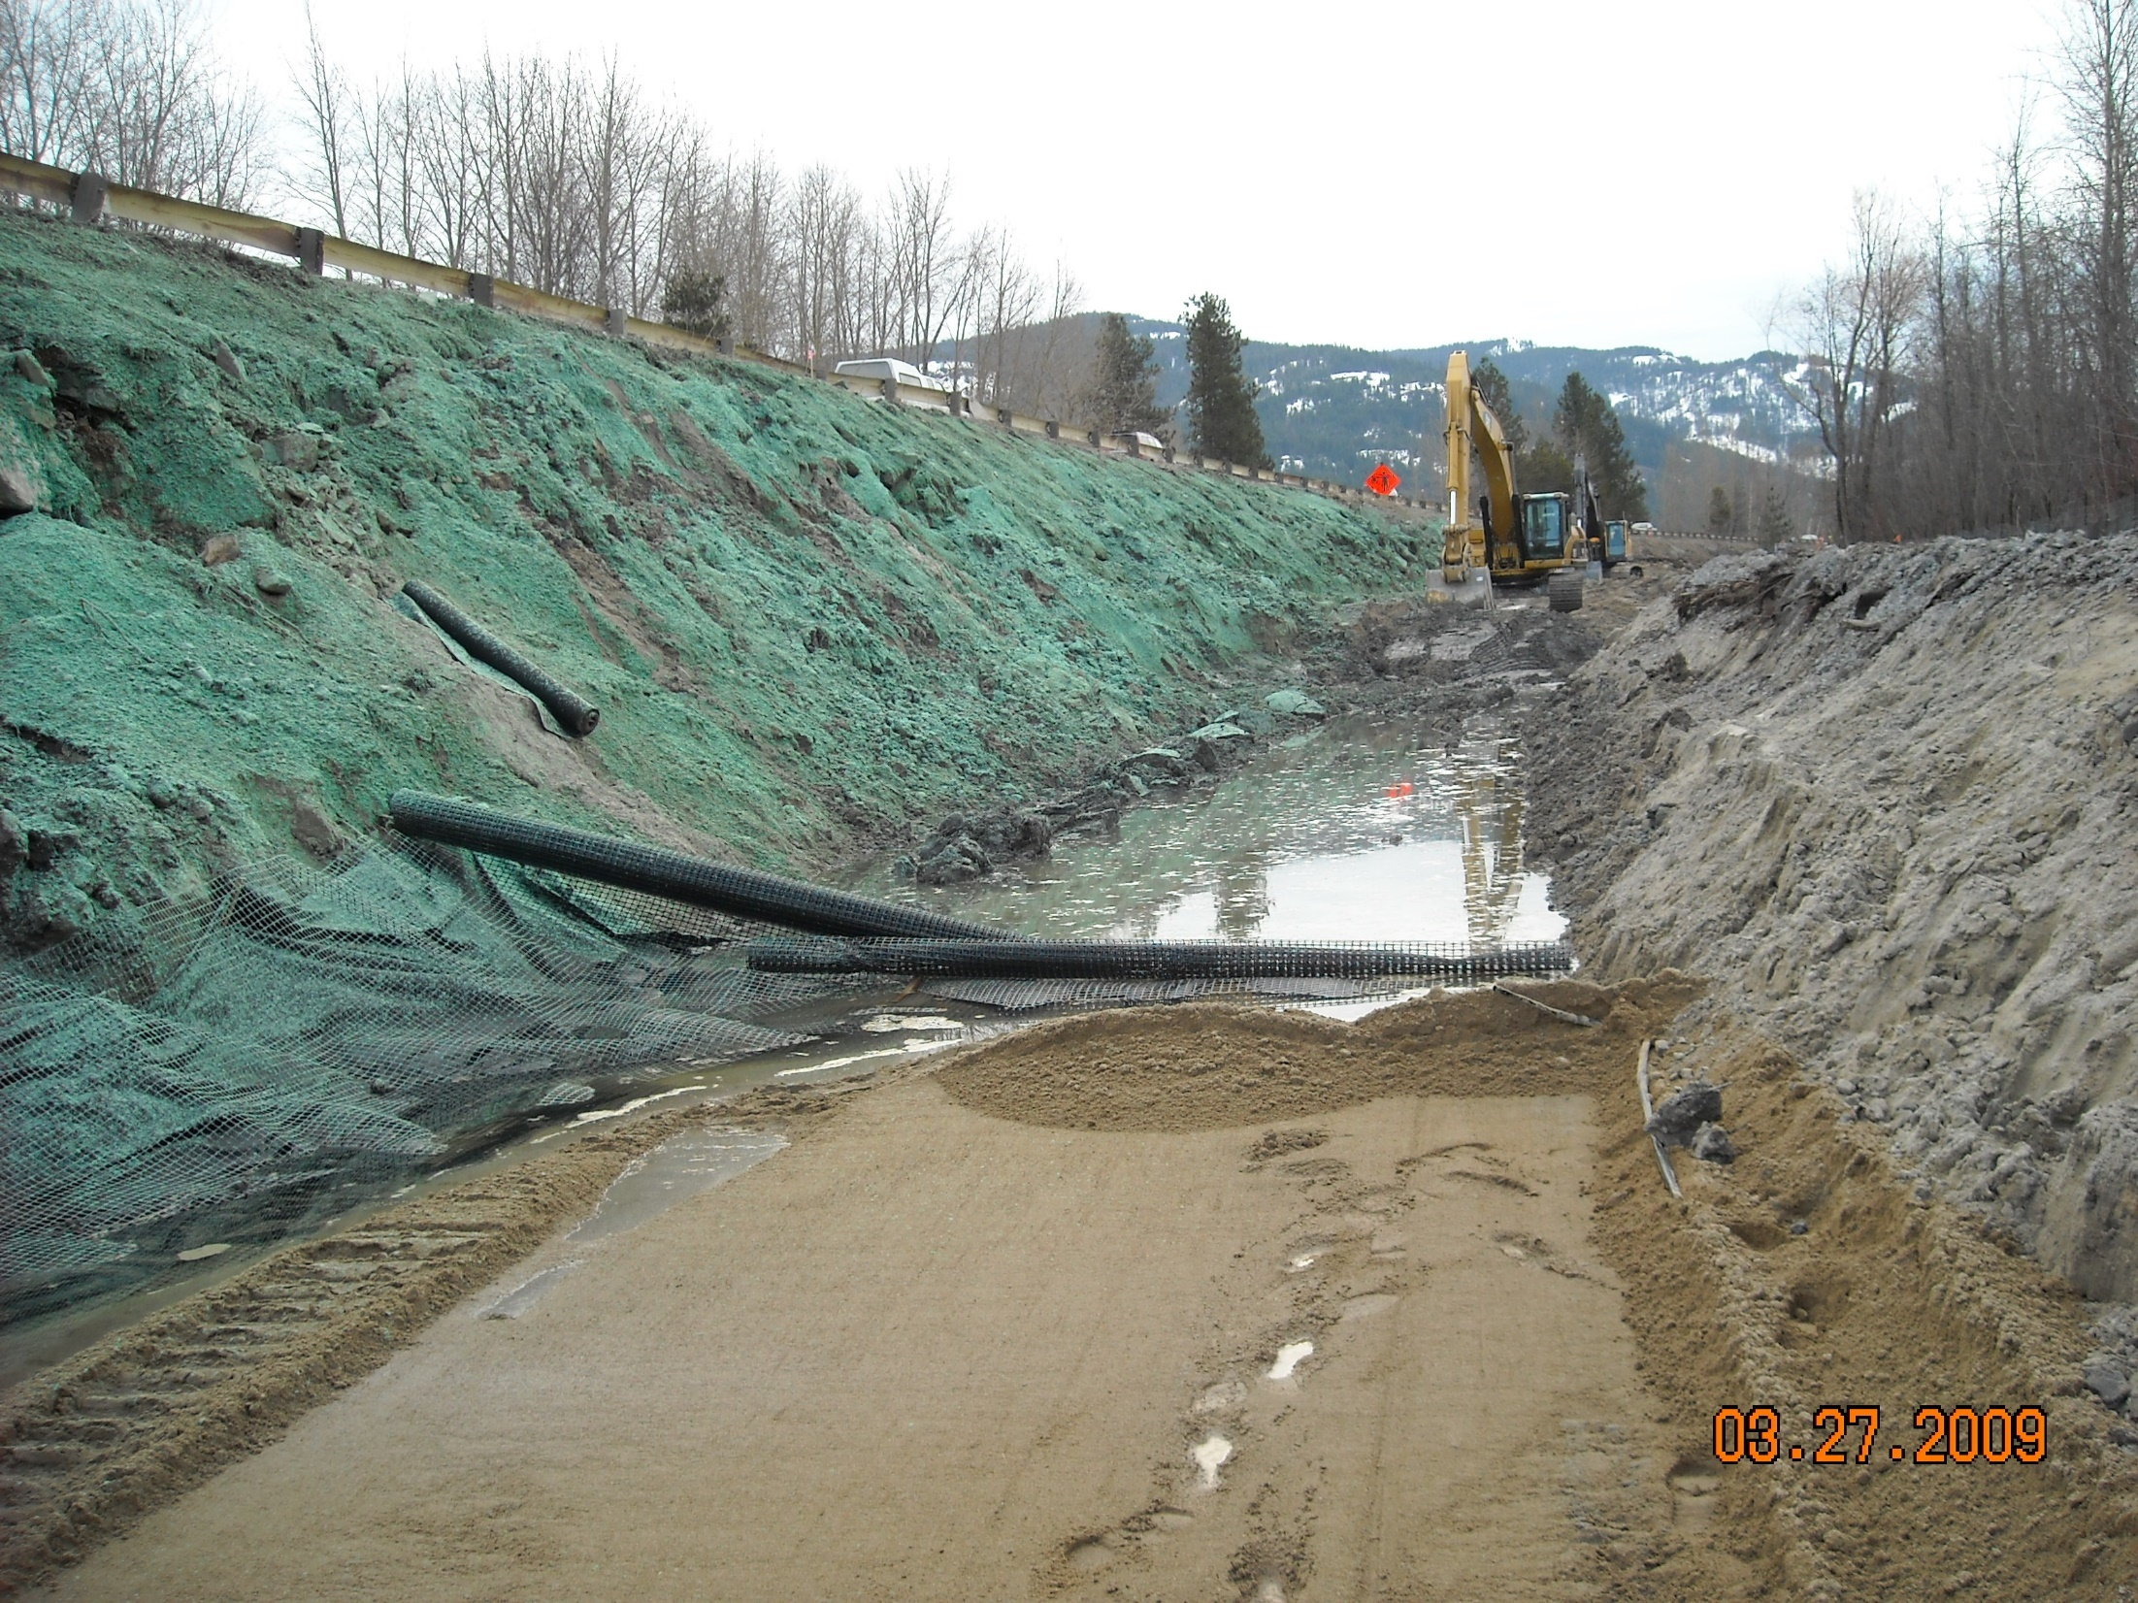

Slide 40
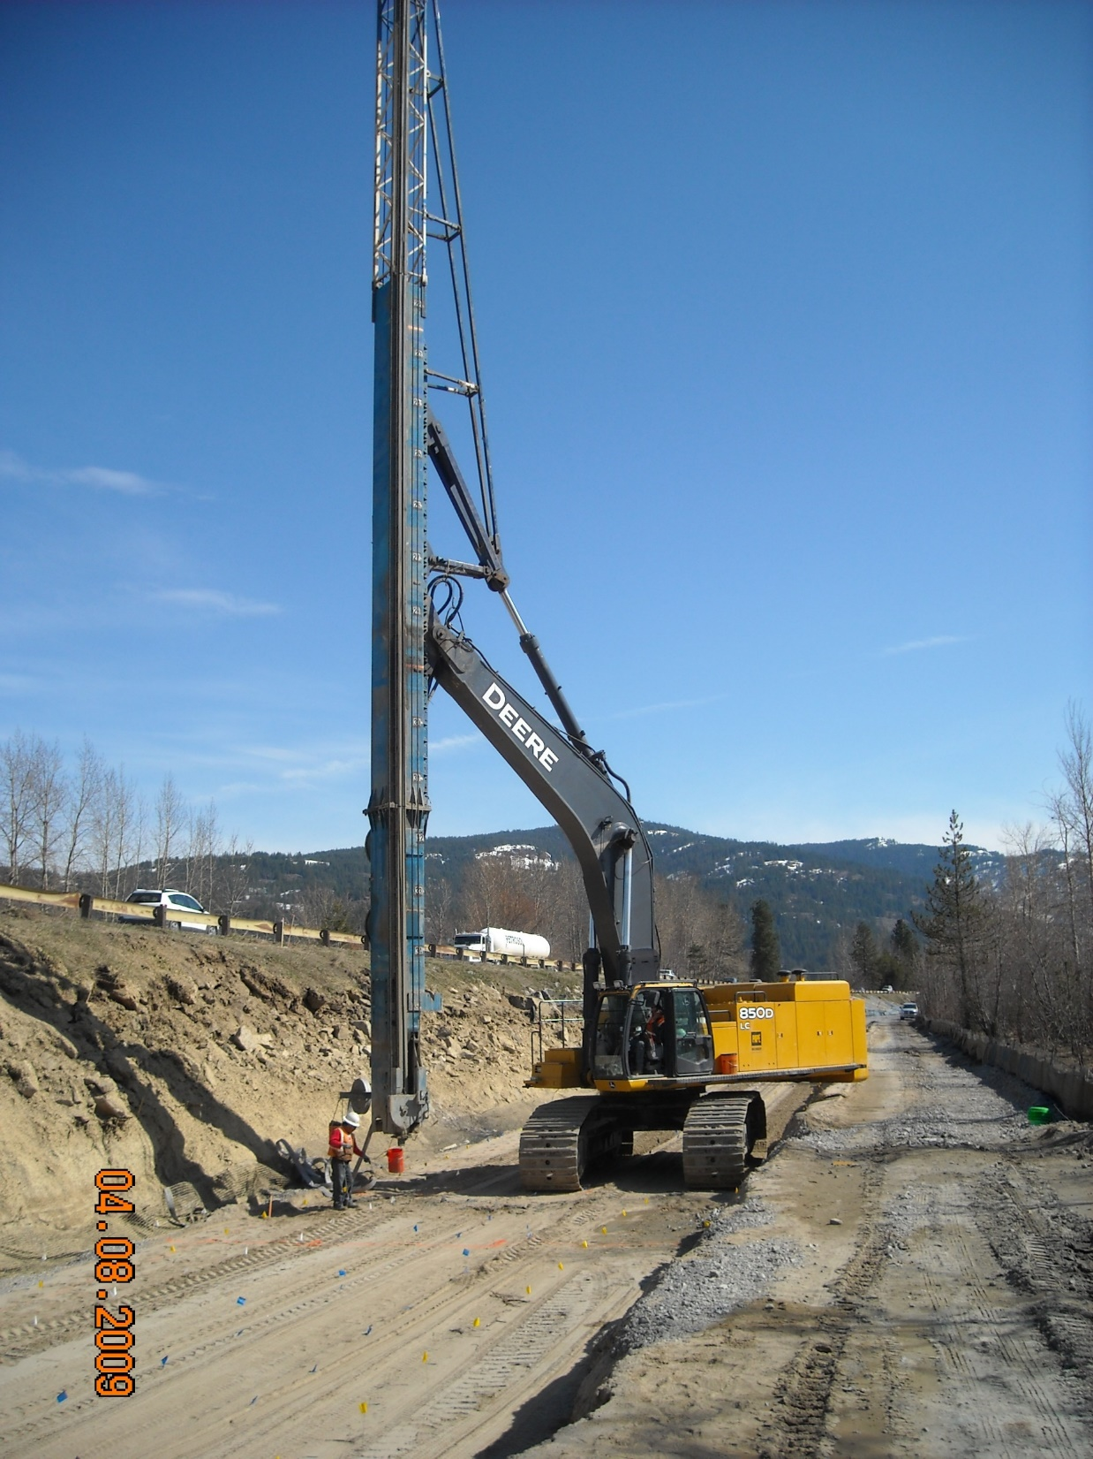
WICK DRAIN CONSTRUCTION

Slide 41
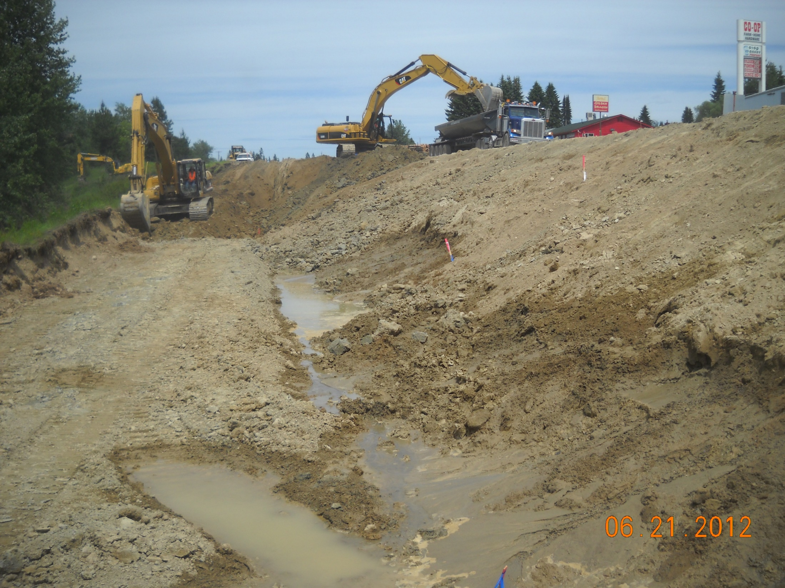
CHALLENGING BACKSLOPE CONDITIONS

Slide 42
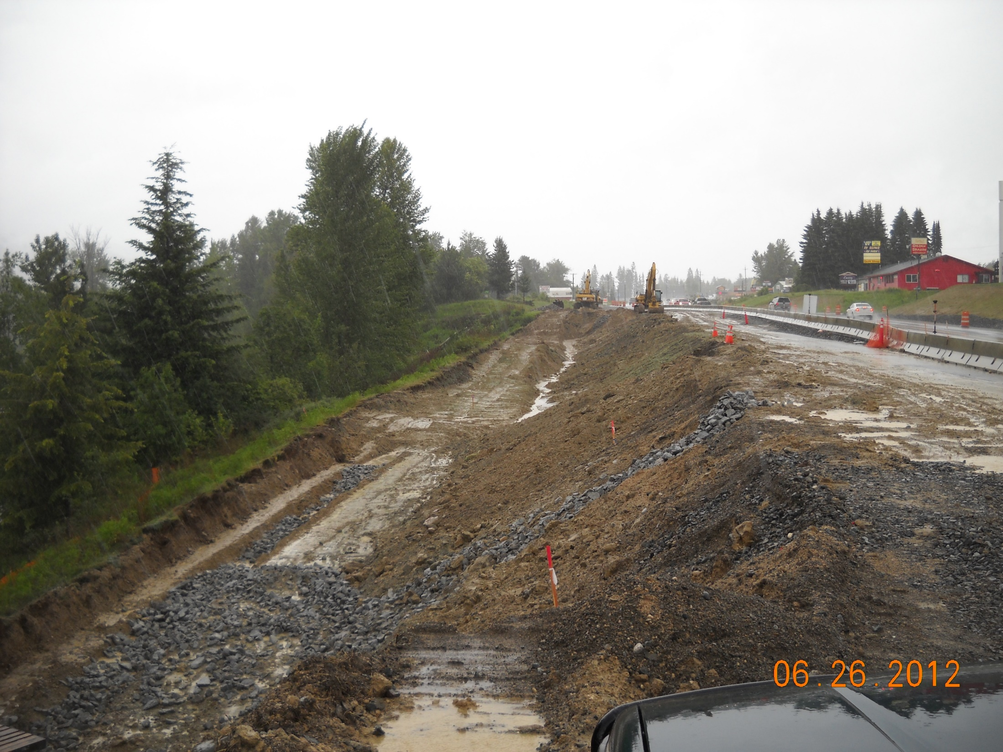
UNCOOPERATIVE JUNE WEATHER

Slide 43
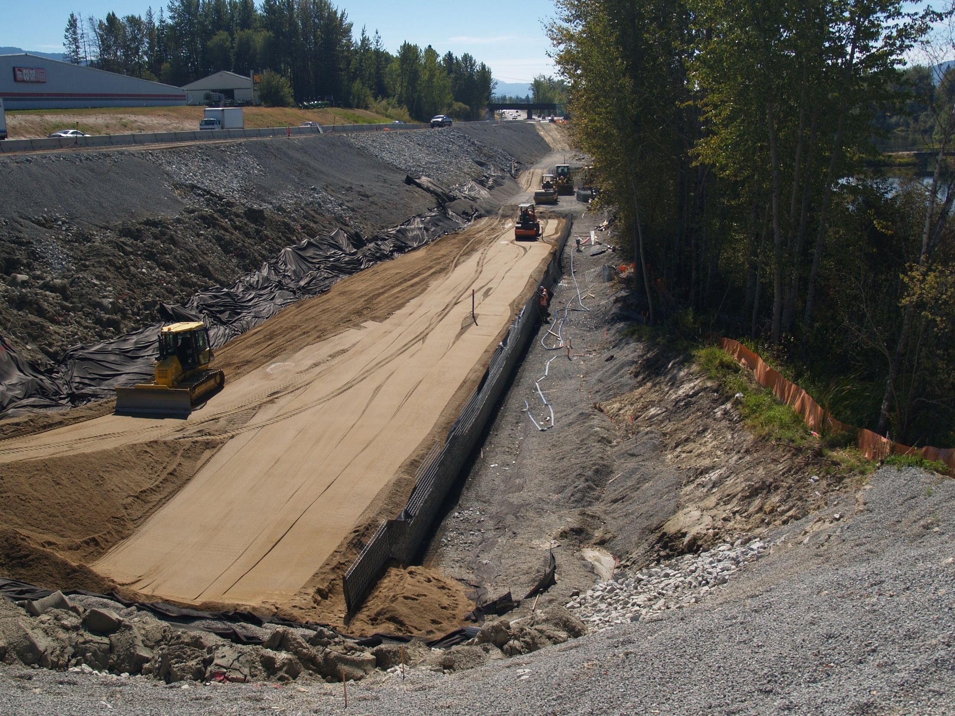

Slide 44
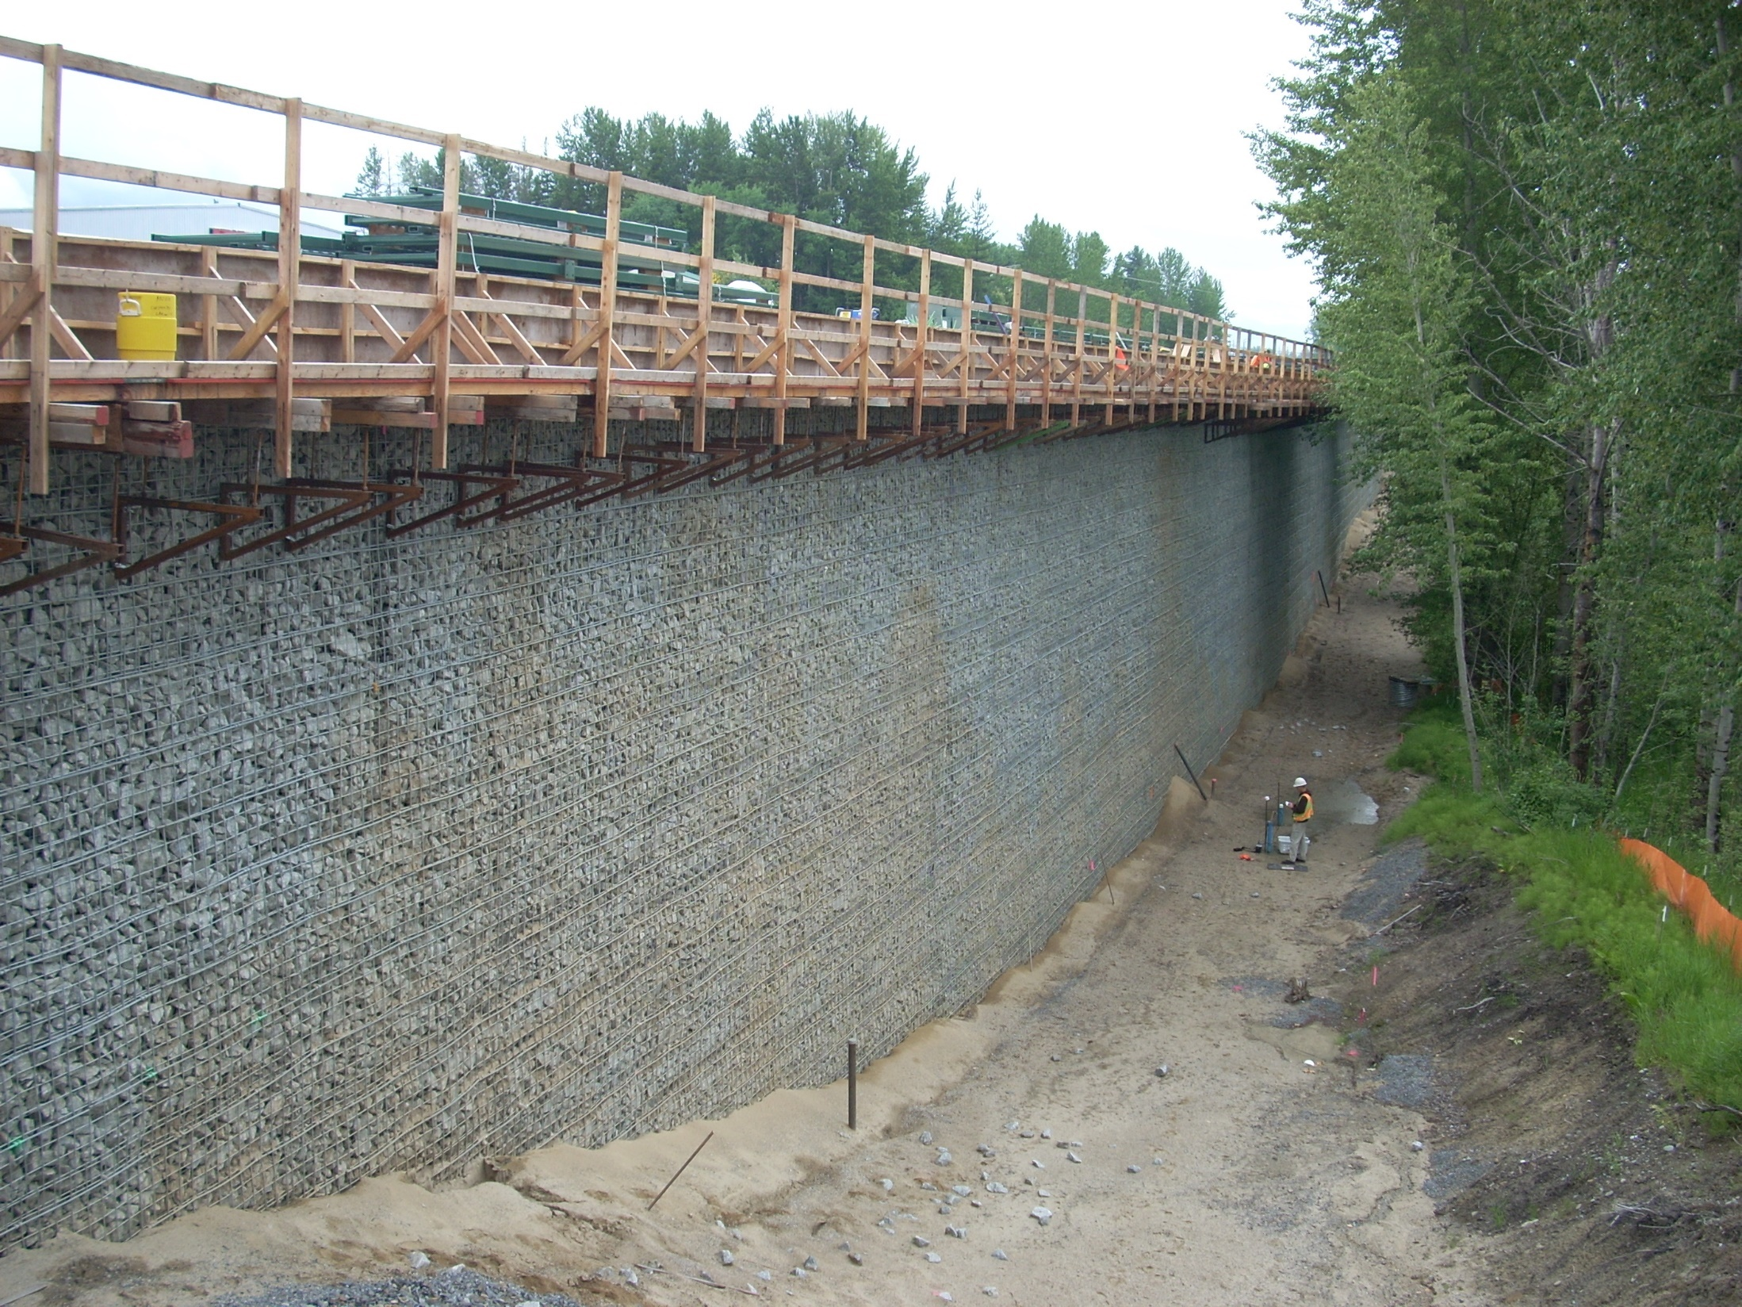
SUCCESSFUL MSE WALL CONSTRUCTION

Slide 45
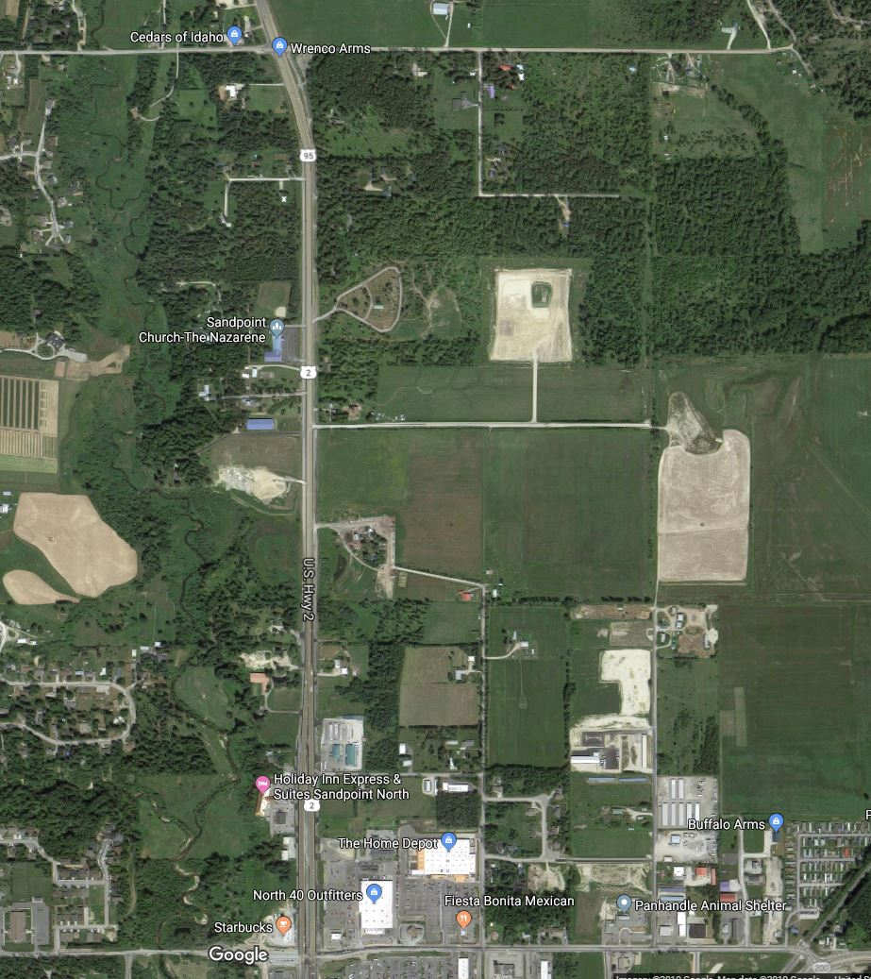
US-95 STA 106
PEAT BOG CHALLENGE

Slide 46
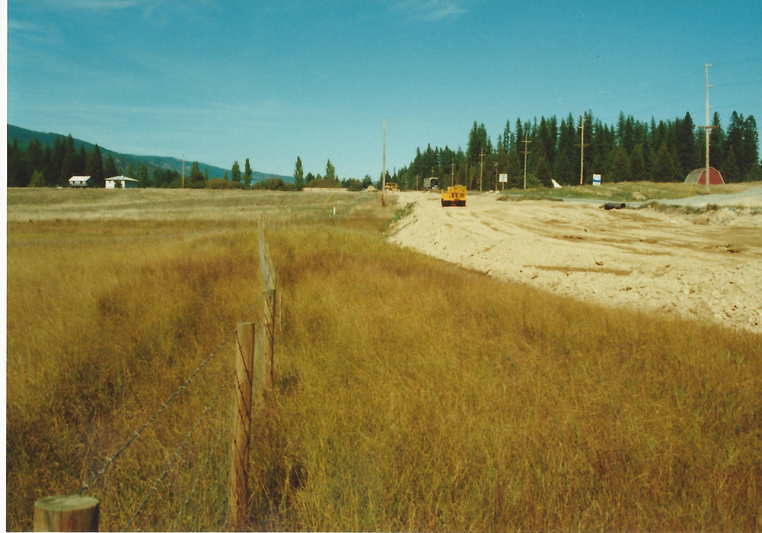

Slide 47
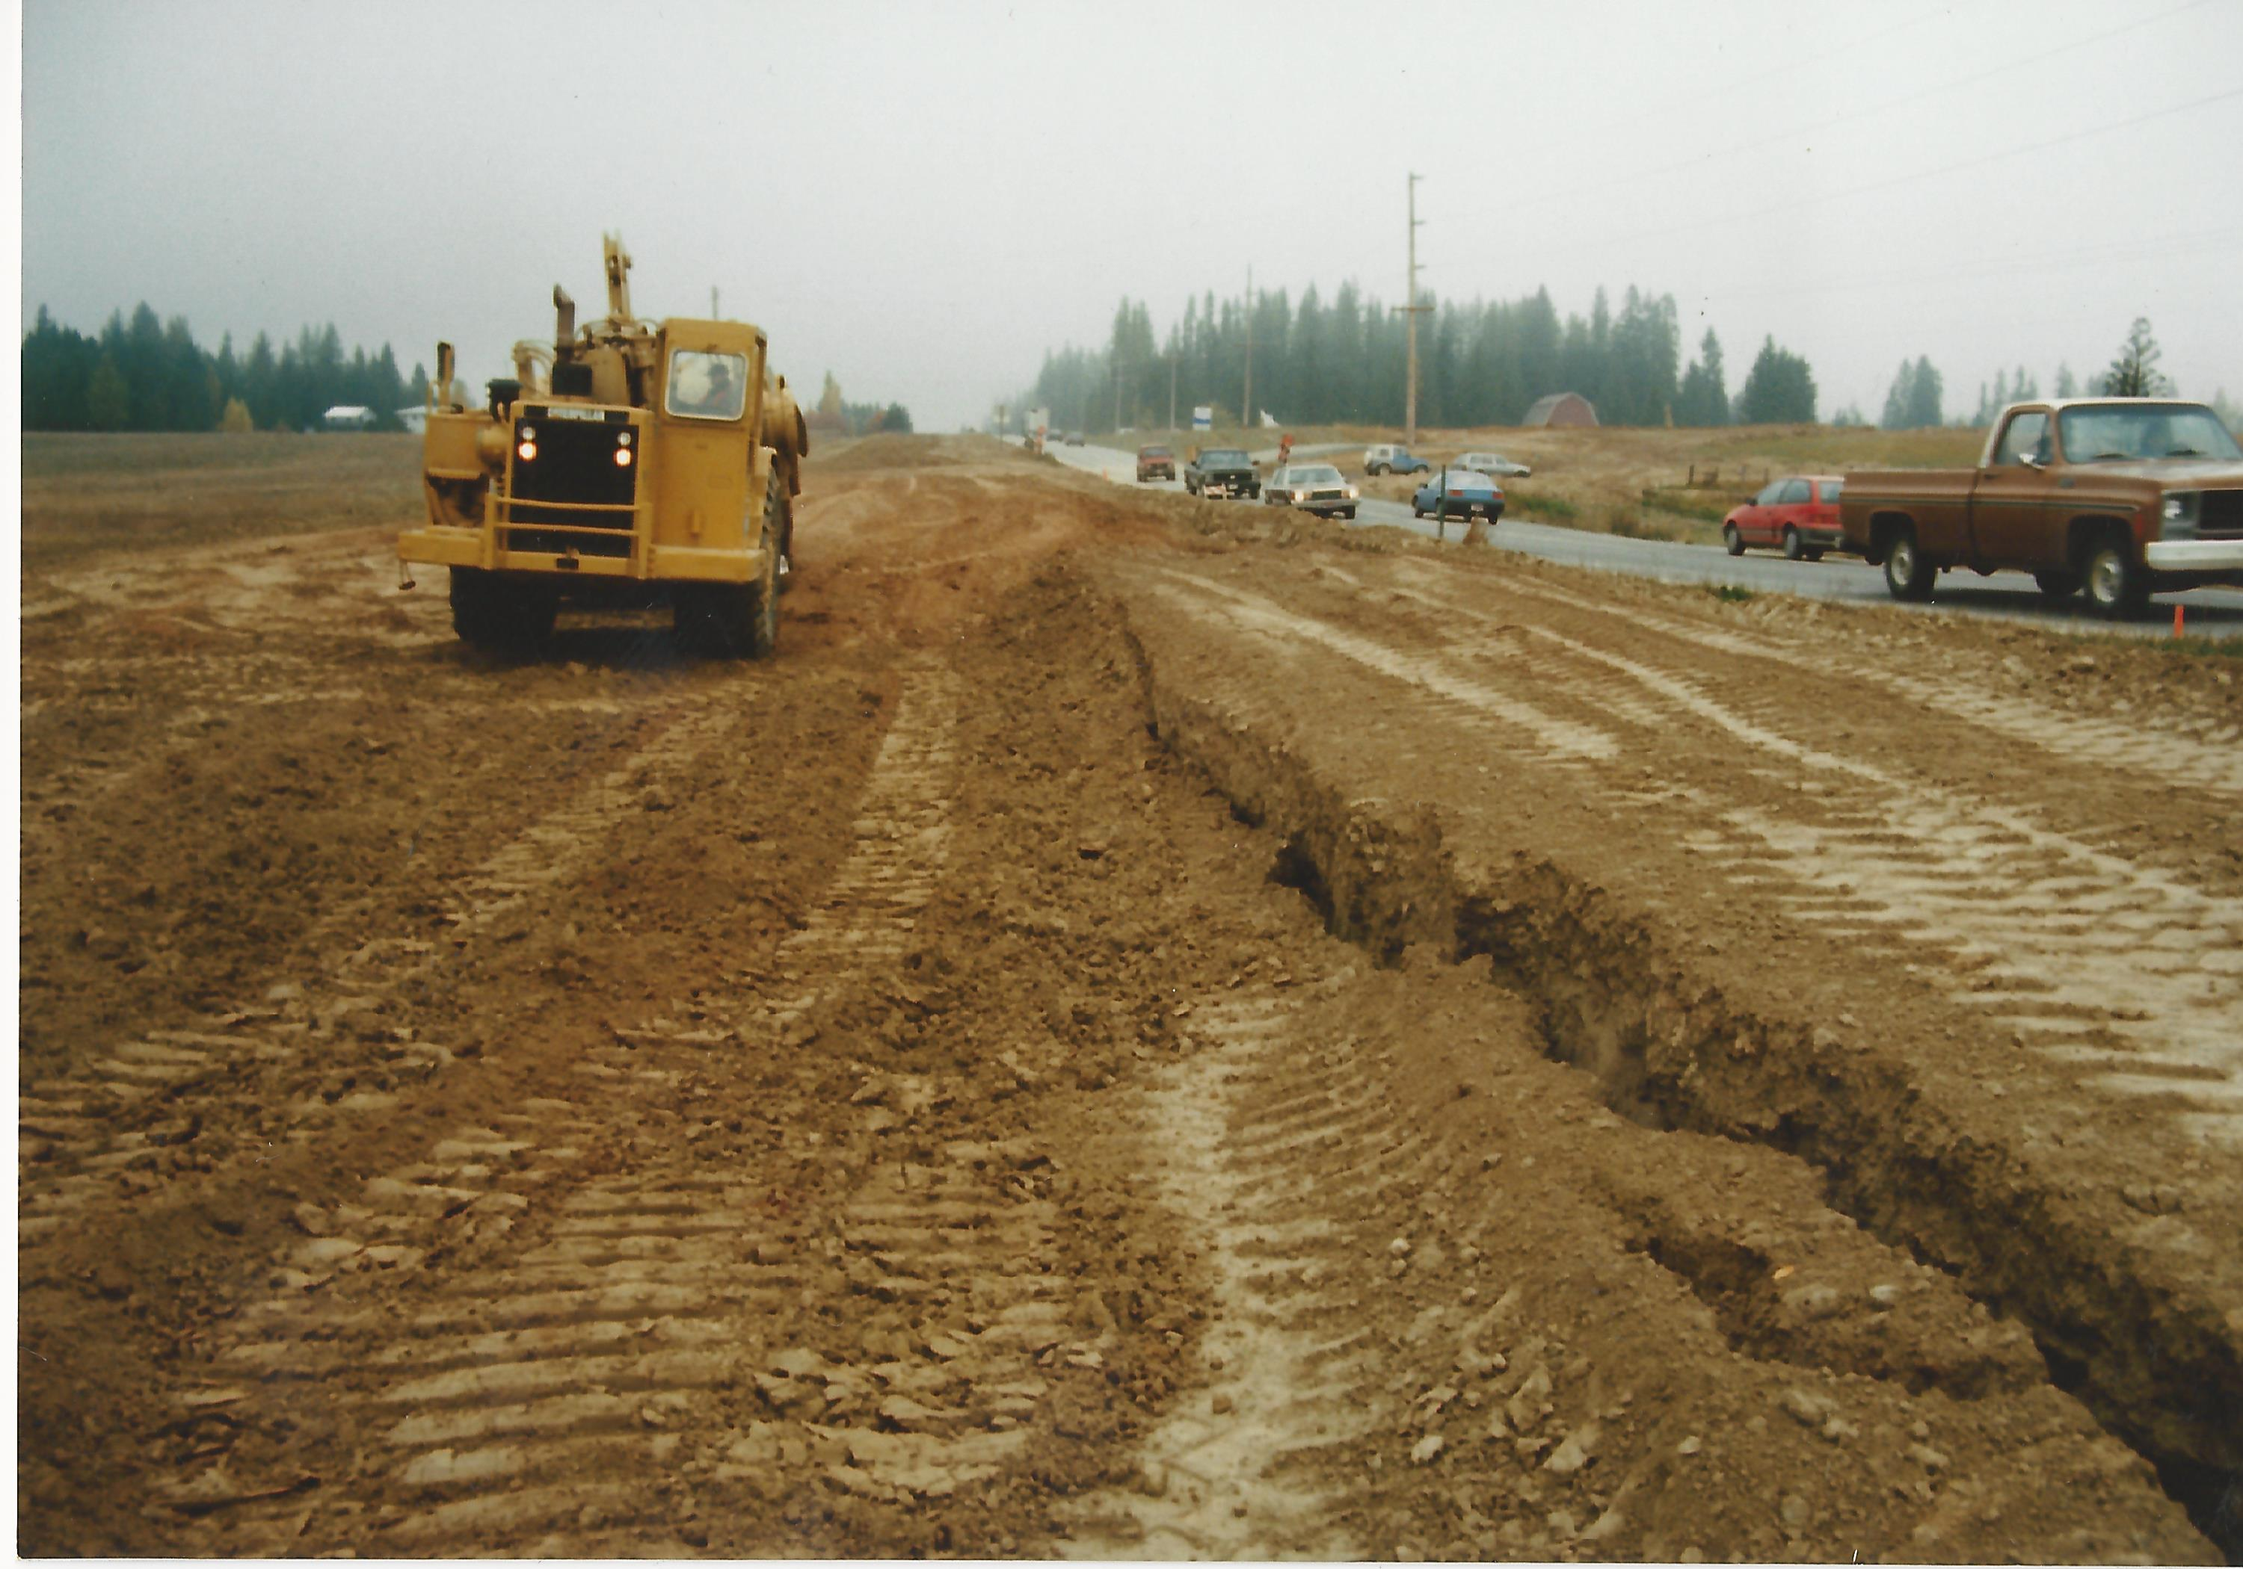

Slide 48
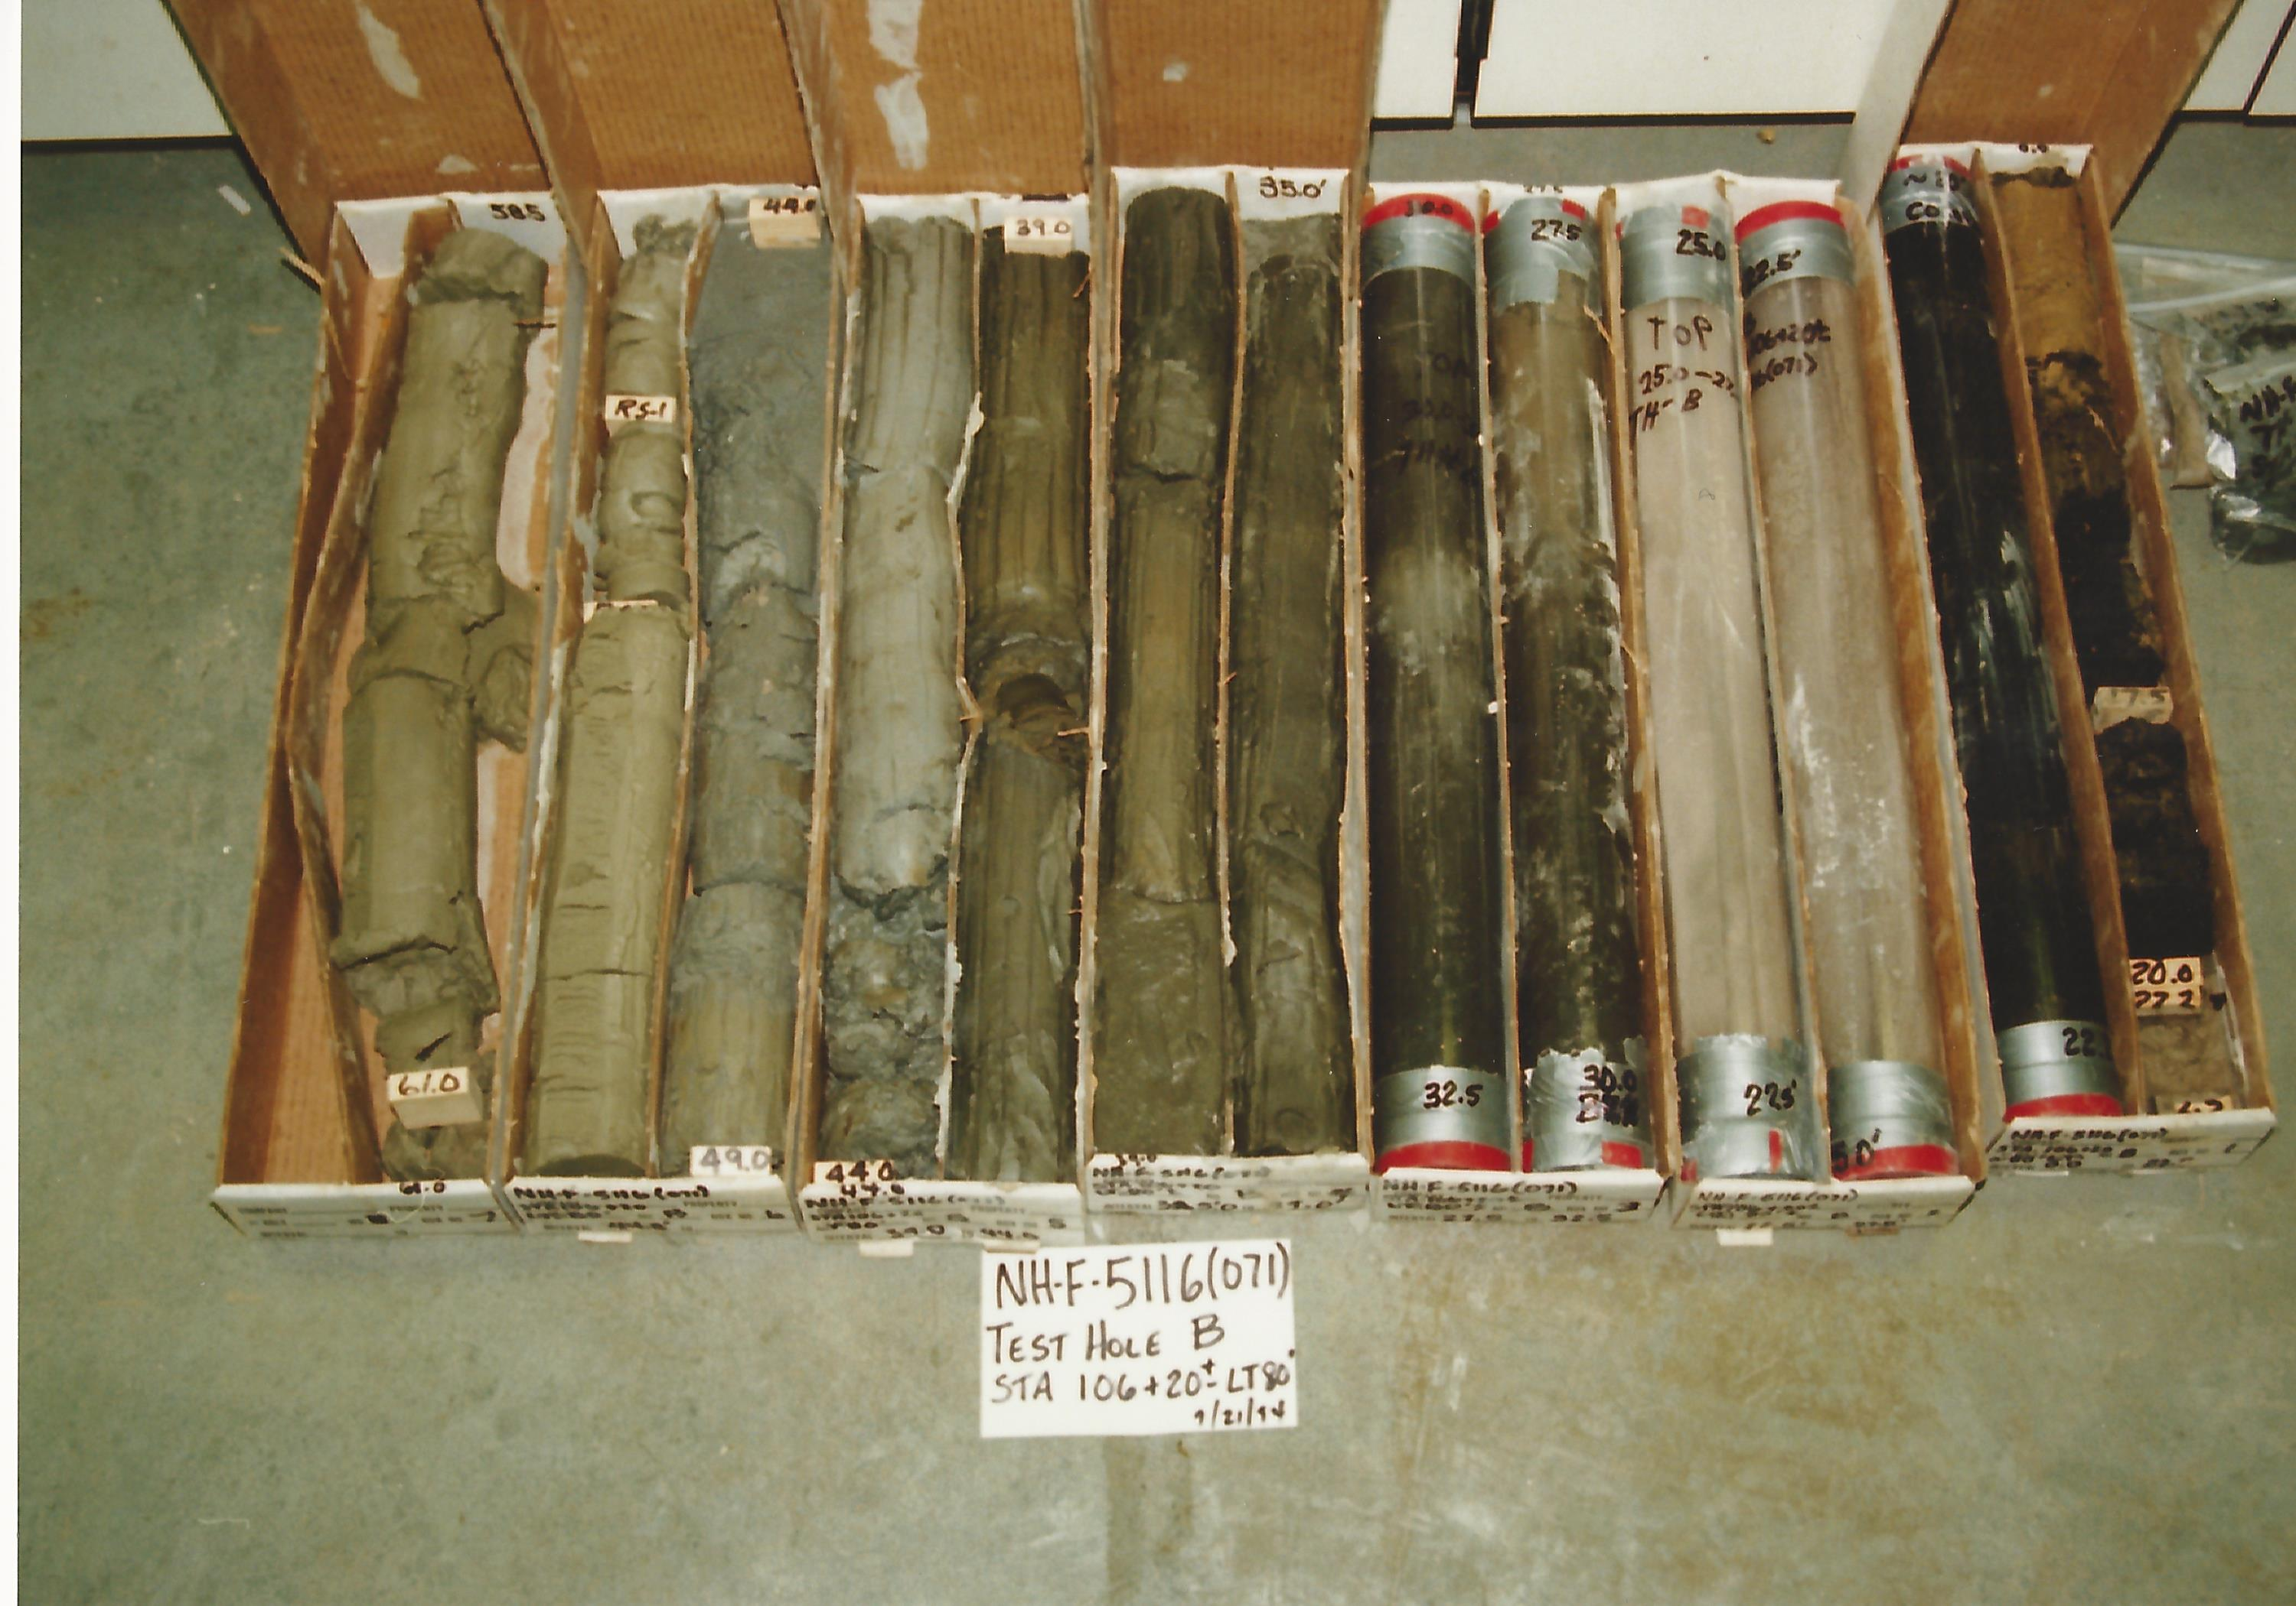

Slide 49
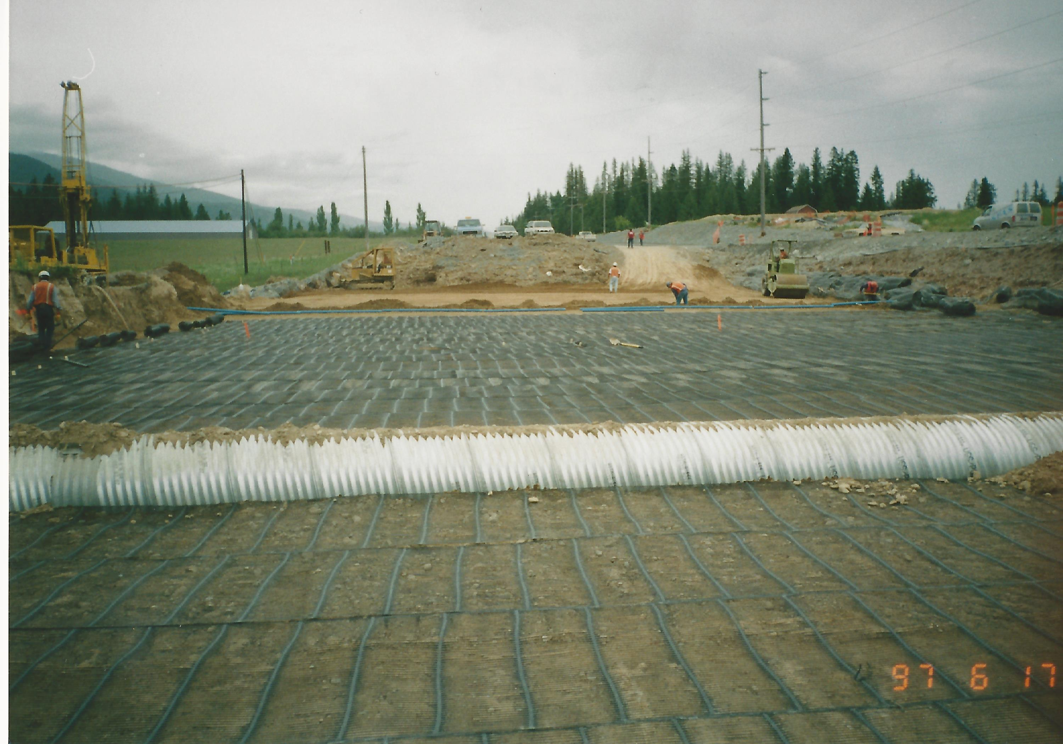
GEOGRID REINFORCED FOUNDATION

Slide 50
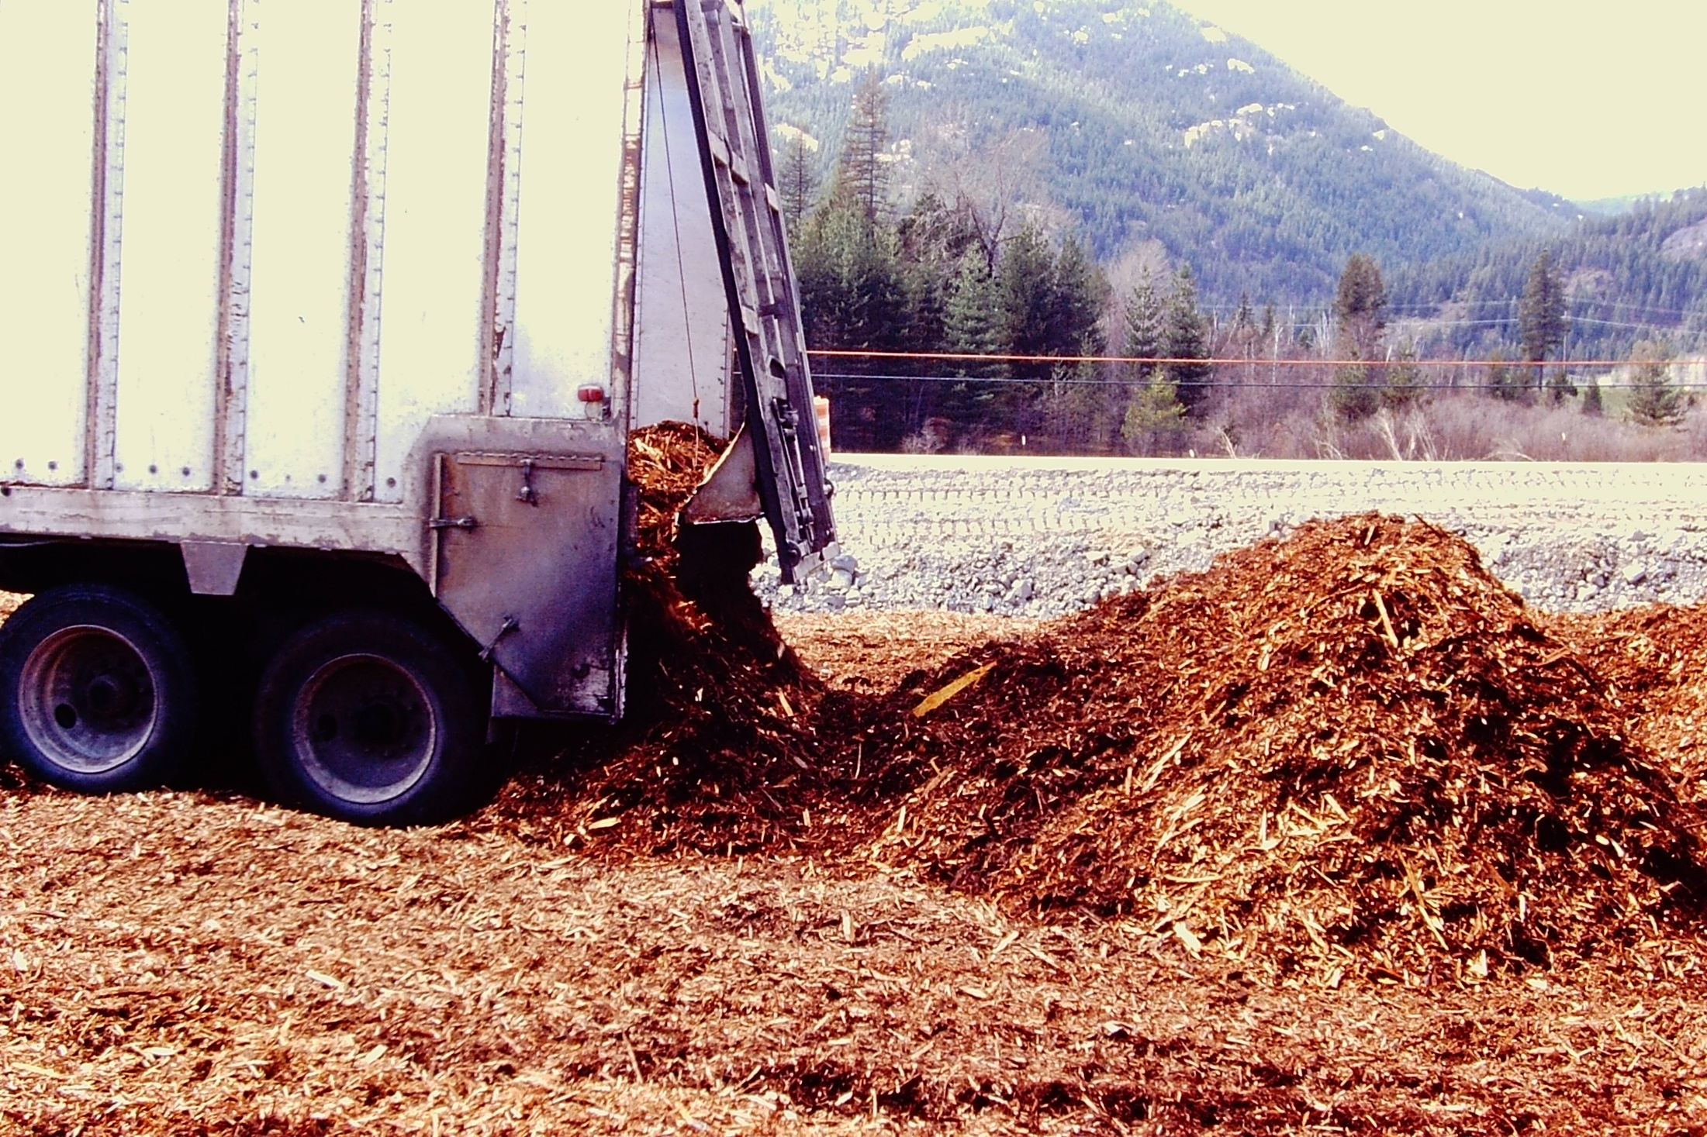
SHREDDED WOOD FILL

Slide 51

WOOD FILL SHOULD NOT BE READY TO COMBUST

Slide 52

110’ HIGH EMBANKMENT
FOUNDATION SUBEXCAVATION
US-95 BONNERS FERRY N. HILL

Slide 53

US-95 CLOSURE

Slide 54


Slide 55


Slide 56

NOT ALL SOFT SOILS
HARD ROCK EXCAVATION

Slide 57

13 Cubic Yard Shovel
100 Ton Truck
US-95 Copeland NE

Slide 58

Clark Fork River Pile Driving

Slide 59

Sandpoint Byway Pile Driving

Slide 60

Full Scale Pile Load Testing

Slide 61

PILING UP TO 260 FT LONG US-2 DOVER BRIDGE

Slide 62

Pile Point Protection

Slide 63

DOESN’T ALWAYS
WORK

Slide 64


Slide 65

Dynamic Pile Testing with PDA

Slide 66

Deep Soil Mixing
Sandpoint Byway

Slide 67


Slide 68

Light Weight, Cellular Concrete
Sandpoint Byway

Slide 69

I-90 Wallace
SOLDIER PILE WALLS

Slide 70

DRILLING FOR SOLDIER PILES

Slide 71

DHH ANCHOR DRILLING

Slide 72

Completed Viaduct
thru Wallace

Slide 73

DRILLED SHAFT FOUNDATION
15-40,000 PSI BASALT

Slide 74

Not so Controlled Blasting

Slide 75

Eastport, ID

Slide 76

THANK YOU

