Slide 1
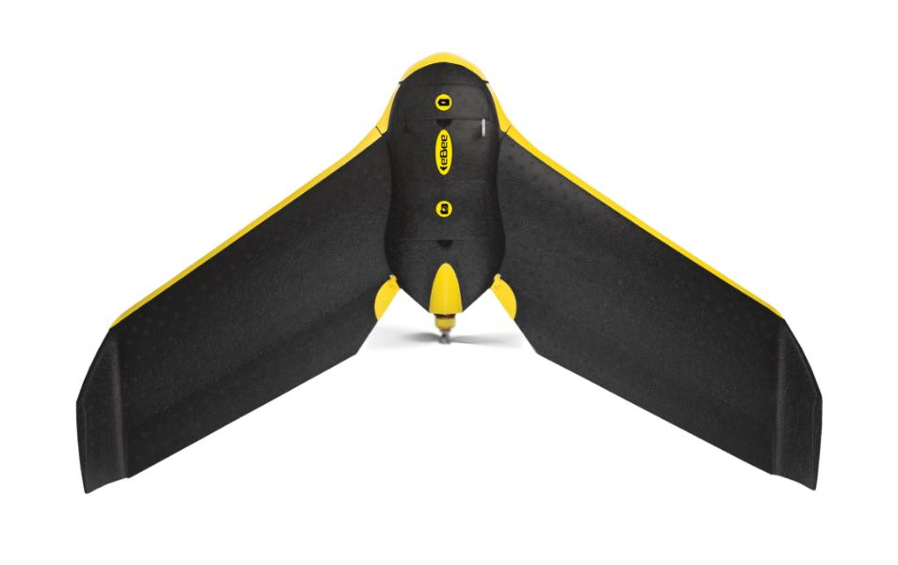
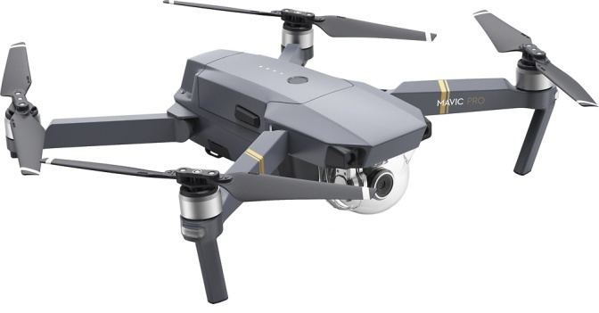
sUAS Capabilities & Regulations
Kelly Francis, President
Aero-Graphics, Inc.

Slide 2
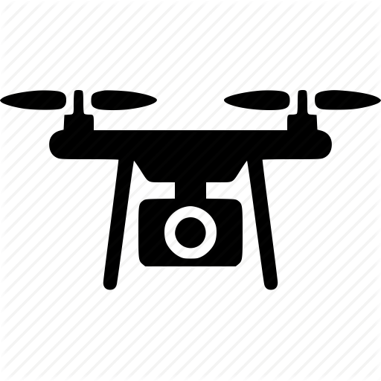
Small Unmanned Aircraft Systems
A small unmanned aircraft system (sUAS), often referred to as a drone, is an aircraft without a human pilot onboard – instead, the sUAS is controlled from an operator on the ground.
Also known as Unmanned Aerial Vehicle (UAV)
  Can be Fixed wing or Rotary Wing
  Can be Recreational or Commercial

Slide 3

FAA REGULATIONS
Final Rule implemented August 2016
Recreational UAV
  You are considered a recreational user if you fly your drone for fun, as a hobby
  Permitted under Section 349 or Part 107
Commercial UAV
  If a UAV is operated for any form of work or business
  Permitted under Part 107

Slide 4
FAA REGULATIONS
Educational UAV
  Permitted under Part 107 or Section 349
Public Safety and Government
  Permitted under Part 107; or
  Permitted under the statutory requirements for public aircraft (49 U.S.C. §40102(a) and § 40125). Operate with a Certificate of Waiver or Authorization (COA) to be able to self-certify UAS and operators for flights performing governmental functions.

Slide 5
Recreational UAV (Sec. 349)
Pilot Requirement:
  No pilot requirements, yet.
    The FAA Reauthorization Act of 2018 requires recreational flyers to pass an aeronautical knowledge and safety test.
    The FAA is currently developing a training module and test in coordination with the drone community.
The FAA Reauthorization Act of 2018 provides eight conditions that must be satisfied to use the exception for recreational small unmanned aircraft, Otherwise, the recreational operations must be conducted under 14 CFR part 107.

Slide 6
Recreational UAV (Sec. 349)
Eight statutory conditions to fly recreationally:
  1) The aircraft is flown strictly for recreational purposes.
  2) The aircraft is operated in accordance with community-based safety guidelines.
  3) The aircraft is flown within visual line of sight.
  4) The aircraft does not interfere with manned aircraft.
  5) Prior authorization required to operate in Class B, C or D
  6) Operate at < 400’ in Class G airspace.
  7) Pass an aeronautical knowledge and safety test.
  8) The aircraft is registered and marked.

Slide 7
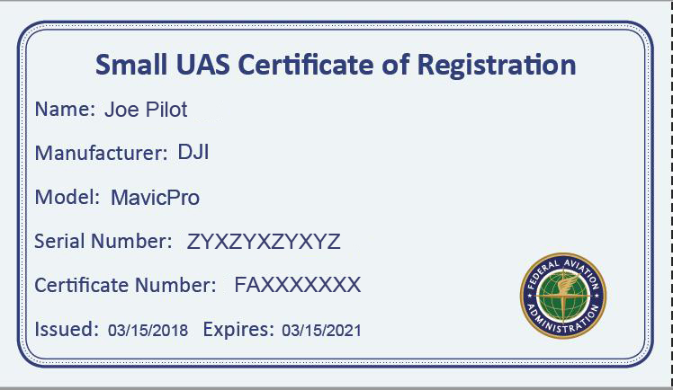
Recreational UAV
Aircraft Requirements:
  Must be registered with the FAA if the UAV is over 0.55 lbs
  Mark the UAV with the FAA registration number
  Must be 13 or older to register; registration good for 3 years, cost: $5
  The remote pilot in command must conduct a preflight check of the UAV to ensure that it is in a condition for safe operation

Slide 8
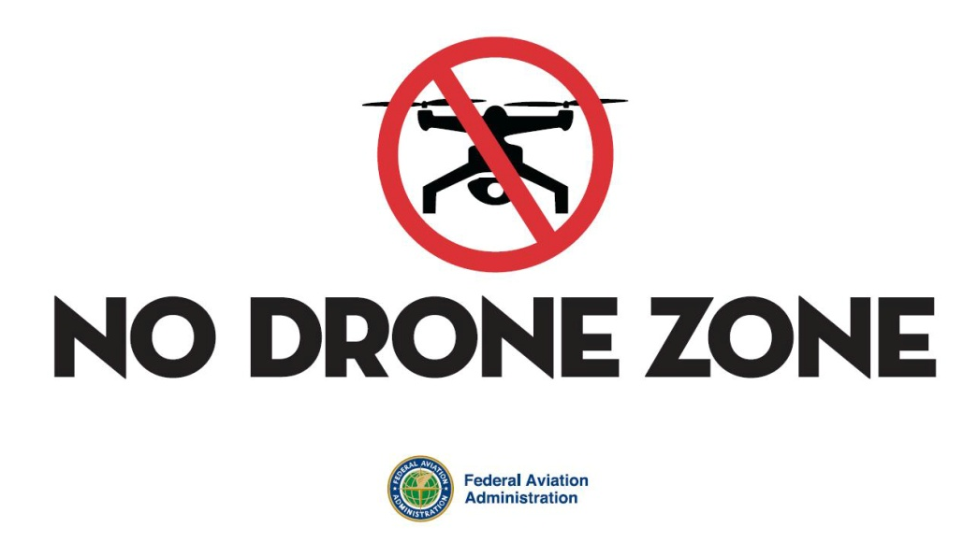
Recreational UAV
Operating Rules:
Never fly near other aircraft. Always give way to other aircraft
Never fly over groups of people, public events, or stadiums full of people.
Never fly near or over emergency response efforts
Never fly under the influence of drugs or alcohol
Follow all FAA airspace restrictions

Slide 9
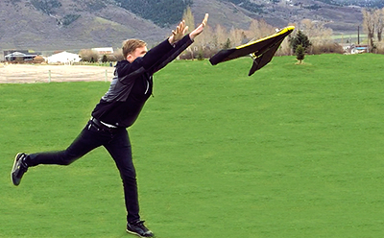
Commercial UAV
What Constitutes “Commercial” Use?
  Providing aerial surveying or inspection services
  Flying incidental to a business (e.g. performing roof inspections, real estate photography, marketing photos)

Slide 10
Commercial UAV (Part 107)
Pilot Requirement:
  Demonstrate aeronautical knowledge by either:
    Passing an initial aeronautical knowledge test at an FAA-approved knowledge testing center; or
    Hold a Part 61 pilot certificate other than student pilot, complete a flight review within the previous 24 months, and complete a small UAS online training course provided by the FAA.
  Be vetted by the Transportation Security Administration
  Be at least 16 years old
  Be able to read, speak, write, and understand the English language
  Renew certification after 24 months

Slide 11
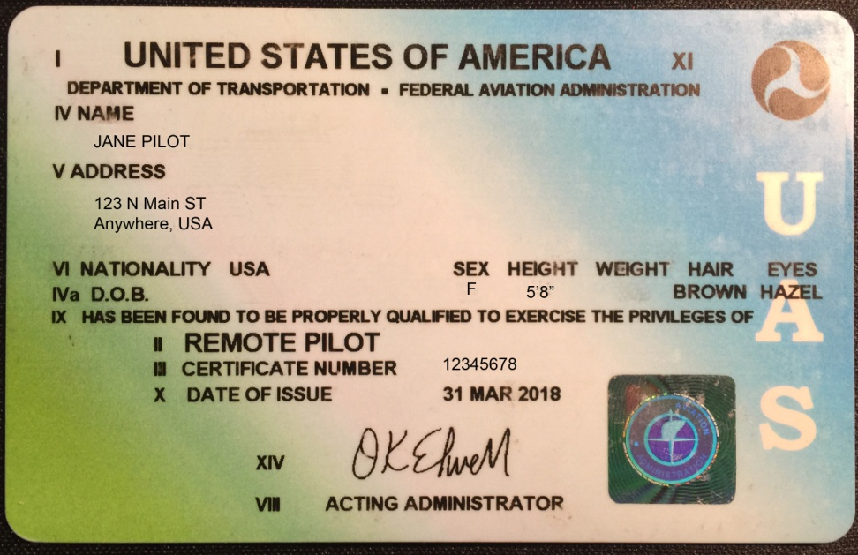
Commercial UAV
  The remote pilot-in-command is directly responsible for:
    the operation of the sUAS
    ensuring that the sUAS will pose no undue hazard to other people, other aircraft, or other property in the event of a loss of control of the aircraft for any reason

Slide 12
Commercial UAV
Aircraft Requirements:
  UAV must be registered with the FAA if it weighs over 0.55 lbs, cost is $5, good for 3 years
  Mark the UAV with the FAA registration number
  FAA airworthiness certification is not required. However, the remote pilot in command must conduct a preflight check of the sUAS to ensure that it is in a condition for safe operation

Slide 13
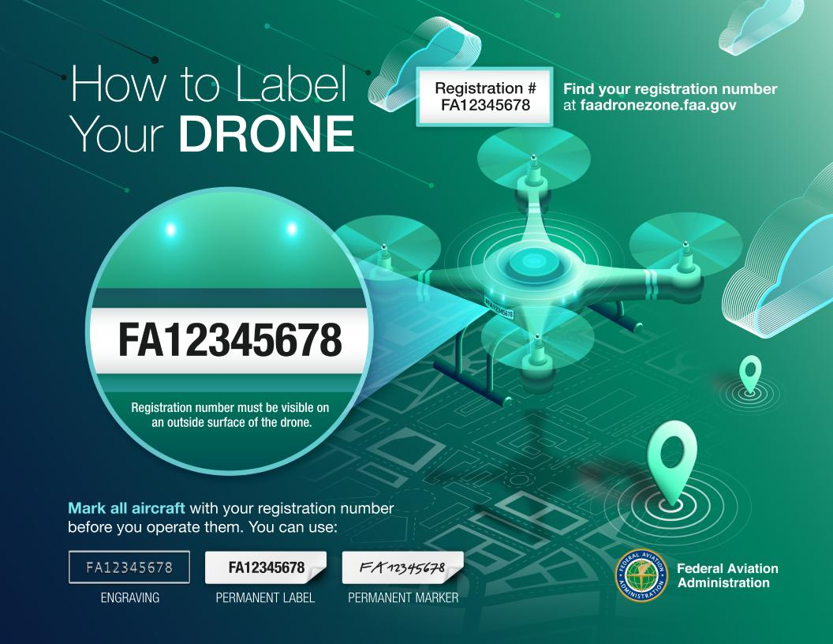
UAV Marking Rule
14 CFR Part 48: External Marking Requirement for Small Unmanned Aircraft (2019)

Slide 14
Commercial UAV
Operating Rules:
  sUAS must weigh less than 55 lbs. including payload
  Visual line-of-sight (VLOS): the sUAS must remain within VLOS of the remote pilot-in-command and the person manipulating the flight controls of the sUAS. Alternatively, the unmanned aircraft must remain within VLOS of the visual observer
  At all times the UAV must remain close enough to the remote pilot in command and the person manipulating the flight controls for those people to be capable of seeing the aircraft with vision unaided by any device other than corrective lenses

Slide 15
Commercial UAV
Operating Rules:
  UAV’s may not operate over any persons that are not directly involved with the operation that are not inside a covered structure or stationary vehicle
  Only daylight operations, or during civil twilight with anti-collision lighting
  Must yield right of way to other manned aircraft
  May use visual observer (VO) but not required
  First-person view camera cannot satisfy “see-and-avoid” requirement but can be used as long as requirement is satisfied in other ways.

Slide 16
Commercial UAV
Operating Rules:
  Maximum ground speed of 100 mph
  Maximum altitude of 400 feet above ground level (AGL) or 400 feet above a structure
  Minimum weather visibility of 3 miles from control station
  Minimum 500 Feet below clouds, 2000 feet horizontally from clouds
  Operations in Class B, C, D and E controlled airspace are allowed with the required ATC permission.
  Operations in Class G airspace are allowed without ATC permission

Slide 17

Commercial UAV
Operating Rules:
  No person may act as a remote pilot in command or VO for more than one unmanned aircraft operation at one time
  No operations from a moving vehicle (including boats) unless the operation is over a sparsely populated area
  Never fly under the influence of drugs or alcohol
  No operations from a moving aircraft
  No operations over moving vehicles
  No careless or reckless operations
  No carriage of hazardous materials

Slide 18
Commercial UAV
Operating Rules:
  The small UAS rule (14 CFR part 107) includes the option to apply for a certificate of waiver, which allows for a small UAS operation to deviate from certain operating rules if the FAA finds that the proposed operation can be performed safely

Slide 19
Commercial UAV
Waivers:
  Daylight operation(§ 107.29)
  Operating over a person or people (§ 107.39)
  Flying from a moving vehicle or aircraft, not in a sparsely populated area (§ 107.25)
  Operating multiple UAV (§ 107.35)
  Flying beyond the pilot's visual line-of-sight (§ 107.31)
  Operating limitations for UAV (§ 107.51)
  Flying in certain airspace (§ 107.41)
  Visual observer (§ 107.33)

Slide 20
Idaho State Drone Law
SB 1213 // 2016
This law prohibits the use of drones for hunting, molesting, or locating game animals, game birds, or fur-bearing animals.
SB 1134 // 2013
This law requires warrants for the use of drones by law enforcement, establishes guidelines for their use by private citizens, and provides civil penalties for damage caused by their improper use.

Slide 21
Commercial UAV
To fly a UAV that weighs 55 lbs. or more, operators will need to use the Public Law 112-95 Section 333 exemption process.

Slide 22
FAA Part 107 Knowledge Test
sUAS system rating privileges, limitations, and flight operation;
Airspace classification, operating requirements, and flight restrictions affecting sUAS operation;
Aviation weather sources and effects of weather;
sUAS loading and performance;
Emergency procedures;
Radio communication procedures;
Physiological effects of drugs and alcohol;

Slide 23
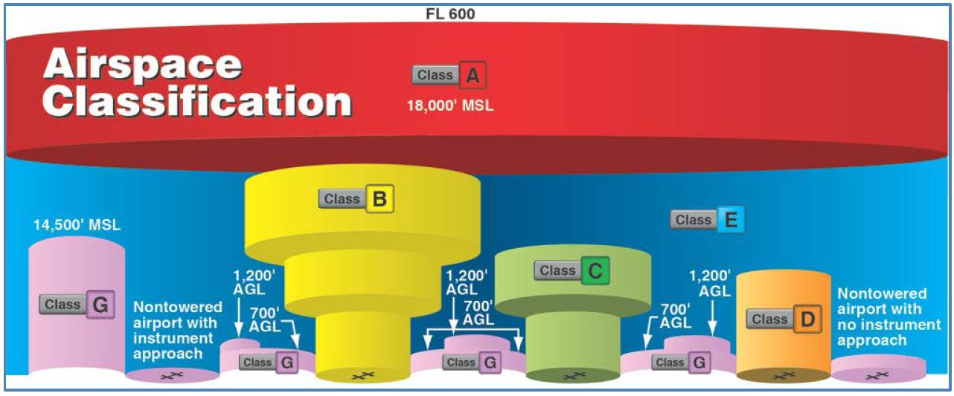
Where Can I Fly?
Classifications for Airspace
  Controlled: Class A, B, C, D, E
  Uncontrolled: Class G

Slide 24
Where Can I Fly?
Recreational UAV (Sec. 336):
  Uncontrolled Class G airspace
  Fly in controlled airspace only at pre-approved FAA sites
  Up to 400 feet AGL
Commercial UAV (Part 107):
  Operations in Class B, C, D and E controlled airspace are allowed with the required ATC permission.
  Operations in Class G airspace are allowed without ATC permission
  Up to 400 feet AGL

Slide 25
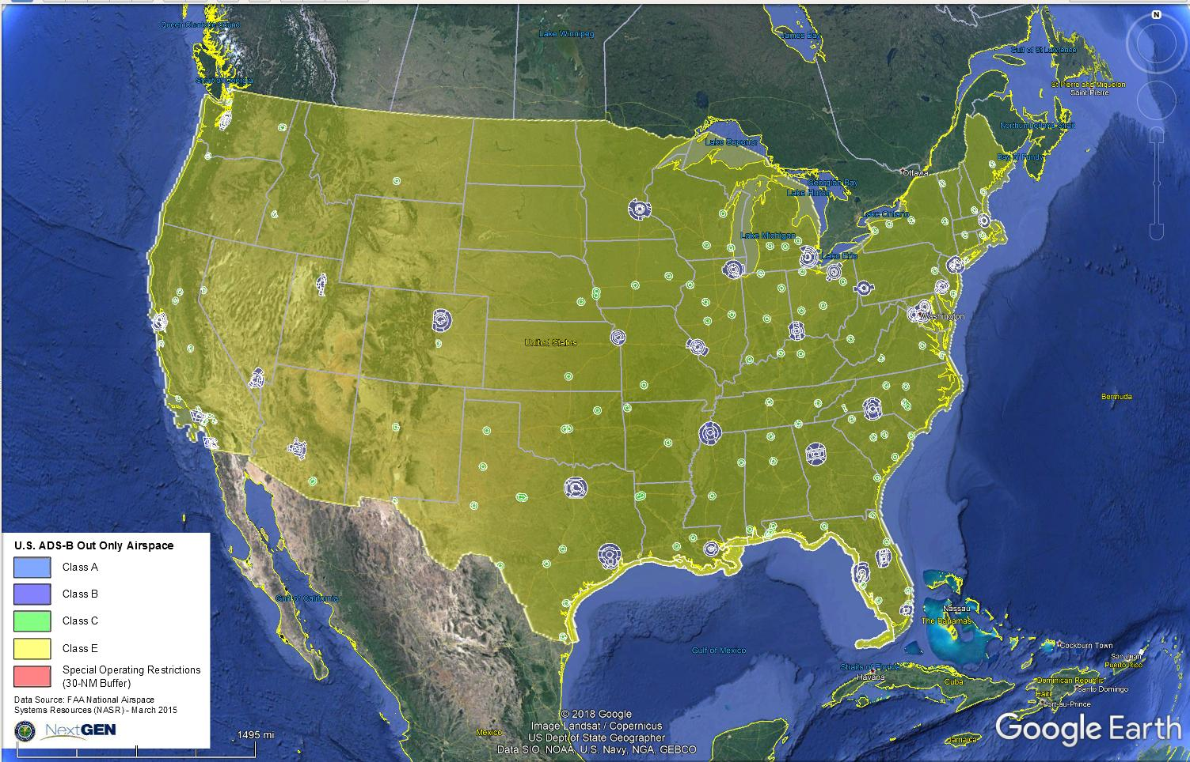
Where Can I Fly?

Slide 26
Where Can I Fly?
Class B Airspace
  Class B airspace is generally airspace from the surface to 10,000 feet mean sea level (MSL) surrounding the nation’s busiest airports in terms of airport operations or passenger enplanements.
Class C Airspace
  Class C airspace is generally airspace from the surface to 4,000 feet above the airport elevation (charted in MSL) surrounding those airports that have an operational control tower, are serviced by a radar approach control, and have a certain number of instrument flight rules (IFR) operations or passenger enplanements.

Slide 27
Where Can I Fly?
Class D Airspace
  Class D airspace is generally airspace from the surface to 2,500 feet above the airport elevation (charted in MSL) surrounding those airports that have an operational control tower.
Class E Airspace
  Class E airspace is the controlled airspace not classified as Class A, B, C, or D airspace. A large amount of the airspace over the United States is designated as Class E airspace. In most areas, the Class E airspace base is 1,200 feet above ground level (AGL). In many other areas, the Class E airspace base is either the surface or 700 feet AGL.

Slide 28
Where Can I Fly?
Class G Airspace
  Uncontrolled airspace or Class G airspace is the portion of the airspace that has not been designated as Class A, B, C, D, or E. It is therefore designated uncontrolled airspace. Class G airspace extends from the surface to the base of the overlying Class E airspace

Slide 29
Where Can I Fly?
Special Use Airspace
  Special use airspace or special area of operation (SAO) is the designation for airspace in which certain activities must be confined, or where limitations may be imposed on aircraft operations that are not part of those activities. Certain special use airspace areas can create limitations on the mixed use of airspace.

Slide 30
Where Can I Fly?
Special use airspace usually consists of (shown on Aeronautical Charts):
  Prohibited areas
  Restricted areas
  Warning areas
  Military operation areas (MOAs)
  Alert areas
  Controlled firing areas (CFAs)

Slide 31
Where Can I Fly?
Other Airspace Areas
A general term referring to the majority of the remaining airspace. It includes:
  Local airport advisory (LAA)
  Military training route (MTR)
  Temporary flight restriction (TFR)
  Parachute jump aircraft operations
  Published VFR routes
  Terminal radar service area (TRSA)
  National security area (NSA)

Slide 32
Where Can I Fly?
Locations where UAV’s are prohibited:
  All National Parks
  Washington DC
  Airports
  Military bases
  Where Temporary Flight Restrictions (TFR) are active
  Consult the maps at faa.maps.arcgis.com for additional restricted areas

Slide 33
Air Traffic Control Authorization
Low Altitude Authorization Notification Capability (LAANC)
  LAANC provides access to controlled airspace near airports for Part 107 operators through near real-time processing of airspace authorizations below approved altitudes in controlled airspace.
  Requests are checked against multiple airspace data sources in the FAA UAS Data Exchange such as temporary flight restrictions, NOTAMS and the UAS Facility Maps. If approved, pilots receive their authorization in near-real time.
  LAANC provides airspace authorizations only.

Slide 34
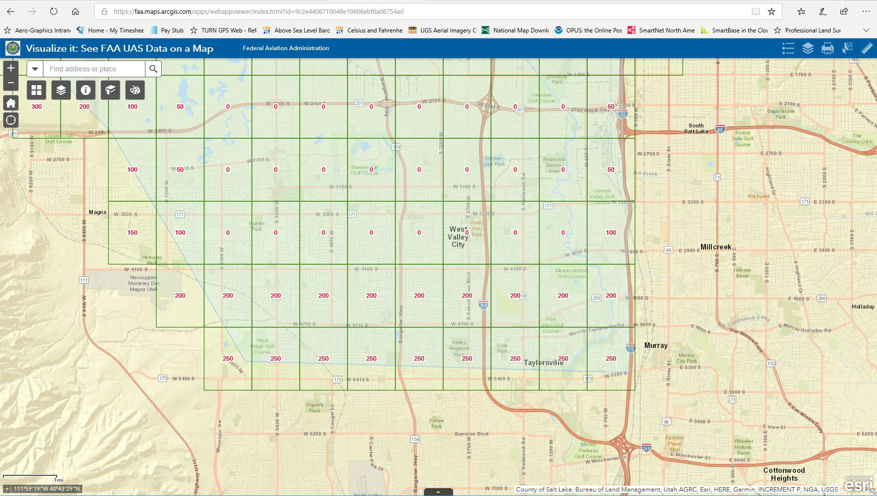
LAANC
https://faa.maps.arcgis.com/apps/webappviewer/index.html?id=9c2e4406710048e19806ebf6a06754ad

Slide 35
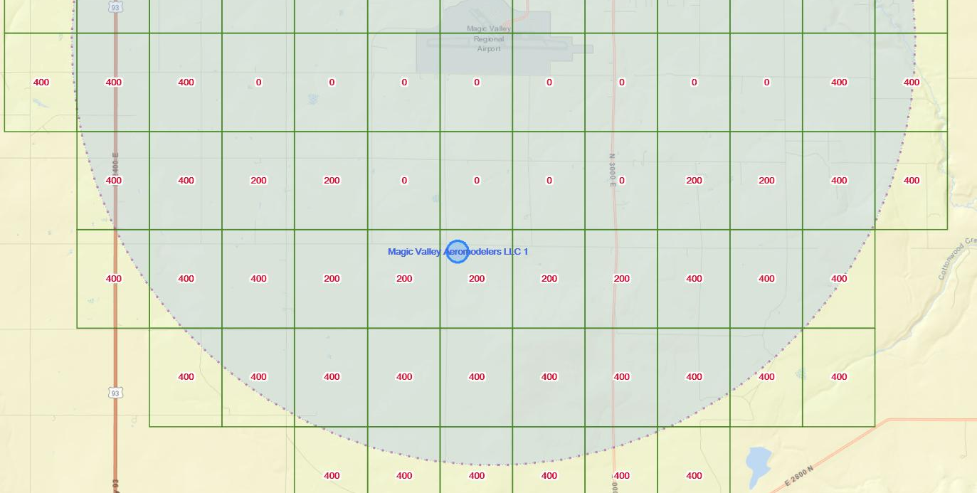
LAANC
Twin Falls Magic Valley Airport, Class D controlled airspace

Slide 36
Where Can I Fly?
Recreational flying:
  The FAA is granting temporary airspace authorizations to fly recreationally in certain “fixed sites” that are in controlled airspace (Class B, C, D, & E) throughout the country. The fixed sites are listed online and will be routinely updated.
  The FAA is upgrading LAANC to allow recreational flyers to use the system in the future to receive authorization to fly in control airspace.

Slide 37

B4UFLY App
An easy-to-use smartphone app that helps UAV operators determine whether there are any restrictions or requirements in effect at the location where they want to fly.

Slide 38
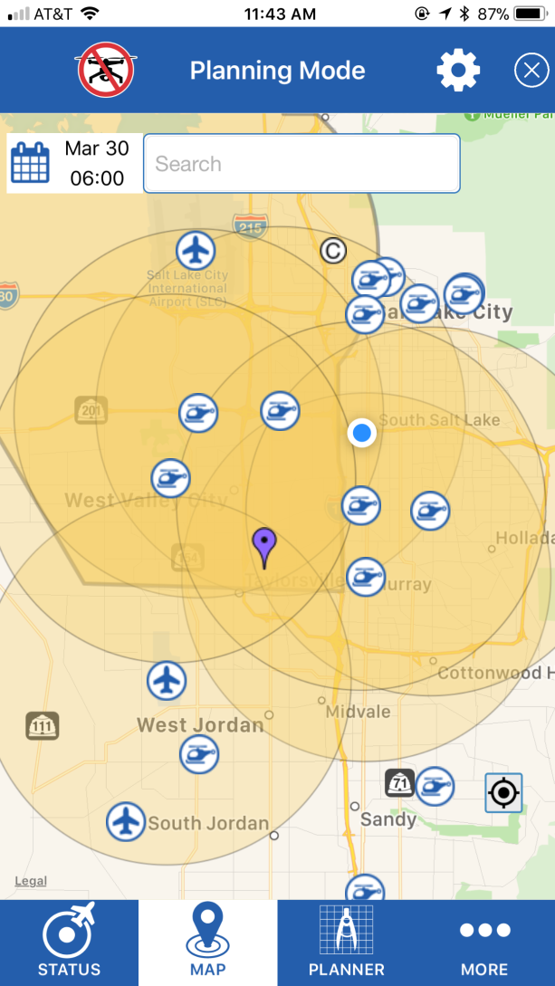
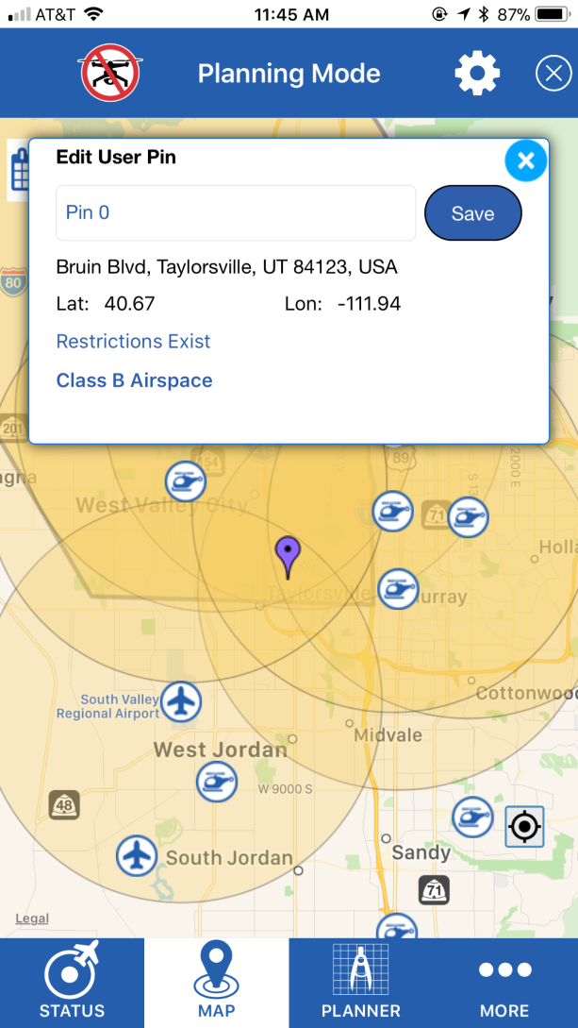
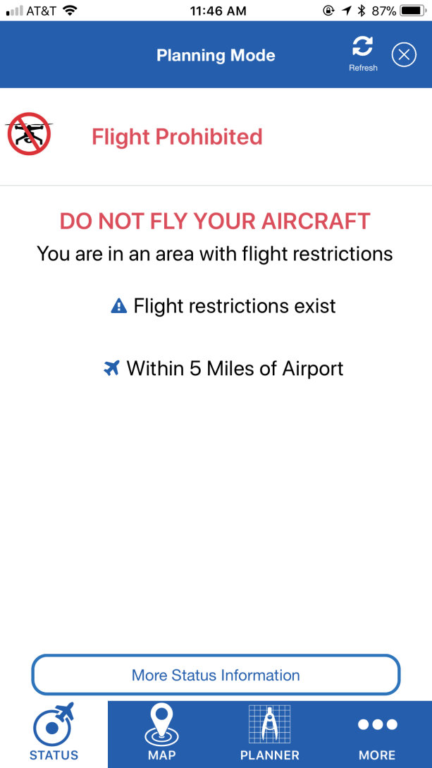
B4UFLY App

Slide 39
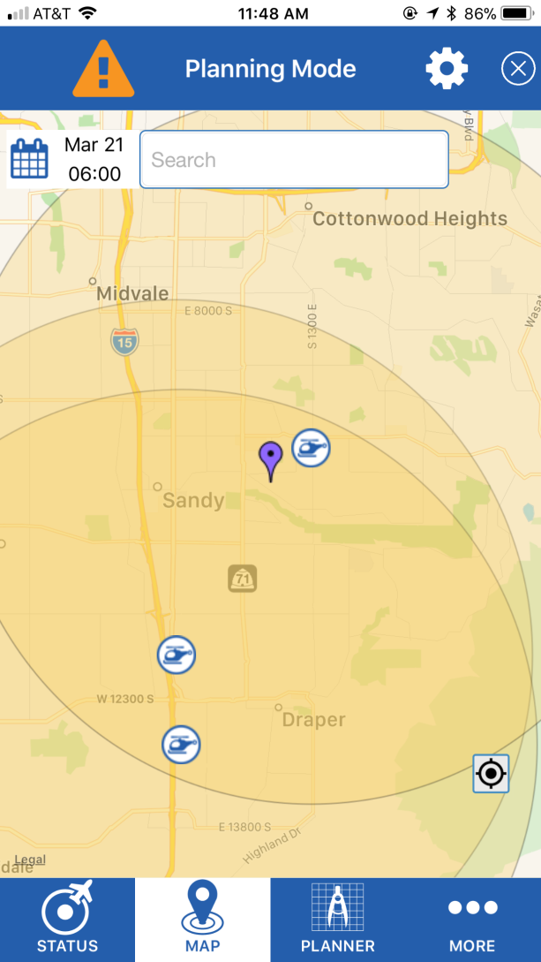
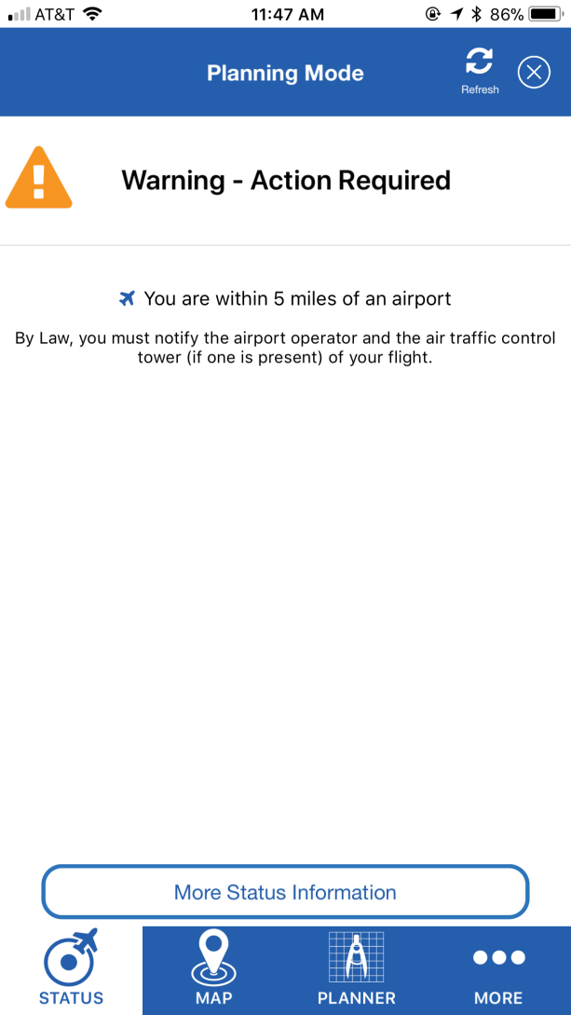
B4UFLY App

Slide 40
B4UFLY App
The Federal Aviation Administration (FAA) has partnered with Kittyhawk to redevelop the B4UFLY app, to improve the user experience so that recreational drone operators know where they can and cannot fly.
The current B4UFLY App will continue to be available to the public until the new App is deployed. The data reflected in the current App will continue to be updated regularly, but no new features will be added.
The FAA and Kittyhawk plan to launch the new App in 2019.

Slide 41
FAA Drone Zone
https://faadronezone.faa.gov/#/
  Register your drone, Part 107 and Section 336
  Apply for operational waivers
  Report an accident

Slide 42
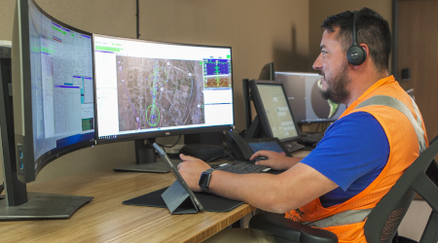
FAA Proposed Rule Changes
Night Operations
Operations over People
Integrate flights within the nation’s airspace system
  BVLOS at low altitudes (under 400 feet above ground level (AGL) in airspace where FAA air traffic services are not provided.

Slide 43
Enforcement
Violations:
  FAA regulations and/or state/local laws
  Operating an aircraft without registration or necessary airman certification
  Operating an aircraft in an unsafe manor so as to endanger persons or property
  Local ordinances that may apply include, but are not limited to: Reckless endangerment, criminal mischief, voyeurism, inciting violence.

Slide 44
Enforcement
The FAA is responsible for the safety of U.S. airspace
There are multiple options to fly a drone legally
If an operator chooses not to follow the requirements he/she could face civil penalties and potential criminal prosecution.
Enforcement actions can include revocation or suspension of a pilot certificate, and up to a $20,000 civil penalty per violation.

Slide 45
Ethical use of UAV’s
Just because you can do something with a UAV, should you?
Would operating the UAV violate others safety and rights, including privacy and property rights?
If it’s legal to operate a UAV at a certain location, should you?

Slide 46
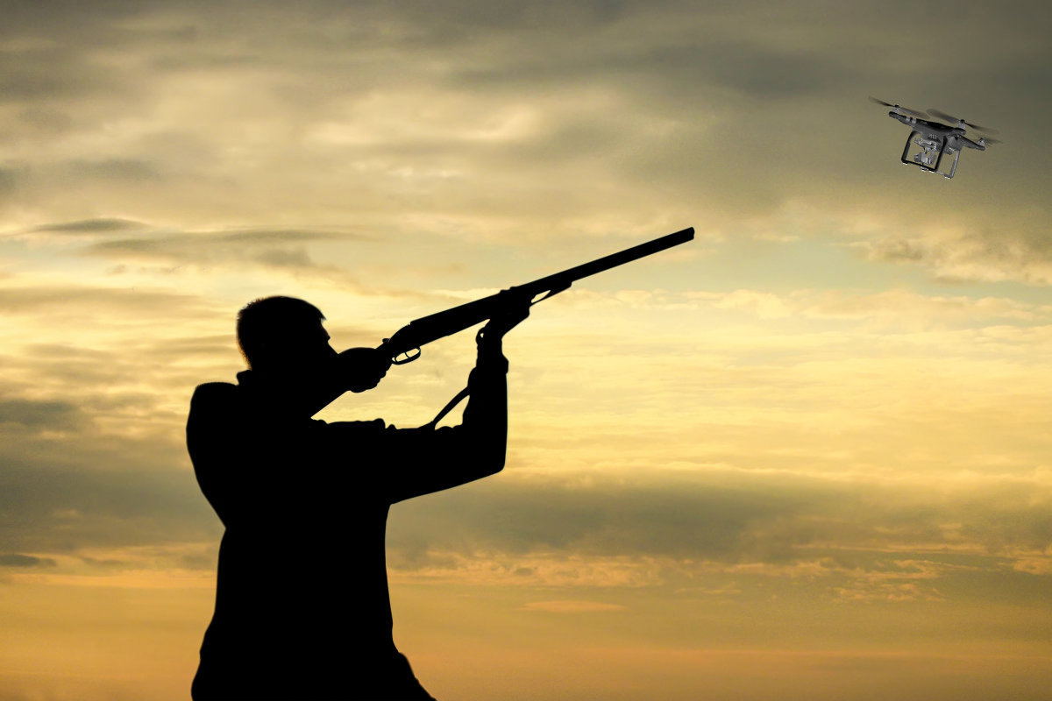
Ethical use of UAV’s
The UAV must be operated in a manner which is least disruptive to the general population
The UAV must be operated in a fashion that does not needlessly compromise privacy

Slide 47
Ethical use of UAV’s
Would you operate a UAV…
  Next to or over a cemetery during a funeral?
  In a park near others that are having a picnic?
  Over or near a school yard during school hours?
  In a nature park where people go to enjoy a quiet area?

Slide 48
Ethical use of UAV’s
There are gray areas to operating a UAV that technically are illegal but that you would not be prosecuted for doing.
  Do you ever drive above the speed limit? You are breaking the law, but you are not likely to get cited for it unless it is egregious for the circumstance.

Slide 49
Ethical use of UAV’s
Flights diverted after Gatwick Airport 'drone sighting’; BBC, Apr 28, 2019
  A suspected drone closed the airport for 33 hours in December, disrupting the journeys of about 140,000 passengers. A huge police operation and the Army eventually brought the incident under control.

Slide 50
Ethical use of UAV’s
Photo and video drones are not toys. They are regarded as aircraft by the FAA and should be treated as such.
Landowners have control over as much airspace as can be used in connection with the privacy, enjoyment and use of their land. There is no defined AGL, yet (65-100’?).
The airspace from the ground up to 500 ft AGL is a gray area of ownership/control.

Slide 51

Questions?

