Slide 1
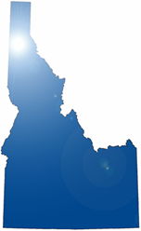
BEIPC
Basin Environmental Improvement Project Commission

Slide 2
Mining History in the CDA Basin
Mining began in the late 1800’s mostly for lead, zinc and silver with some gold. At one time the “Silver Valley” (CDA River drainage) was one of the largest silver producing areas in the U.S. Over 1000 mining sites were prospected with over 300 sites developed along with huge industrial plants to process the ore which were also used to process mining products from as far away as foreign countries.
Much of the waste from mining and processing was disposed of in the side drainages and the North and South Forks of the CDA River. Around 100 million tons! The processing plants belched out smoke laden with heavy metals that settled over the Upper Basin.
The South Fork of the CDA River was so polluted with mining waste that it was renamed Lead Creek by the locals. The communities in the Upper Basin dumped their raw sewage in the side drainages and CDA River as well.

Slide 3
What finally Got People’s Attention?
Children were sick! In 1974 blood lead tests on young children indicated that over 99% of the kids living within one mile of the lead and zinc smelters had blood lead levels averaging 67.4ug/dl; 5ug/dl is the current level of concern!
The locals refused to close the school near the smelters. Because of citizen and local government concerns about economic stability and jobs, most were against cleanup actions. Most folks in the CDA Basin did not want the “stigma” of a Superfund cleanup. Many in CDA still don’t accept that the Lake is full of mine waste. Because of foot dragging, cleanup of the site really did not begin until 1986.
So how do you force a process on the locals required by the law of the land when some would just as well shoot you as speak to you?
The BEIPC was the state of Idaho’s answer to that question.

Slide 4

CDA Basin Superfund Cleanup Project
A Constantly Evolving Challenge!
Comprehensive Environmental Response, Compensations, and Liability Act (CERCLA) of 1980/Superfund - process EPA and federal land management agencies use to secure funding and cleanup areas where hazardous substances are being or have been released.
In 1983, EPA listed the Bunker Hill Mining and Metallurgical complex in northern Idaho, Operable Units 1&2, as a Superfund site because of the high level of heavy metals that had been released into the environment by mining operations and high blood levels in children. Local folks, government leaders, and industry were very upset.
Initial cleanup decisions and operations concentrated on the areas with the most contamination and the greatest human health effects, a 21 square mile area called the Box (Pinehurst, Smelterville, Kellogg, Wardner).
In 1998, EPA began applying CERCLA requirements beyond the Box to areas throughout the 1,500 square mile Basin and in 2002 issued an interim record of decision addressing cleanup requirements in the Basin OU-3 outside the Box. This really stirred up the locals. Federal government sticking their nose in our business!

Slide 5
Superfund Cleanup Project (continued)
Idaho State Legislature established the BEIPC (Basin Environmental Improvement Project Commission) in response to the concern that the Federal Government would make Superfund decisions concerning the Basin without adequate local stakeholder involvement.
The BEIPC is made up of Commissioners appointed by the Governor to represent the State and 3 local counties in the Basin.
The CDA Tribe, Federal Government, and State of Washington chose to join the BEIPC through a MOA executed in August 2002.
BEIPC established to implement, direct, and/or coordinate remediation, natural resource restoration, and related measures to address water quality and heavy metal contamination in the CDA Basin. First of its kind in the nation and the only one so far. How could we meet this constantly evolving challenge?

Slide 6
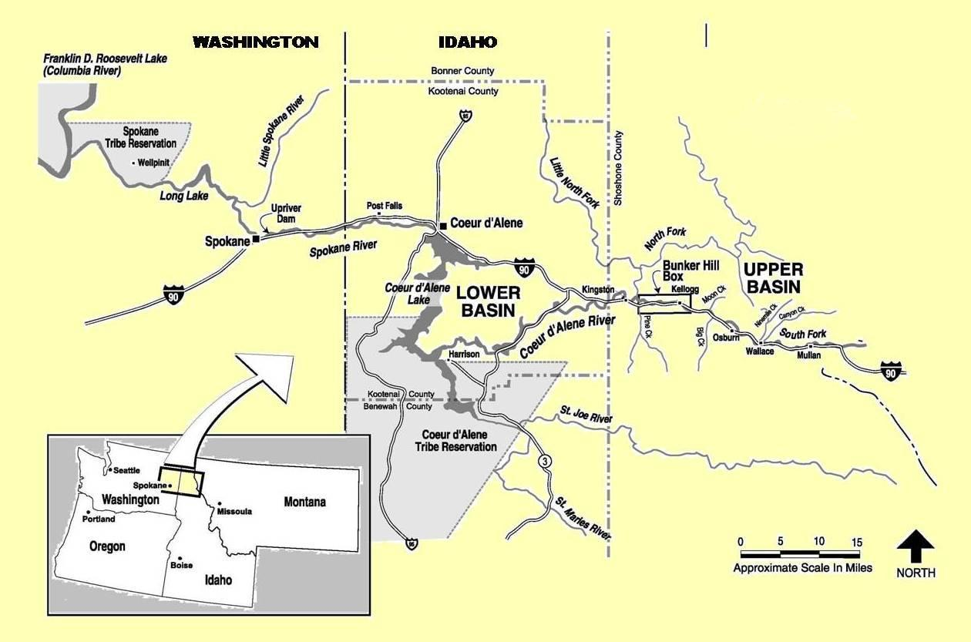
The area covered by the CDA Basin cleanup effort includes the Coeur d’Alene River Watershed, Coeur d’Alene Lake, and the upper reaches of the Spokane River. The total length of this system is 166 miles, and the boundary includes an area of approximately 1,500 square miles, one of the largest Superfund sites in the nation.

Slide 7
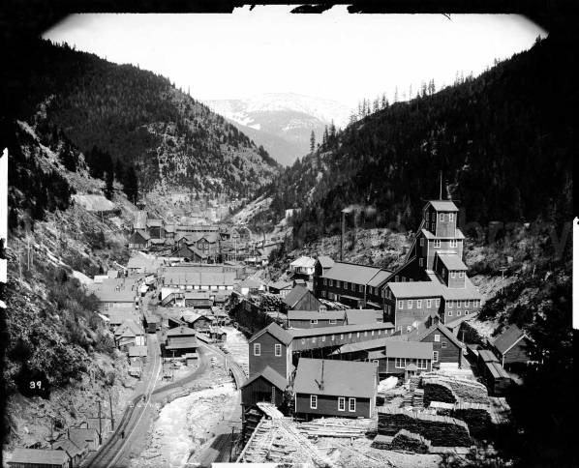
Typical Mine Site in Side Drainage
Note the creek between the R/R, road and mine buildings. Where do you put the waste? Why, in the creek!

Slide 8
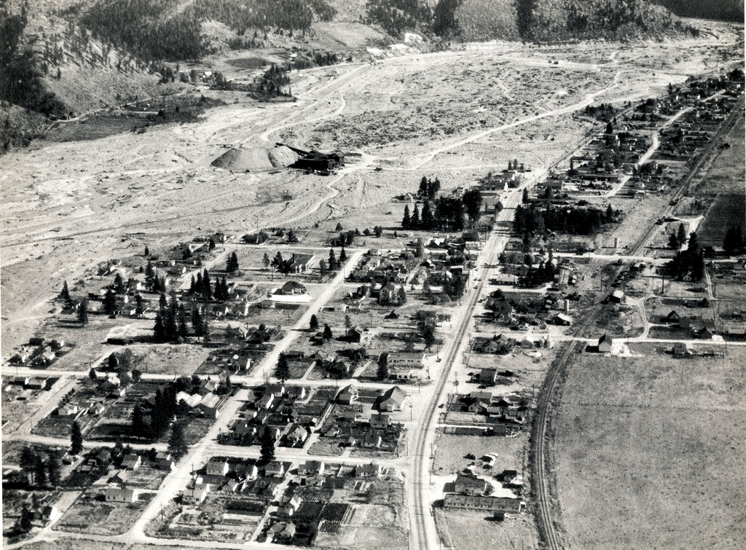
Osburn Tailings Extraction
Tailings were captured behind a wooden dam and extracted before they moved further downstream. This dam failed resulting in a huge volume of waste moving down stream.

Slide 9
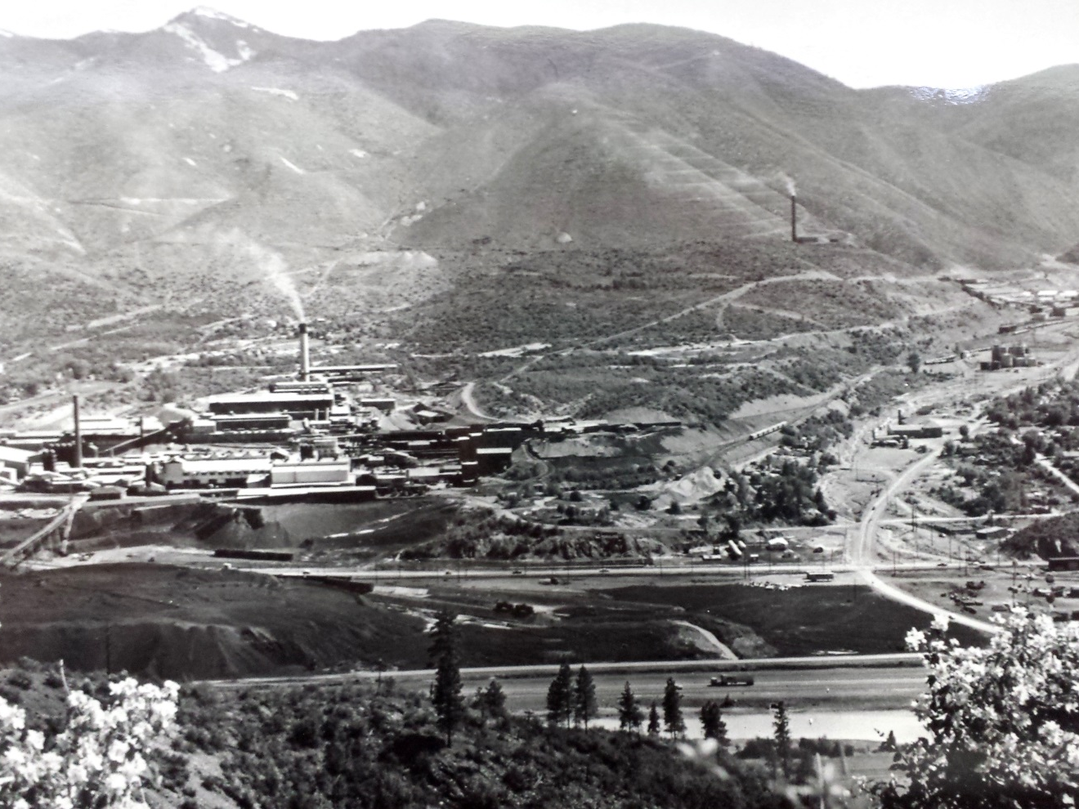
The Lead and Zinc Smelters
Early 1960’s Photo, note the Interstate Highway, the black waste pile, and grade school between the plants

Slide 10
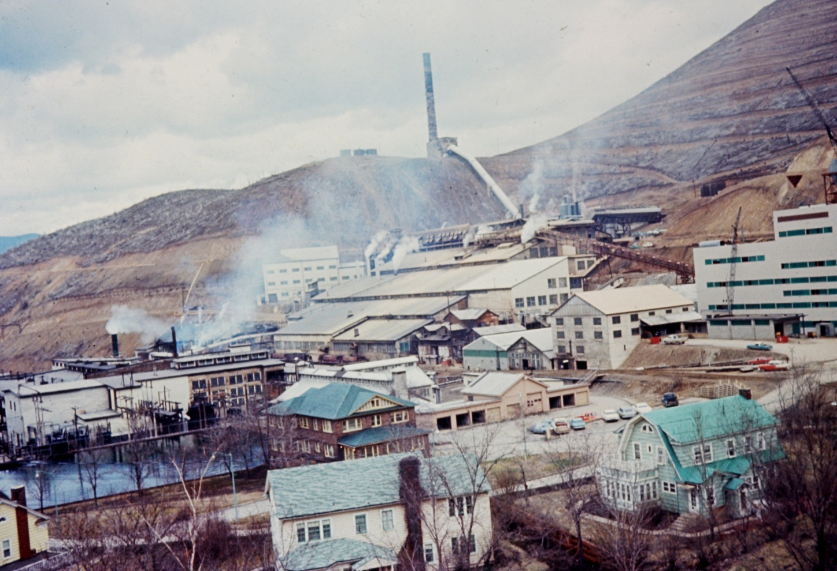
Zinc Smelter with Employee Housing
Some of the finest homes in the Valley were next to the most contaminated areas.

Slide 11
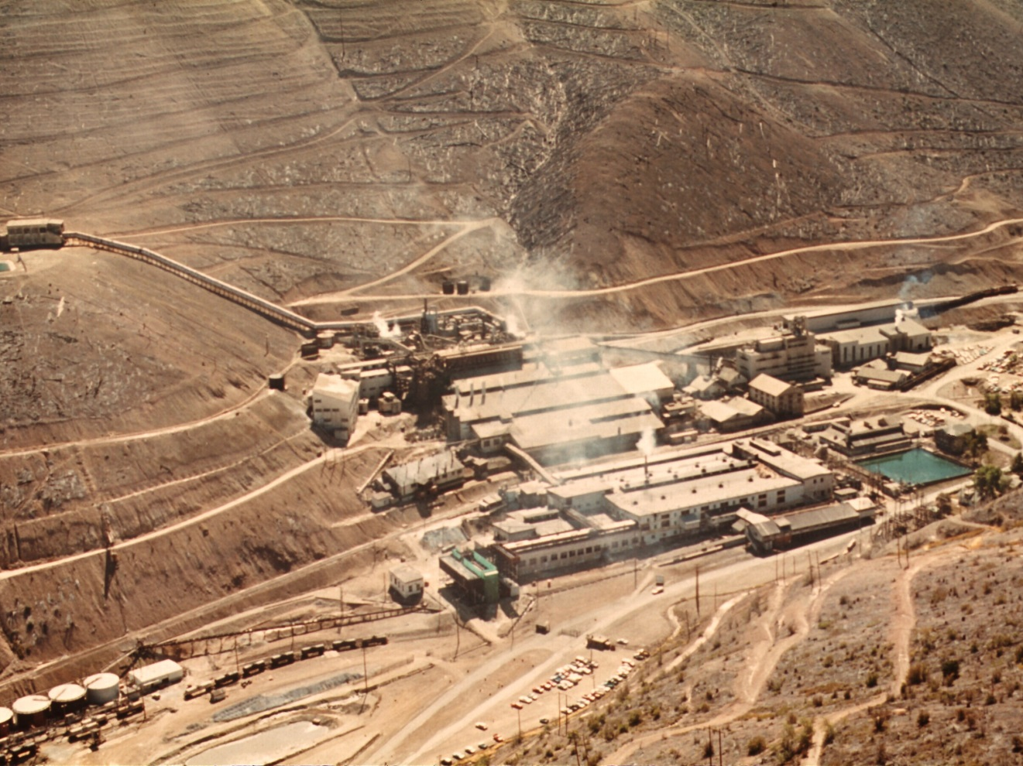
Zinc Smelter in Government Gulch
Note the terraced hillside with no vegetation; hill sides were terraced to prevent landslides of saturated soils during
spring snow melt and heavy rains.

Slide 12
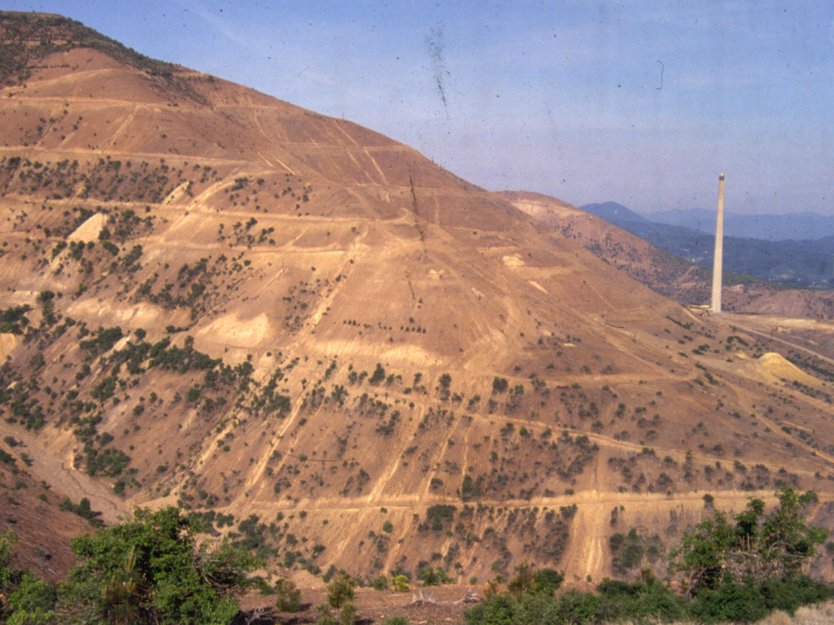
Hill Side Above Zinc Smelter
Photo prior to reforestation effort looking west.

Slide 13
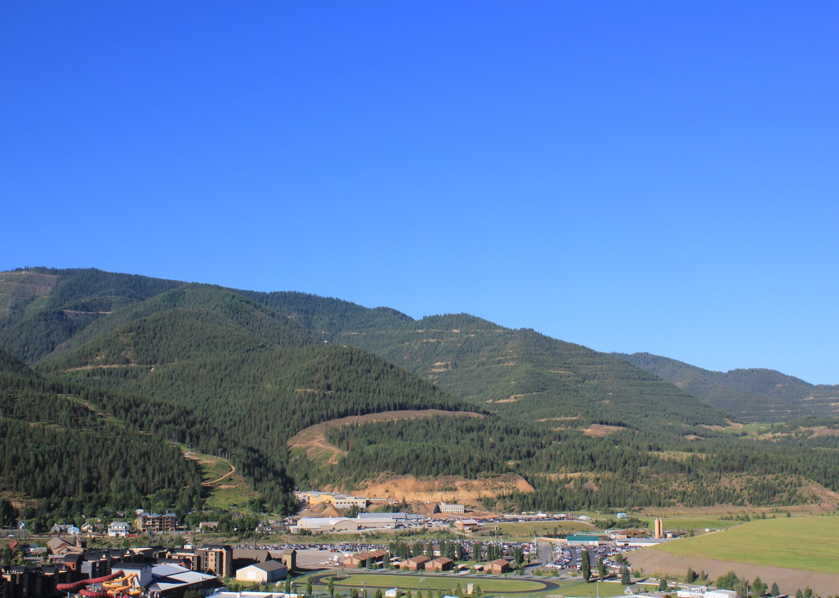
Hill Sides Above Kellogg
Looking West Toward Lead and Zink Smelter Locations After Remediation

Slide 14
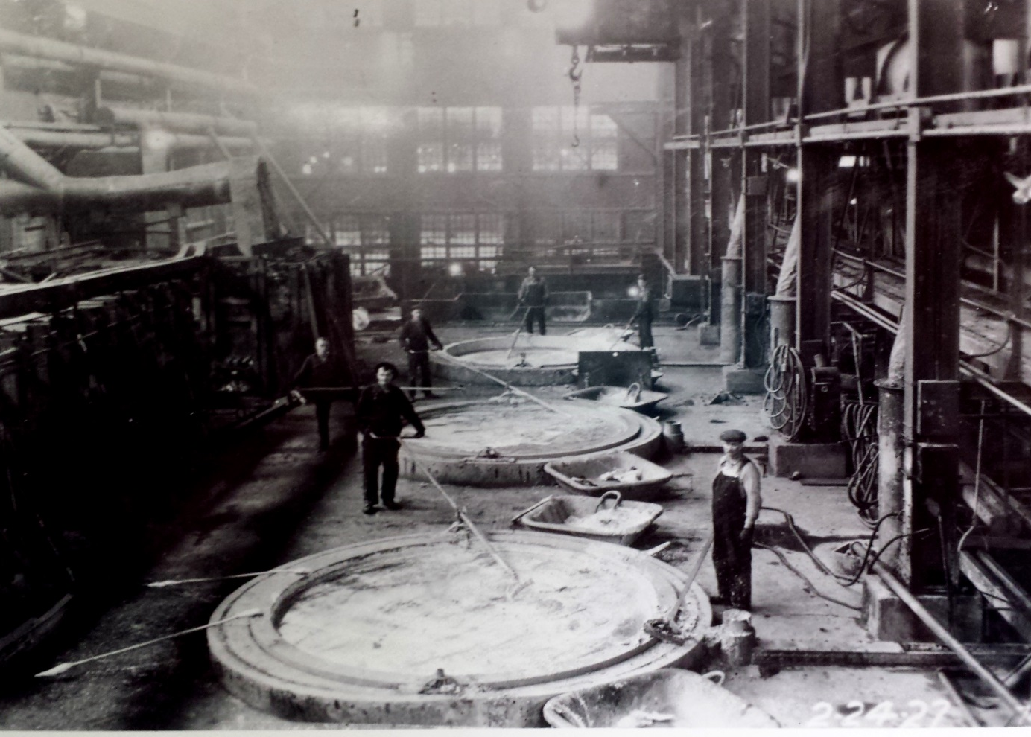
Lead Pots in Lead Smelter
Note the protective coverall clothing and the mustache respirators.

Slide 15
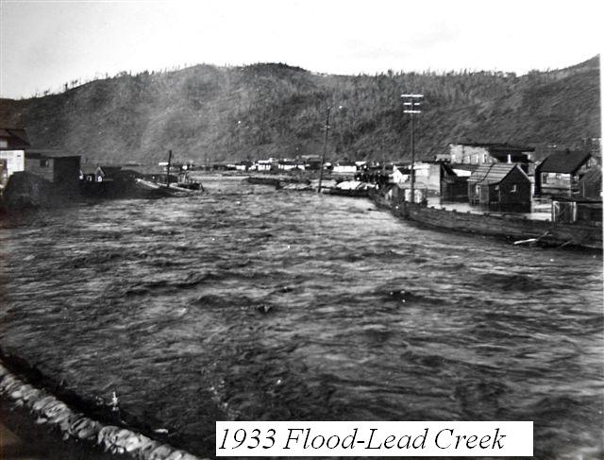
100 Year Floods in 1933, 1974, and 1996
Note the reference to Lead Creek not the So. Fork of the CDA River

Slide 16
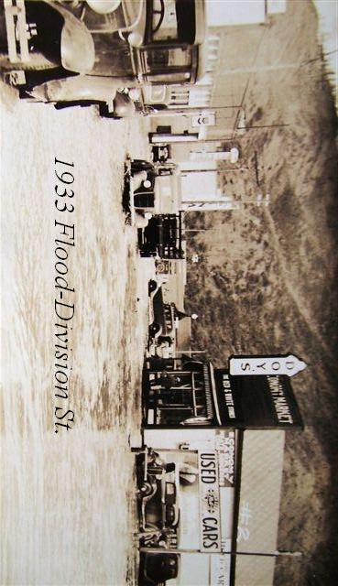
Mine Waste Laden Flood Water
Main Street in Pinehurst

Slide 17
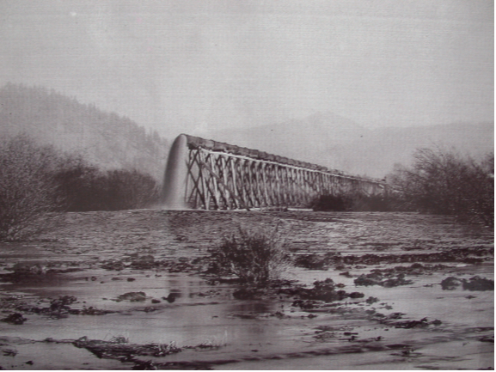
Cataldo Flats Dredge Discharge Pipe
Why was this needed?

Slide 18
Why the Cataldo Dredge?
The previous photo shows mine tailings discharge pipe coming off of the river dredge, near the Cataldo Mission site. This dredge operated from 1930 to 1968.
The Lower Basin farmers and ranchers had complained to the Idaho Governor and sued over the mine waste coming downstream contaminating their lands and killing their live stock. The mine companies purchased the flood plain lands, dammed up the CDA River to trap the waste coming downstream from the Upper Basin and dredged the River.
Contaminated sediment was dredged out of the river bed and pumped onto the Cataldo Flats wetlands (which were uncontaminated before dredging).
Hundreds of acres of mine tailing deposits with about 30 million cubic yards several feel deep still exist at Flats today. Wildlife and waterfowl use this area extensively.

Slide 19
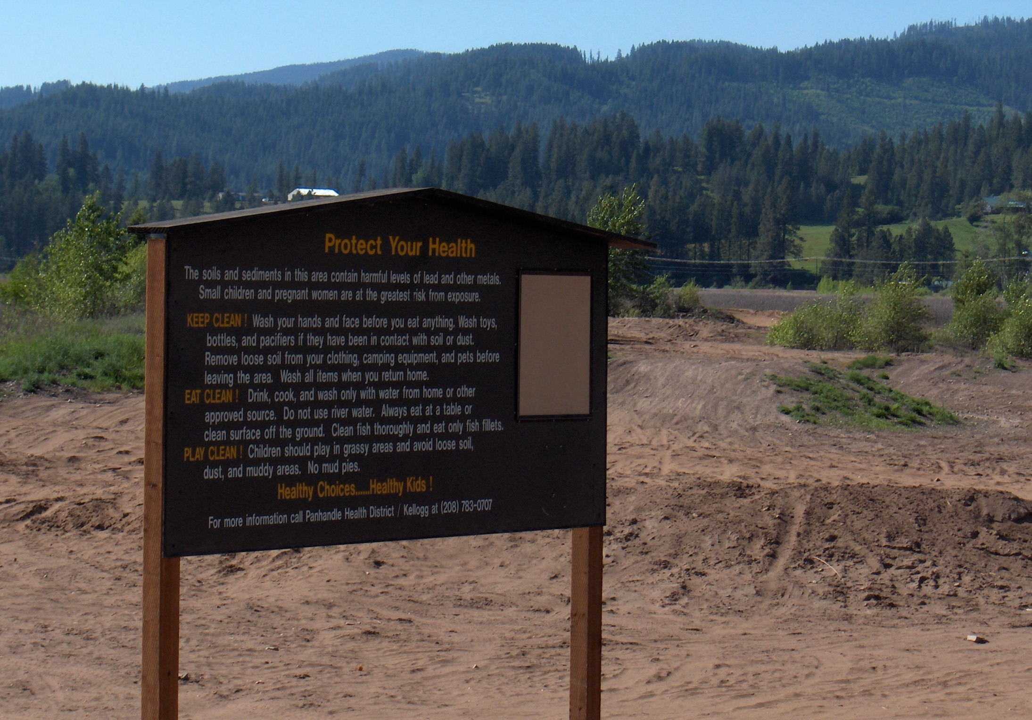

Slide 20

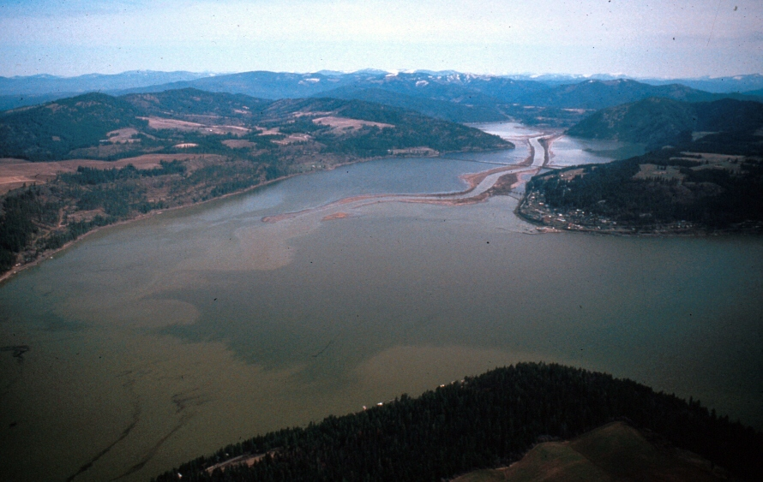
2008 flood showing the contaminated sediment in the flooded main CDA River entering CDA Lake.

Slide 21
IMPACTS OF SUPERFUND LISTING
Requires cleanup of all contaminated developed residential, public and commercial properties above contamination action levels (Silver Valley and South Fork and Main CDA River Corridor to Harrison).
Requires cleanup and restoration of natural resources.
  Ground and surface water contamination in CDA River and tributaries.
  Wildlife and fish habitat, vegetation and other biota.
Requires that the CDA Lake Management Plan (LMP) be developed, funded and implemented by the State and CDA Tribe to manage the environmental quality of CDA Lake including control of contamination on the bottom of the Lake and Lake water quality. The CDA Tribe has currently taken the position that the LMP is a failure.

Slide 22
IMPACTS OF SUPERFUND LISTING (continued)
Cleans up mess and restores damaged natural resources, generates many jobs and insures continuation of commerce in the involved communities.
Makes polluters and responsible parties pay. Responsible parties have performed a considerable amount of the property cleanup and paid large settlements with the governments exceeding $700 million for cleanup and $140 million for resource restoration.
Impacts communities and industry in both a positive and negative way.
Real property impacts can be substantial where property agents and brokers, title companies and banks have CERCLA liability concerns on contaminated properties.
Costly.
  $2.3 billion total estimated cost for Basin cleanup and restoration.
  Currently investing between $20 and $25 million per year on work.

Slide 23
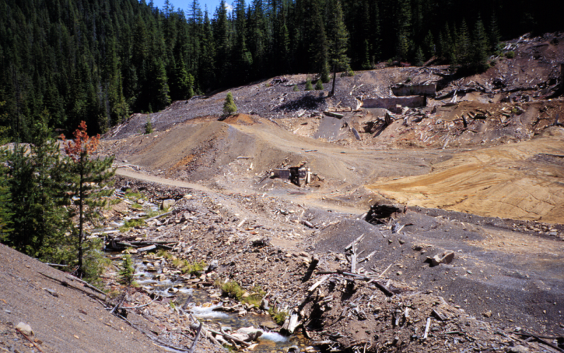
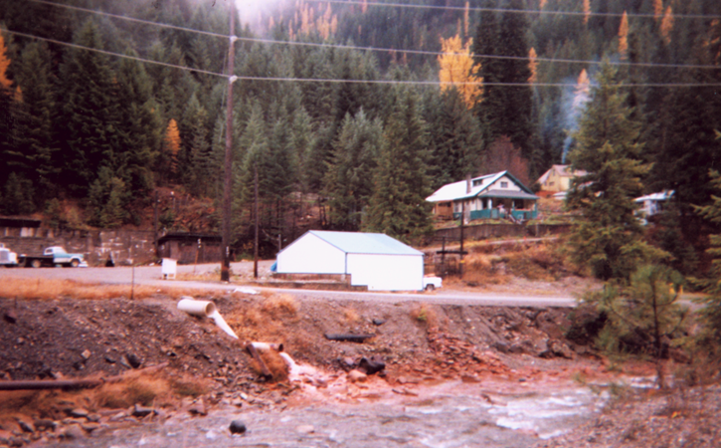
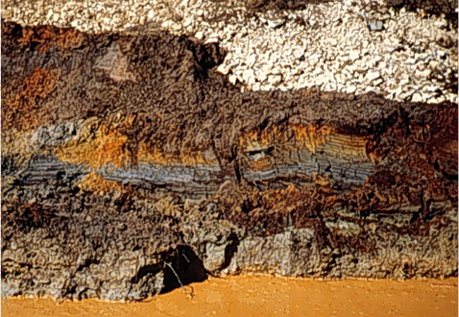
TYPICAL PROBLEMS

Slide 24
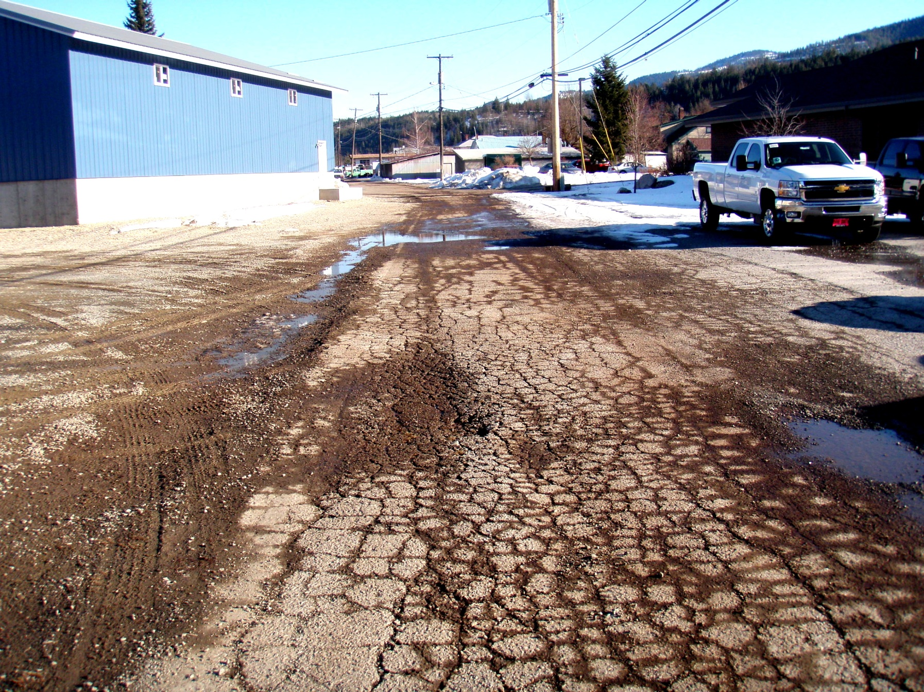

Slide 25
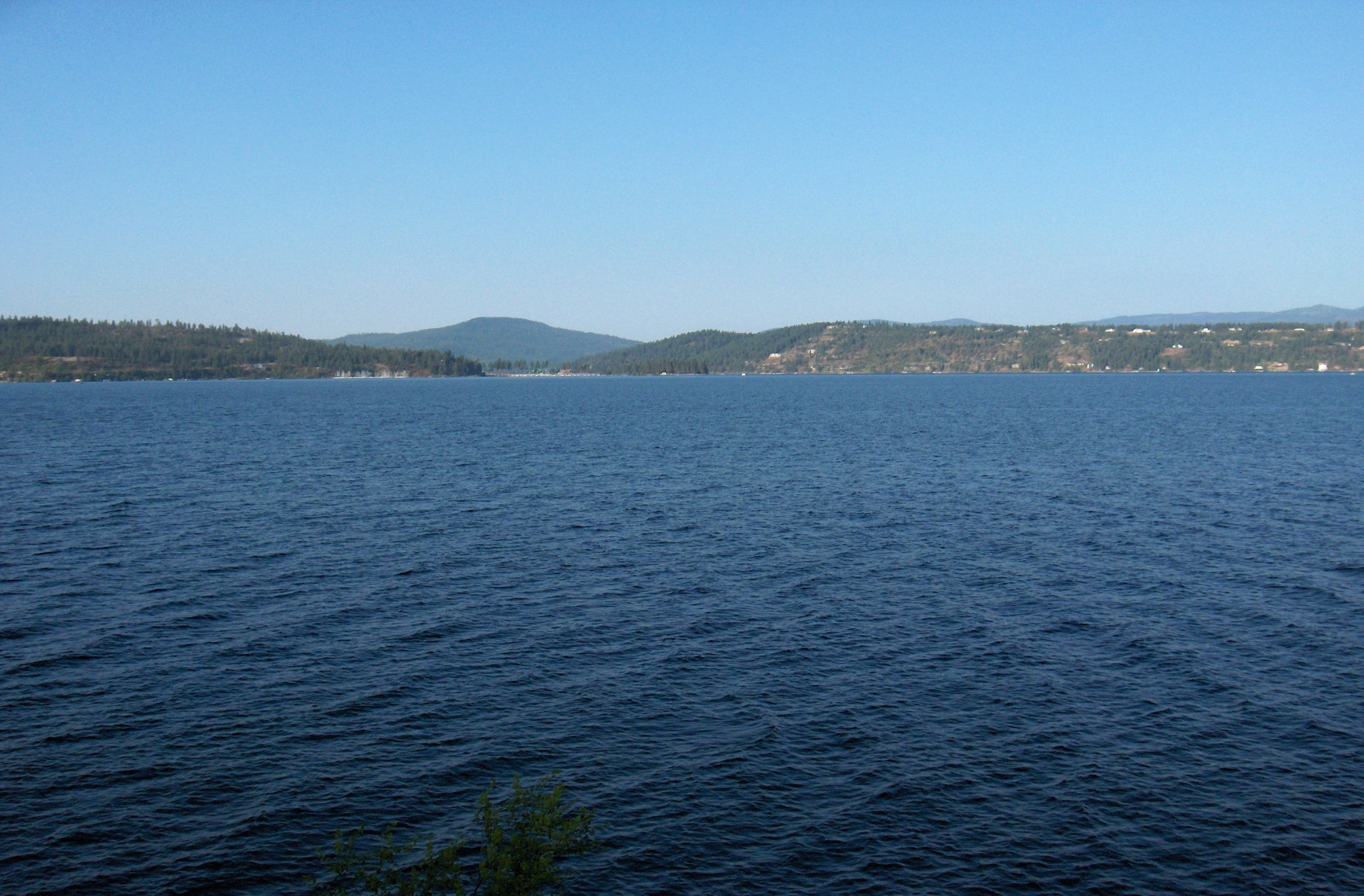
KEY CLEANUP ISSUES
Actions are required to protect human health and the environment.
Two main types of contamination require remediation:
  ground and surface water containing dissolved heavy metals (zinc); and
  soils and sediments contaminated with heavy metals such as lead.
Management of CDA Lake is required to address water quality and ensure that 70 million cubic yards of contaminated sediments on the Lake bottom stay in a stable condition and metals are not released into the water. The Lake is basically the largest waste repository in the Basin.
Management of cleanup actions and protection of the remedy upstream of the Lake is required to protect its quality and value to the Basin Community.

Slide 26
KEY RESTORATION ISSUES
Requires evaluation of damages and establishment of a restoration program through the environmental impact statement (EIS) process by the Trustees; CDA Tribe, U.S. Forest Service, U.S. Department of Interior, and Idaho Departments of Environmental Quality and Fish and Game.
Funds from the $140 million settlement will be used to develop and implement restoration projects to deal with wildlife and fish habitat, vegetation and other biota.
Trustees currently reviewing submitted proposals from the public and agencies to select projects for implementation of the program outlined in the EIS.

Slide 27
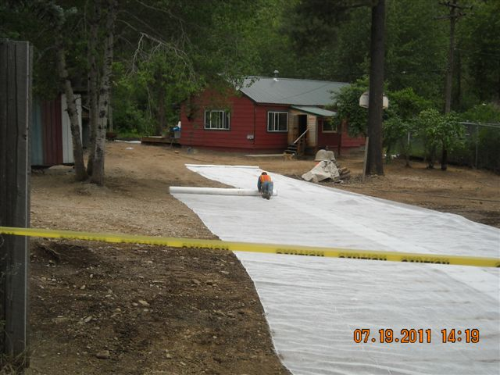
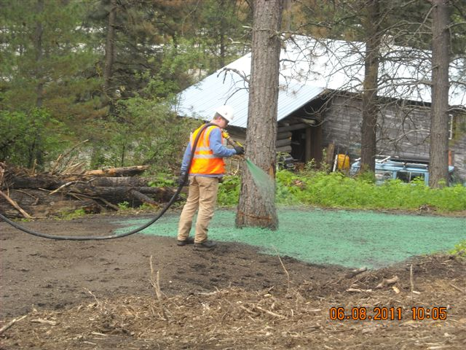
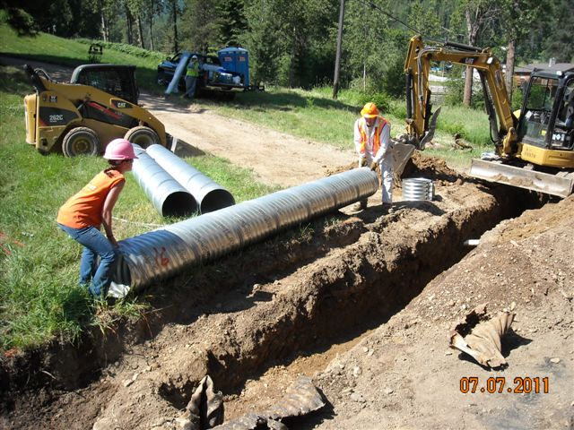
ACCOMPLISHMENTS (by responsible parties, federal, state, tribal and local agencies)
Over 7000 residential, public and commercial properties remediated.
All industrial sites in the Box remediated.
Average blood levels in children down to below 3ug/dl since 2006.
Many mine and mill sites in the Basin remediated.
Continuous management of contaminated waste soils generated from cleanup actions by construction and operation of waste repositories.
Cleanup of recreation areas along CDA & Spokane Rivers.

Slide 28
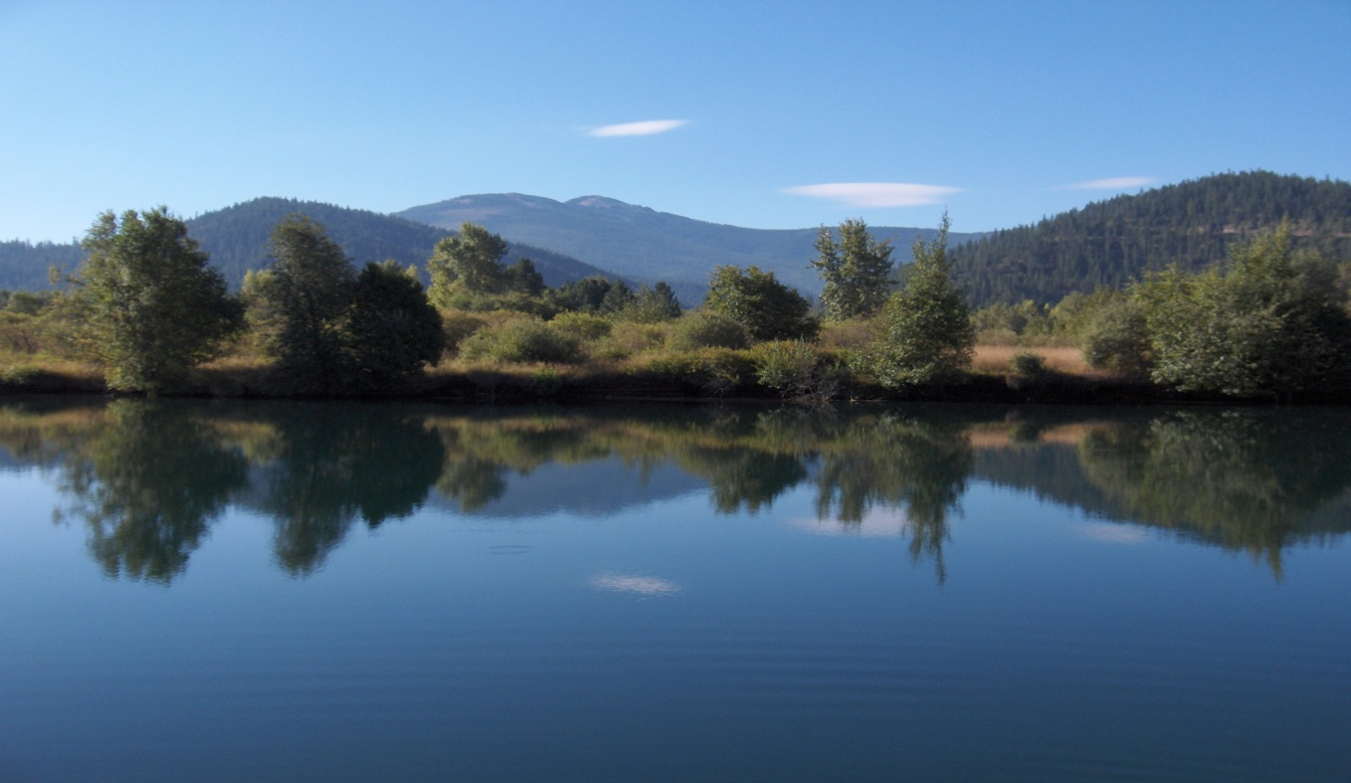
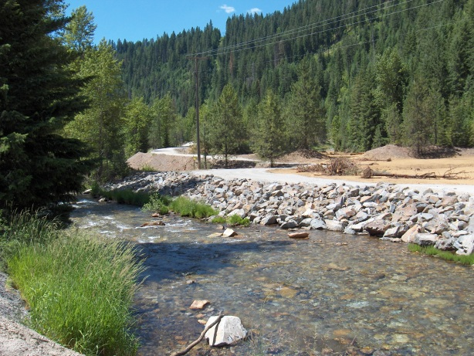
ACCOMPLISHMENTS (continued)
Capping of all contaminated gravel roads in the Basin ($6 million program).
Purchase of a conservation easements and construction of clean wetlands on agricultural lands in the Lower Basin for waterfowl habitat.
Development of storm water runoff, flood control and drainage management projects to protect the remediated areas in the Basin. 22 Projects completed with 4 remaining for construction in 2019 ($38 million program).
Repaving of over 500 deteriorated contaminated paved roads segments in the Box and Basin, over 100 projects still remaining ($54 million program).

Slide 29
IMPORTANT WORK REMAINING
What does the work include and when will it be done?
Complete remediation of residential, public and commercial properties from Harrison to the head waters. (2019 last year of this program).
Complete environmental cleanup of many high priority mine and mill sites in Canyon and 9 Mile Drainages and Pine Creek.
Remediation of contaminated ground and surface water from the Box, 9 Mile and Canyon Creek (Burke).
Cleanup of contaminated wildlife and fisheries habitat along Lower CDA River and Pine Creek (About 18,000 acres of contaminated wetlands).
Cleanup the contaminated banks and beds and additional recreation use areas along the CDA River.
Continue implementing the Lake Management Plan to manage the contamination on bottom of CDA Lake and nutrient loadings to Lake from all sources.
Implement the Natural Resource Restoration Plan.

Slide 30
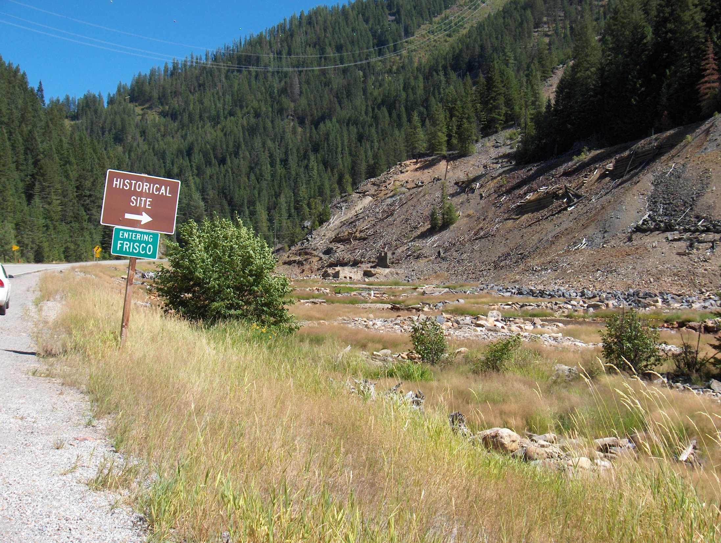

Slide 31
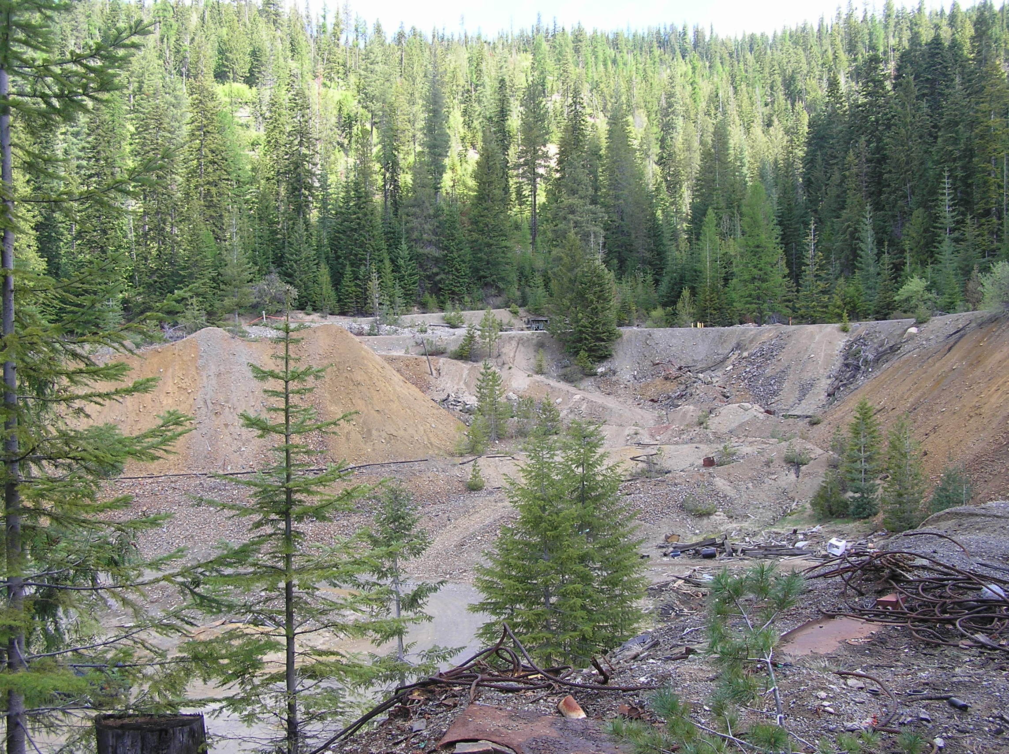
Notes:
Rex remediation

Slide 32
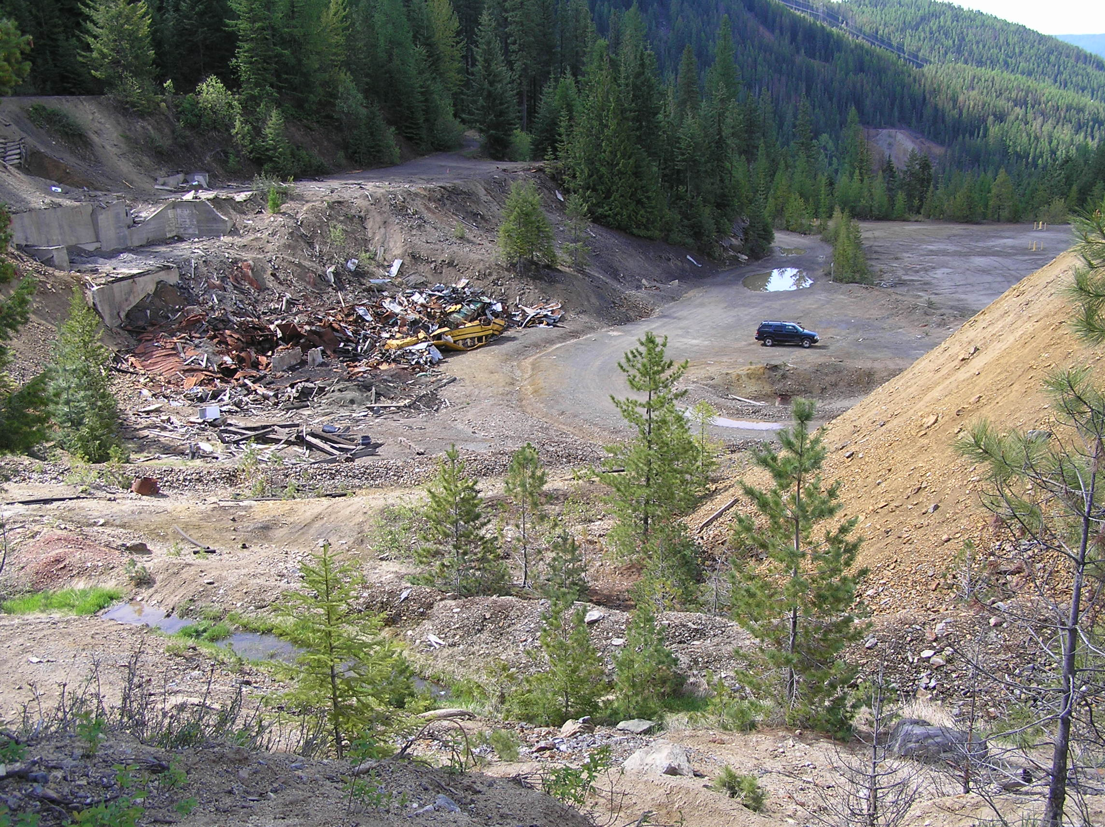
Notes:
Before

Slide 33
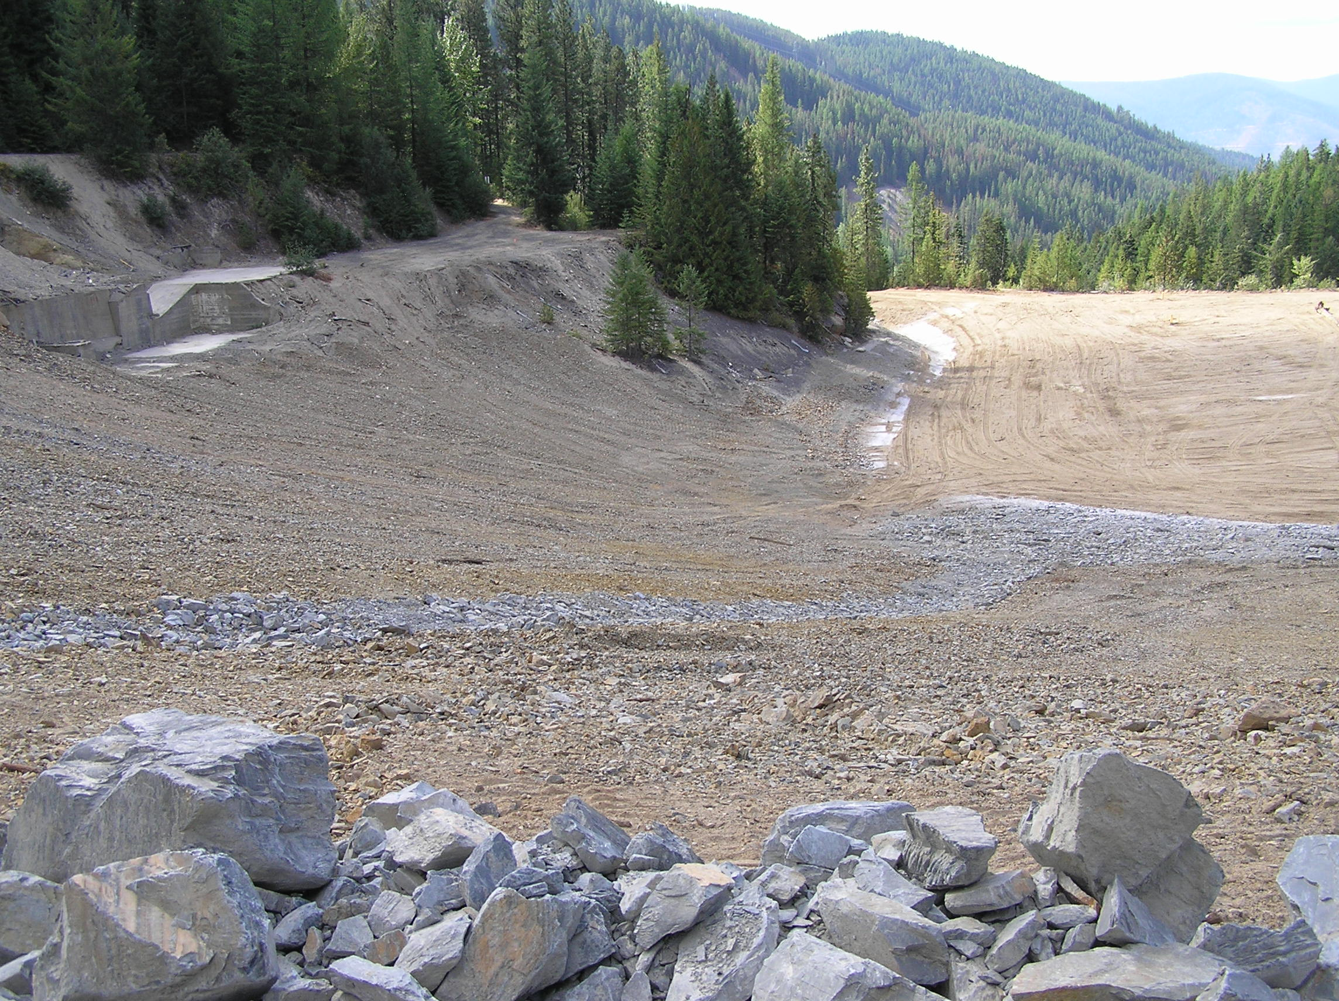
Notes:
After

Slide 34
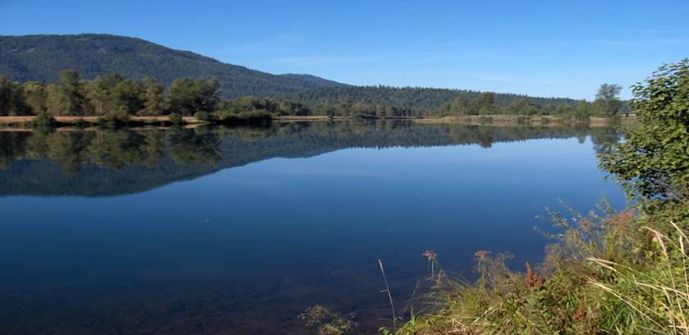
www.basincommission.com

