Slide 1
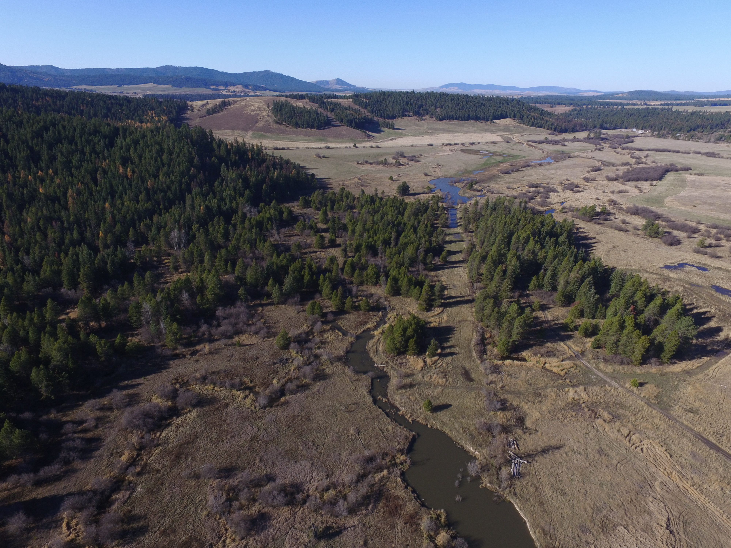
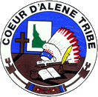
In-Stream Restoration Strategies for a Highly Impacted Watershed:
From Inception to Design to Construction (and Repair)
Thomas Biladeau
Notes:
Title

Slide 2
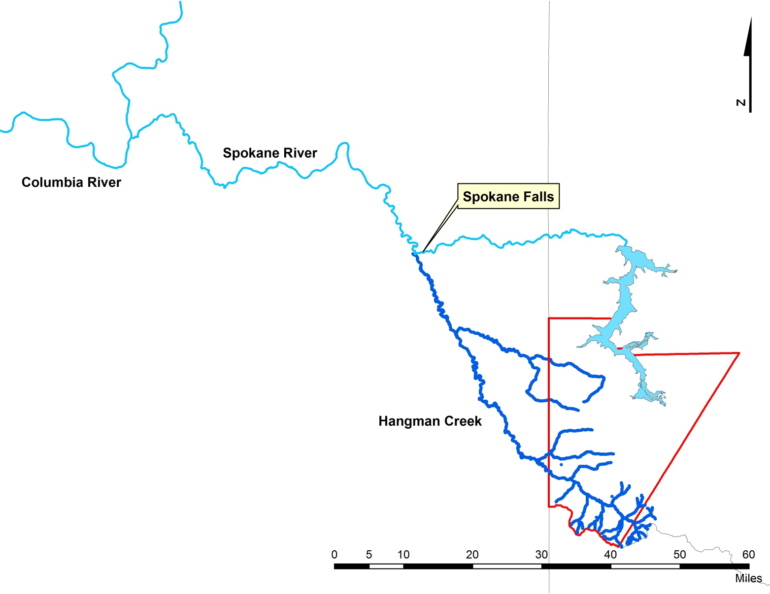
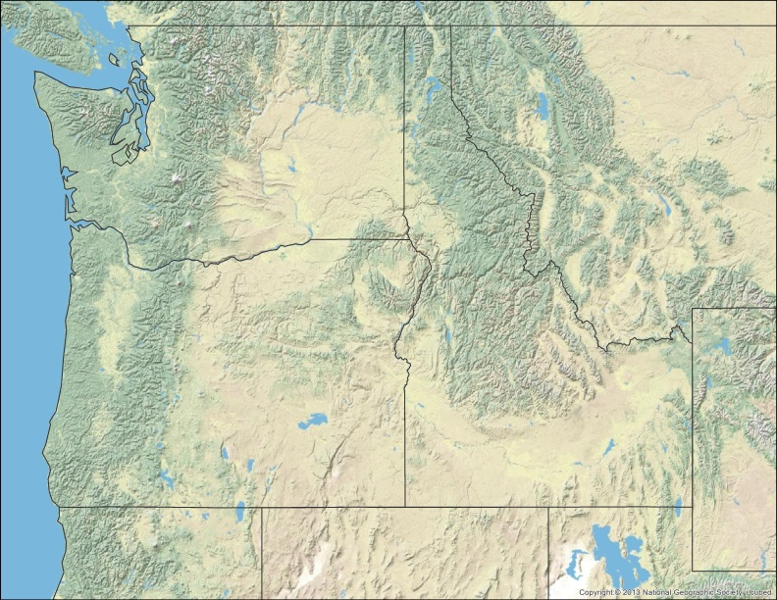
Coeur d’Alene
Reservation

Slide 3
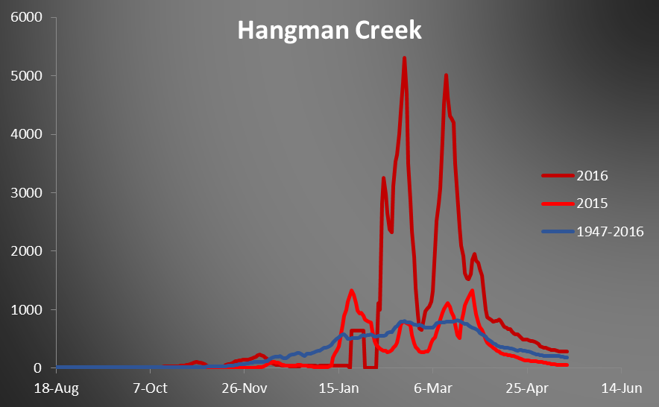
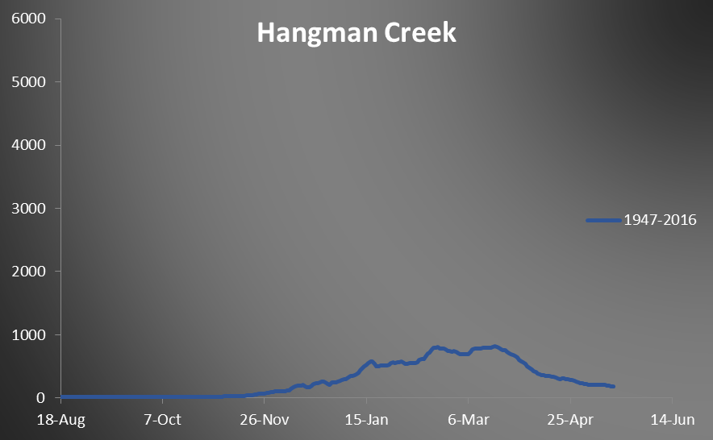
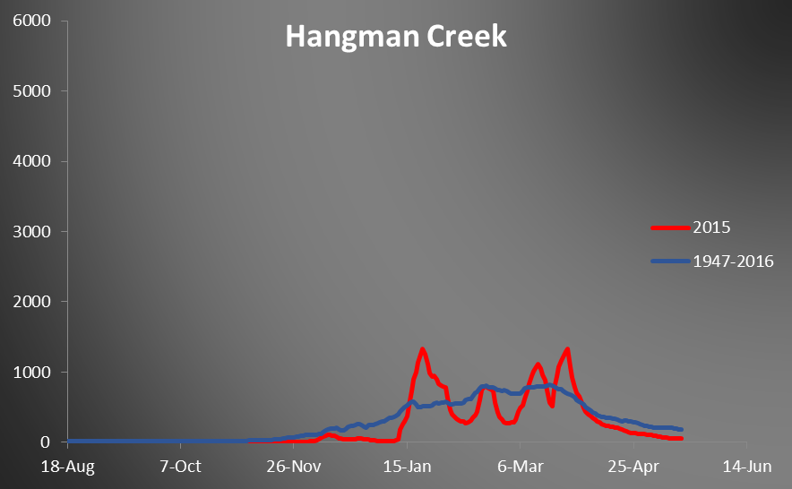

Slide 4
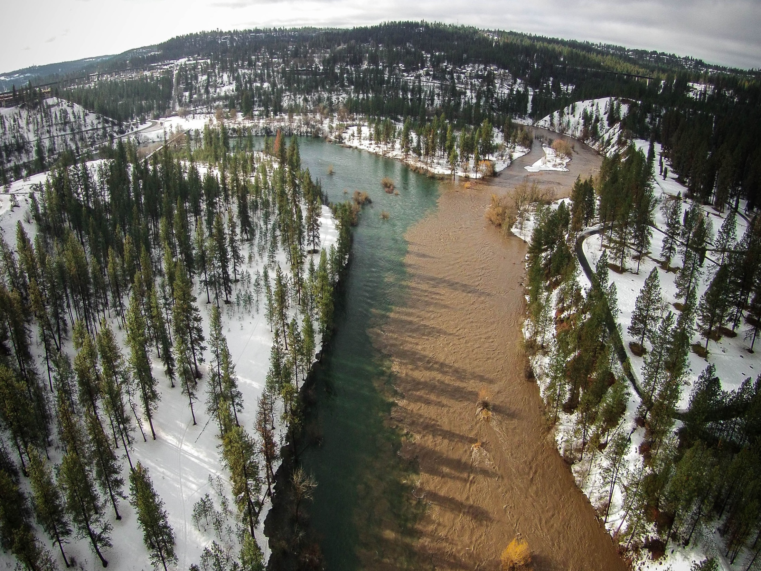

Slide 5
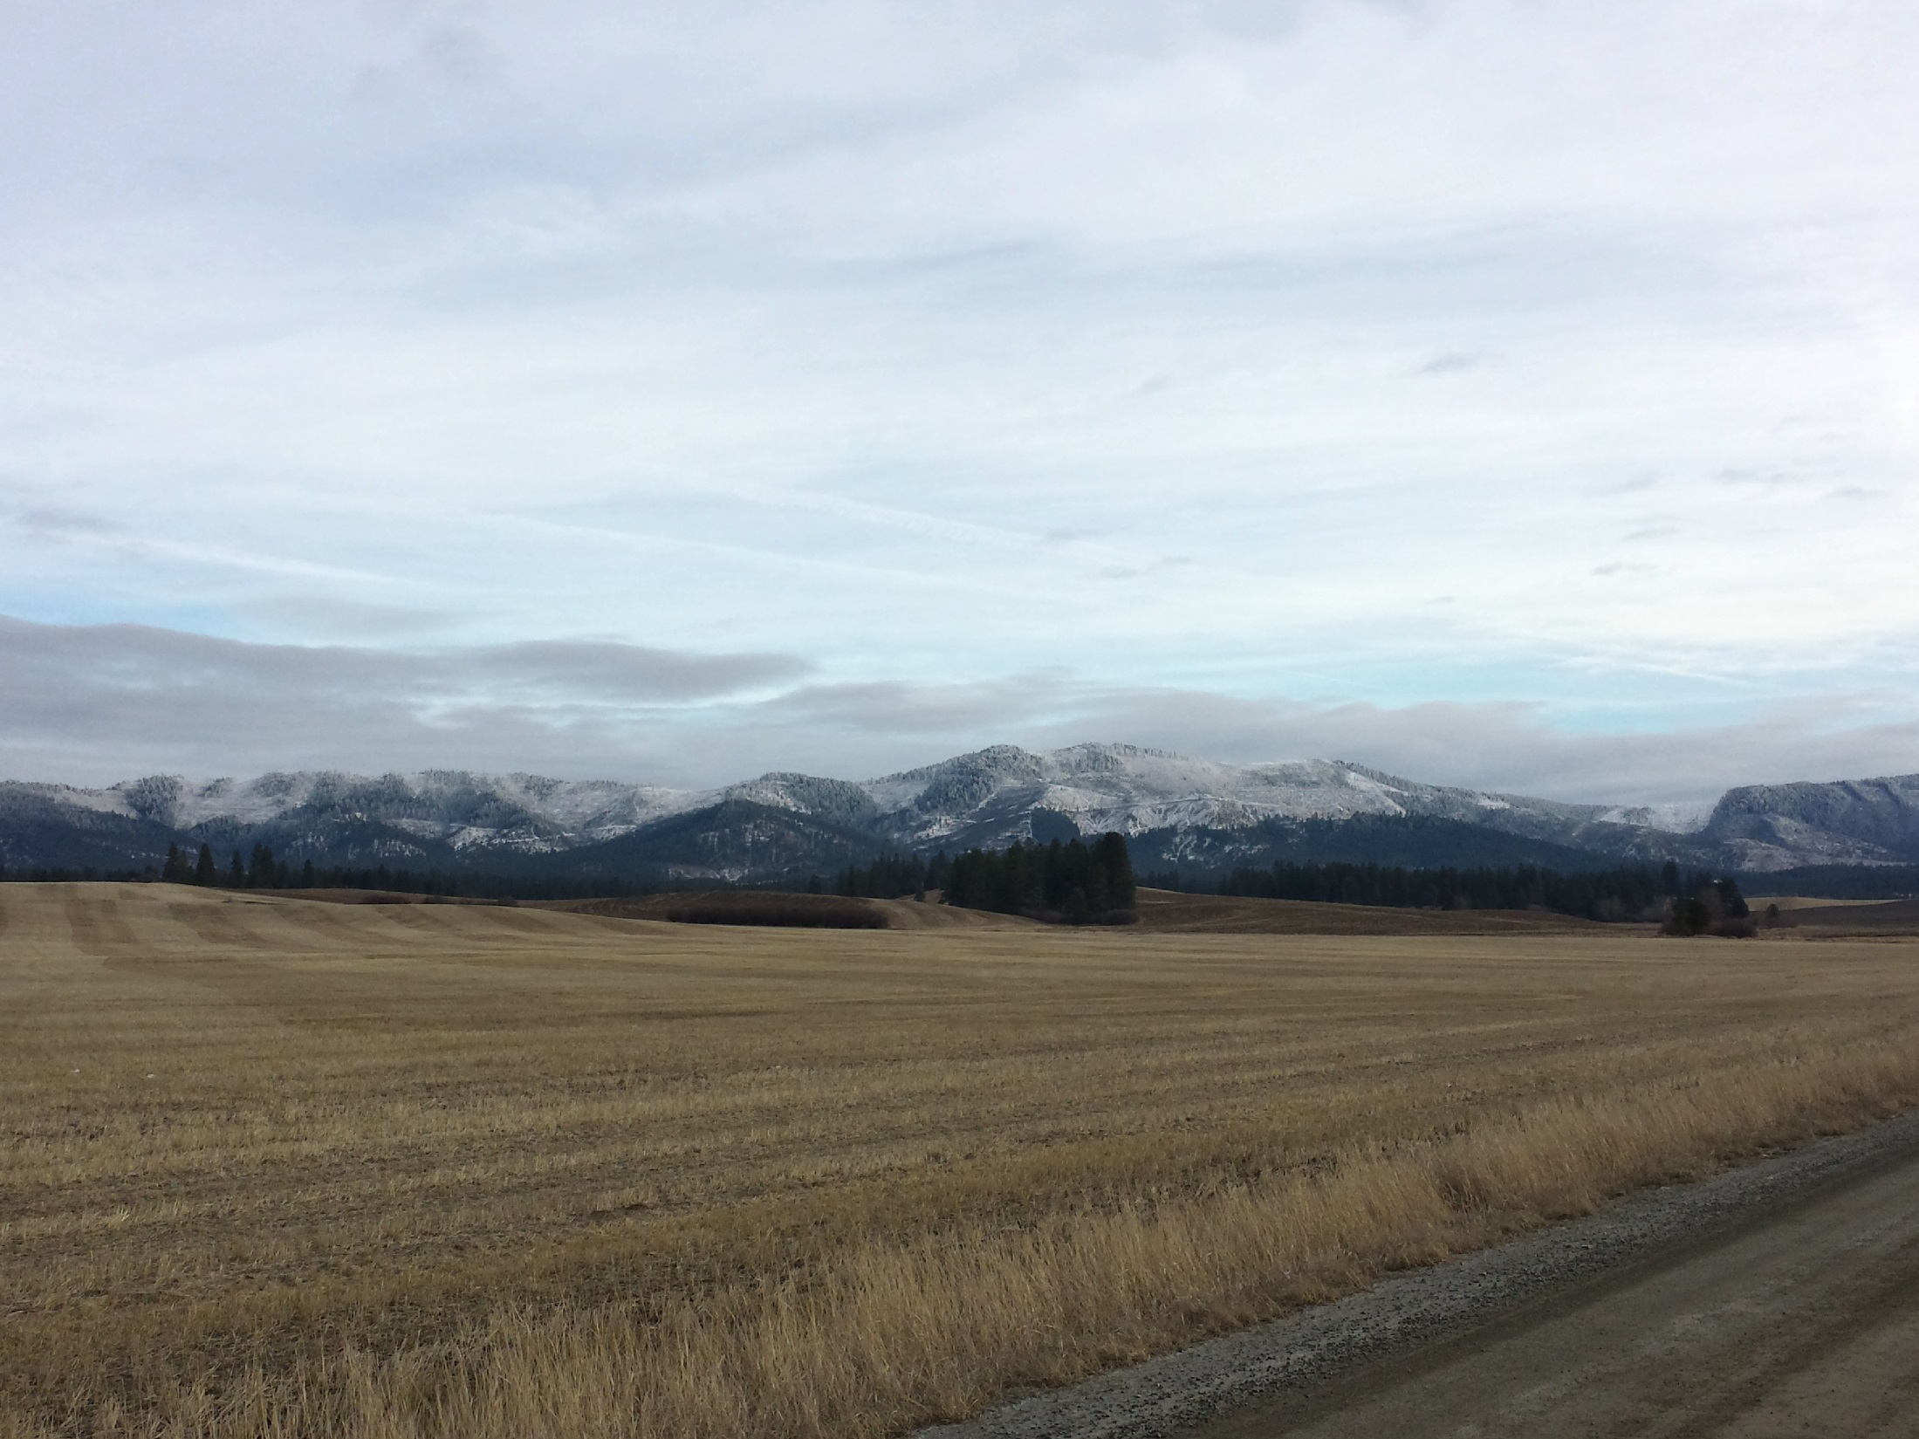
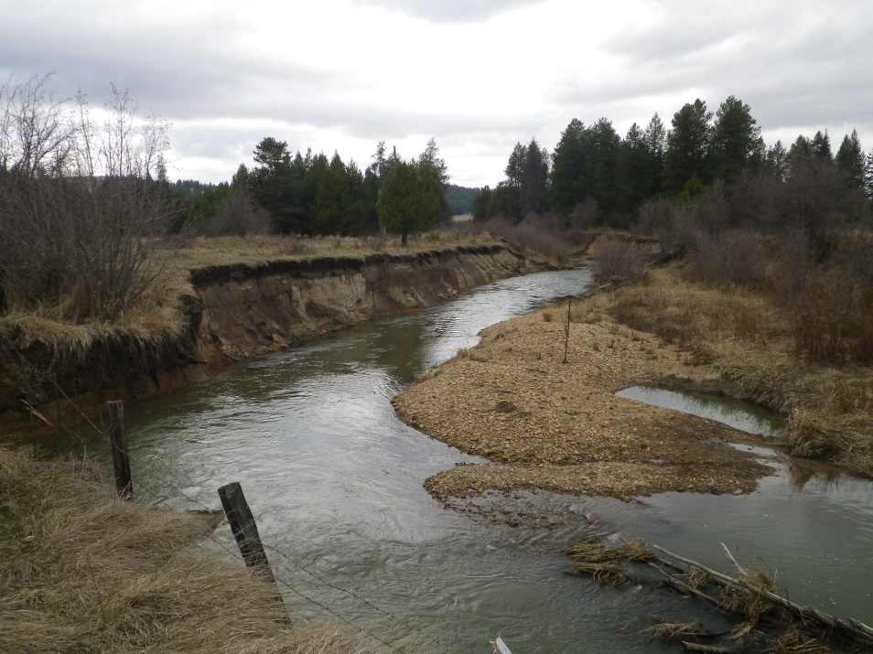
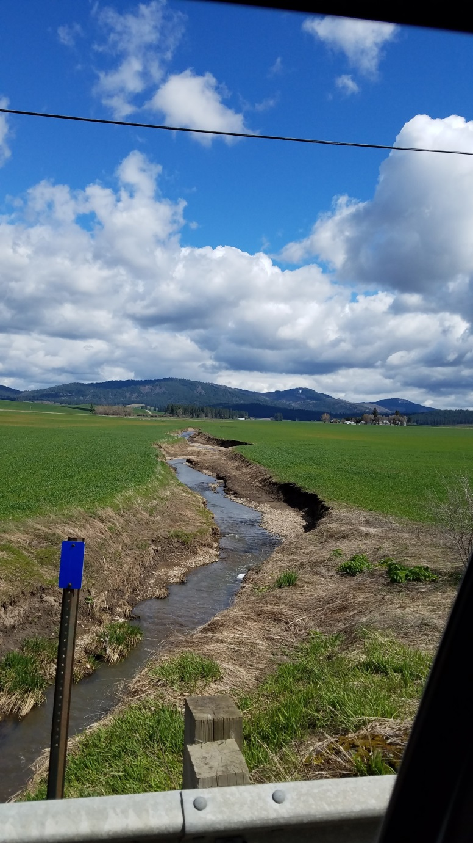

Slide 6
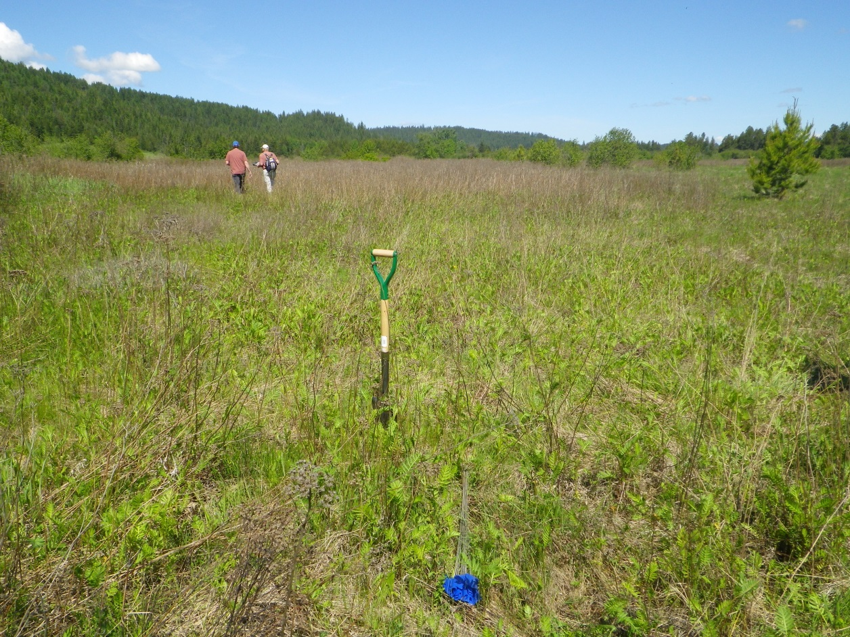
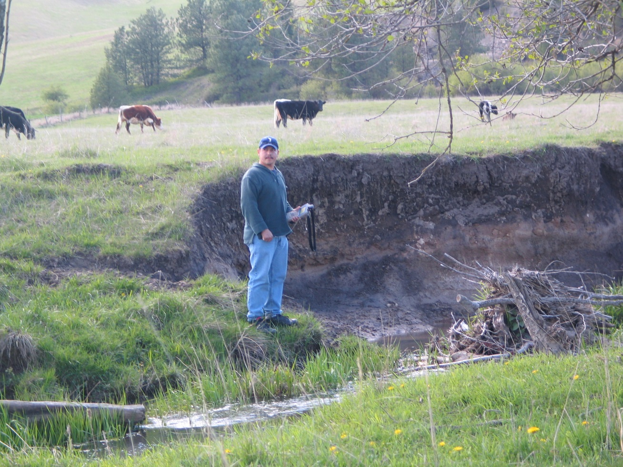
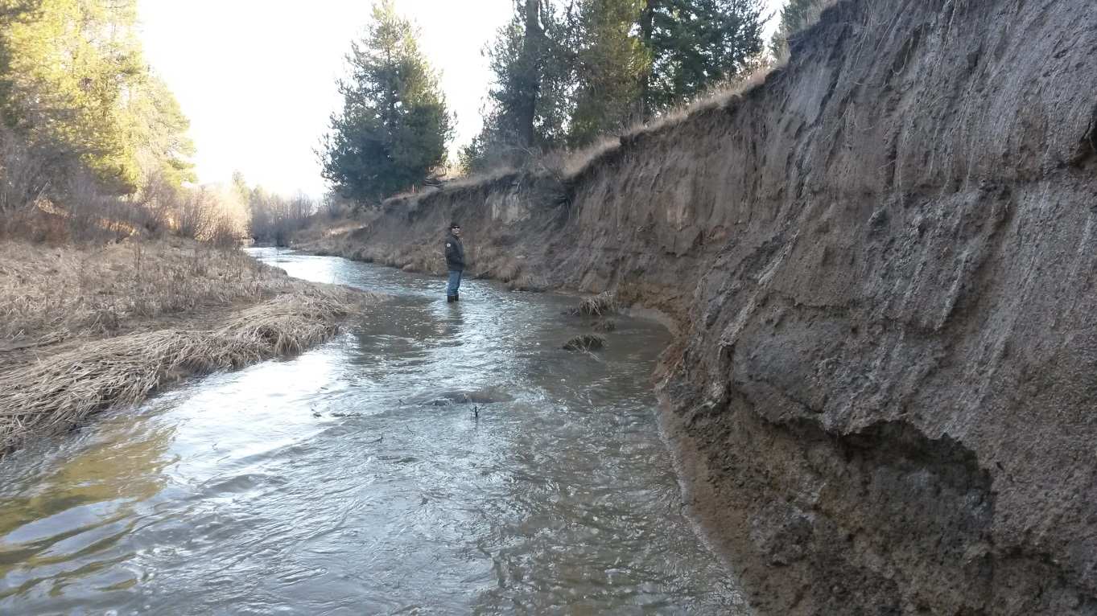
Hangman Creek Watershed
Bank Erosion
Perched Water Table
Stream Incision
Change in Vegetative Community

Slide 7
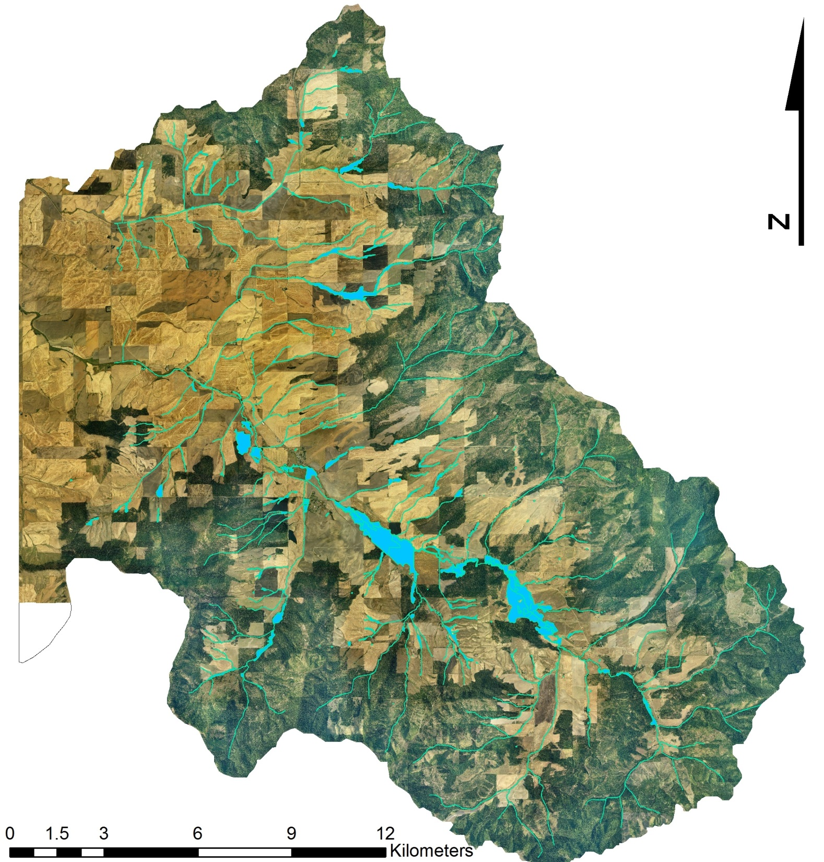
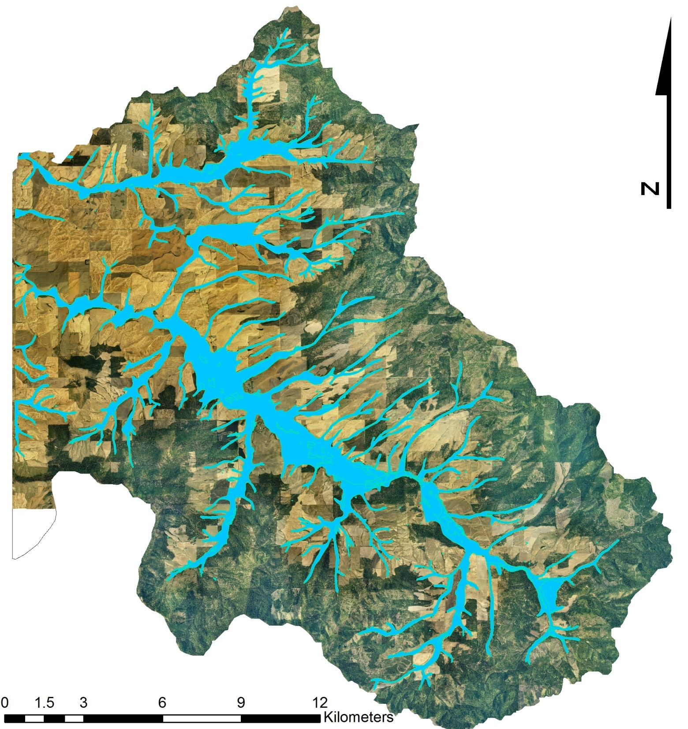
Historic Floodplain:
18,600 acres
Current Floodplain:
3,485 acres

Slide 8
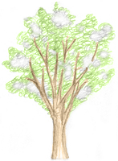
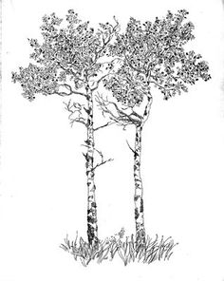
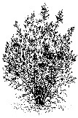
Notes:
Cross section diagram of entrenched channel and adjacent floodplain with animation of a perched water table with and without drainage tiles. Animation of historic stream channel and influence on water table.

Slide 9
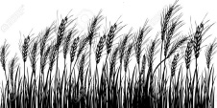
Notes:
Cross section diagram of entrenched channel and adjacent floodplain with animation of a perched water table with and without drainage tiles. Animation of historic stream channel and influence on water table.

Slide 11
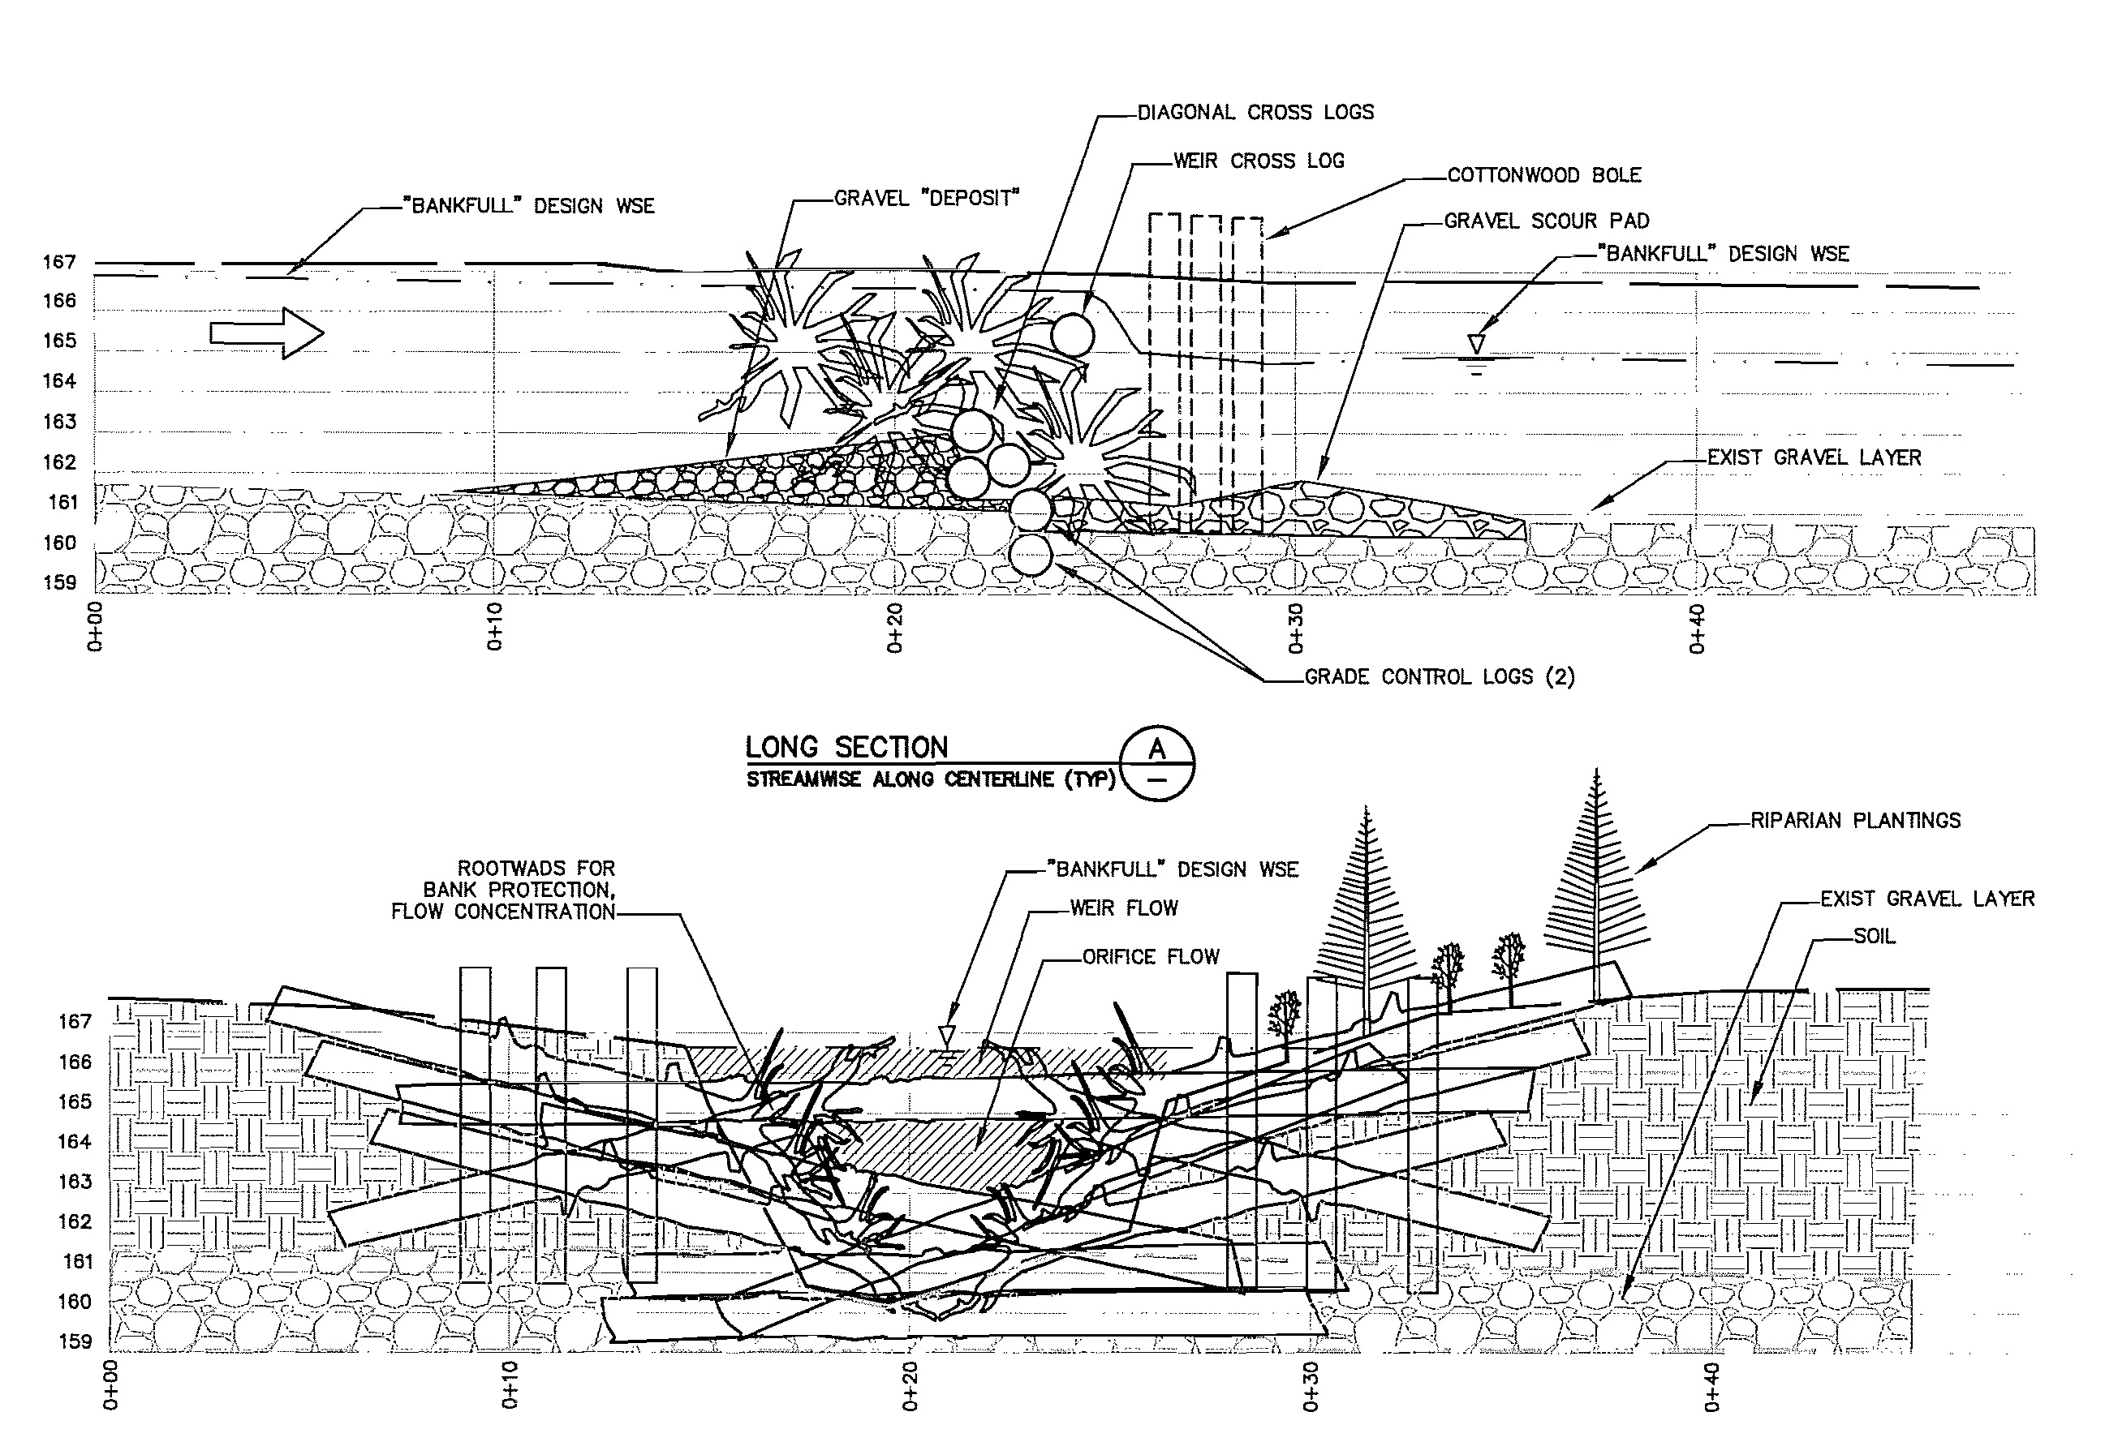
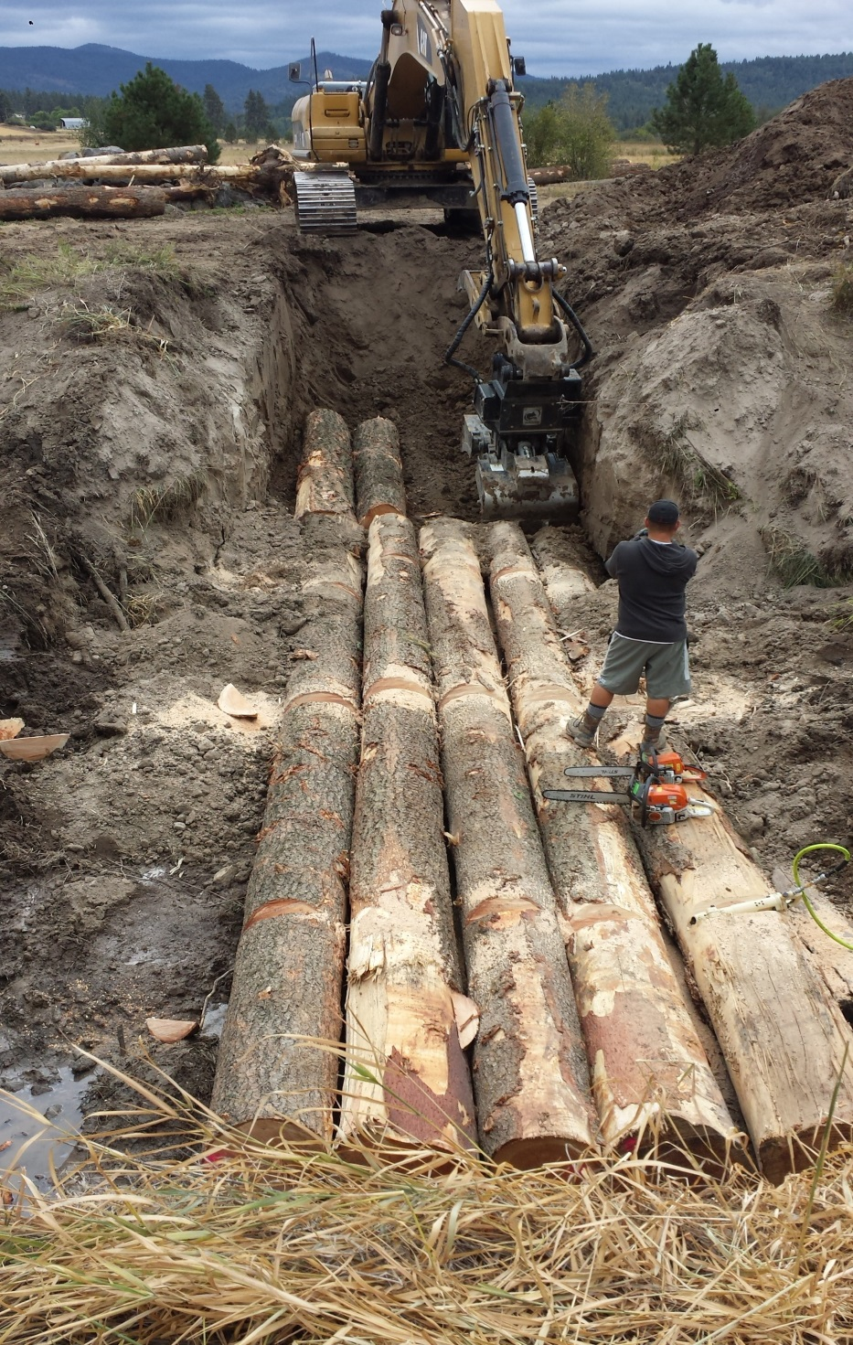
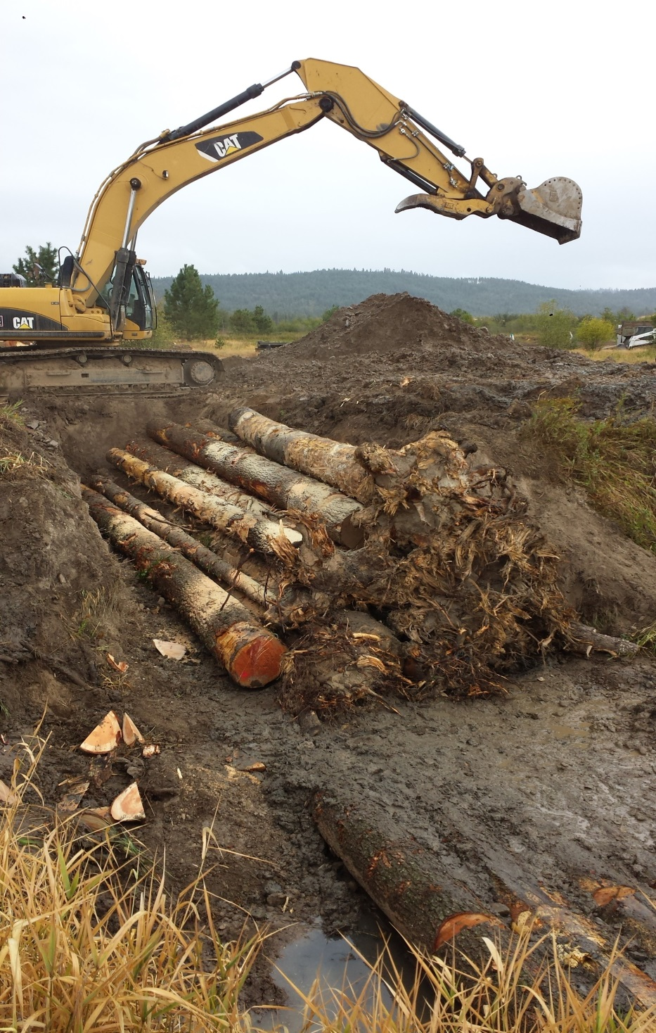
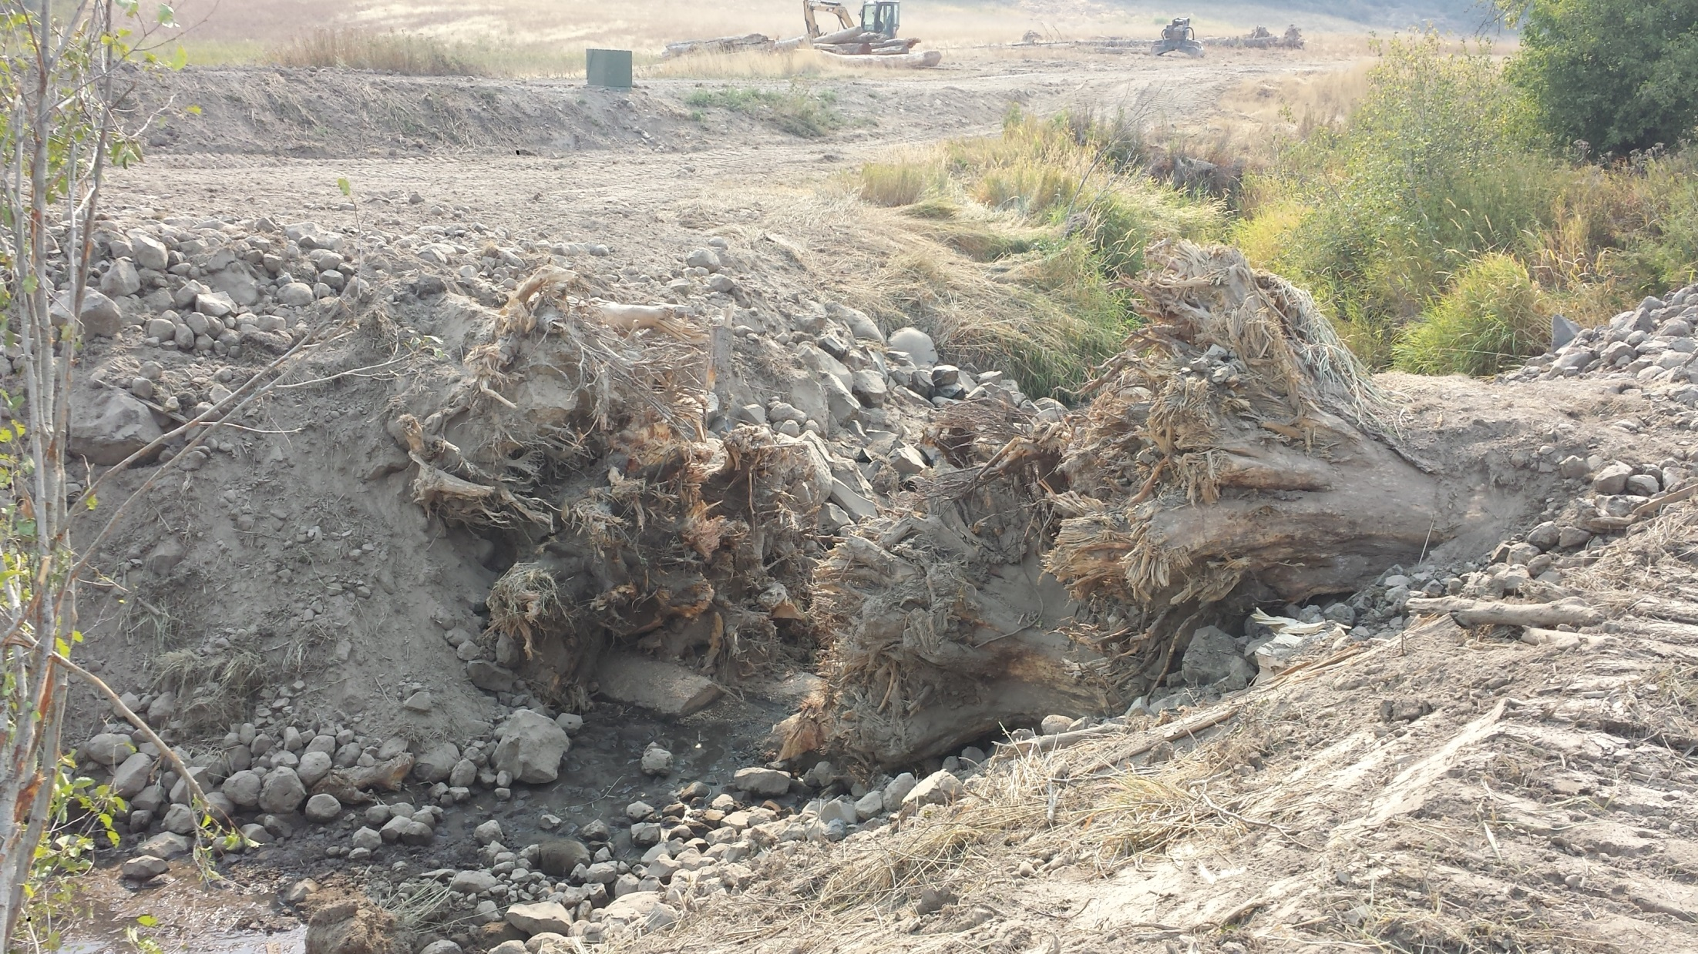
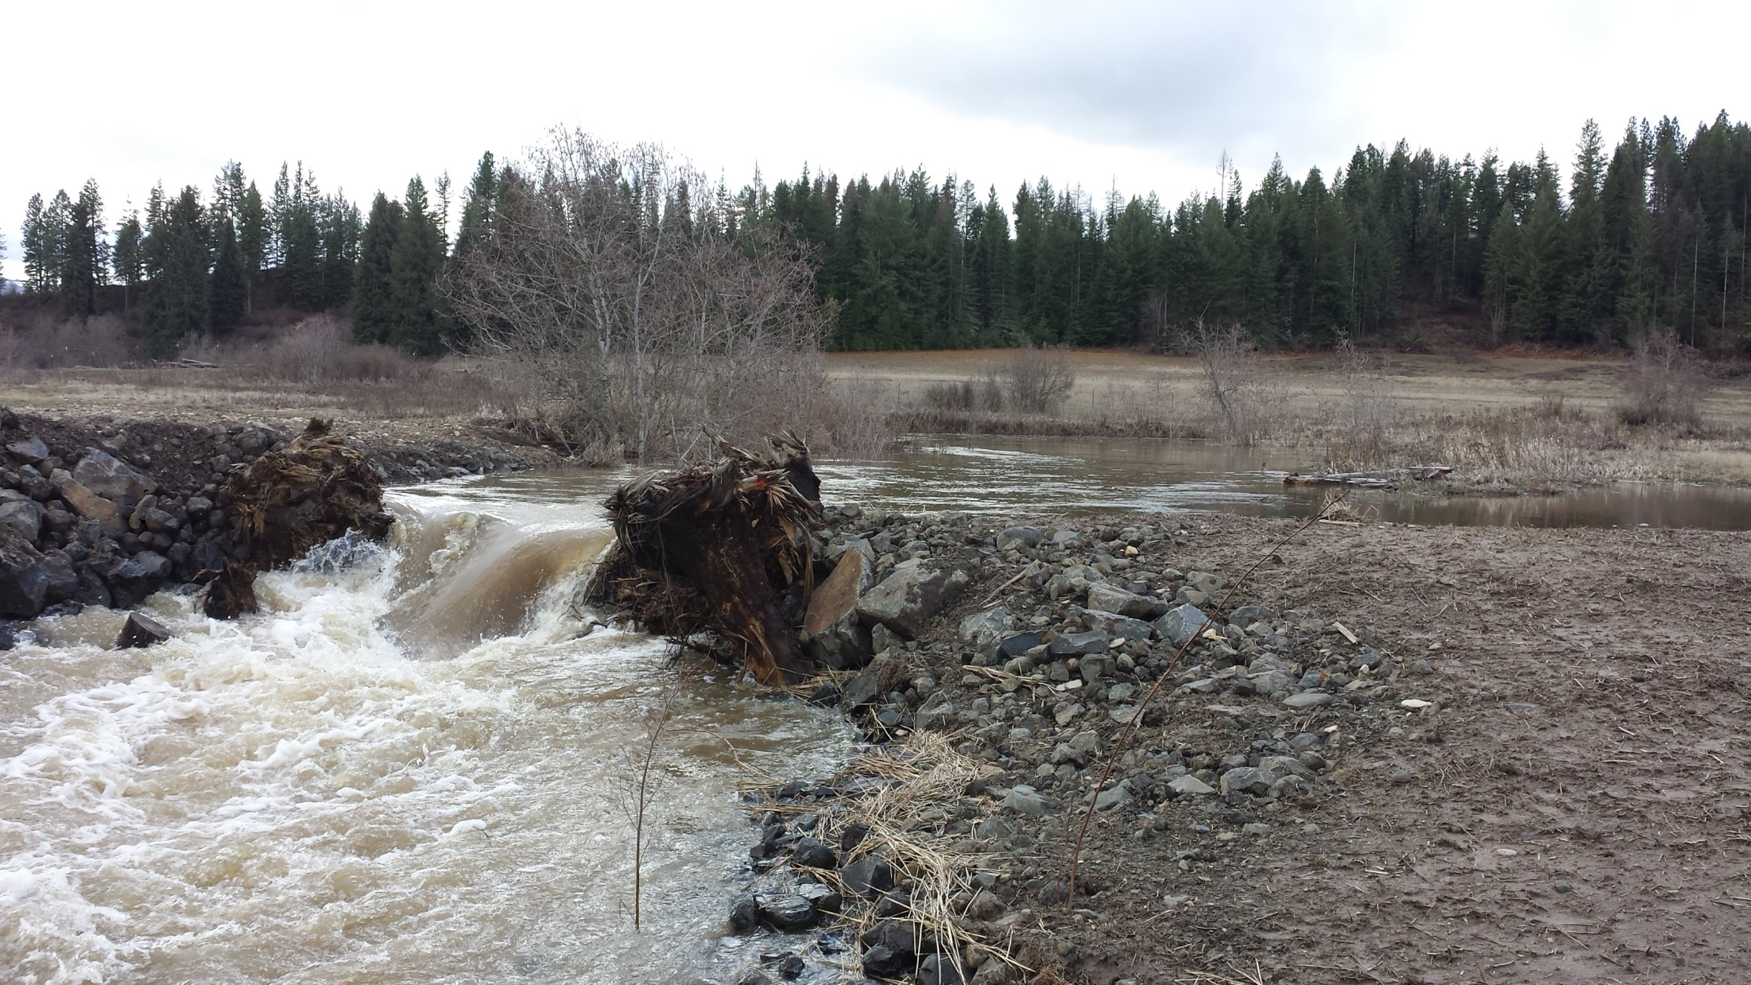
Engineered Log Jams
Notes:
Using roughness additions into the stream (engineered log jams) to help relieve pressure downstream. A band aid fix for immediate area.

Slide 12
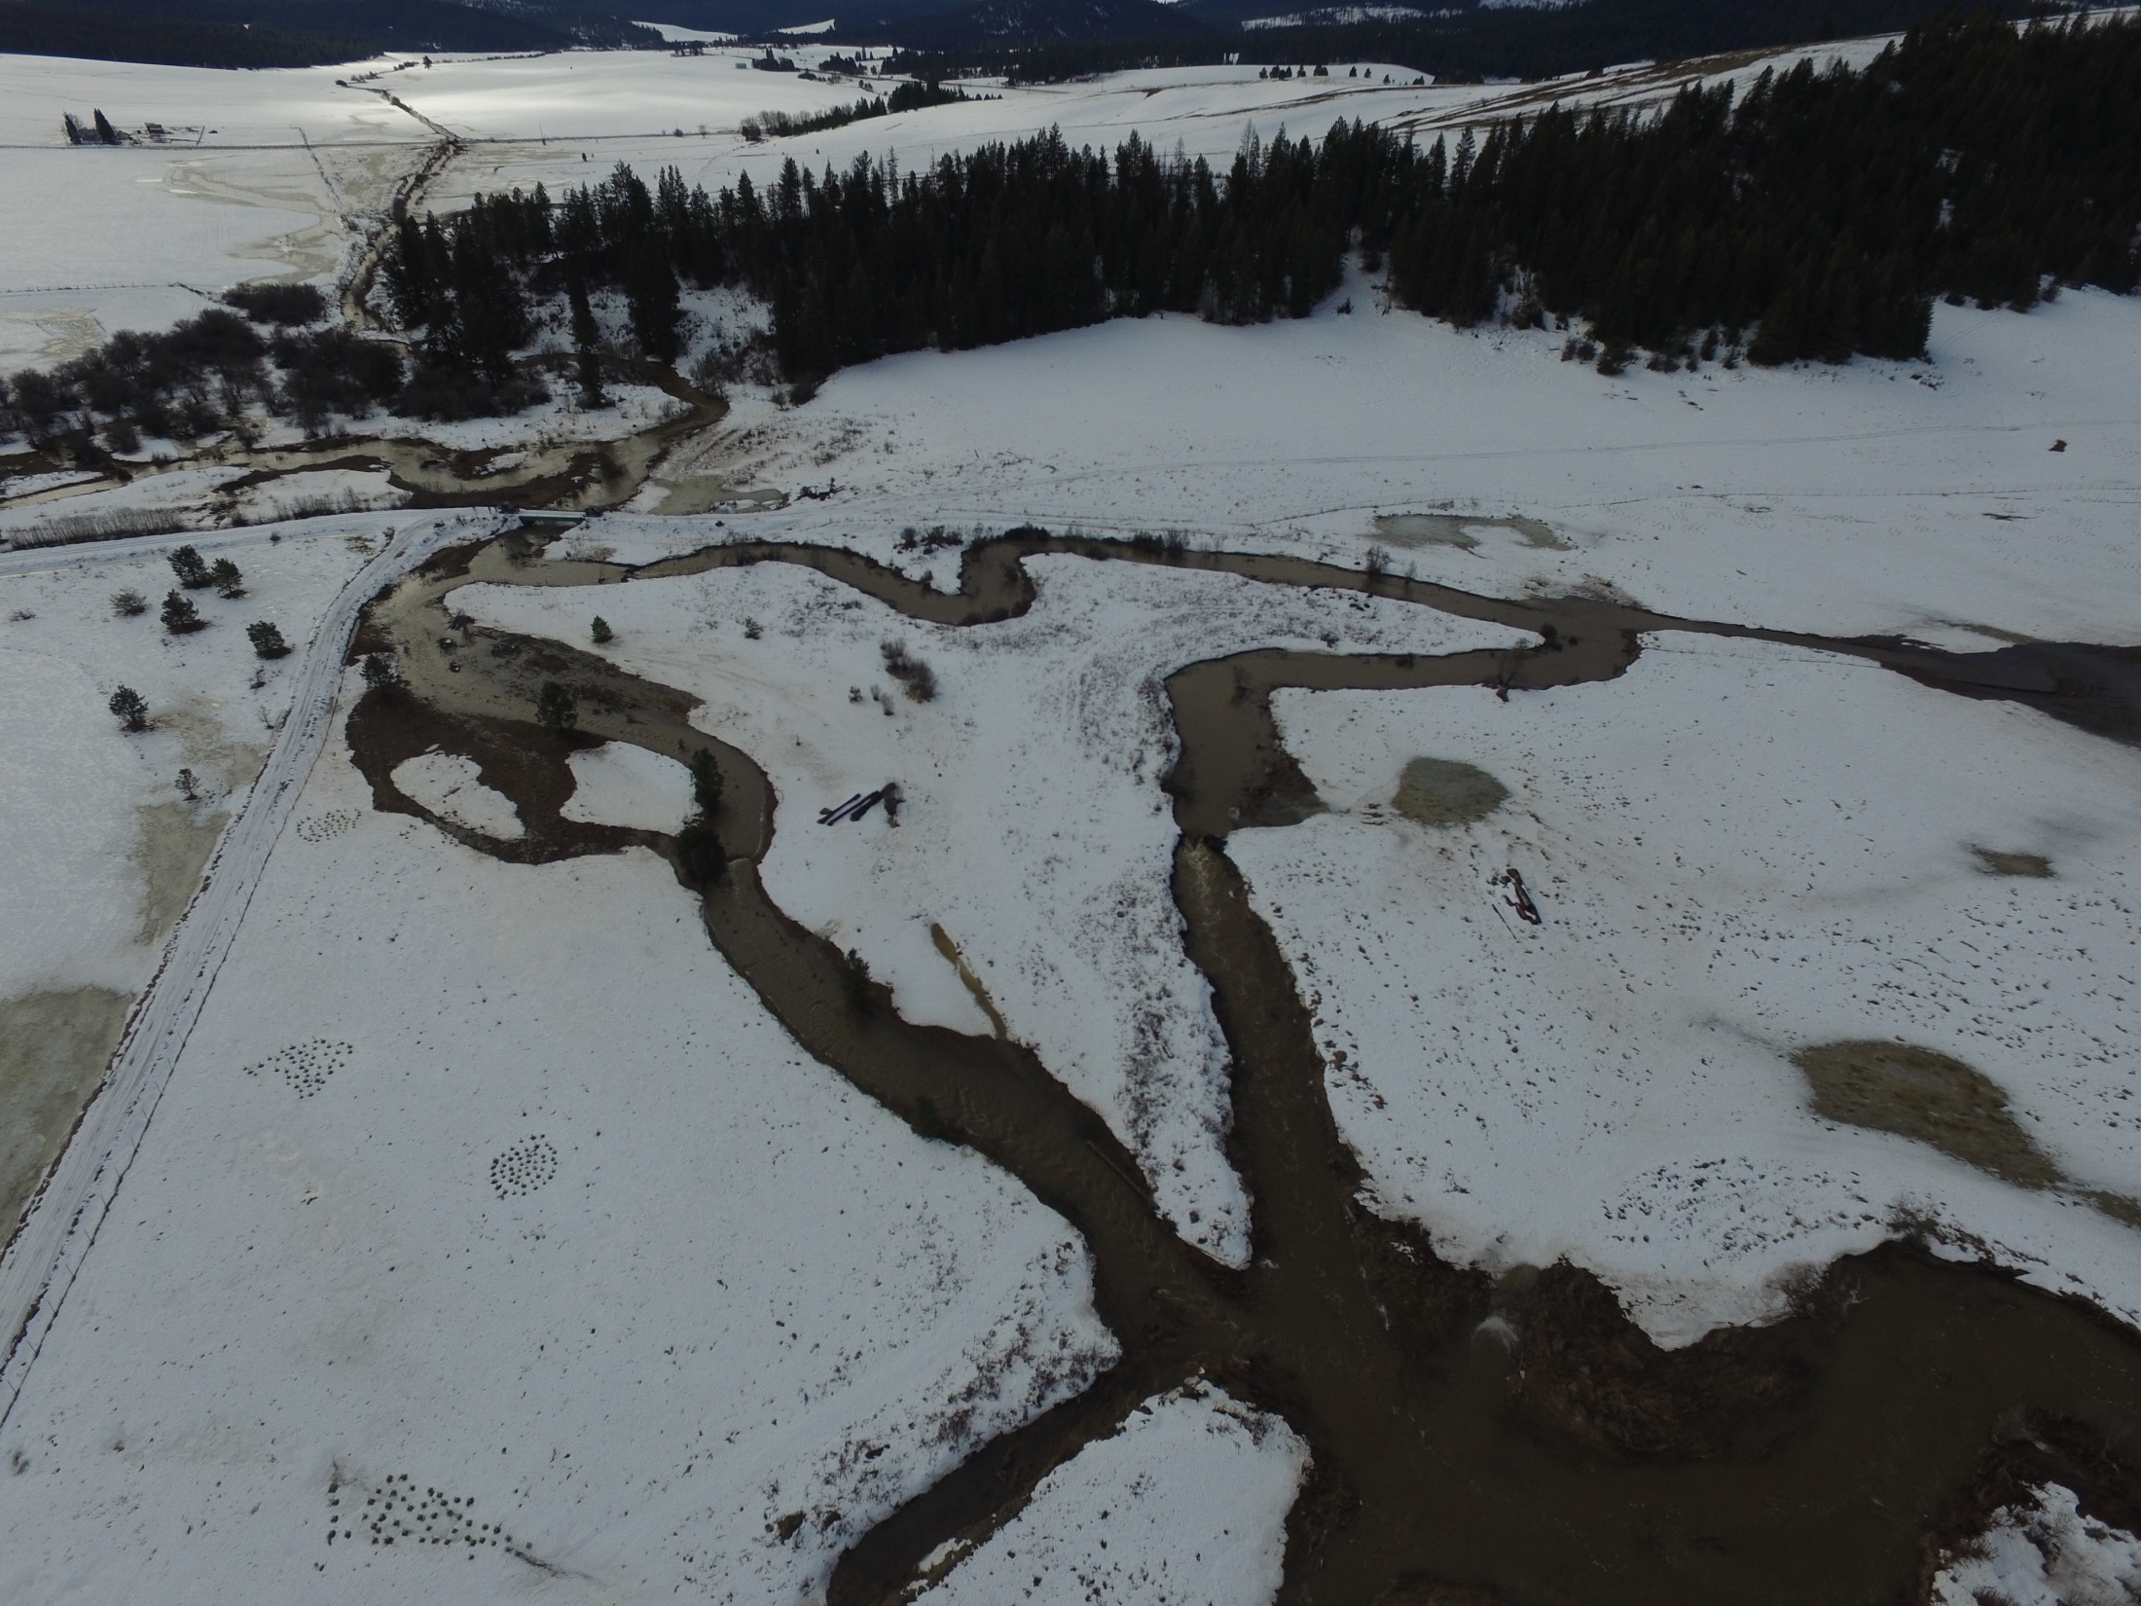
Notes:
More photos of restoration work

Slide 13
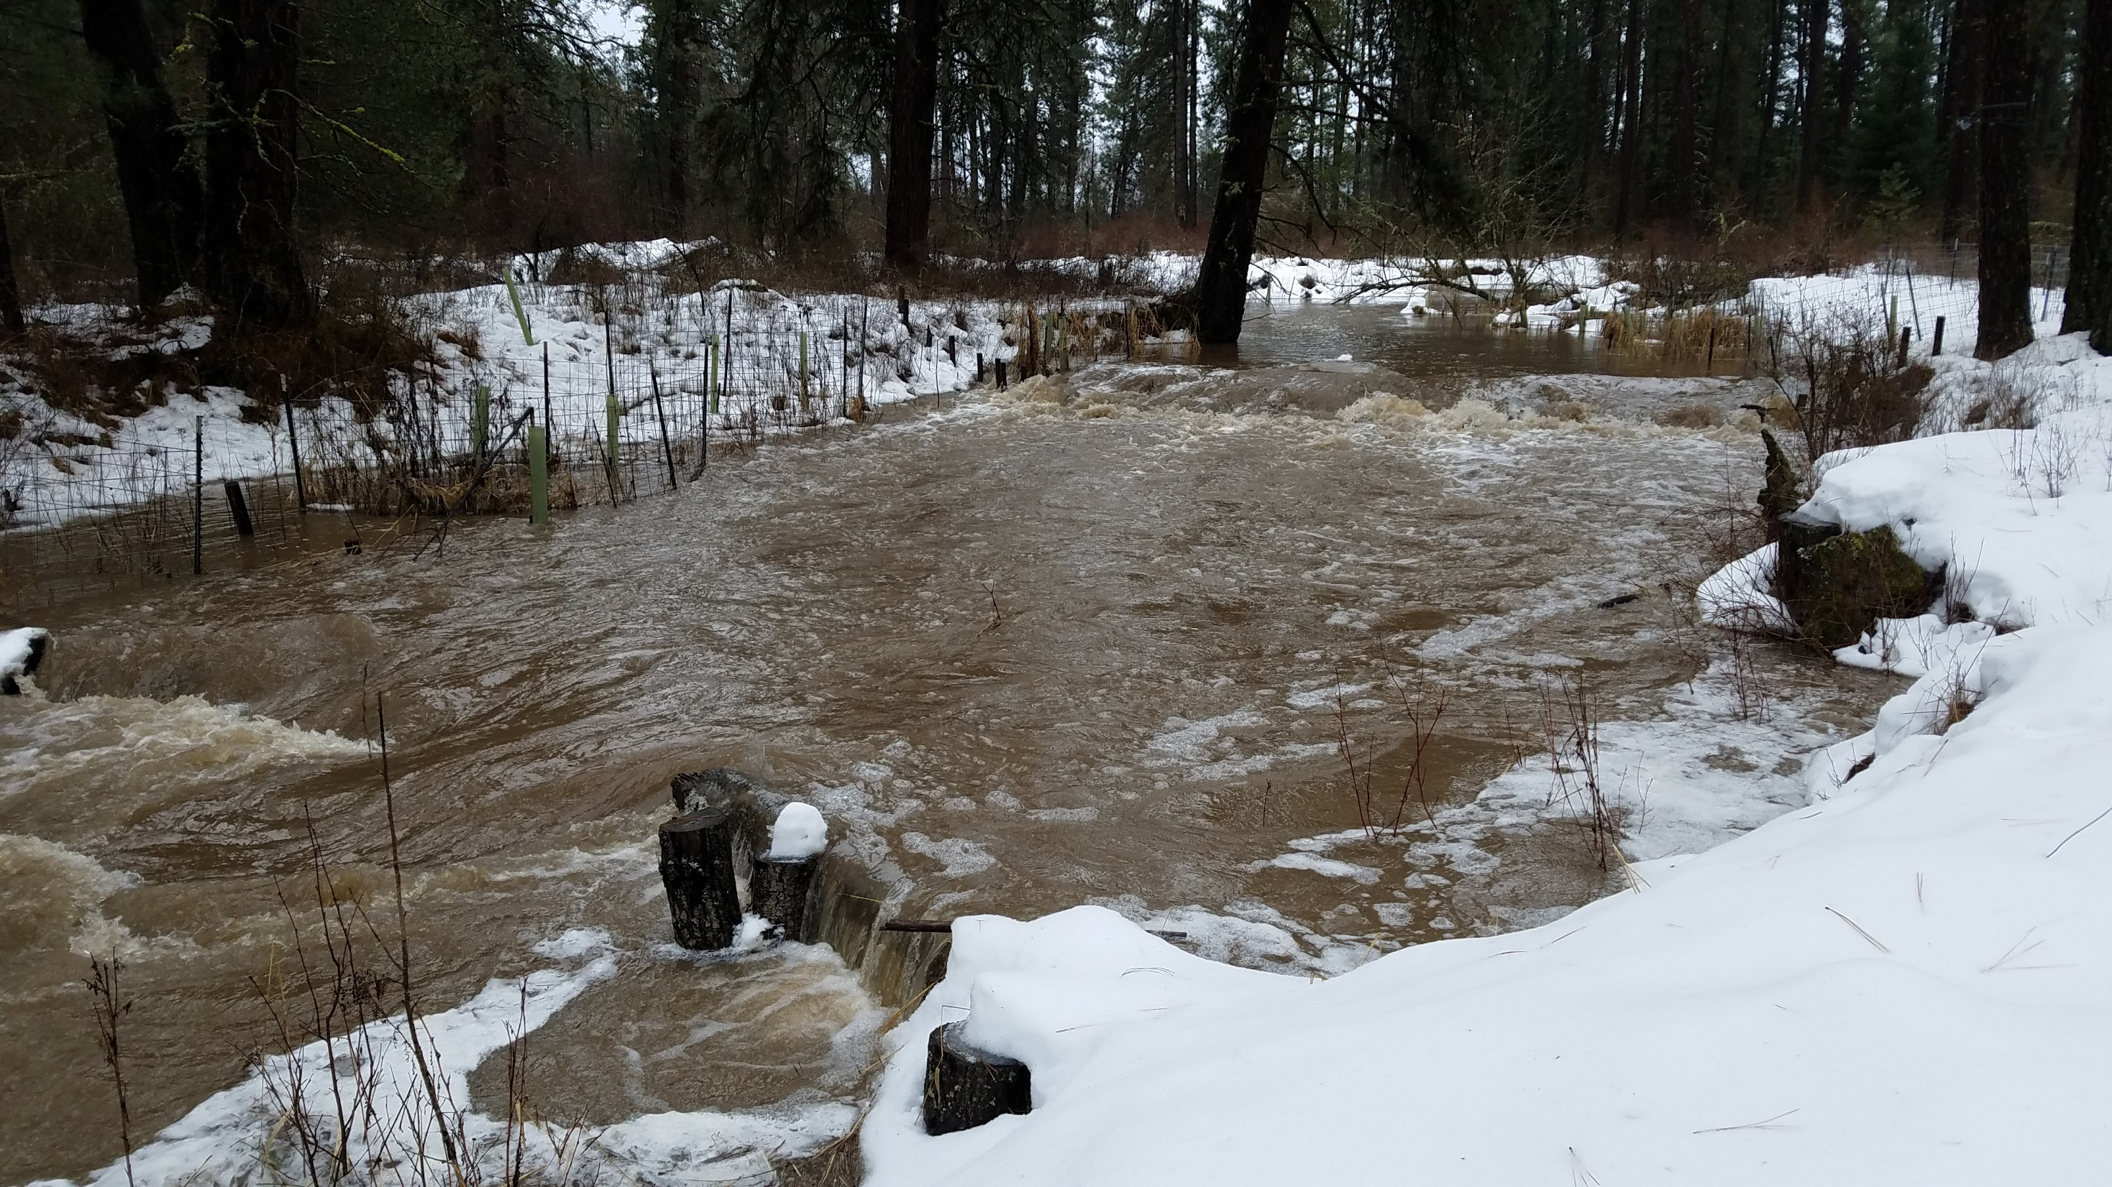
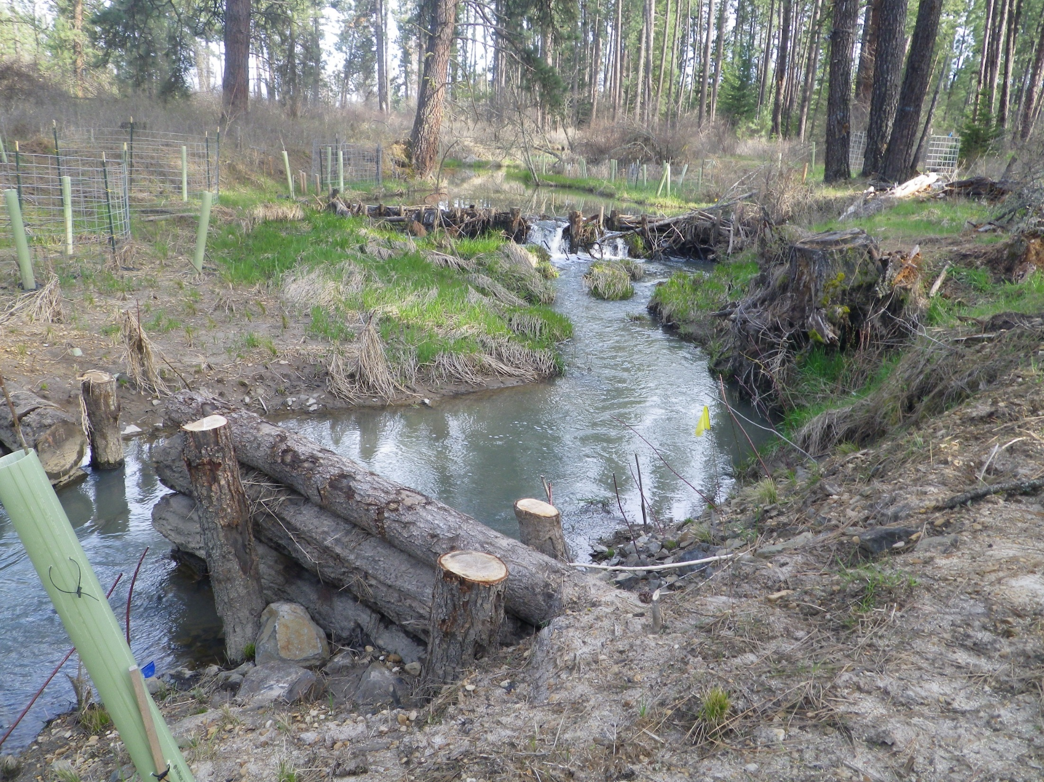
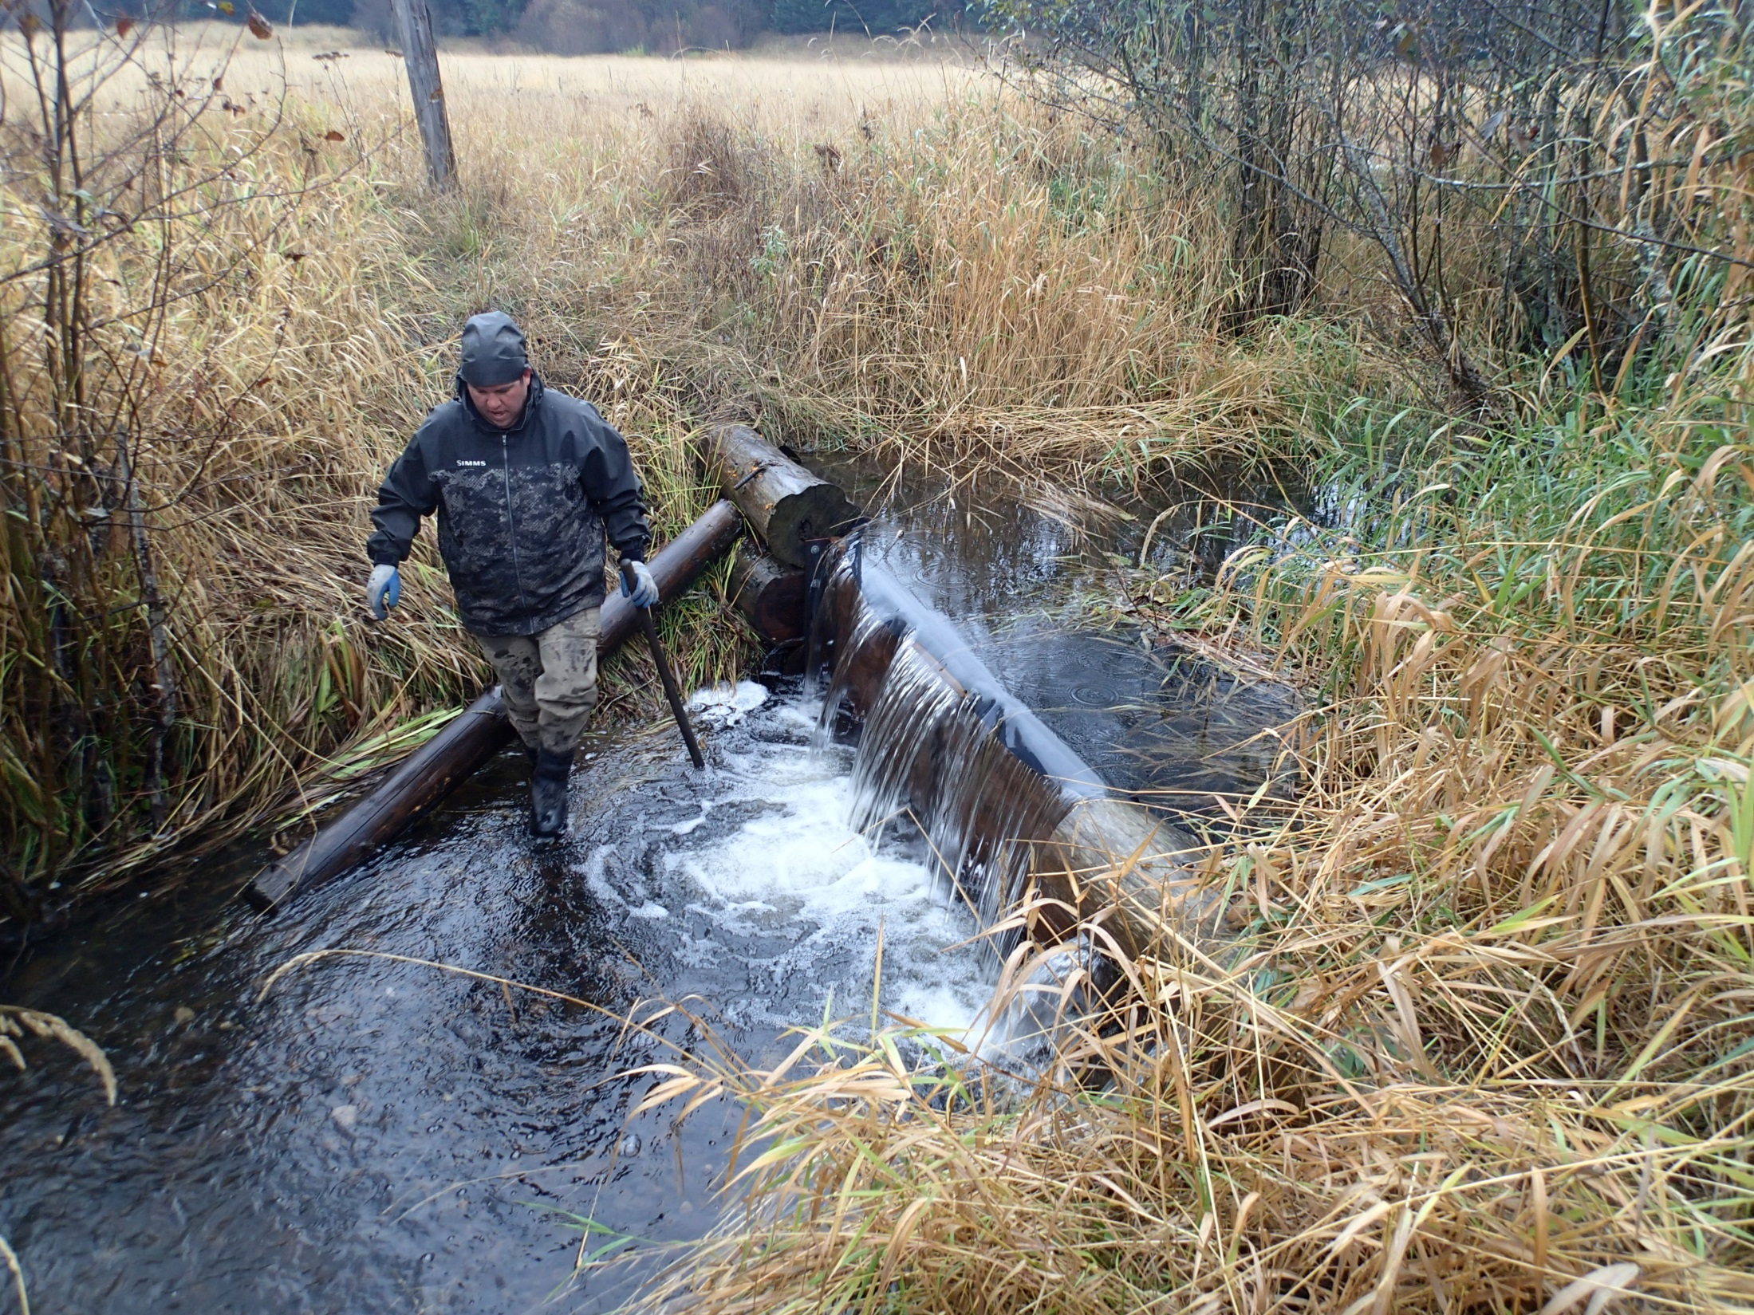
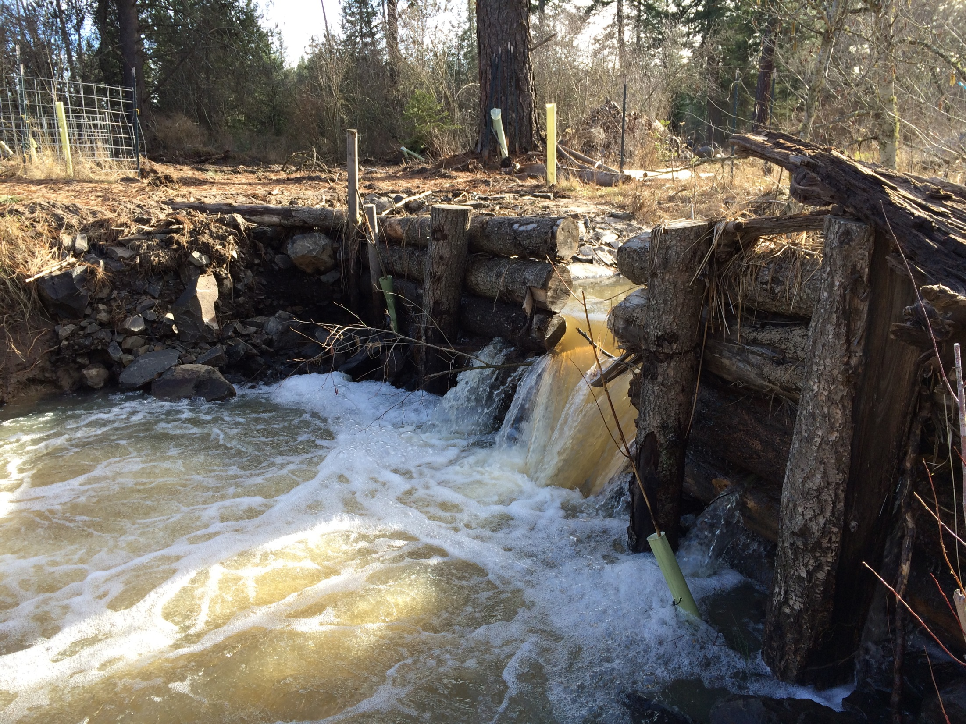
ELJ 1.0

Slide 14
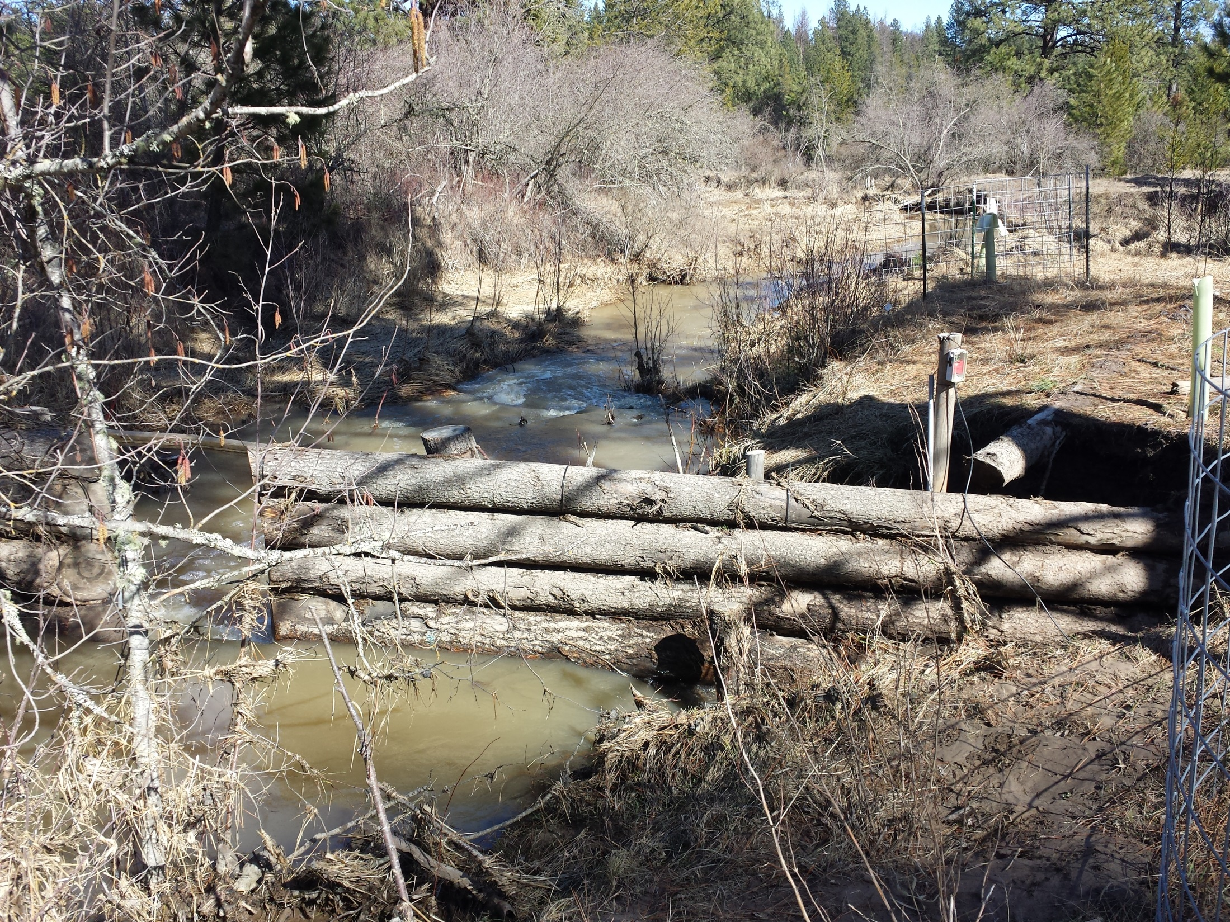
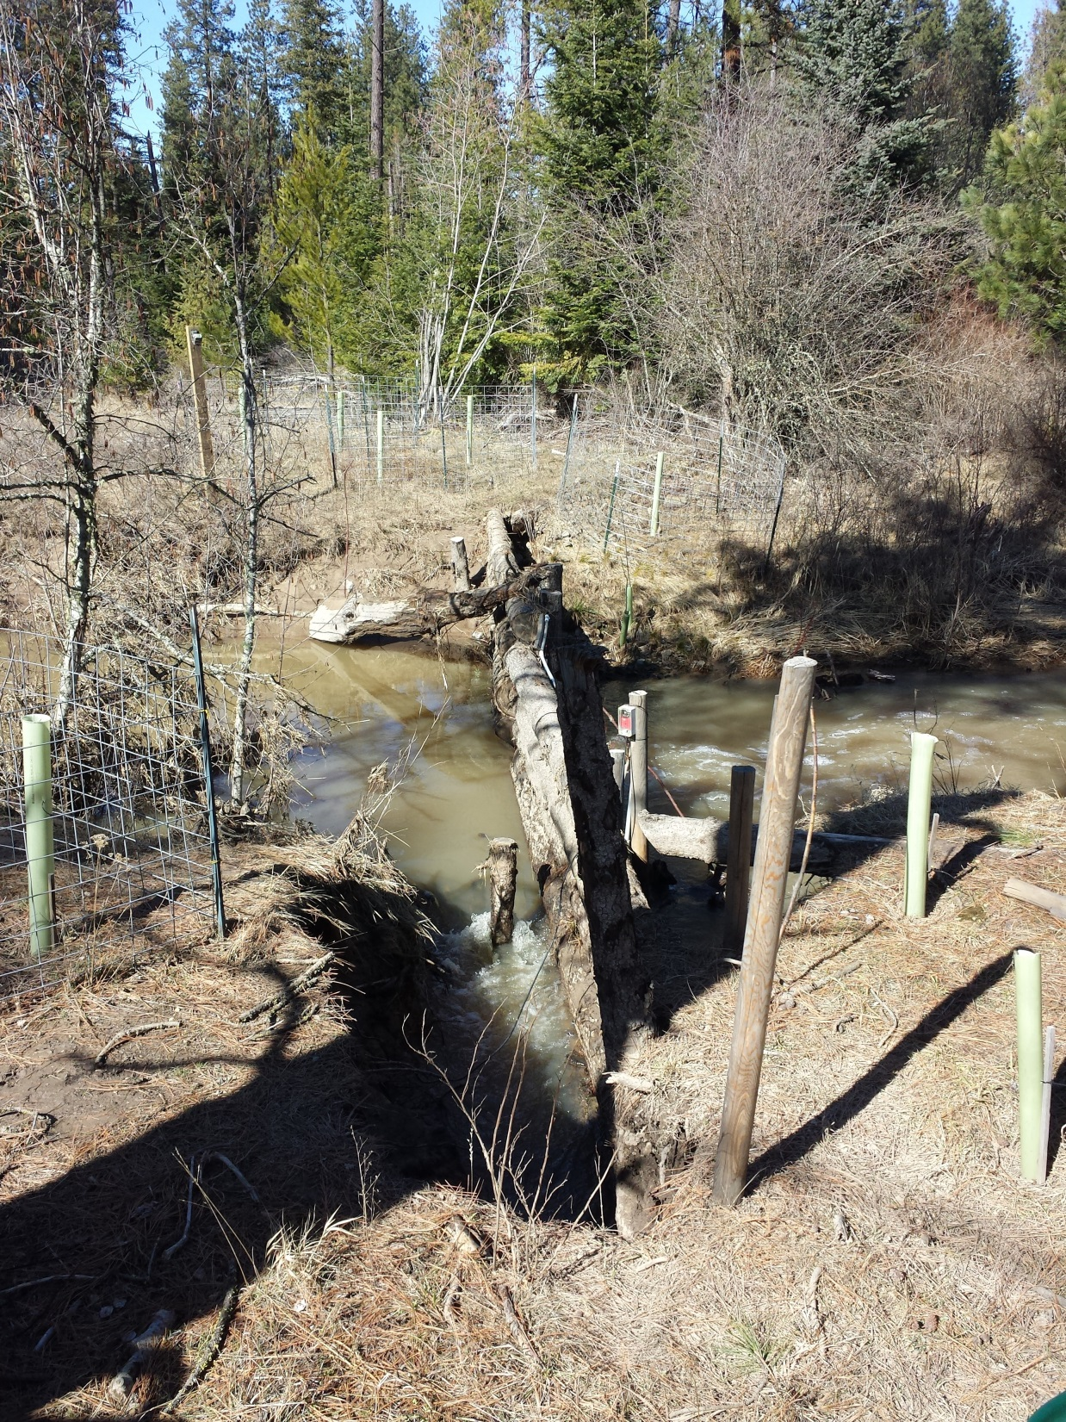
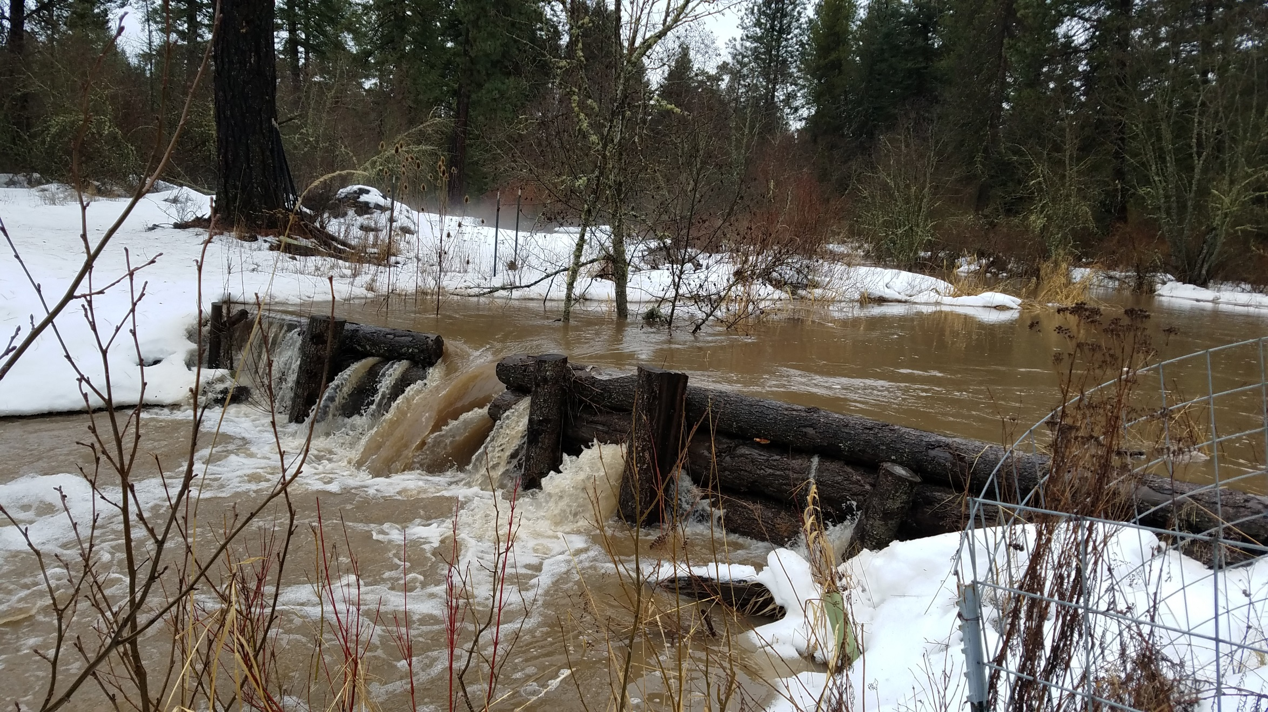
Functional Issues
Notes:
Promote runoff energy dissipation and improve baseflow conditions: holding water within floodplain and channel

Slide 15
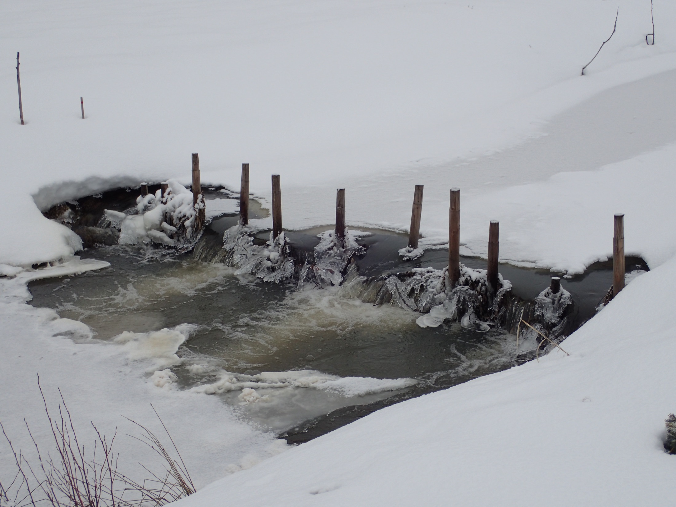
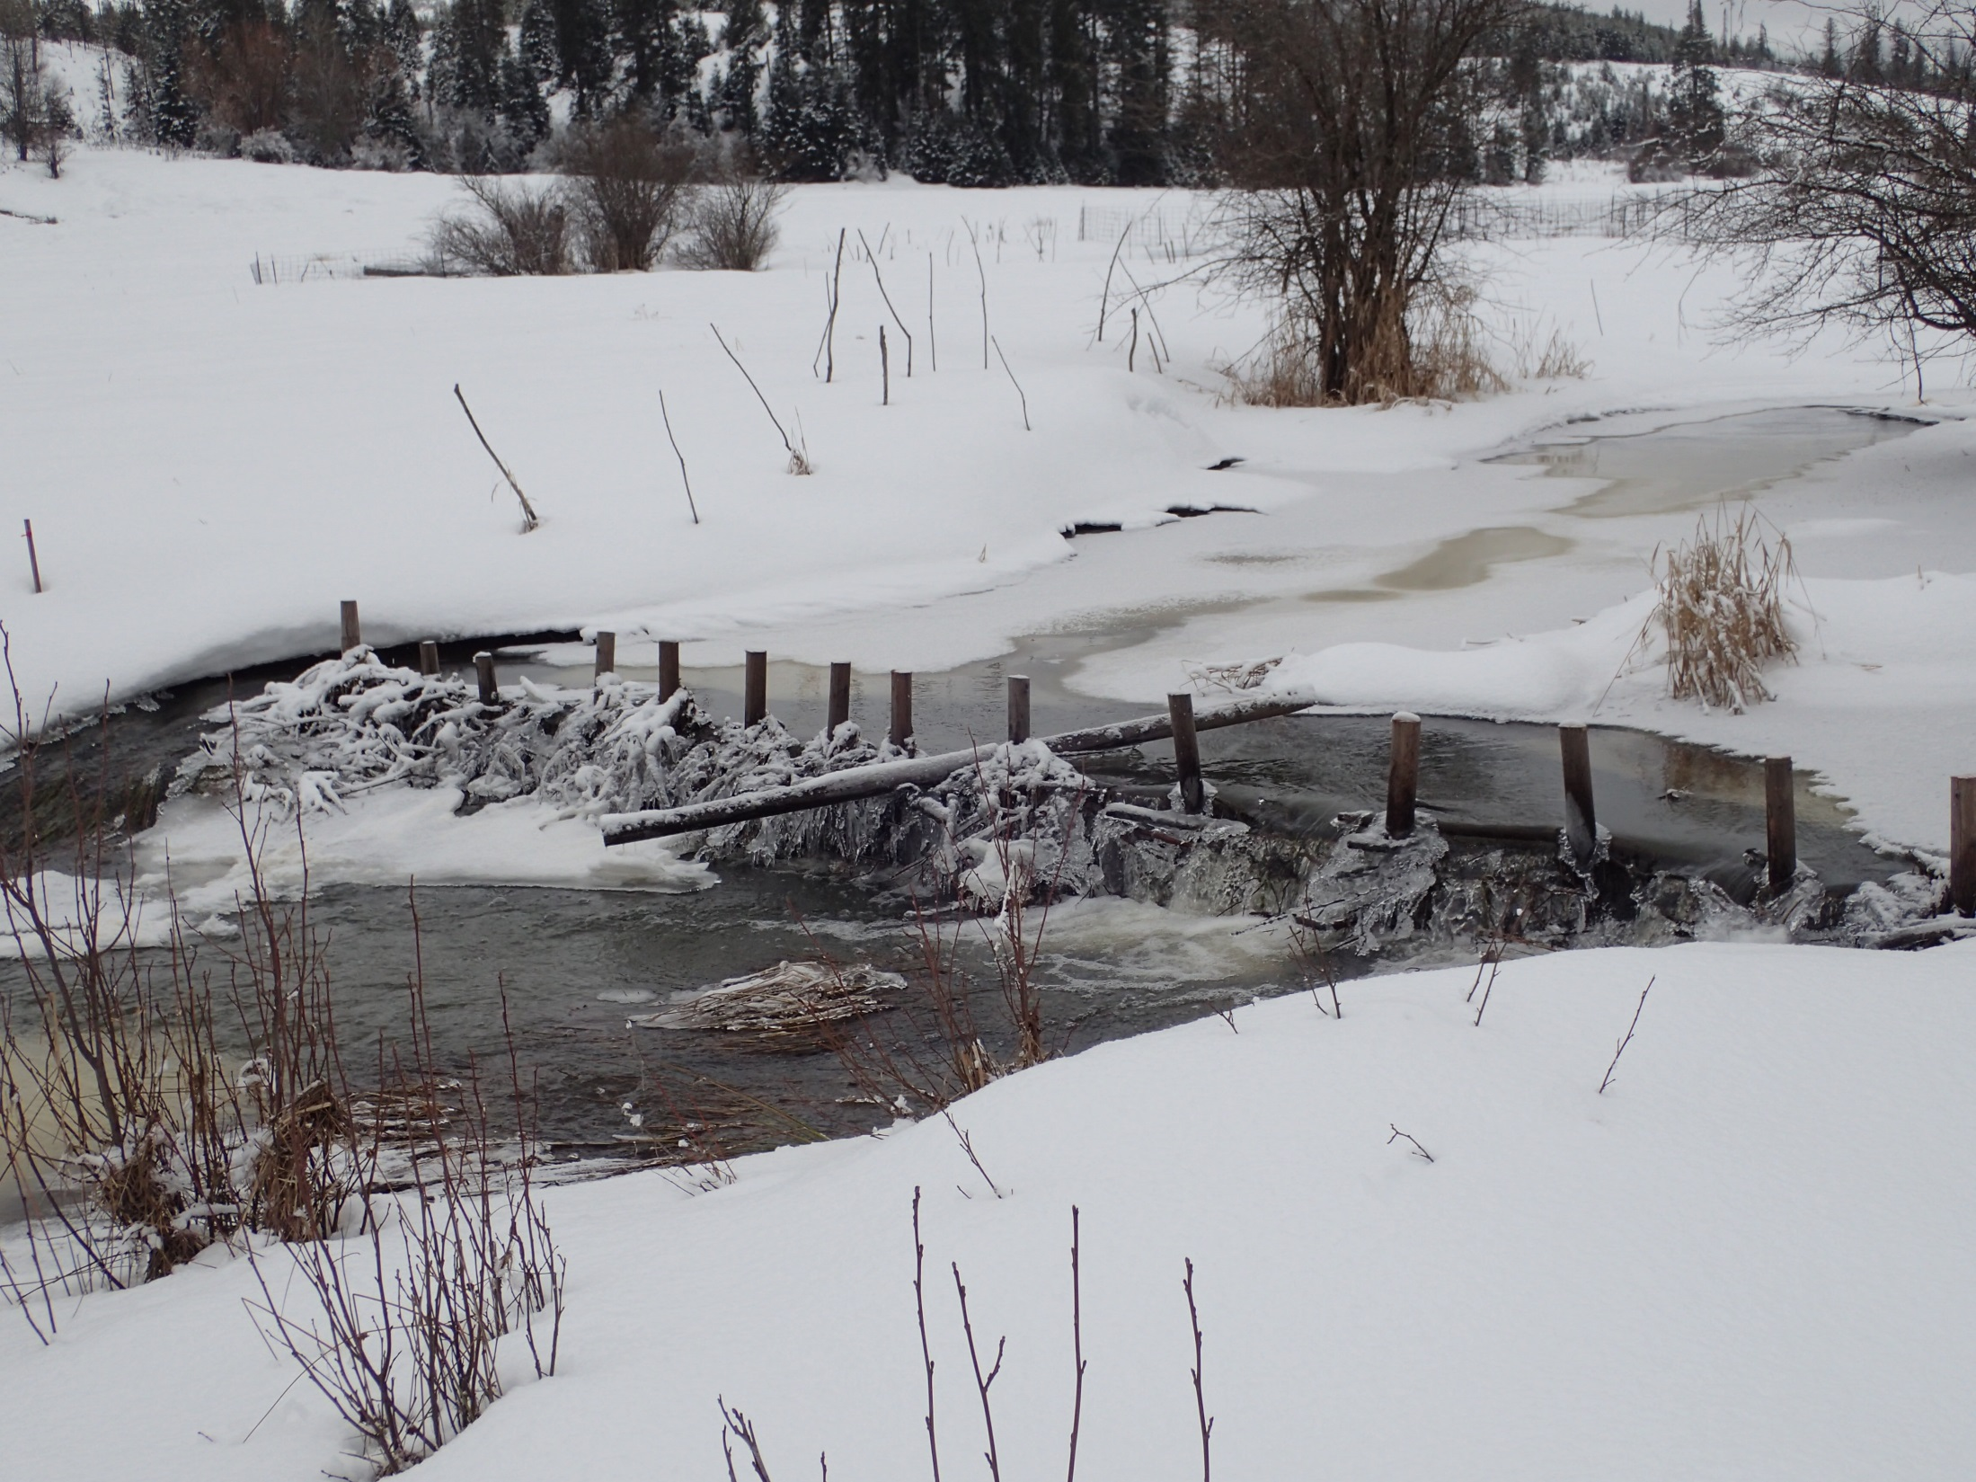
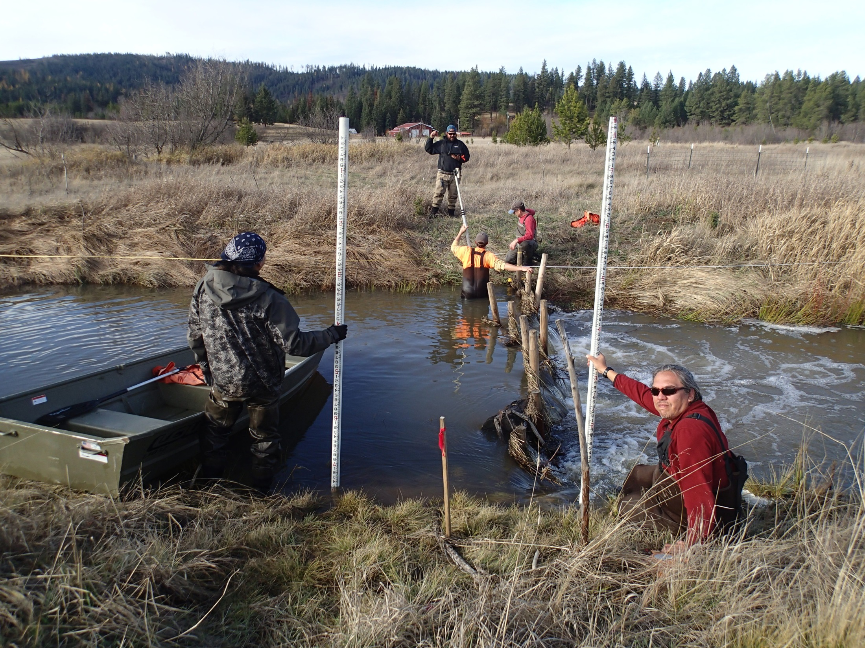
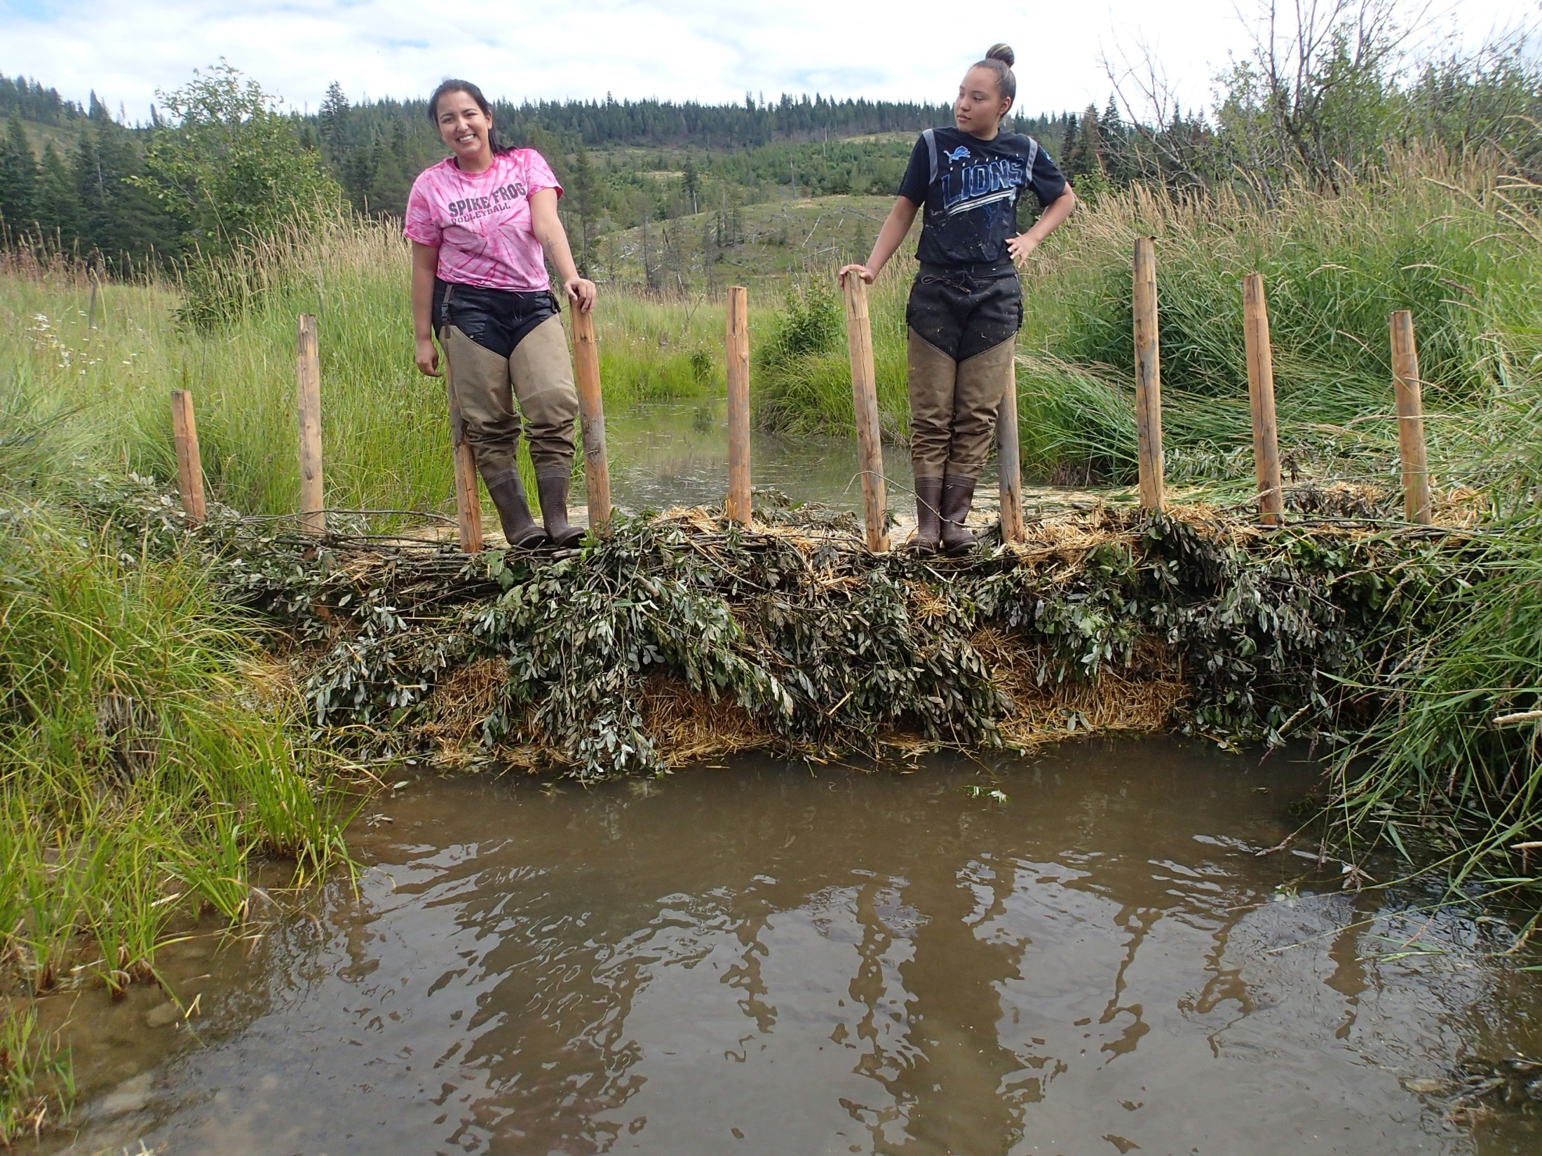
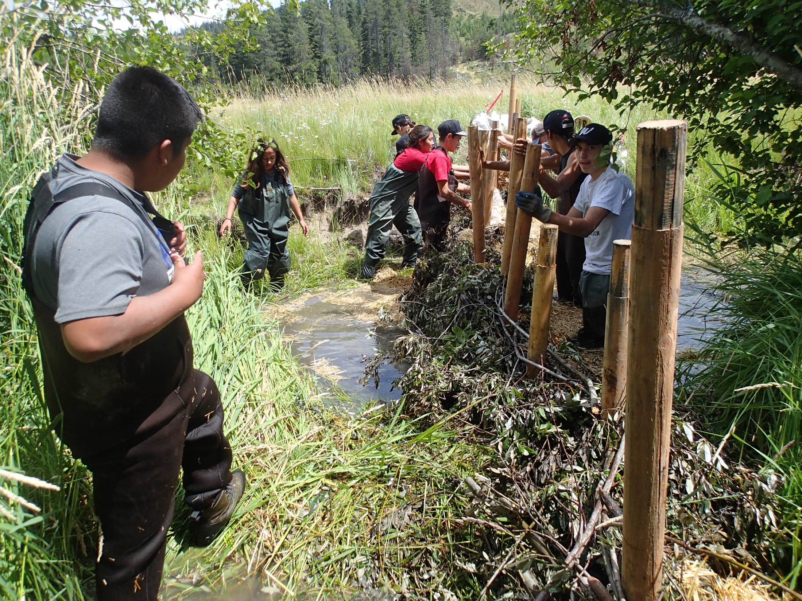
Post Line Willow Weaves
Notes:
Bridge Creek in John Day Watershed

Slide 16

Historic Channel Activation

Slide 17
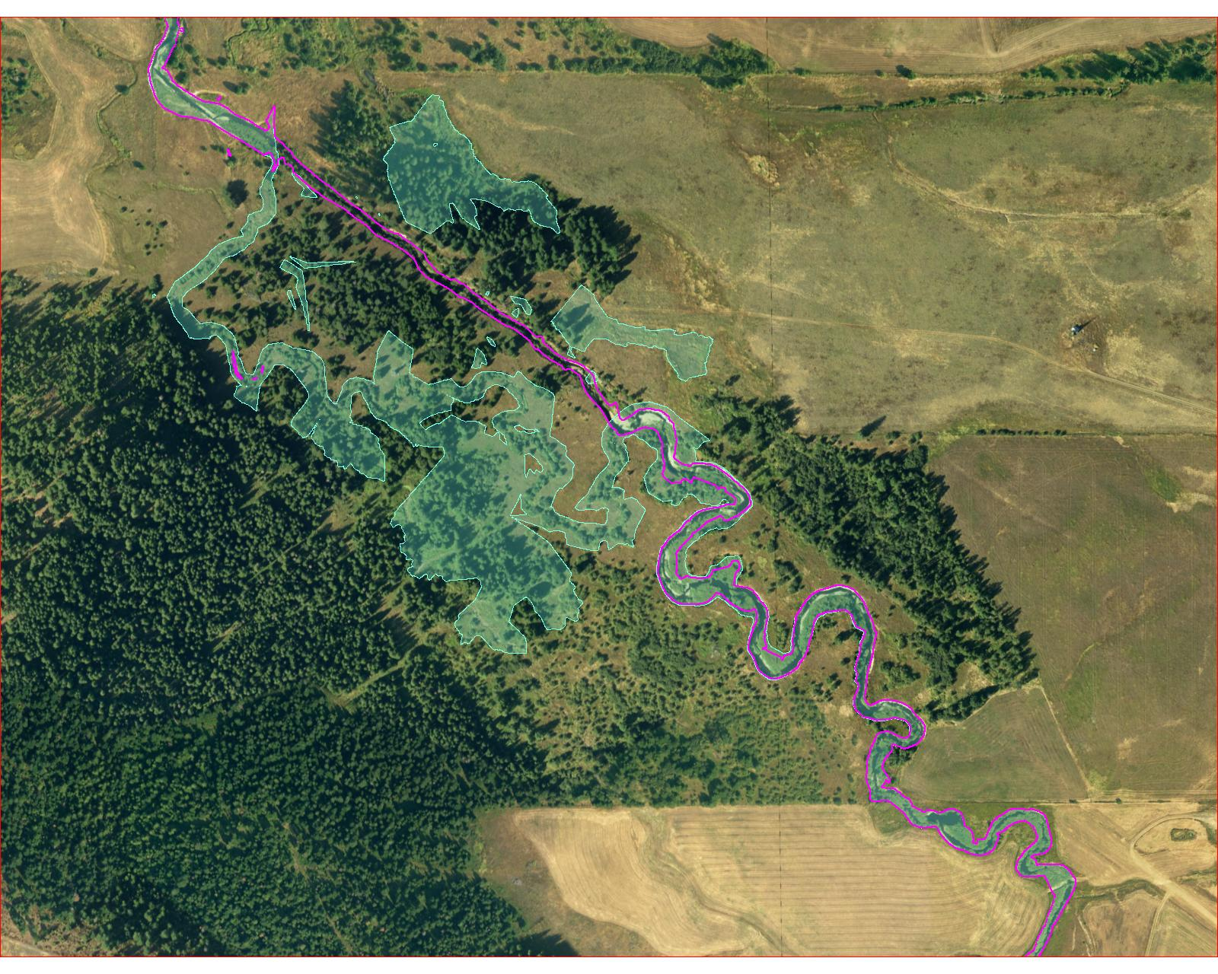
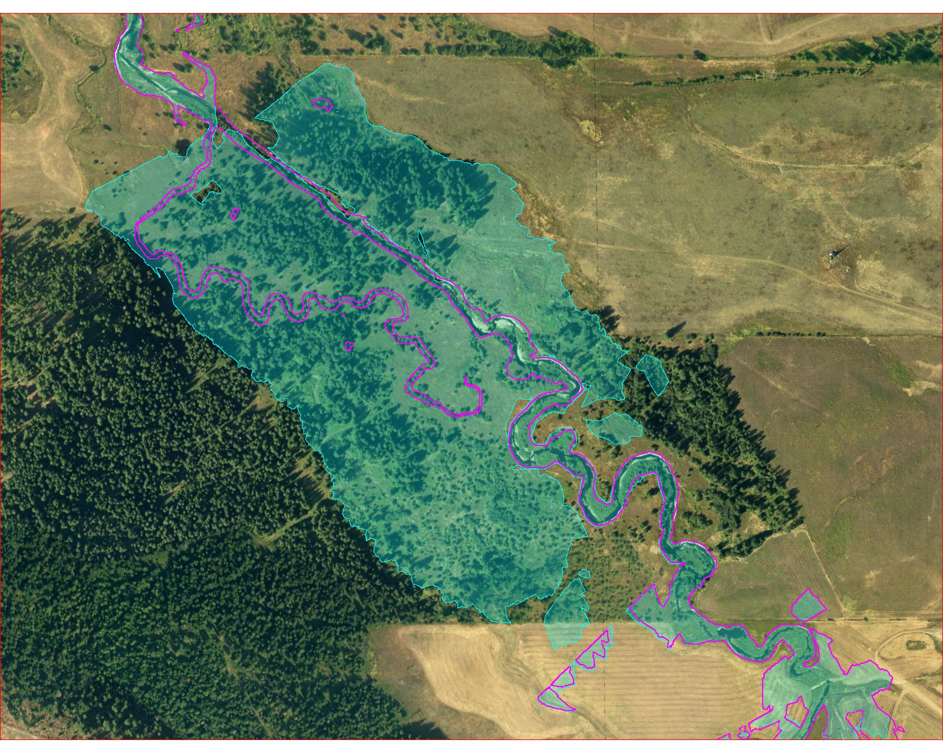
100 Year Flood Event
Bankfull Flow

Slide 18
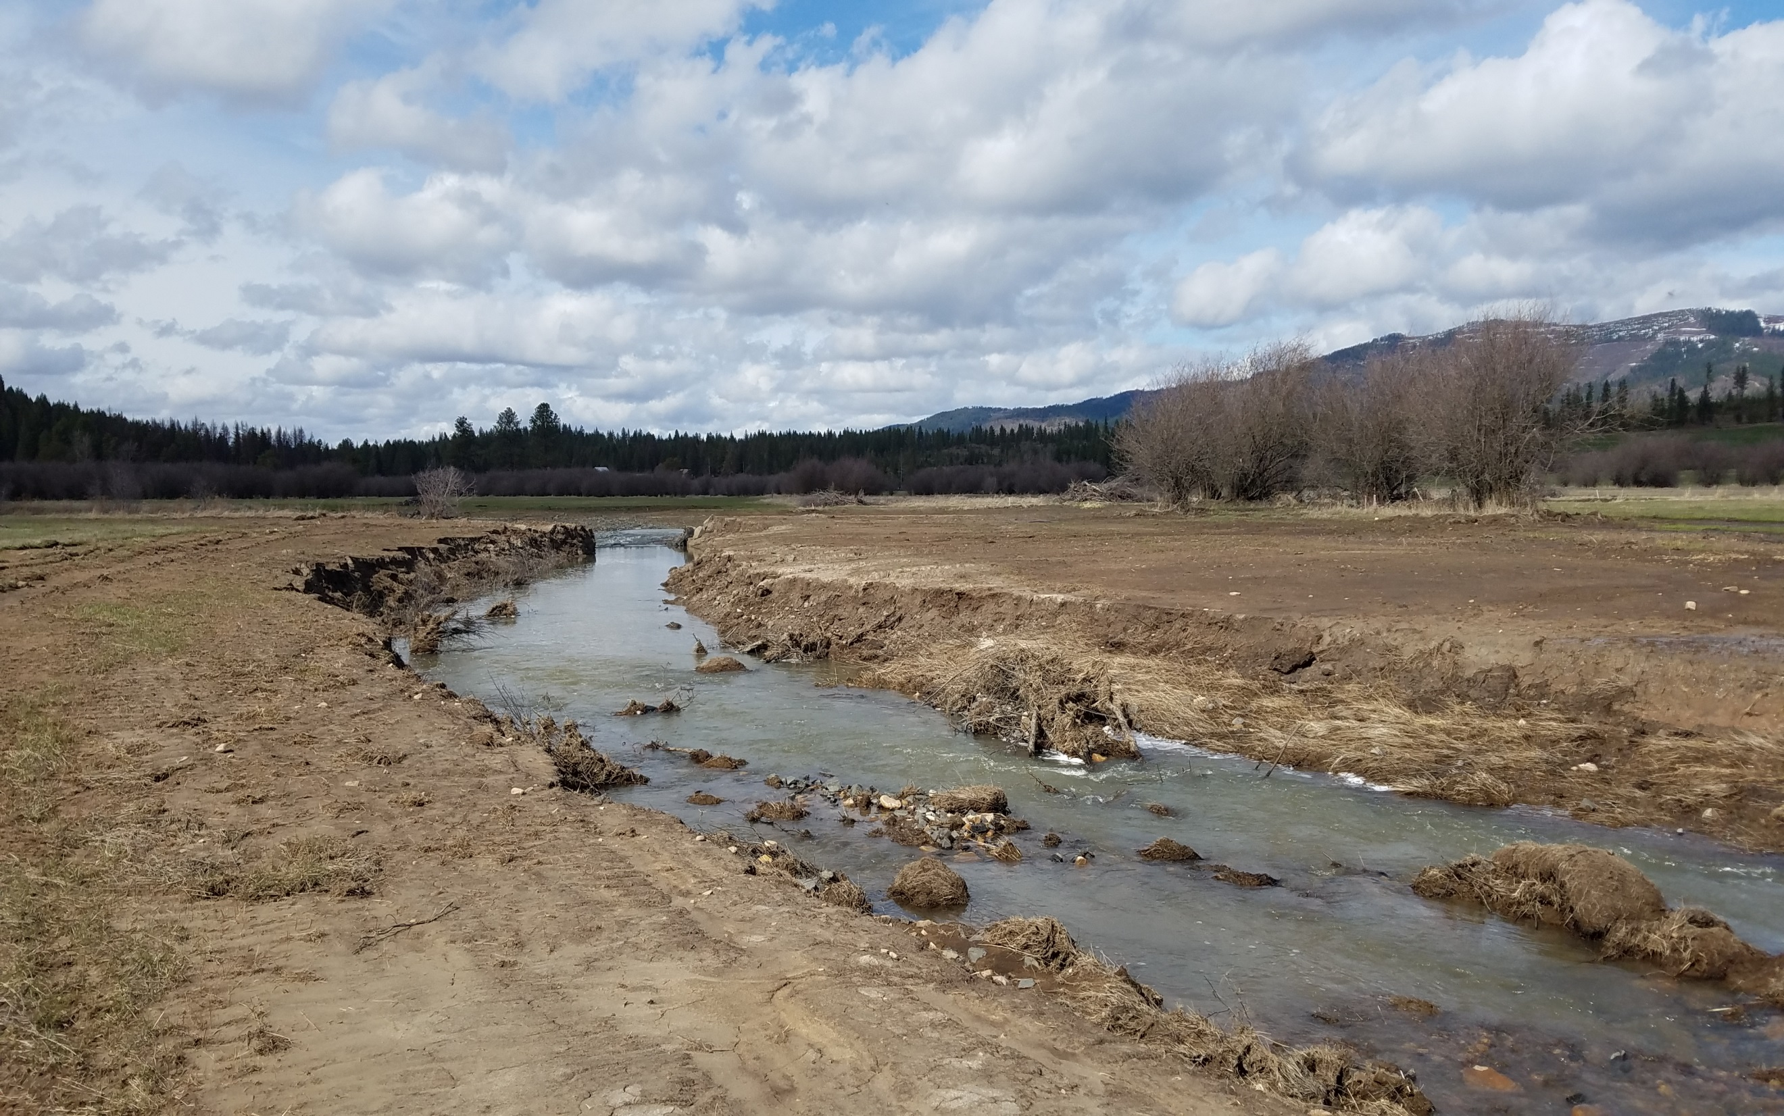
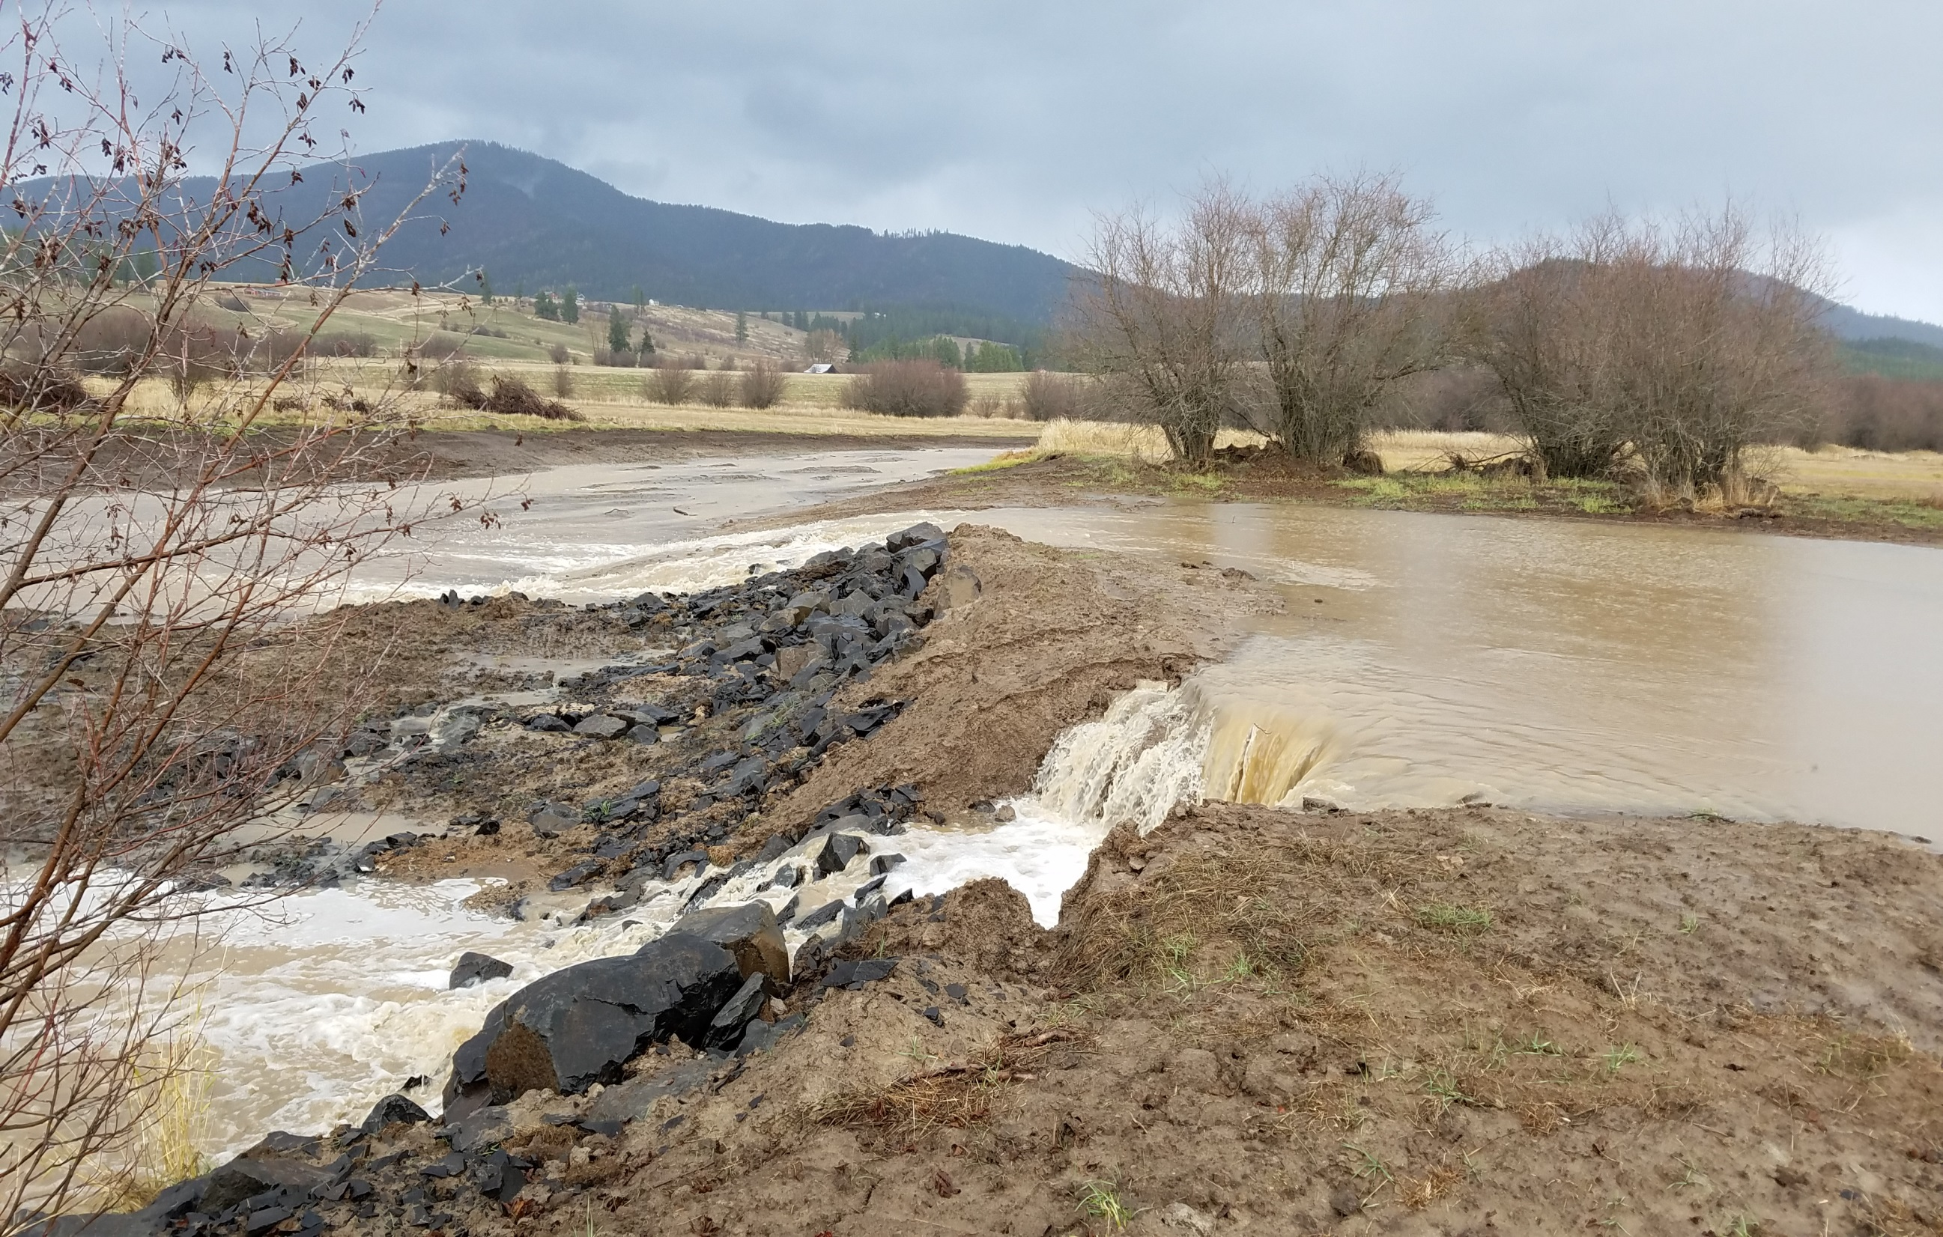
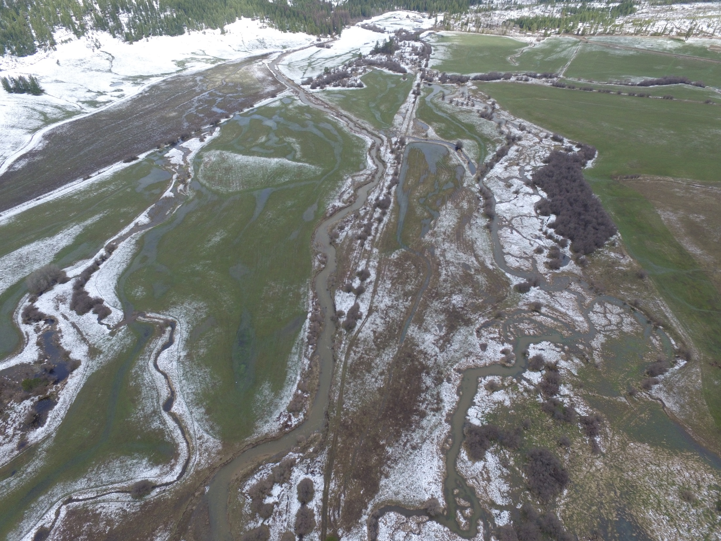
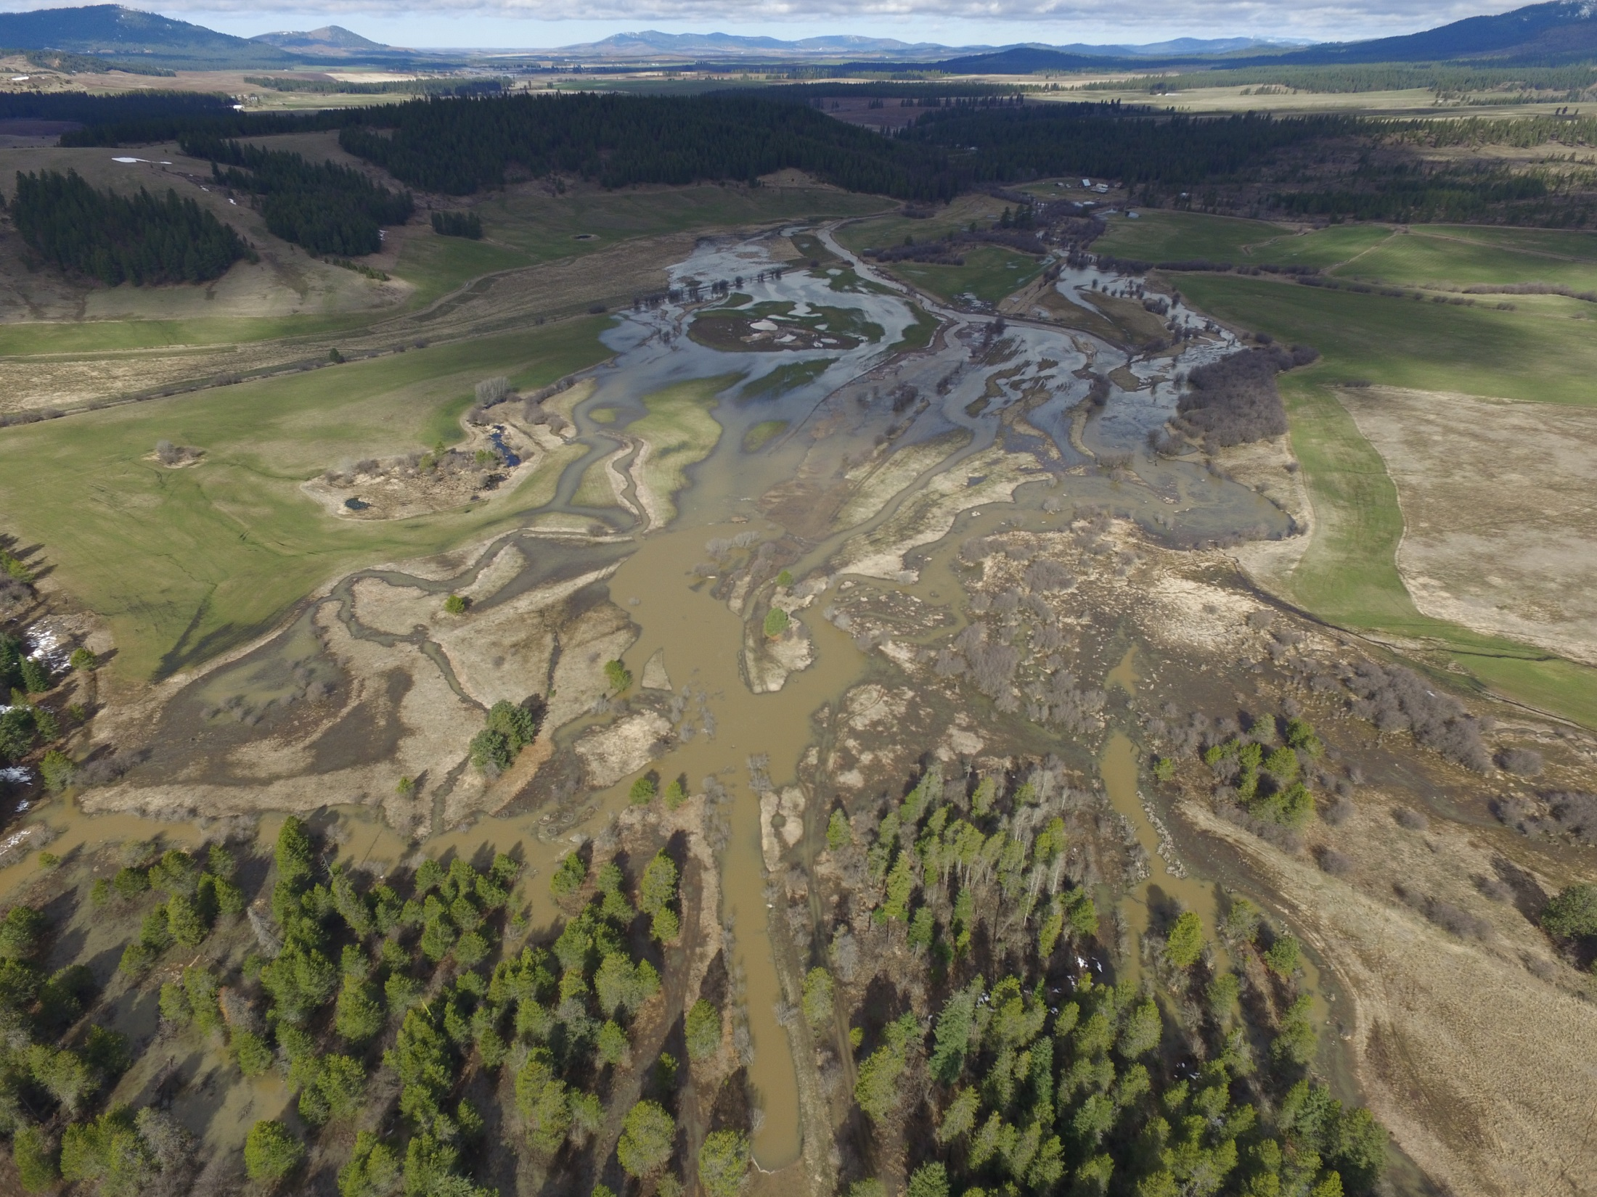

Slide 19
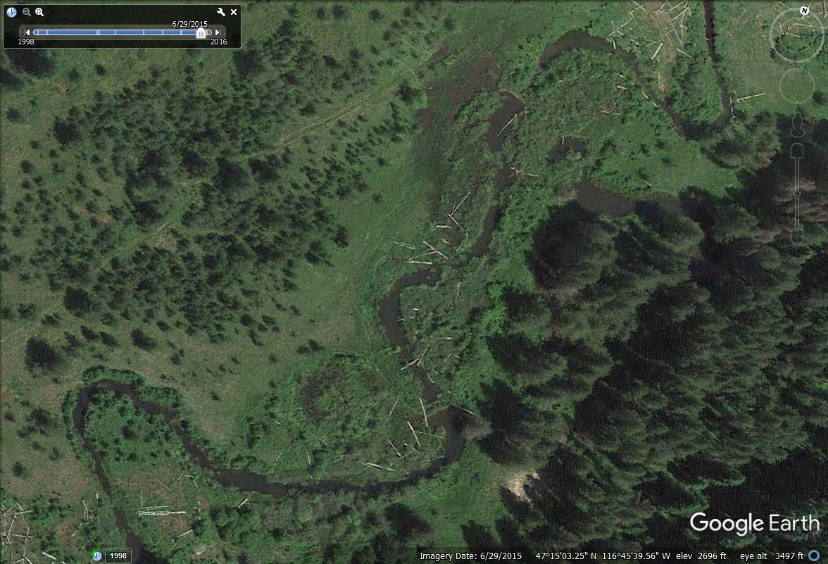
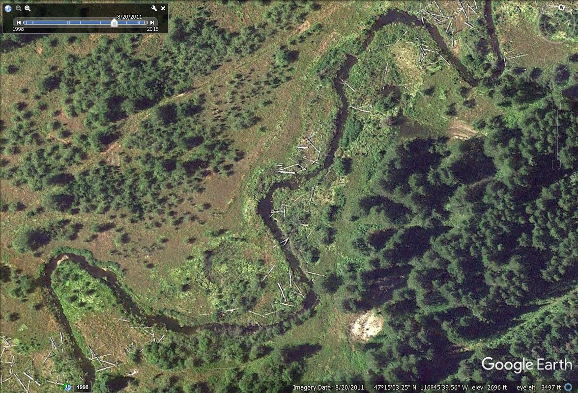
Persistence of Beaver
Notes:
Other Restoration Projects/Strategies: Benewah Creek,

Slide 20
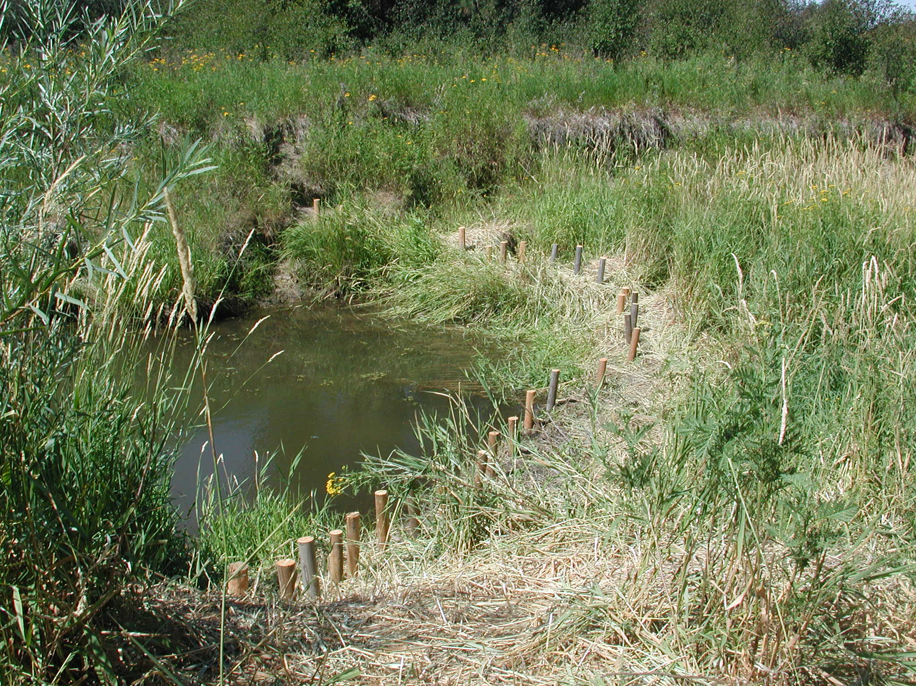
Beaver Dam Reinforcement
Notes:
Bridge Creek in John Day Watershed

Slide 21
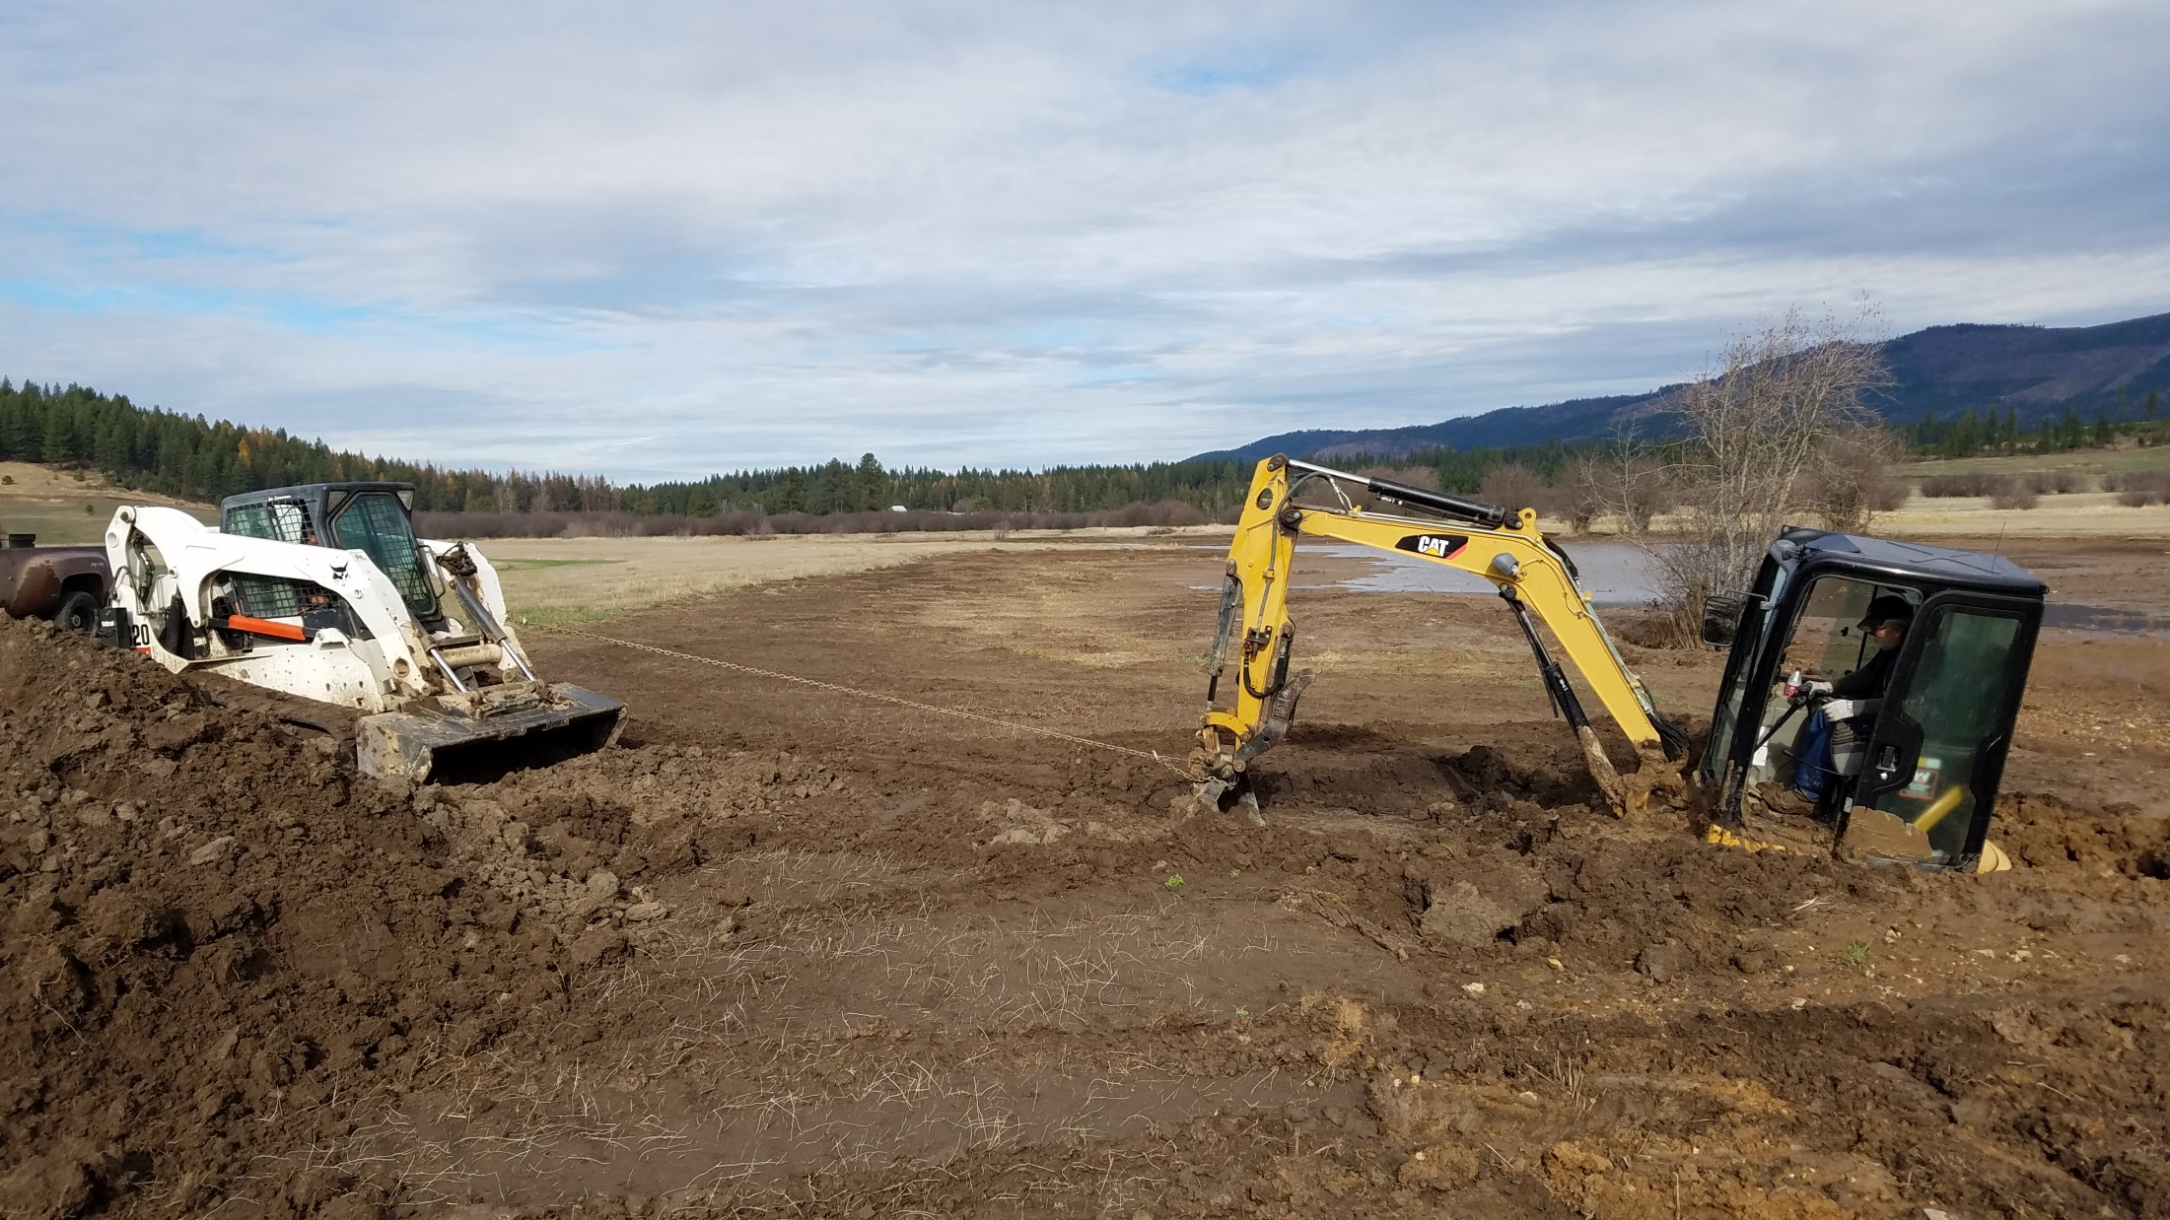
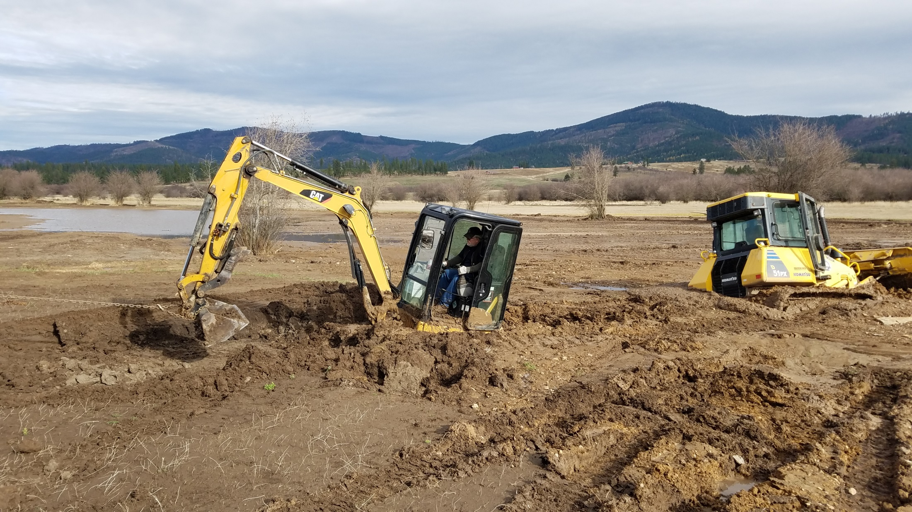

Slide 22
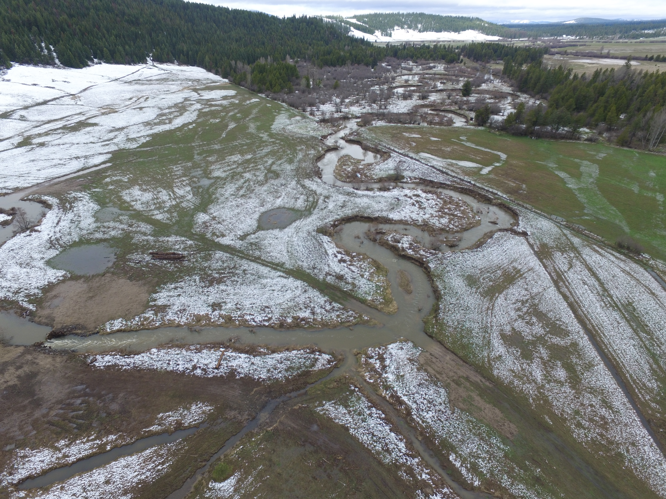





In-Stream Restoration Strategies for a Highly Impacted Watershed
Thomas Biladeau
Habitat Restoration Biologist
tbiladeau@cdatribe-nsn.gov
Notes:
Title

