Slide 1


IDAHO SOCIETY
OF
PROFESSIONAL ENGINEERS
2017 ANNUAL MEETING
Tim Austin, PE, F.NSPE
President – 2015-16
National Society of Professional Engineers

Slide 2
Transcending the
Professional Engineer

Slide 3
Is Engineering Licensure still relevant in today’s economic world?

Slide 4
The Dichotomy of Engineering
Engineers focus on tools and solutions that help people to help themselves.
In other words, engineers must ask themselves, "How can I make myself irrelevant?"

Slide 5
The Professional Engineer
Licensed engineers continue their commitment to protecting the health, safety, and welfare of the public through demonstrated competency and subjecting themselves to a code of conduct backed by the force of law.
To a client, it means you've got the credentials to earn their trust.
To an employer, it signals your ability to take on a higher level of responsibility.
To the regulator, it means competency.

Slide 6
What does it mean to the public?

Slide 7
The Non-Engineer Perspective
Non-technical or technologist can be as qualified or suitable substitute
Licensed professionals cost more
Turf protection
Certifications are sufficient protection
Codes, standards and regulations provide acceptable protection
Lack of awareness or understanding as to PE

Slide 8

What does your license mean to YOU?

Slide 9
The Professional Engineer
To yourself, it's likely a symbol pride and measure of your own hard-won achievement.
BUT IT IS MORE
Willingness to accept risk
Willingness to serve
Willingness to be accountable

Slide 10

But can it mean even more?

Slide 11
NSPE Code of Ethics
Preamble
Engineering is an important and learned profession. As members of this profession, engineers are expected to exhibit the highest standards of honesty and integrity. Engineering has a direct and vital impact on the quality of life for all people. Accordingly, the services provided by engineers require honesty, impartiality, fairness, and equity, and must be dedicated to the protection of the public health, safety, and welfare. Engineers must perform under a standard of professional behavior that requires adherence to the highest principles of ethical conduct.

Slide 12
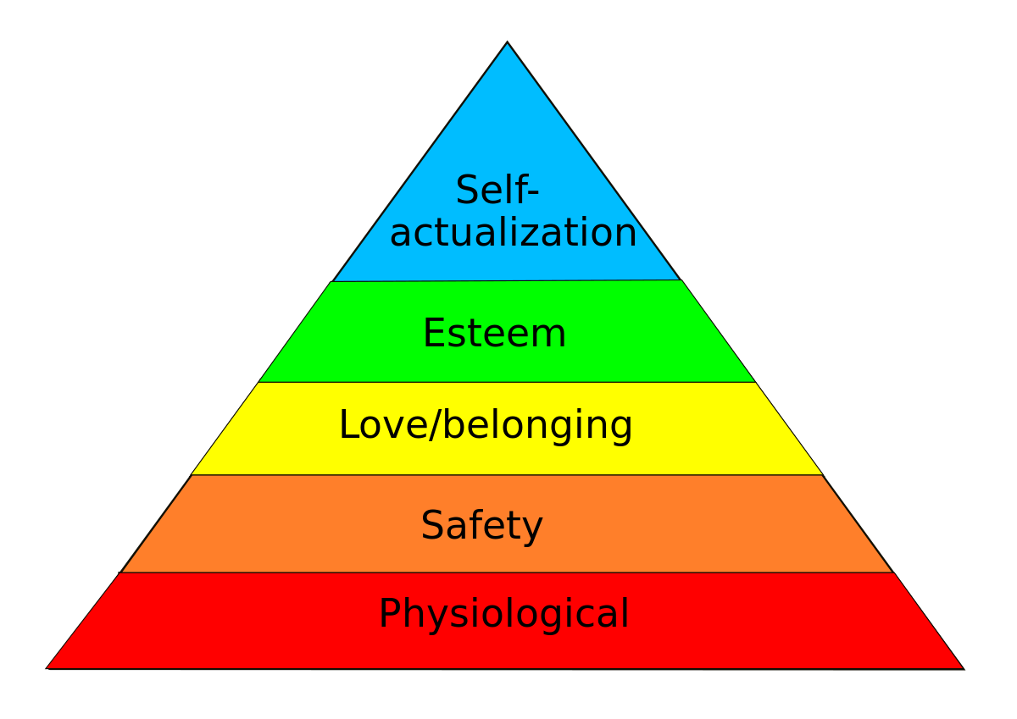
MASLOW’S HEIRARCHIY OF NEED

Slide 13
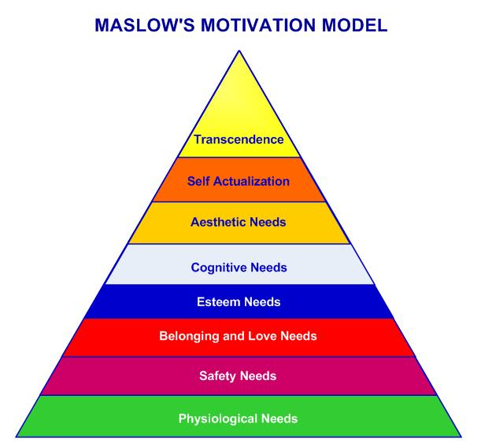

Slide 14
Transcendence -
That is, such individuals seek a benefit beyond the purely personal and seek communion with the transcendent, perhaps through mystical or transpersonal experiences; they come to identify with something greater than the purely individual self, often engaging in service to others.

Slide 15

Have “we” given everything?

Slide 16
Growing chorus that engineers are not doing enough for humanity.

Slide 17
Chronicle for Higher Education
“Fools for Tools”,
by John Kaag and Sujata Bhatia.
“We worry that the many conveniences delivered by modern engineering makes citizens loath to interrogate the moral implications of technological progress.”

Slide 18
NSPE Code of Ethics
I. Fundamental Canons
Engineers, in the fulfillment of their professional duties, shall:
Hold paramount the safety, health, and welfare of the public.
“If we take this canon seriously, it implies something counterintuitive about the skill set of tomorrow’s engineers, namely they should be experts in discussing and determining what constitutes the common good.” ~ Ibid

Slide 19
NSPE Code of Ethics
III. Professional Obligations
Engineers shall at all times strive to serve the public interest.
a. Engineers are encouraged to participate in civic affairs; career guidance for youths; and work for the advancement of the safety, health, and well-being of their community.
“Encouraged? That tepid suggestion fails to reflect the nature of the obligation that engineers should have to their fellow citizens”. ~ Ibid

Slide 20
NSPE Code of Ethics
I. Fundamental Canons
Engineers, in the fulfillment of their professional duties, shall:
6. Conduct themselves honorably, responsibly, ethically, and lawfully so as to enhance the honor, reputation, and usefulness of the profession.
“The call to conscience of the final canon…might be regarded as a moment of wishful thinking or as the lynchpin that ensures that all of the other, more specific tenets of its ethical code will be followed”. ~ Ibid

Slide 21
“Engineers bear a responsibility to consider both nontechnical and technical solutions to societal challenges. Because engineers have the skills to bring their visions to fruition, the engineer is both an arrowsmith and archer, shaping the future direction of society. The key question for the engineer is: What kind of society am I creating?”
~ Ibid

Slide 22
The Great Reversal
- How We Let Technology Take Control of the Planet
By David E. Tabachnick
“the occasion for the writing this book is the related concern that the increasing technological character of the world is somehow threatening the future of humanity”.

Slide 23
“On the surface it makes sense that only those who fully understand the complexities of a technology – who know what it can and cannot do – are qualified to make decisions about its larger health and societal effects. In turn, legislators and regulators should heed the advice of the technologists and develop and enforce appropriate laws and prohibitions.”
~ Tabachnick

Slide 24
“For Aristotle, to be ethical was more than simply knowing right from wrong, but also meant the capacity to act upon the knowledge.”
~ Ibid

Slide 25

What role should professional engineers play in technological change?

Slide 26
EXAMPLES
AUTONOMOUS VEHICLES
INTERNET OF THINGS
ARTIFICIAL INTELLIGENCE
GENE EDITING
TRANSHUMANISM

Slide 27
“They didn't understand what they were doing. I'm afraid that will be on the tombstone of the human race.”
~ Michael Crichton

Slide 28
As technological advances increase, it is apparent more than ever before that professional engineers need to take a leadership role in the ethical development, application and use of technology.

Slide 29
How will you transcend as a Professional Engineer?

Slide 30
WHAT IS NSPE DOING FOR YOU?
NSPE values:
“Protection of the public health, safety, and welfare above all other considerations”
~ NSPE Strategic Plan

Slide 31
WHAT IS NSPE DOING FOR YOU?
Advocating for licensure
Active leadership
Building public awareness

Slide 32
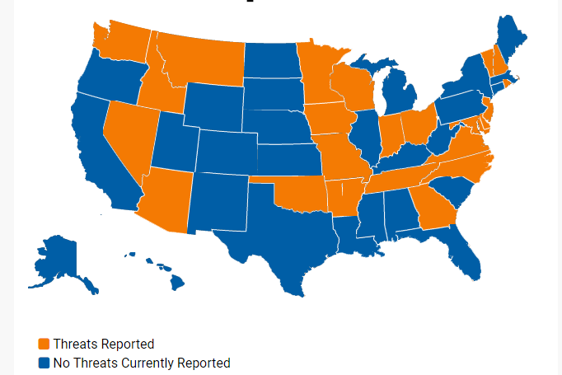
Threats to professional licensure

Slide 33
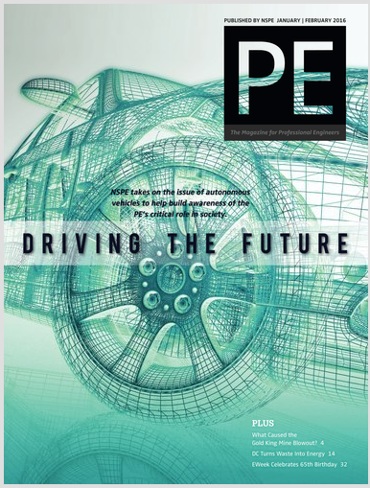
Autonomous vehicles

Slide 34

Licensure of federal engineers

Slide 35
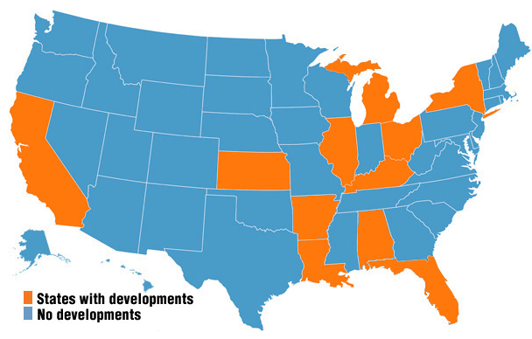
Protecting QBS

Slide 36
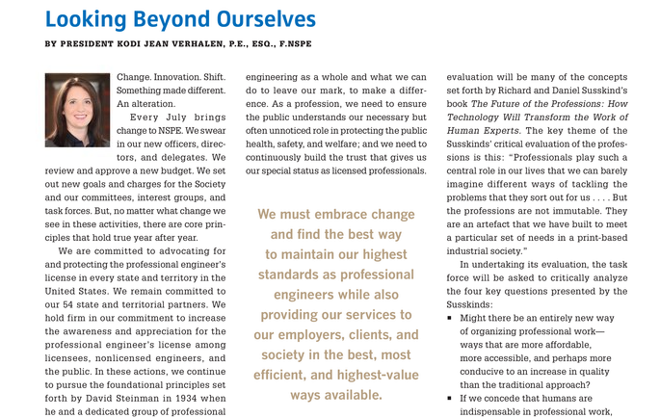
FUTURE OF THE PROFESSIONS

Slide 37
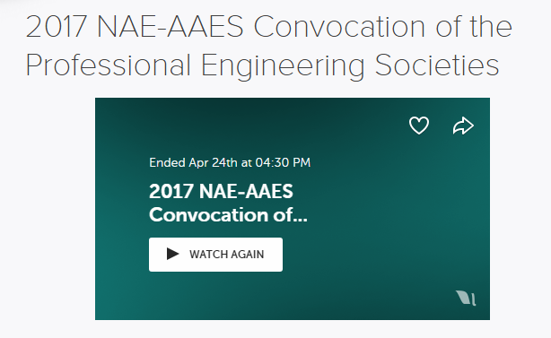
Artificial Intelligence
Artificial intelligence (AI) and autonomous systems are increasingly present in engineering applications and are extending their roles into social systems. With their expanding role come unique challenges, opportunities, and complexities, including unforeseen consequences.

Slide 38


Slide 39
WHAT IS YOUR RELATIONSHIP WITH NSPE?
Daily Designs
NSPE Communities
PE Magazine
LinkedIn
Facebook
Storify
Twitter
@NSPE_HQ
@TimAustin_PE

