Slide 1


Slide 2
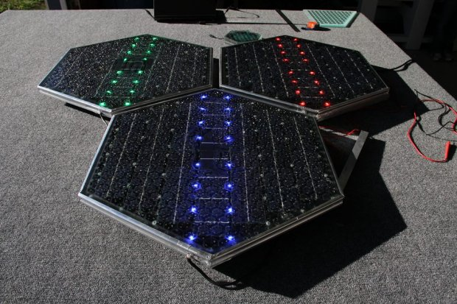
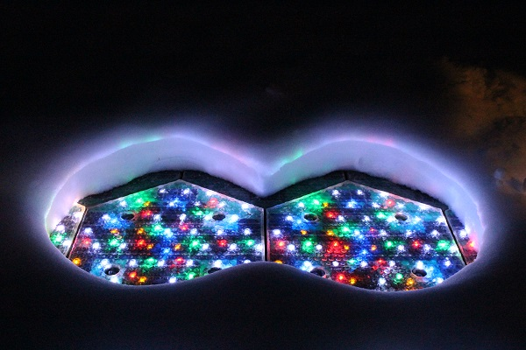
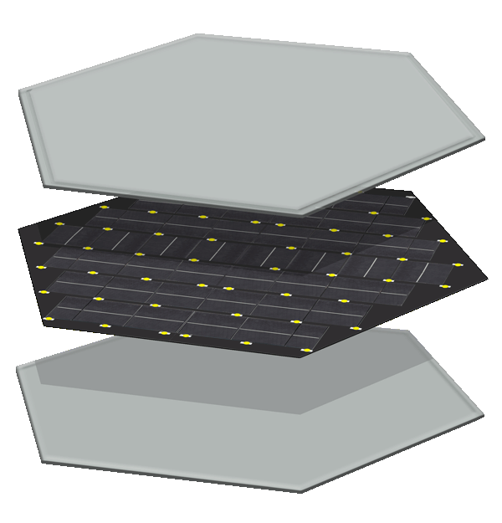
What are Solar Roadways?
Each Solar Road Panel contains:
Microprocessor (RF)
Heating elements
Solar cells - 44 watts
336 LEDs
4.39 square feet, 70 pounds

Slide 3

Infrastructure
Shear testing
Freeze-thaw cycling
Moisture conditioning
Advanced loading
Traction tested
Load tested
Impact resistance tested

Slide 4
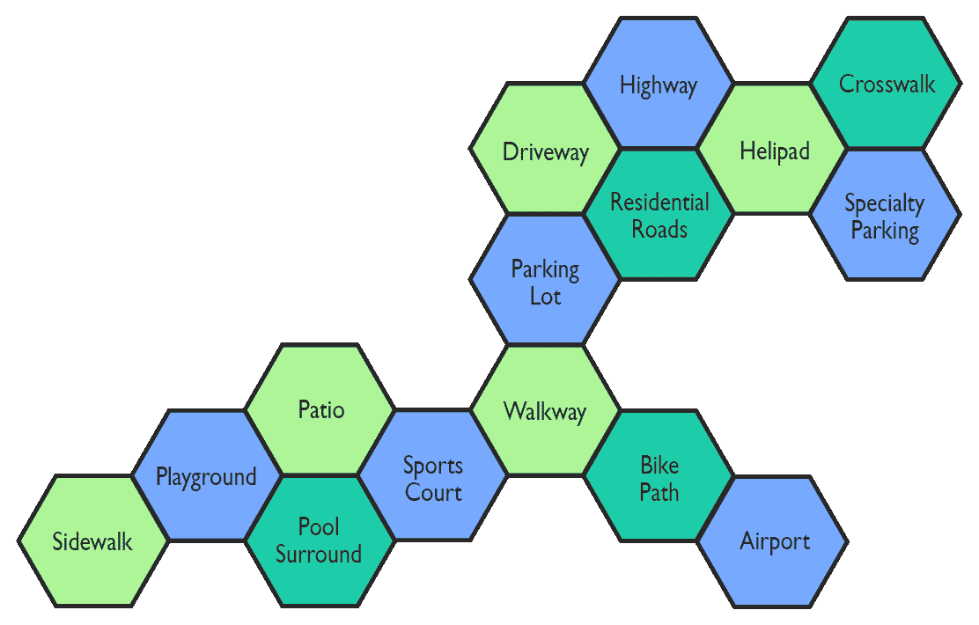
Solar Road Panel Applications

Slide 5
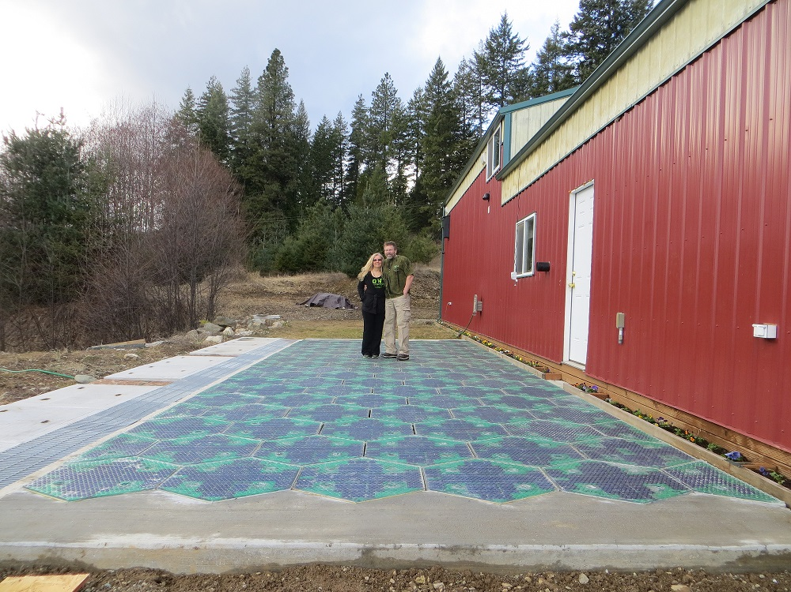
36’ Parking lot/highway section

Slide 6
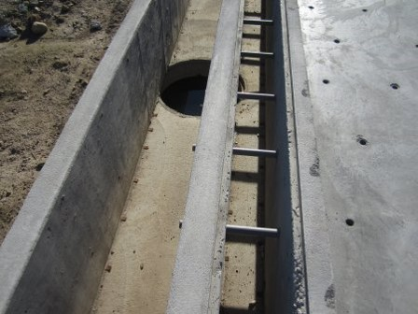
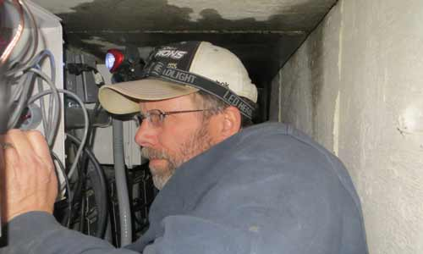
Cable Corridor
New home for electrical cables
Stormwater treatment on site – DOT’s request
Reduces power outages
Safer for utility workers

Slide 7
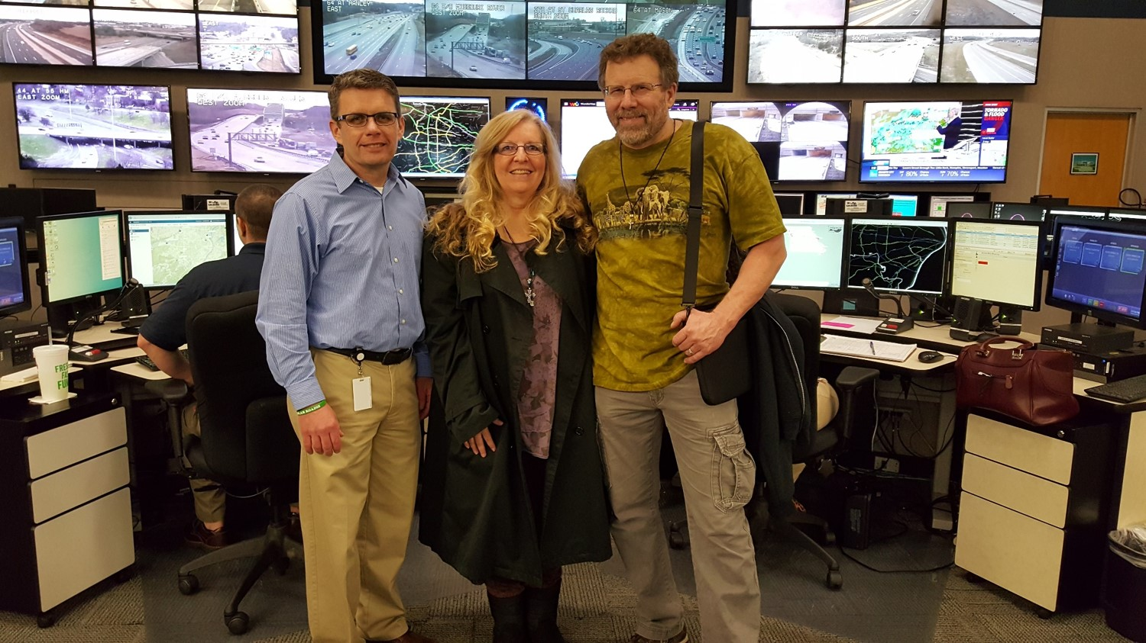
MoDOT Transportation Management Center

Slide 8


Slide 9
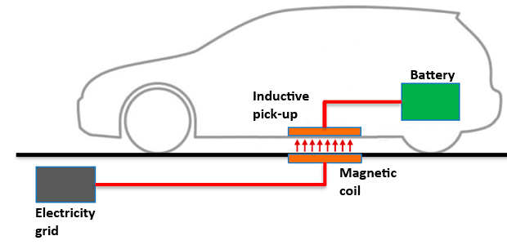
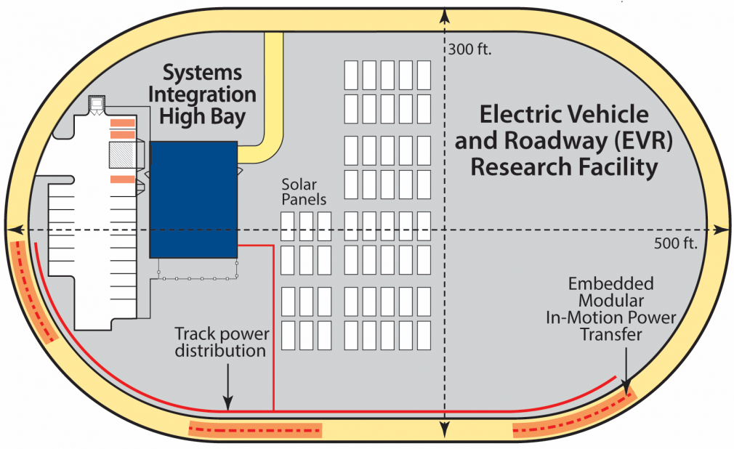
Dynamic
Charging

Slide 10
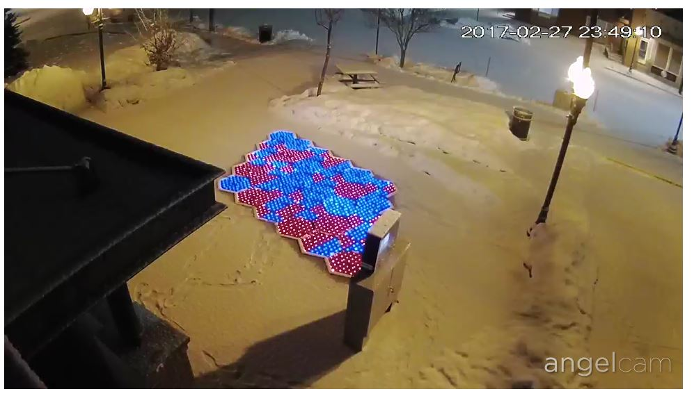
Sandpoint Pilot Project web cam
http://www.cityofsandpoint.com/visiting-sandpoint/solar-roadways#ad-image-7

Slide 11
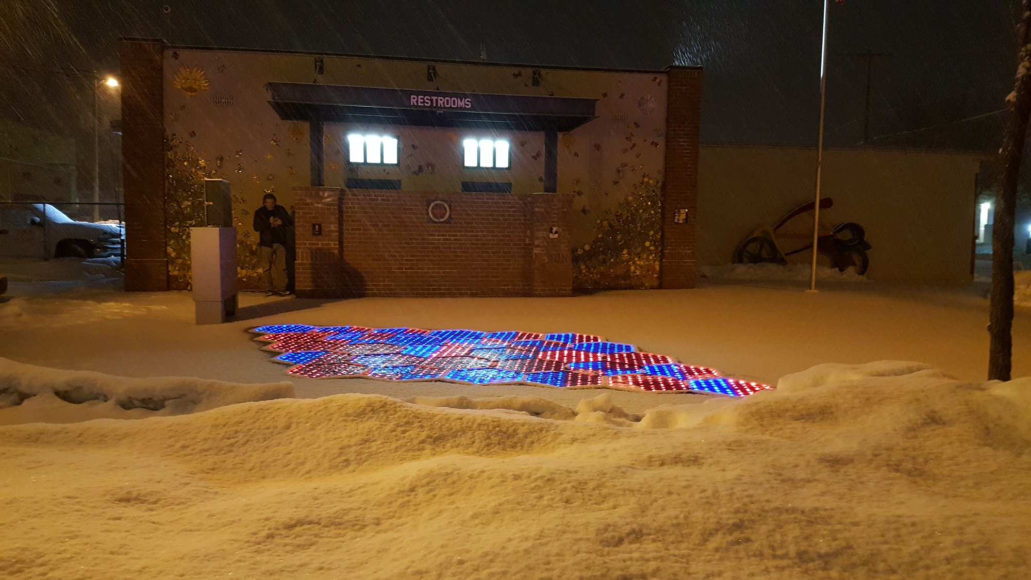

Slide 12
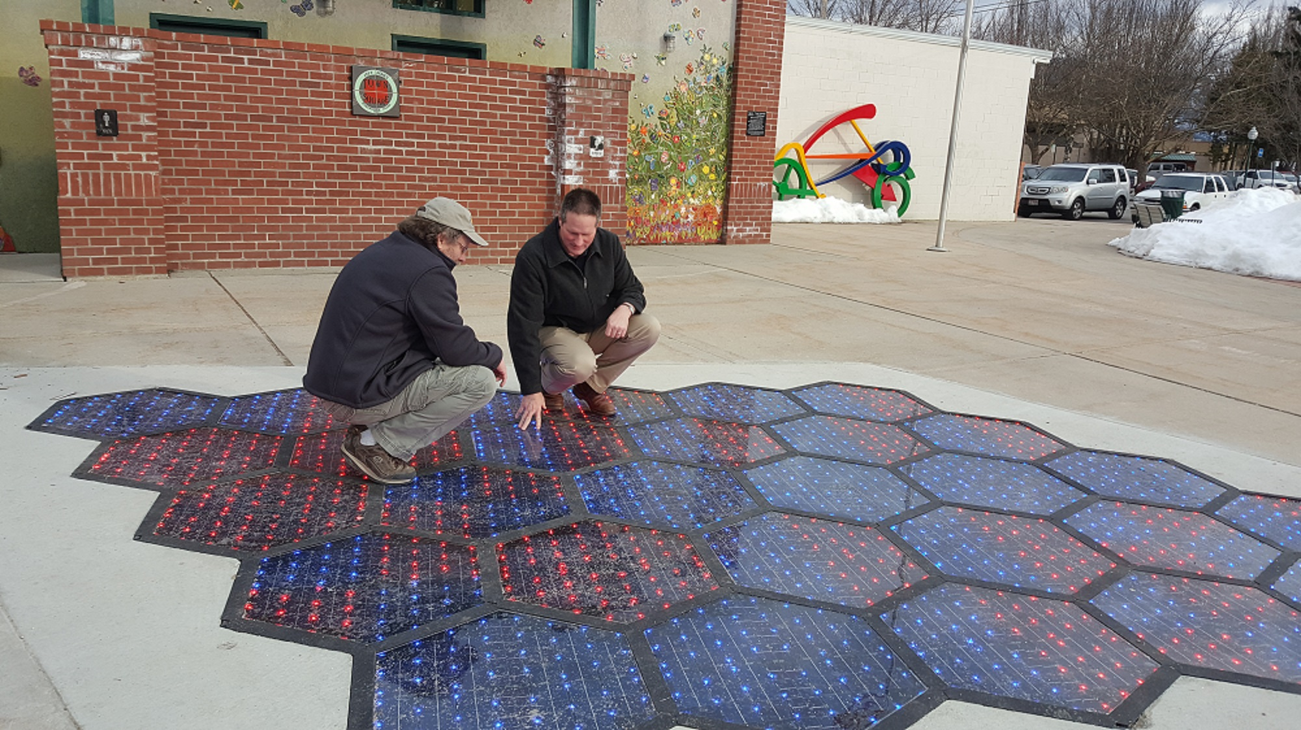

Slide 13
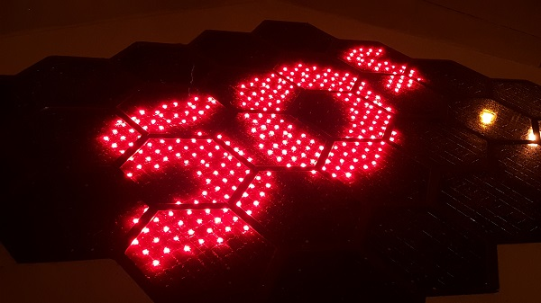
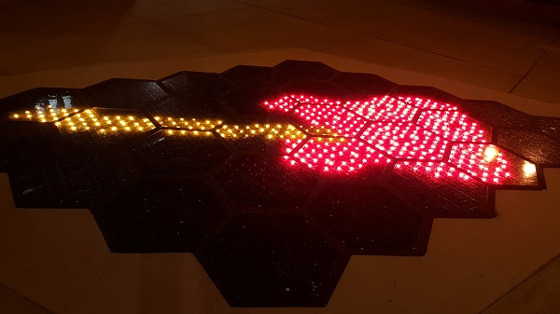
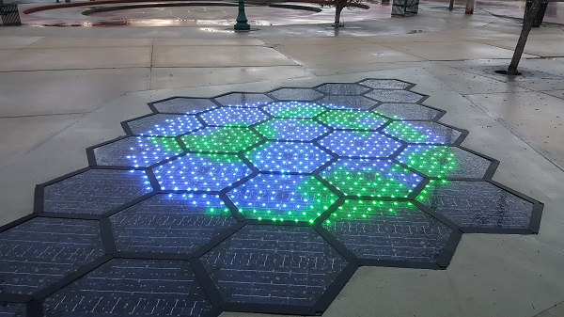
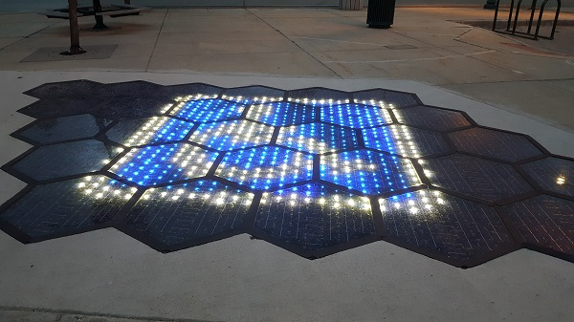

Slide 14


Slide 15


Slide 16
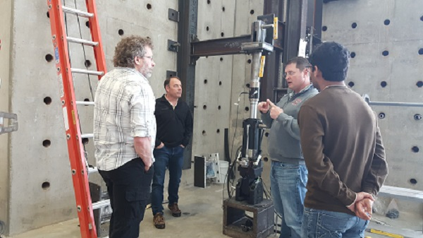
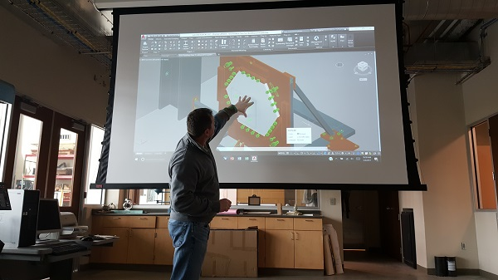
Marquette University (Milwaukee) Civil Engineering Lab
Sheer testing
Moisture conditioning
Freeze/Thaw cycling
Advanced loading

Slide 17
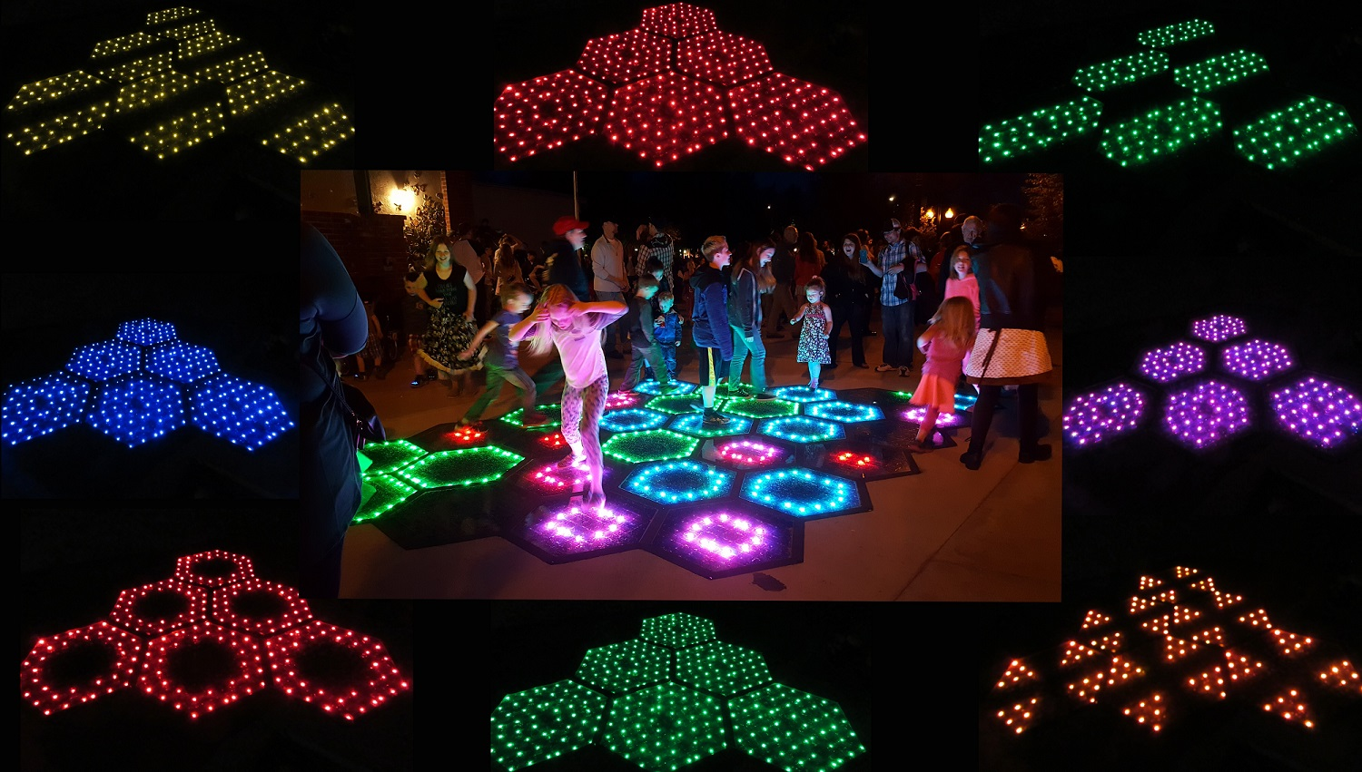
Colorado DOT RoadX Bicycle & Pedestrian Challenge

Slide 18
Economy AND Environment
Jobs
Manufacturing
Distribution
Installation
Monitoring
Maintenance
Growth in supporting industries
Energy independence
Modularity of panels ($165B)
Smart Grid
Increased safety (lower liability)
Airports – reduced delays
Clean water
Stormwater treatment on site
Transport water
Reduce the need for road salt or other chemicals
Cleaner air
Increased health
Reduced fossil fuel emissions
Slows climate change
Implementation on a grand scale
3x more renewable energy than we can use

Slide 19
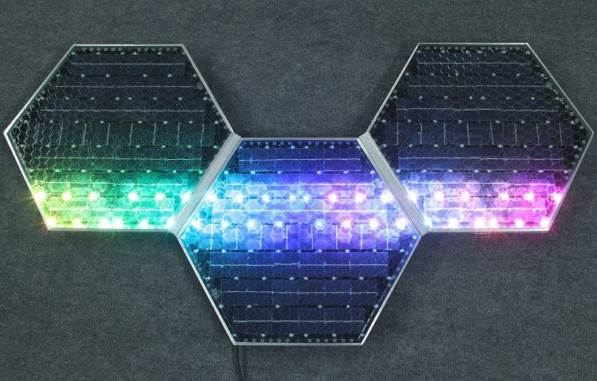
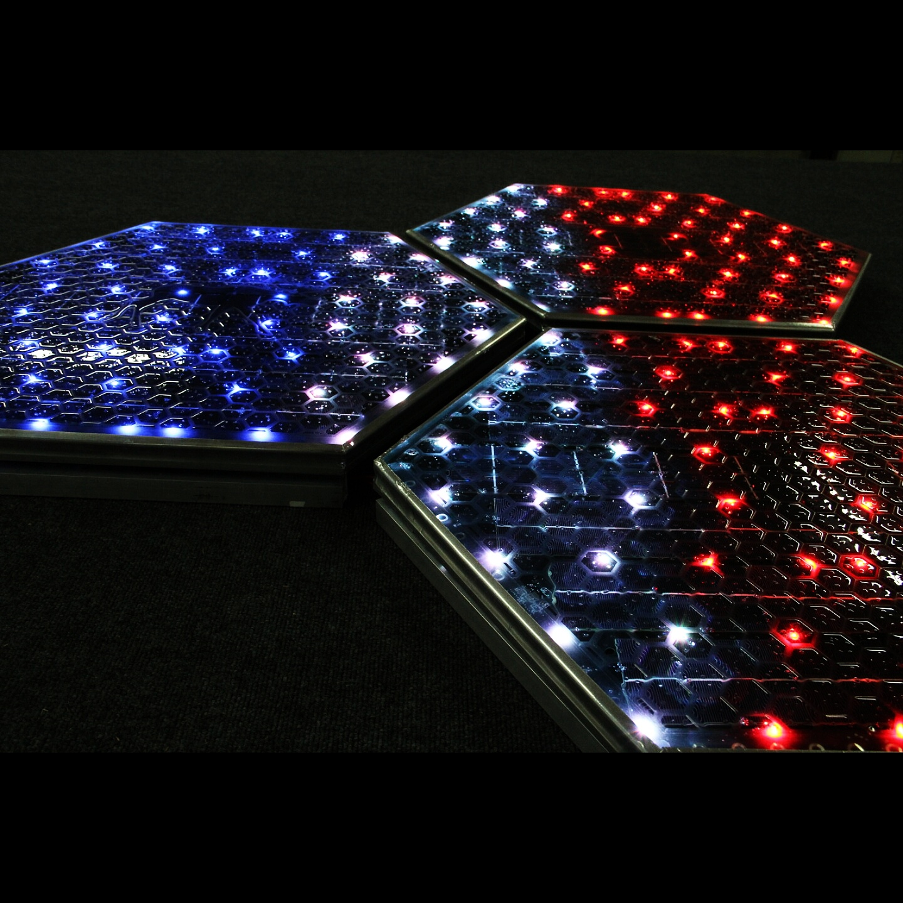
Home Owners
Options:
Driveways
Walkways
Patios
Sports courts
Pool surrounds
Coming soon:
Matching roof panels

Slide 20
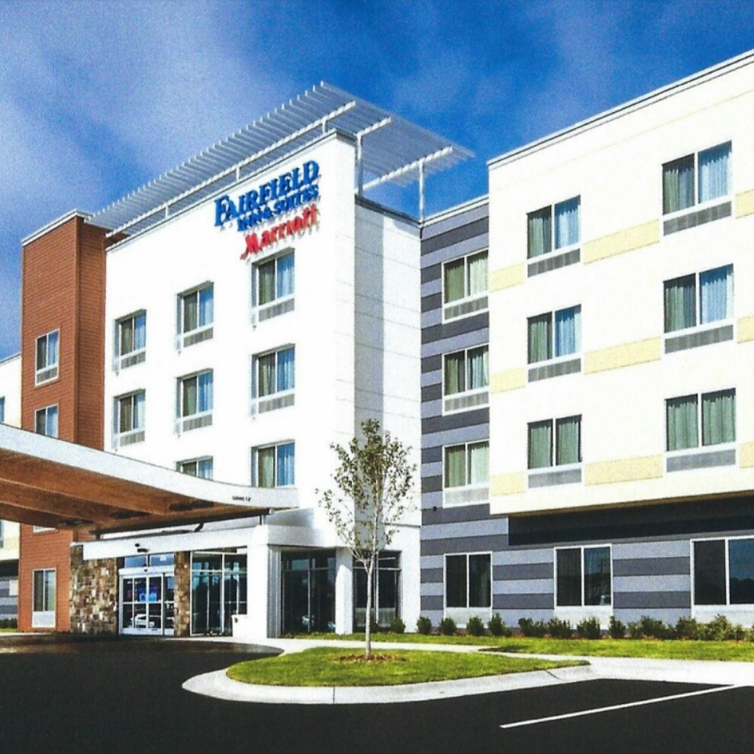

Business Owners
Flexible parking lines
Signage
Increased customer safety
Attract customers
Charge EVs with clean energy

Slide 21

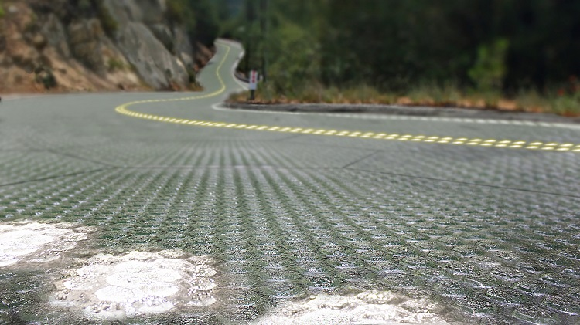
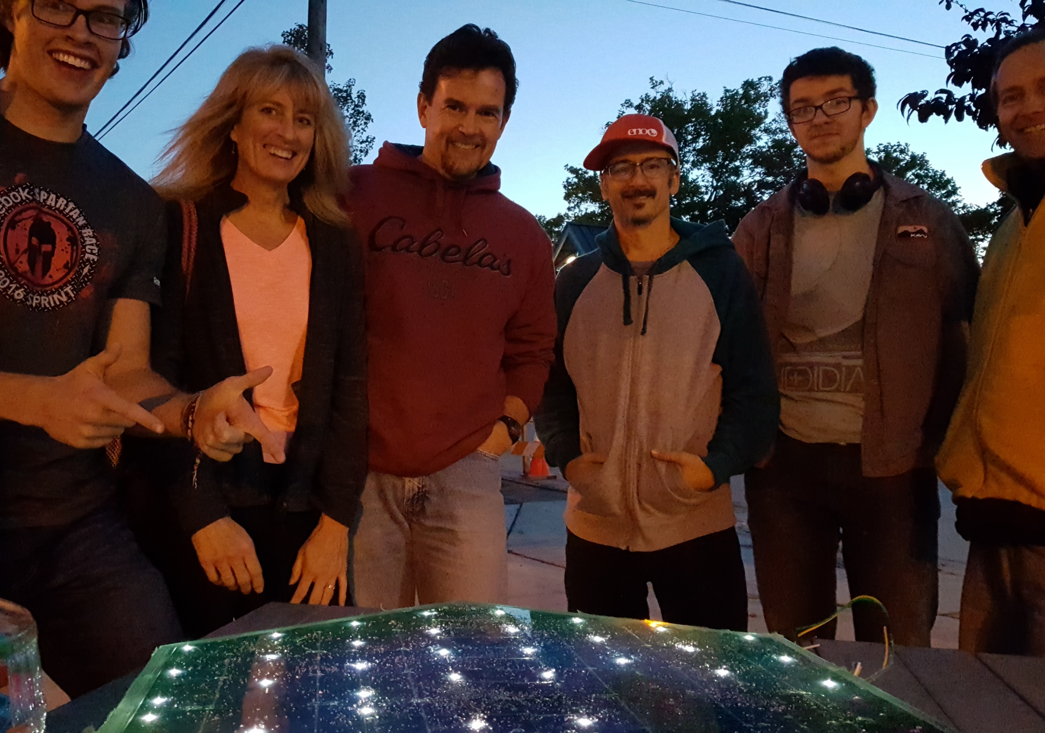
Scaling Up
2017 – time to acquire funding for full production
Chose a model to meet worldwide demand:
Strategic partnerships?
Distributorships?
Franchise opportunities?

Slide 22



Inspiration
H
O
P
E
For all of our grandchildren

