Slide 1
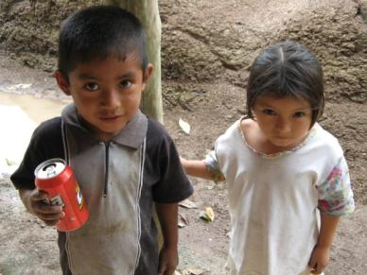
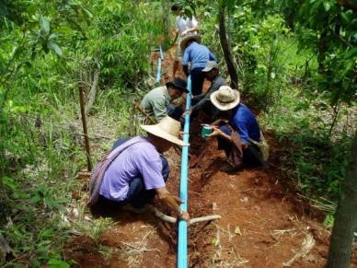
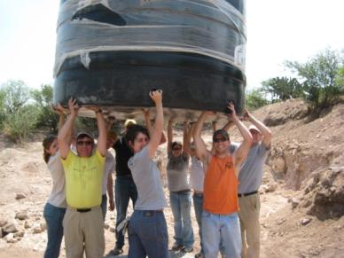
Engineers Without Borders–USA (EWB-USA)
National Organization Overview
Barry Borges, President
EWB – High Plains Professional Chapter
Idaho Society of Professional Engineers – Annual Meeting
June 10, 2010
Building a better world one community at a time

Slide 2
EWB–USA: Vision and Mission
Vision
A world in which the communities we serve have the capacity to sustainably meet their basic human needs, and that our members have enriched global perspectives through the innovative professional educational opportunities that the EWB-USA program provides.
Mission
EWB-USA supports community-driven development programs worldwide by collaborating with local partners to design and implement sustainable engineering projects, while creating transformative experiences and responsible leaders.

Slide 3
EWB–USA: History and Mission
2000 – First project in San Pablo, Belize, to bring water from the local river to small village
2002 – University of Colorado Engineering Professor, Bernard Amadei, founded EWB-USA as a 501(c)(3) nonprofit
2004 – First International Conference in Denver
2005 – Initiated 83 projects
2006 – Over 6,000 members in 200 Chapters
2007 – 228 projects in 45 countries
2008 – Heinz Award for the Environment given to Dr. Bernard Amadei
2009 – Over 250 student and professional chapters, more that 12,000 members, and 400+ projects in 45 countries
2010 – Staff of 24 full-time and part-time professionals

Slide 4
The World Today
1.2 billion lack clean water
2.4 billion lack adequate sanitation
2.4 billion are at risk with malaria
1.2 billion lack adequate housing
1.6 billion have no access to electricity
4.2 billion are unable to read
29,000 children die every day from hunger
1.4 billion live on less than $1.25 per day
Sources: United Nations & World Bank (2009)

Slide 5
EWB–USA Projects
Water | - Sanitation
Structures | Civil Works
- Energy | Agriculture
- Information Systems
More than 350 projects in over 45 developing countries
Over 250 dedicated chapters (180 student chapters)

Slide 6
EWB–USA Project Cycle
Monitoring & Evaluation
Start w/ Community Application
Post-Implementation Report
Acceptance in EWB-USA Program
EWB-USA Projects
Implementation
Phase
Pre-Assessment Review
Pre-Implementation Review
Assessment Phase
Design Phase/ Alternatives Analysis
Post-Assessment Report

Slide 7
EWB–USA Project Teams
Beyond technical expertise, team members from all professions are necessary for the long-term viability of chapters
Sample of valuable skill sets not related to technical disciplines:
- Communications | - Fundraising
Finance | Photography
- Graphic Design | Accounting
- Public Relations | - Legal
- Marketing | - Human Resources

Slide 8
Benefits of Corporate Involvement
EWB-USA provides many benefits to participating companies
Global citizenship - companies can expand their stewardship efforts globally through their employee members.
Transformational opportunities for employees - employee volunteers have access to project work, hands-on training, and educational opportunities
Professional development - young professionals can receive direct real-world experience and education by working w/ experienced professionals
Mentorship and leadership - opportunity to mentor others, adding value to their work while integrating team building, leadership, and management experiences into their repertoire

Slide 9
Benefits of Corporate Involvement (cont.)
EWB-USA provides many benefits to participating companies
Corporate Social Responsibility - engaging in stewardship activities enhances company pride, employee morale, and encourages employee retention, as well as the recruitment of new talent
Retention - investing in the professional development, philanthropic, and volunteer interests of employees builds employee loyalty
Company recognition – Companies’ reputations are enhanced through chapter interaction at the local, regional, and national levels
Corporate diversity awareness – integrating direct international project experience enhances employees’ awareness of global and cultural issues

Slide 10
Benefits of EWB–USA Student Membership
Student chapter memberships at colleges and universities
Apply the skills learned in school by participating in design and implementation of sustainable engineering projects in communities around the world
Real-world experience in cultural awareness and participatory planning
Leadership opportunities
Member of the chapter executive committee (president, vice president, secretary, or treasurer
Project leadership
Regional leadership positions

Slide 11
Getting Involved as a Professional Member
Professional-member positions
Supporter
Informed of EWB-USA activities and projects throughout the year
Professional mentor/faculty advisor
EWB-USA professional member
Involved with student chapter in advisory position
Professional committee engagement
EWB-USA technical advisory committees, Application Review Committee, Health & Safety Committee
Regional leadership position
Project participation
Fully engaged in the project process, design, and implementation of solutions, with travel involved
Lifetime member
One-time gift w/ involvement on any of above levels

Slide 12
EWB–USA: Developing 21st Century Engineers
Expanding education
Providing training on the application of engineering principles to address community needs
Instruction on the design and implementation of energy, water, housing, sanitation, transportation, and agricultural project solutions
Professional engagement
Working in challenging environments
Collaboration among engineering and non-engineering disciplines
Corporate employee-volunteer programs
Working in teams for a common goal with:
Local partners
Community members
Students
Educators

Slide 13
Obtaining Additional Information…
For additional information on EWB–USA, visit www.ewb-usa.org
13

Slide 14
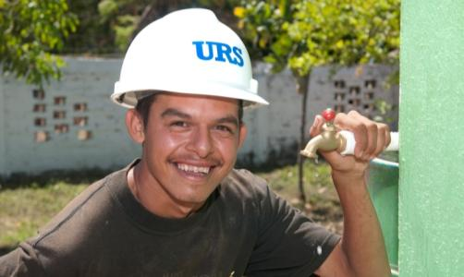
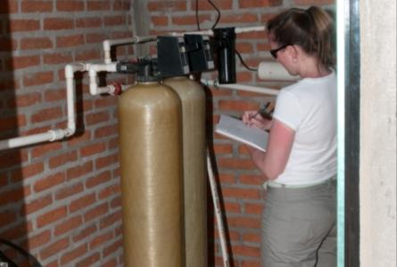
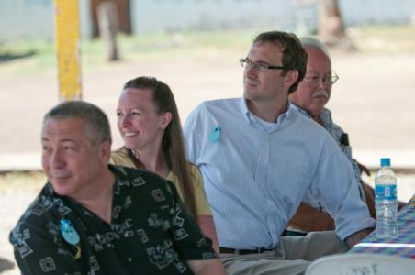
EWB – High Plains Professional Chapter
Chapter Overview

Slide 15
EWB–High Plains Professional Chapter
Chapter inception: October 2007
Grassroots initiative created by Denver-based employees of Washington Group international (a URS heritage company)
Initial company sponsorship of $25,000
Chapter based in Denver, employee volunteers are located across U.S.
Corporate support
Informal relationship with URS as corporate sponsor
Chapter activities promoted in company communications
Use of URS communication and logistics systems, company equipment
Within discretion, employee volunteers can do some “on-the-clock” work
Financial support

Slide 16
EWB–High Plains Professional Chapter (cont.)
Chapter constitution and by-laws
Define chapter’s mission, policies, procedures, and organization
Volunteer base
Active-volunteers pool consists of approximately 150 URS employees
Application Review Committee
Supports EWB-USA by reviewing the technical viability of projects submitted to the national organization
Completed projects
Technical evaluation of a portable shelter and storage unit design for use in emergency-response situations (March 2009)
Otates, Mexico, clean-water project (May 2010)

Slide 17
Chapter Organization
Executive Sponsor
Board of Directors
Chapter President
Vice President
Treasurer
Secretary
Programs
Operations
Engineering
Communications
Membership
Fundraising
College Outreach
Chapter Members and Volunteers

Slide 18
Ongoing Challenges and/or Action Items
Volunteers:
Communications
Engagement
Turnover
Fundraising
Project-development challenges
Training of responsible person for operation/maintenance
Permitting requirements and legal challenges
Designing to local standards and practice
Sourcing local materials for “sustainability”
Community involvement to lower capital cost
Logistics of volunteer travel for implementation
Integrity of system post implementation

Slide 19
Project-Selection Criteria
Projects selected from EWB–USA-authorized project pool
Strive to select projects that are in line with the URS’ areas of expertise, such as water resources, power, and infrastructure projects
Projects must pass a URS safety and security review
Favor projects that benefit children and/or have a safety component
Project community must be strongly committed to collaboration

Slide 20
Additional Information…
More information on EWB–High Plains Professional Chapter is available to-
URS (EC) employees: click on the Engineers Without Borders link on the Virtual Office home page
Non-URS employees: send an e-mail inquiry to projectsforpeople@wgint.com
20

Slide 21
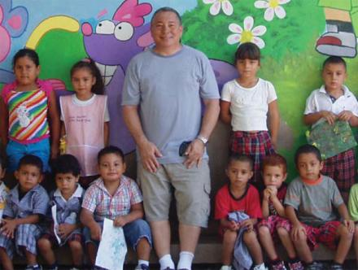
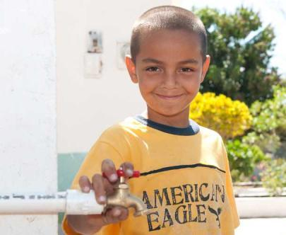
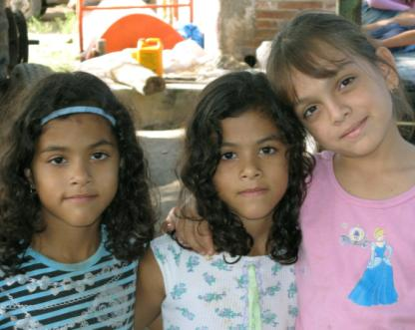
EWB – High Plains Professional Chapter
Clean-Water Project: Otates y Cantarranas, Mexico

Slide 22
Project Fact Sheet
About Otates y Cantarranas
Located approximately two hours by car from Puerto Vallarta
About five miles inland from the Pacific Ocean
Population of ~900 residents
Agriculture-based economy
Project description:
Well drilling, pipeline installation, and water-tank installation to provide a kindergarten, an elementary school, a small middle school, and the village health clinic with fresh running water
Prior to this project, the schools and clinic were forced to use standing water from barrels located outside the schools lavatories and clinic facilities
Work scope included design, engineering, procurement, and construction; water-quality analysis; permitting
Project entailed thousands of URS employee-volunteer hours and extensive fundraising efforts

Slide 23
Project Fact Sheet (cont.)
Major project materials (all materials purchased in Mexico):
One-mile of 2” PVC pipe, including pump-discharge/distribution lines
Two 10,000 liter water tanks
Pump and filtration system
Additional project details:
Overall project cost of ~$50,000
Project timeline was approximately two years from project inception to completion – project commissioning on May 3, 2010
Long development time due to a number of factors
EWB – High Plains Professional Chapter’s first project
Young project team (initially); volunteer turnover
Foreign country logistics
Permitting requirements
Town council negotiations
Construction limited by summer rainy season

Slide 24
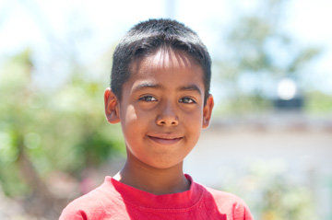
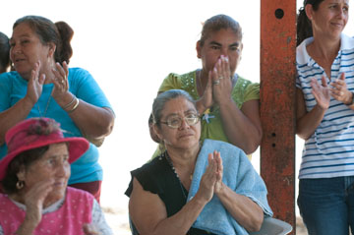
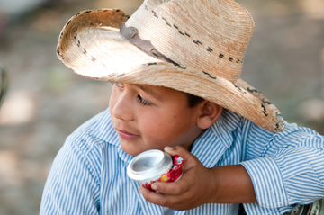
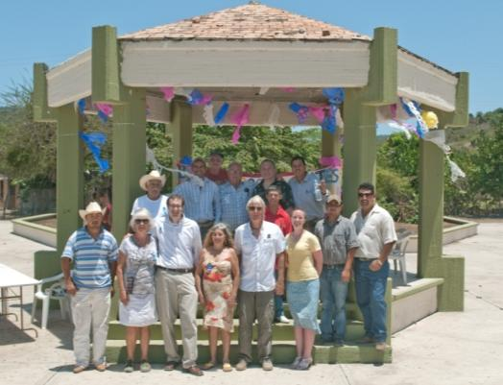
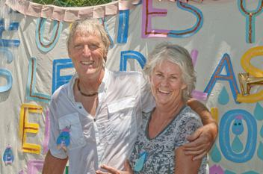
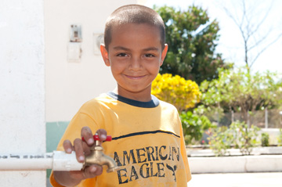
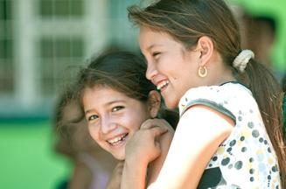
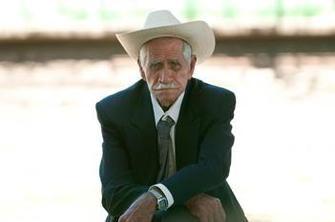
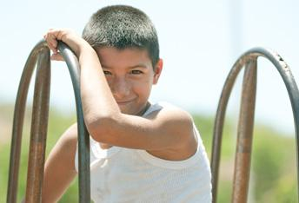
Project Stakeholders…

Slide 25
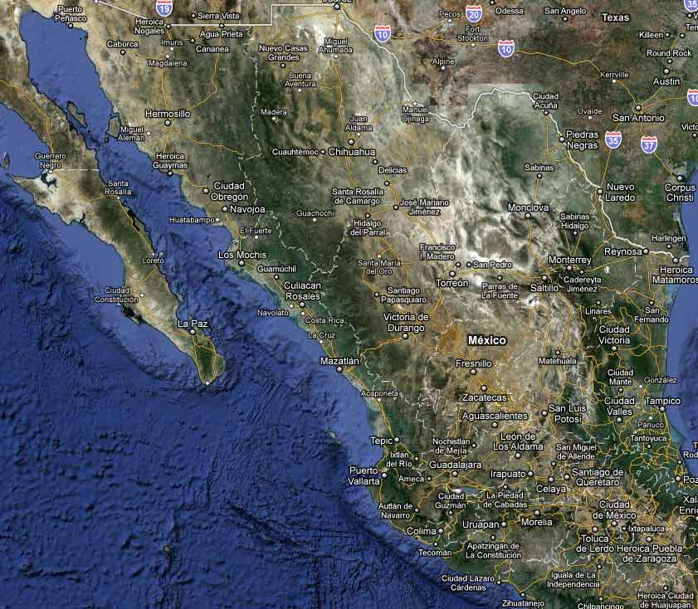
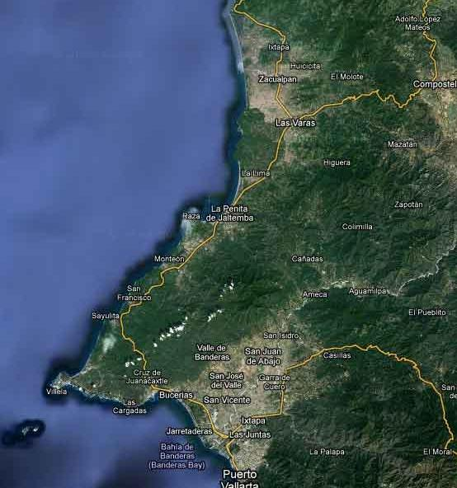
Project Location – Otates y Cantarranas, Mexico
Otates y Cantarranas
Approx. two hours by car from Puerto Vallarta
Otates y Cantarranas
Puerto Vallarta

Slide 26
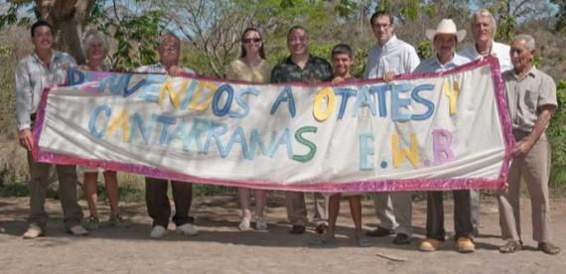
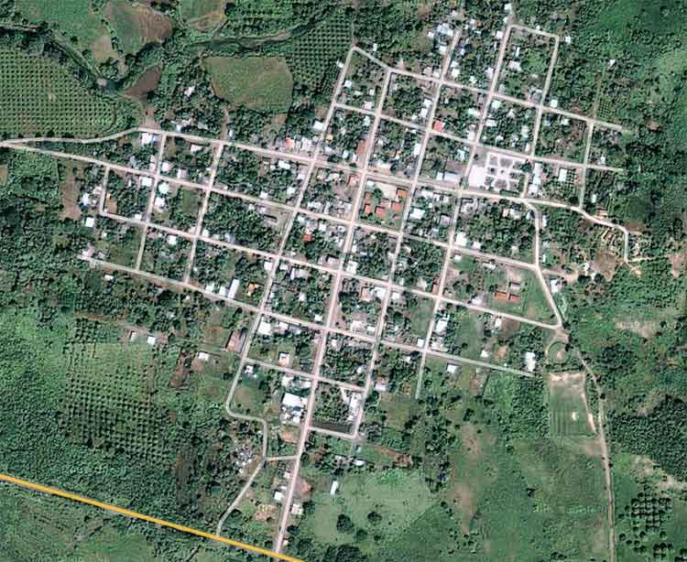
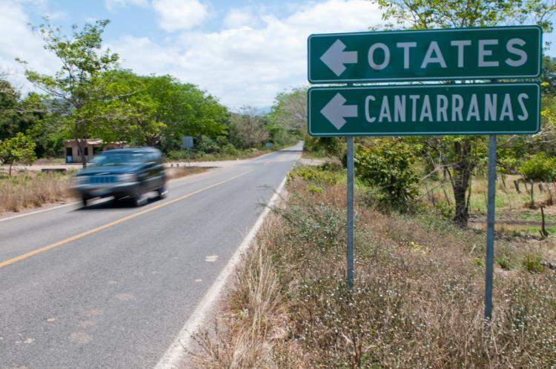
Otates y Cantarranas – Town Entrance

Slide 27
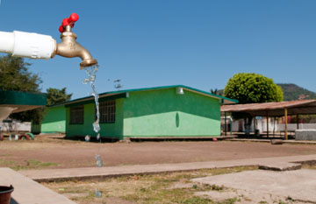
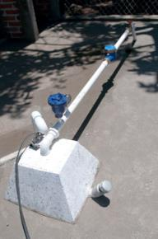
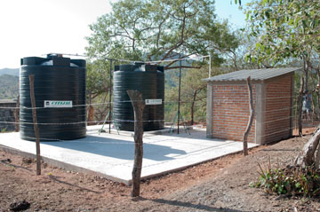
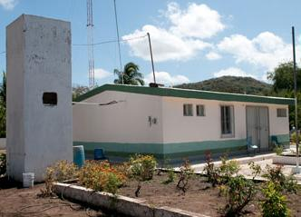
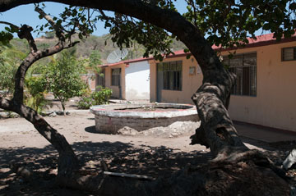
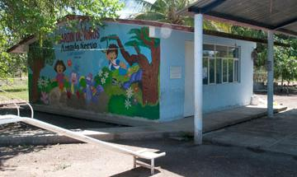
Major Project Sites
Well head
Elementary school
Health clinic
Water tanks, pump house
Middle school
Kindergarten

Slide 28
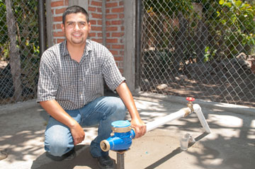
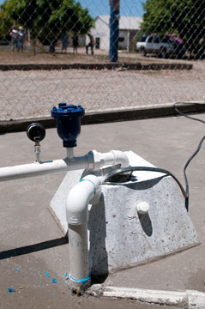
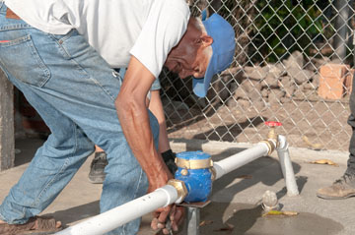
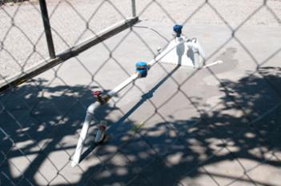
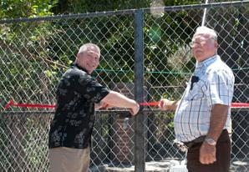
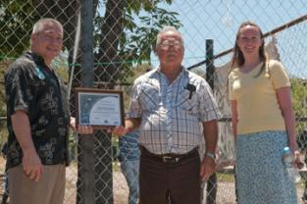
Major Project Sites – Well Head
Well head
28

Slide 29
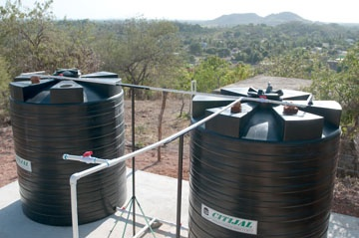
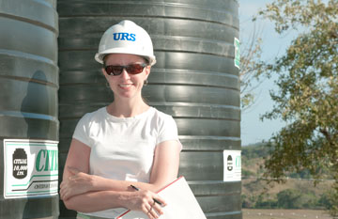
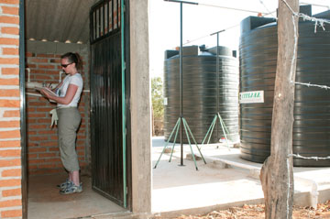
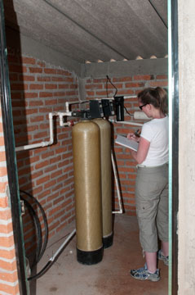
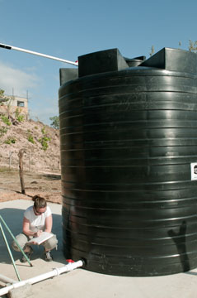
Major Project Sites – Water Tanks, Pump House
Water tanks, pump house
29

Slide 30
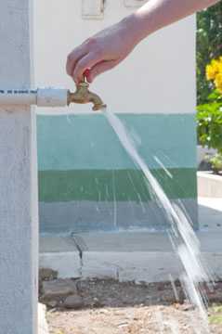
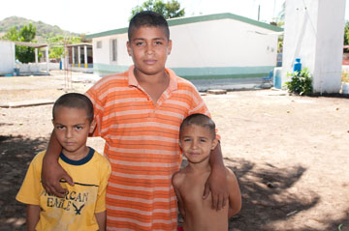
Major Project Sites – Health Clinic
Health clinic
30

Slide 31
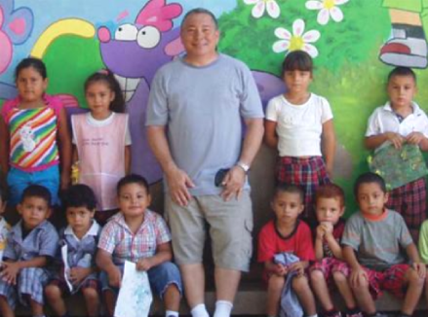
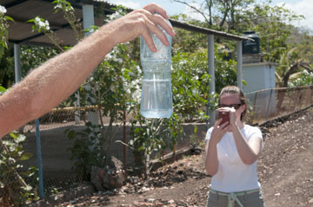
Major Project Sites – Kindergarten
Kindergarten
31

Slide 32
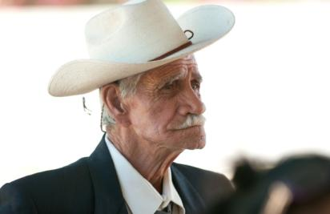
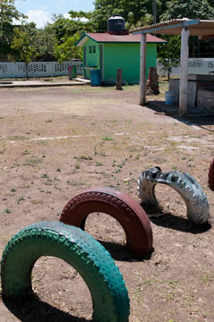
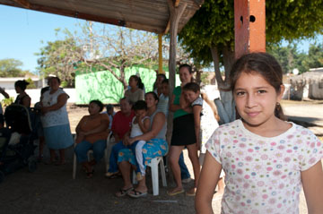
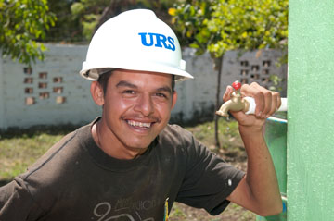
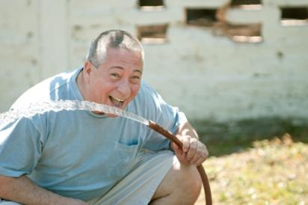
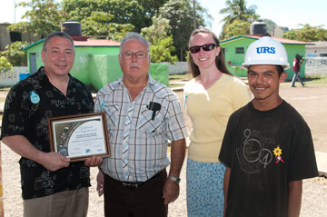
Major Project Sites – Elementary School
Elementary school
32

Slide 33
Major Project Sites – Middle School
Middle school
33

Slide 34
Potential Follow-on Project in Otates y Cantarranas
Children’s playground
34

Slide 35
Potential Follow-on Project in Indonesia
Indonesian hospital
Project scope of work pending/in development
Project will be led by a student chapter (Georgia Institute of Technology has provided some initial support)
Our chapter would provide professional design support to the students
No travel/in-country work involved for our chapter volunteers
35

Slide 36
Q&A
EWB – High Plains Professional Chapter
36

