Slide 1
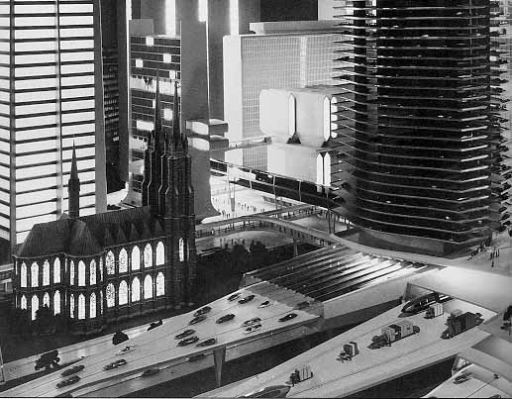
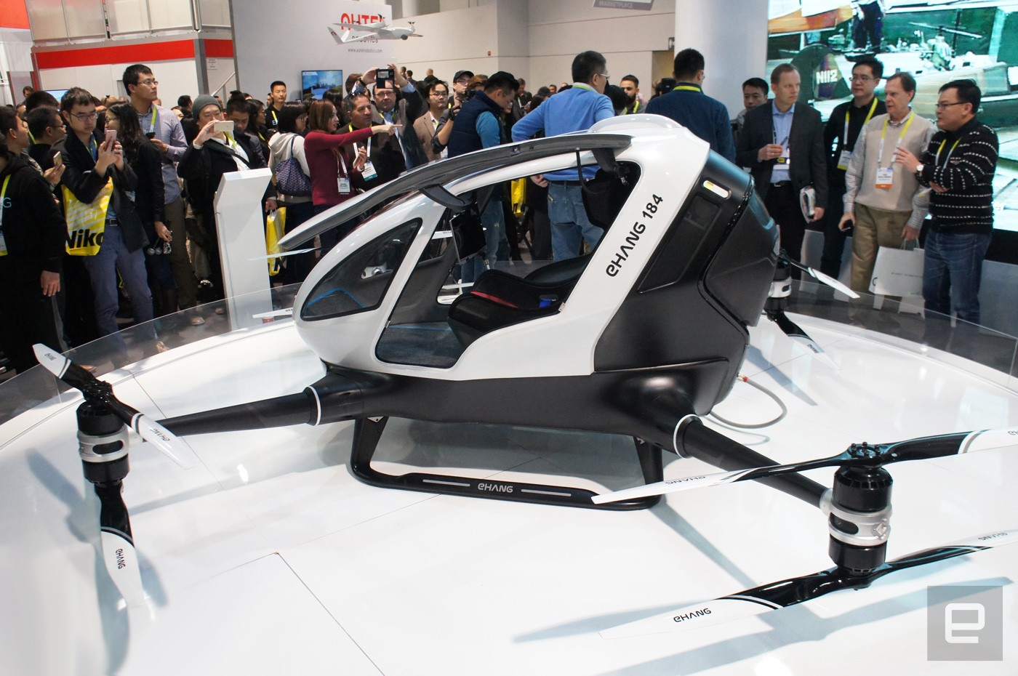
The Future of Transportation?
Rhonda Kae Young, P.E., PhD
Professor of Civil Engineering
Gonzaga University
June 8, 2017
Notes:
Futurama 1964 Worlds Fair in New York City (left) and personal flying vehicle Ehang 184 (right)

Slide 2
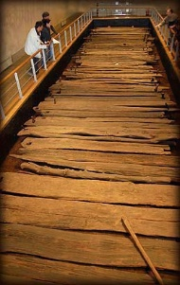
Development of the Current Transportation System
Ancient footpaths were primary transportation routes for centuries
Notes:
Bog trackway from 4000 BC in Corlea Ireland

Slide 3
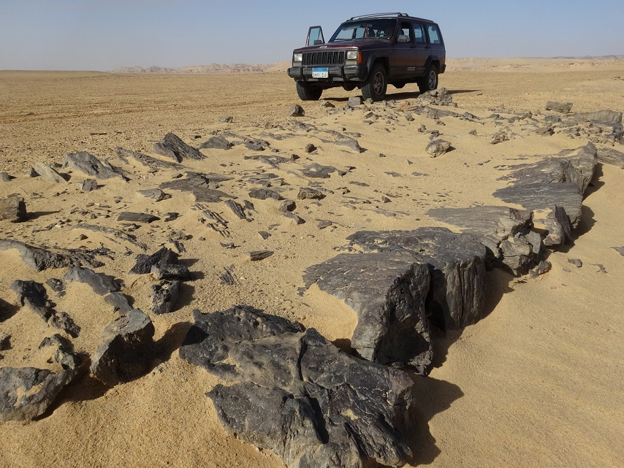
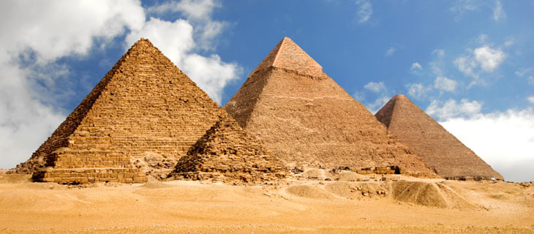
Development of the Current Transportation System
World’s oldest paved roads built in Egypt for construction of great pyramids
(~2,600 B.C.)

Slide 4
Development of the Current Transportation System
Roman Roads
300 B.C. to 400 A.D.

Slide 5
Development of the Current Transportation System

Slide 6
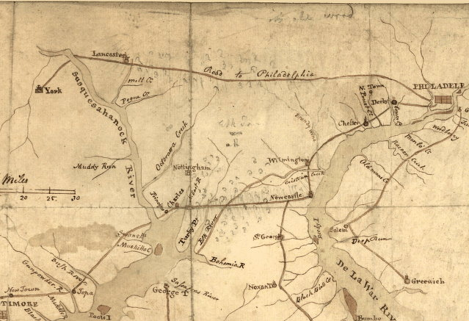
U.S. Transportation History
Early Roads
1795: Lancaster Turnpike – First toll road and first paved, engineered road in US
Notes:
First long distance road linking Lancaster and Philadelphia in Pennsylvania over 62 miles

Slide 7
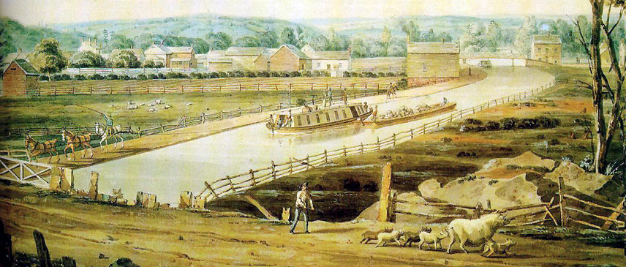
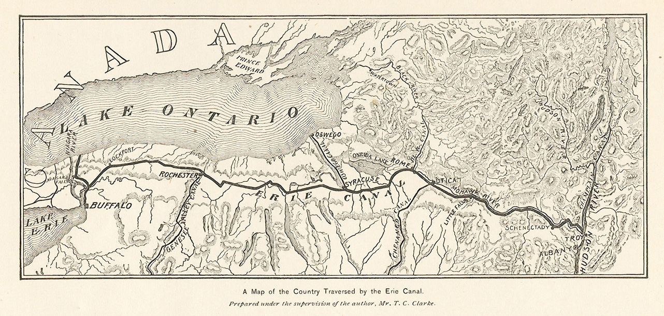
U.S. Transportation History
Canal Boom
1820 – Erie Canal
Notes:
363 miles from Albany to Buffalo NY

Slide 8
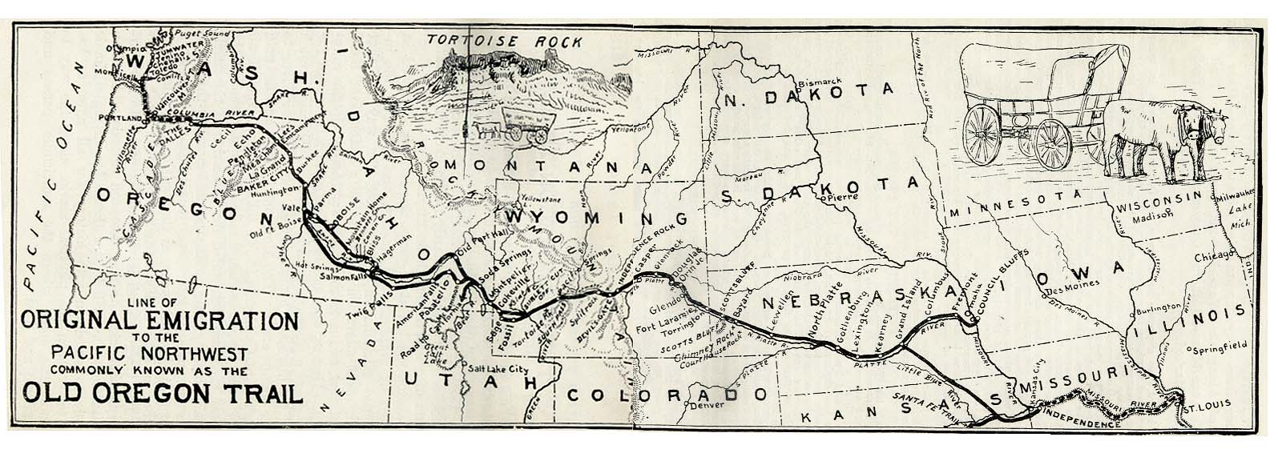
U.S. Transportation History
Oregon Trail
400,000 relocated to western US from ~ 1846-1869

Slide 9
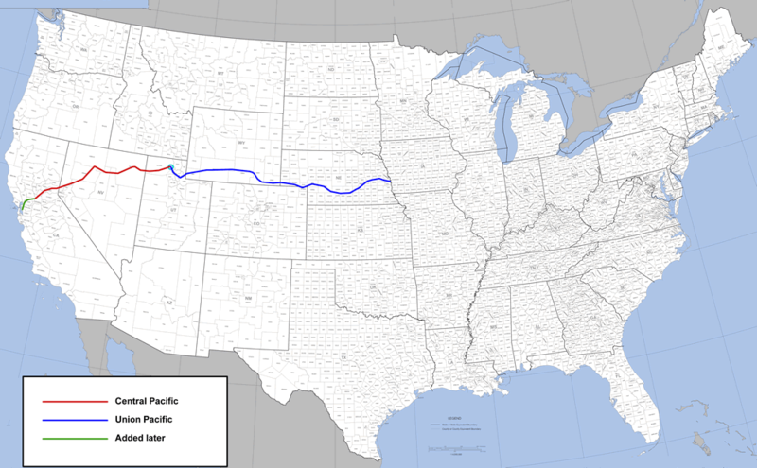
U.S. Transportation History
Railroad Era
1869: Transcontinental Railroad Completed

Slide 10
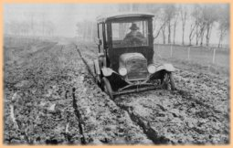
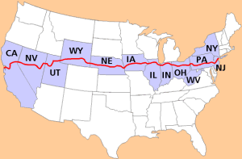
U.S. Transportation History
Lincoln Highway
Dedicated in 1913
Notes:
1919 future president Eisenhower crossed the country in ~ 60 days using the Lincoln Highway
Served in Germany during WWII and experienced the German Autobahn system
New York City to San Francisco for 3,389 miles

Slide 11
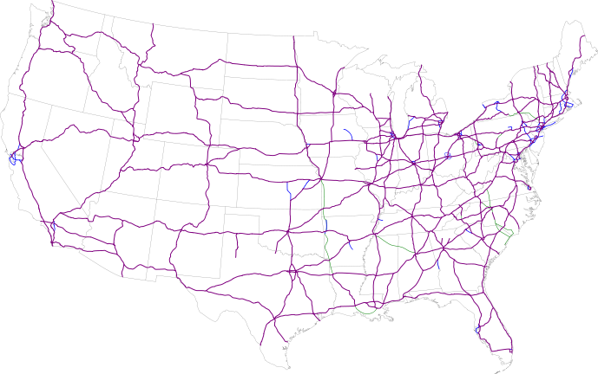
U.S. Transportation History
Interstate System
Dwight D. Eisenhower National System of Interstate and Defense Highways authorized in 1956
Notes:
Founded in 1956 in the Federal-Aid Highway Act of 1956

Slide 12
U.S. Transportation History
Population Changes
1700’s: 5% of the population lived in urban areas
Today: 81% live in urban and suburban areas
Notes:
20.9% as of 2010 census

Slide 13
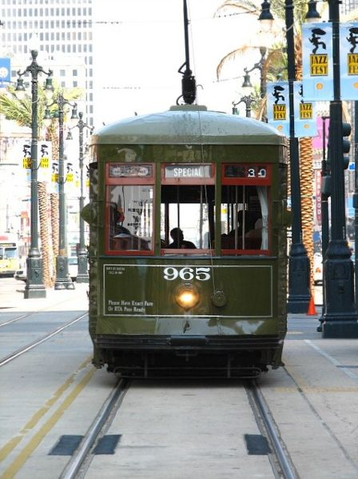
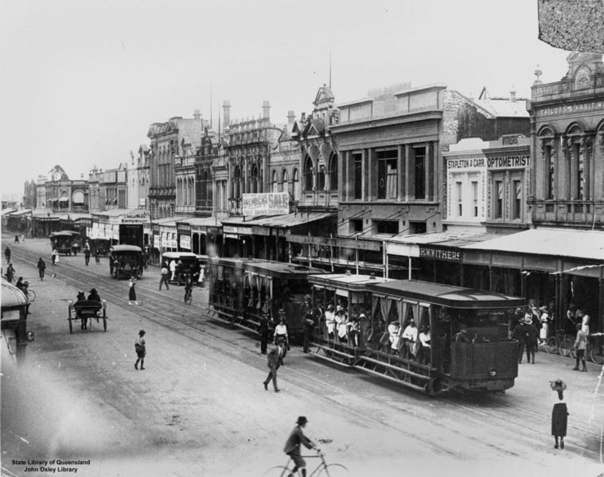
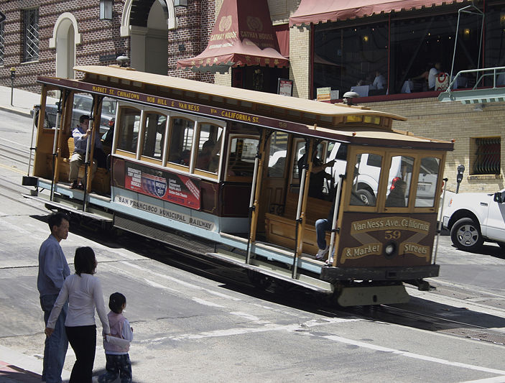
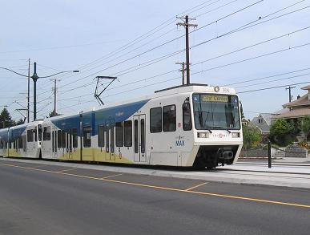
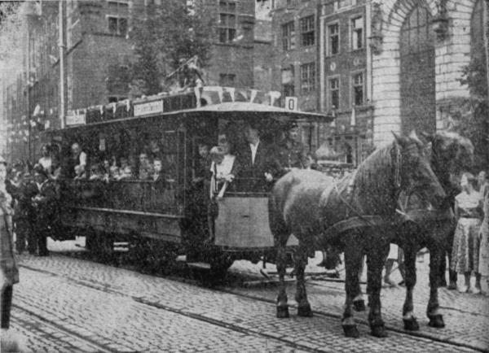
U.S. Transportation History
Transportation in Cities: Trams
Horse drawn
Steam
Cable Pulled
Electric
Light Rail

Slide 14
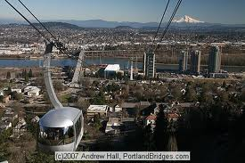
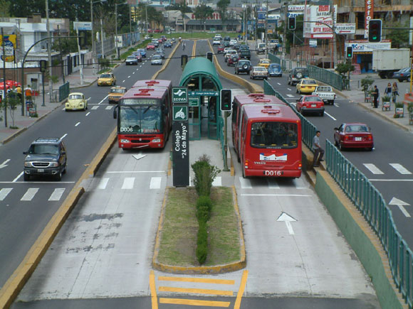
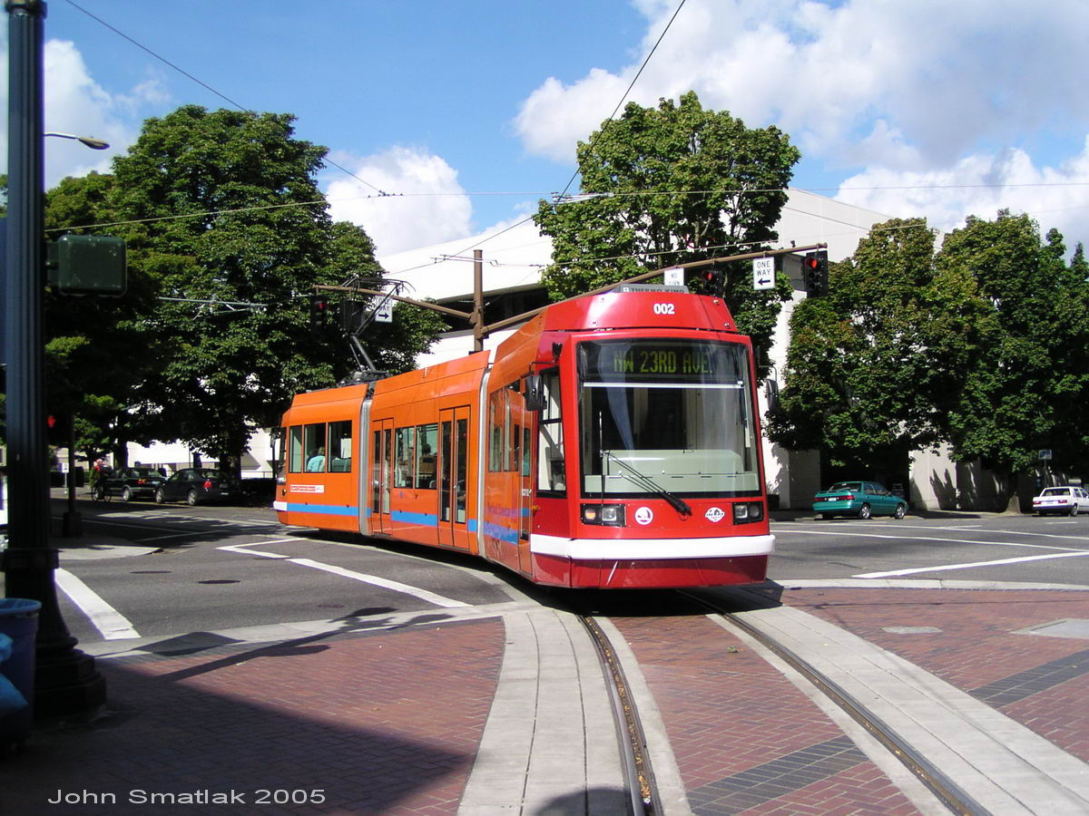
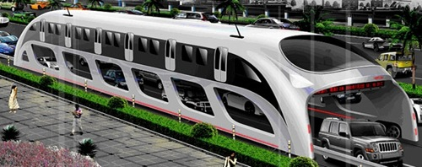
Notes:
https://youtu.be/lPdl3uxW3aI

Slide 15
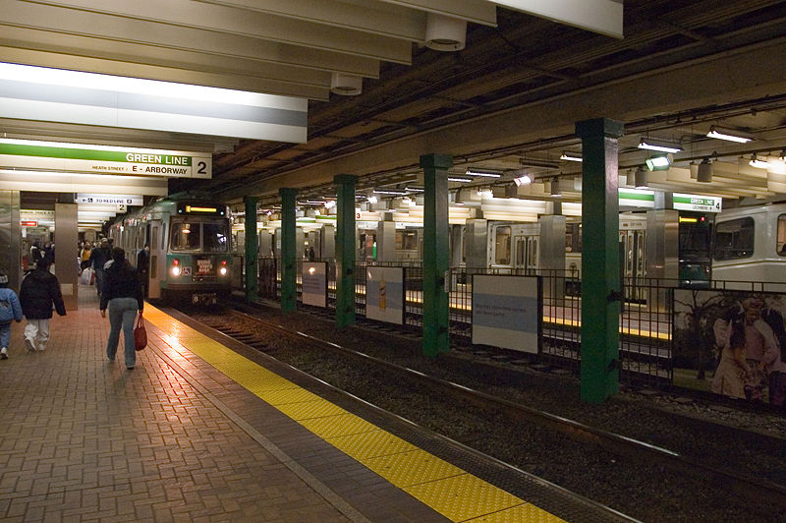
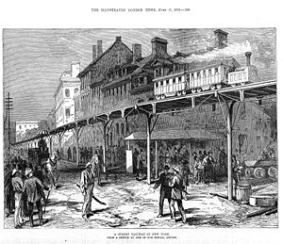
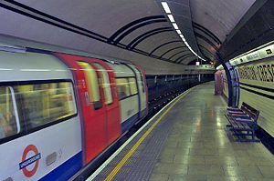
U.S. Transportation History
Transportation in Cities: Subways and Elevated Rails

Slide 16
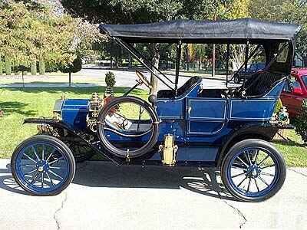
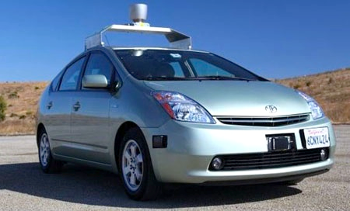
U.S. Transportation History
Automobiles

Slide 17
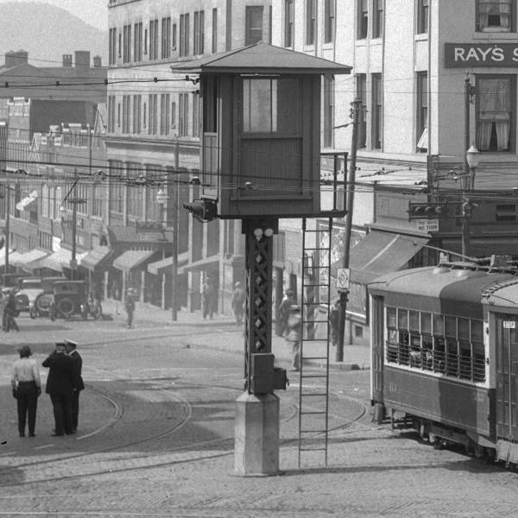
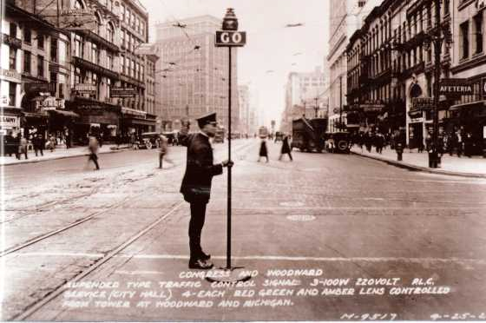
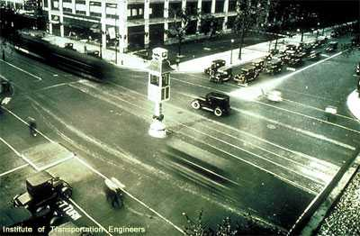

Slide 18
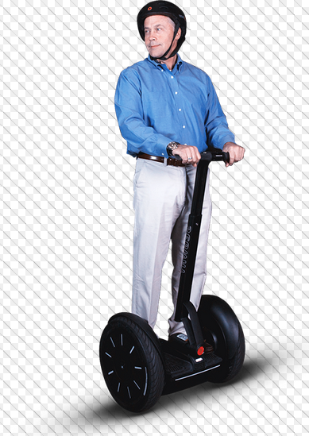
Transportation Future?
How is transportation likely to change in the next 10 years? Next 50 years?

Slide 19
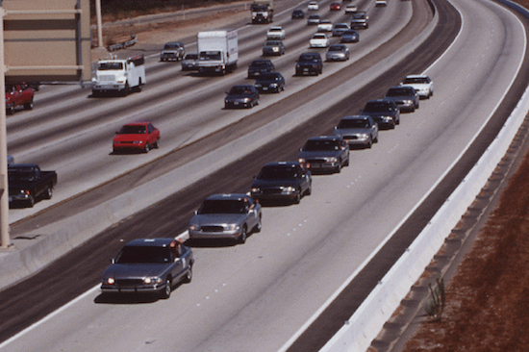
U.S. Transportation History
National Automated Highway System
Piloted in 1997

Slide 20
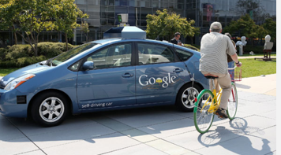
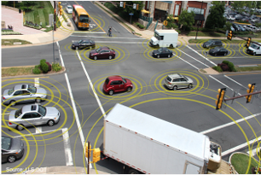
Autonomous and Connected Vehicles
Autonomous Vehicles (driverless or self driving cars) – allow vehicles to make driving decisions based on sensing equipment and on-board decision making
Connected Vehicles – technology where vehicles communicate via 5.9 GHZ DSRC with the infrastructure (V2I), other vehicles (V2V), or mobile devices (V2X)
Hybrid Approach – vehicles have both features

Slide 21
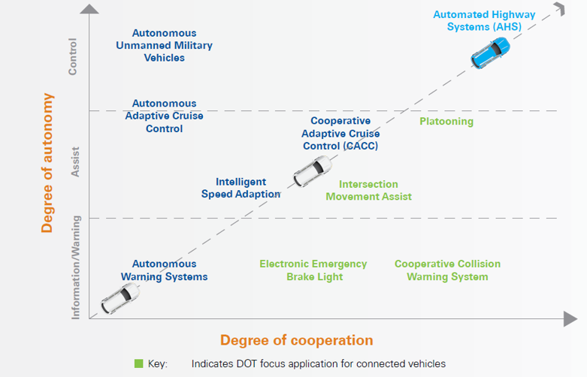
Autonomous and Connected Vehicles

Slide 22
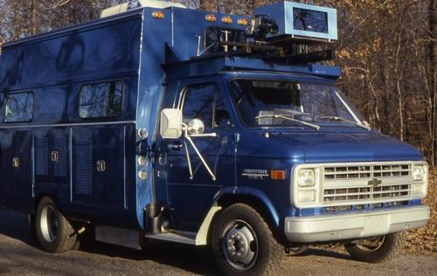
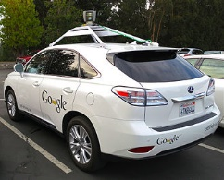
U.S. Transportation History
Autonomous Vehicles

Slide 23
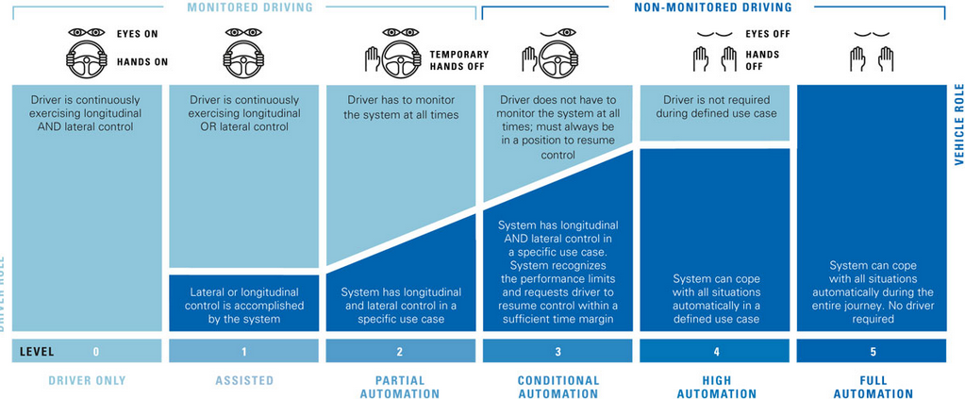
Transportation Future?
Levels of Vehicle Automation

Slide 24
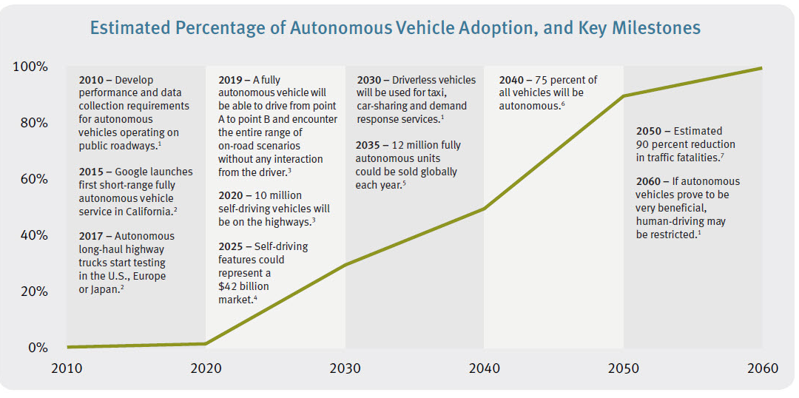
Autonomous and Connected Vehicles

Slide 25
Autonomous and Connected Vehicles
Connected Vehicles
NHTSA currently in comment period for Notice of Proposed Rulemaking on V2V communications for light vehicles
Adds ~$350 to vehicle cost in 2020
No personal information is collected, stored, or transmitted
V2V and V2I data is not vehicle automation but could be used by automated vehicle systems

Slide 26
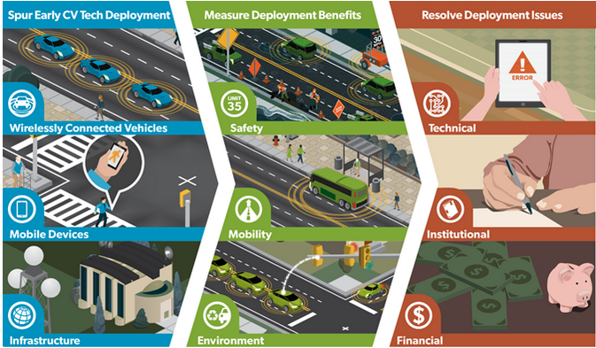
Autonomous and Connected Vehicles
Connected Vehicle Pilot Deployment

Slide 27
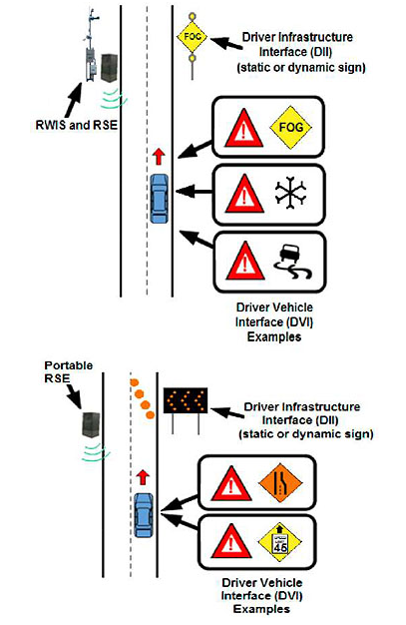
Autonomous and Connected Vehicles
Connected Vehicle Application Examples

Slide 28
Autonomous and Connected Vehicles
3 Pilot Deployment Sites

Slide 29
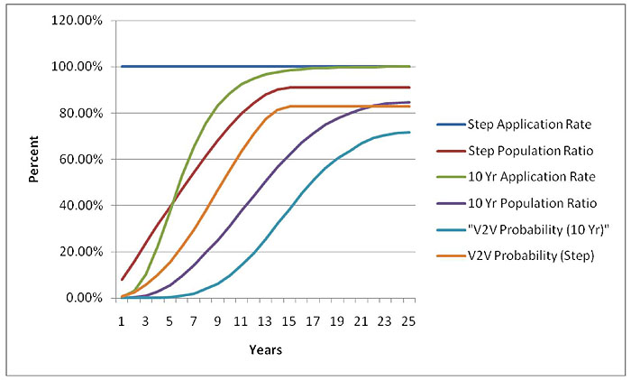
Autonomous and Connected Vehicles

Slide 30
Autonomous and Connected Vehicles
Benefits of Autonomous and Connected Vehicles
Safety
Mobility
Efficiency
Productivity

Slide 31
Autonomous and Connected Vehicles
Role of government in autonomous and connected vehicles?

Slide 32
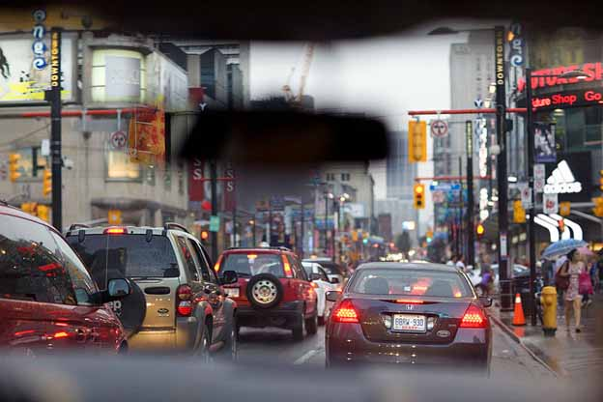
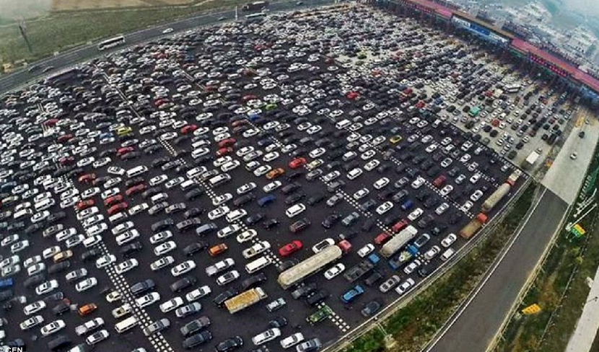
Autonomous and Connected Vehicles
Personal versus System Level Impacts

Slide 33
Autonomous and Connected Vehicles
Personal Level Decision
Parking is $20 downtown so send autonomous car home or have it drive around the block instead of parking
System Level Impact
Extra miles on the system from empty trips

Slide 34
Autonomous and Connected Vehicles
Personal Level Decision
Shopping list ready so send the car to the school to pick up kids and go to the store as separate trip
System Level Impact
Extra miles on the system because of extra trips

Slide 35
Autonomous and Connected Vehicles
Personal Level Decision
Uber rides have gone down in price now that there is no driver labor costs, so use Uber instead of transit
System Level Impact
Extra miles on the system because of extra trips that used to be consolidated onto buses

Slide 36
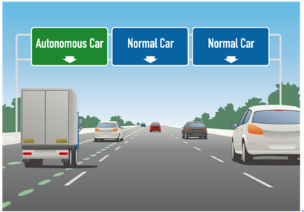
Autonomous Vs. Connected Vehicles
Potential approaches?
Prioritize movement of people over movement of vehicles
Push adoption of technology so that mobility benefits can be realized earlier to offset increased travel
Regulate and/or tax “empty” miles

Slide 37
Autonomous and Connected Vehicles
End of Traffic Lights?
https://youtu.be/kh7X-UKm9kw

Slide 38
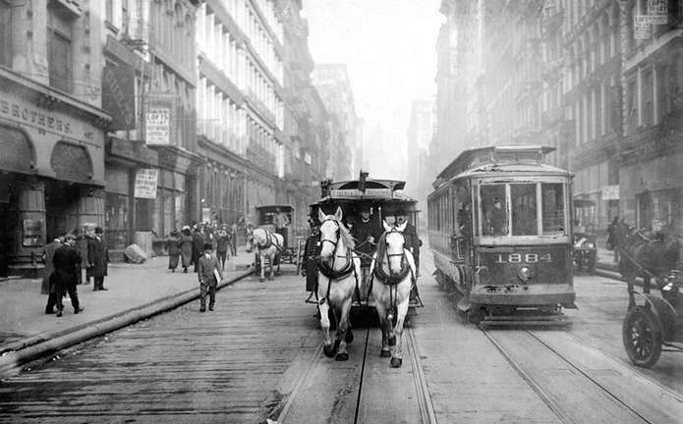
Autonomous and Connected Vehicles
Transition from horses to cars
Generally occurred in US between 1920 and 1939

Slide 39
Managing Transportation Change
Our transportation system has undergone incremental change as new transportation modes and technology have been developed
What would the system look like if we were building from scratch instead of adapting over time?
Does the adoption of autonomous and connected vehicles warrant an out-of-the-box, clean slate vision?

