Slide 1
Powering Our Future
Patty Shea, Todd Kiesbuy, James Gall
2017 ISPE Annual Meeting
June 9, 2017

Slide 2
Agenda
Facilitator Introductions
Brief Overview of Avista
Powering Our Future Exercise
Conclusion
2

Slide 3
Facilitators
Patty Shea, North Idaho Regional Business Manager
Todd Kiesbuy, Spokane Valley-West Plains Regional Business Manager
James Gall, Integrated Resource Plan (IRP) Manager
2

Slide 4
Avista
Incorporated in the state of Washington in 1889
Headquartered in Spokane, Wash.
Primary business is the regulated utility
Over 1,700 employees
Electric and natural gas service
375,000 electric customers
335,000 natural gas customers
2
Notes:
128 YEARS OLD, this March
LONG HISTORY in Spokane and our Region.

Slide 5
Notes:
Electricty and Natural Gas:
Eastern Washington
Northern Idaho
Natural Gas:
Parts of Southern & Eastern Oregon
Largest Dam:
Noxon, Montana

Slide 6
INSERT ALASKA SERVICE TERRITORY HERE
Notes:
We acquired Alaska Electric Light & Power Company (AEL&P)
July 1, 2014
City and Borough of Juneau (CBJ)
Located in the Panhandle of SE Alaska
900 air miles N of Seattle
600 air miles SE of Anchorage
Serve Electricity to:
Population of 32,739

Slide 7
Avista Rates are Among the Lowest in the Country
Average monthly residential bill
Hawaii………….….345.72
USA Average……..137.29
Idaho………………107.43
Avista Idaho………..92.34
Washington……..….94.64
Avista Washington…86.57

Slide 8
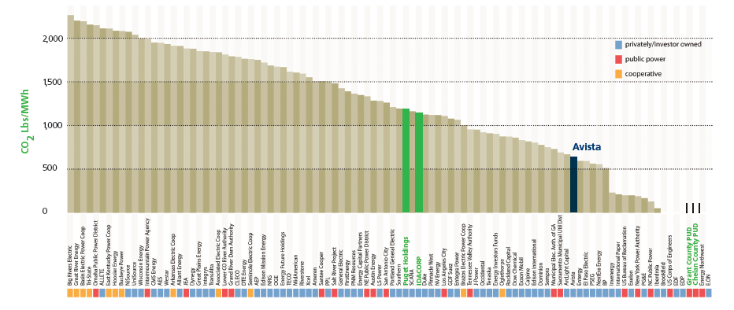
Avista Emissions are Among the Lowest in the Country
Carbon Footprint
Rate of CO2 Emissions of Company-Owned Generation
Source: Natural Resources Defense Council
“Benchmarking Air Emissions of the 100 Largest Electric Power Producers in the U.S.” 2015
based on 2013 data

Slide 9
The Utility Generation Balancing Act
Cost
Reliability
Environment

Slide 10
Natural Gas
Coal
Nuclear
Biomass
Hydropower
Wind
Solar
Dependable
Both
Renewable
Legally Required
Conservation/Energy Efficiency
Notes:
Sources of Power:
Dependable
Renewable
Both!
We are Legally Required:
Some Conservation/Energy Efficiency

Slide 11
Integrated Resource Plan
The IRP is a 20-year look to our energy future that determines how we plan to meet the energy needs of our customers by:
using a diverse energy mix of hydro, coal, natural gas, biomass, and wind that
balances customer rates, the environment and system reliability while meeting Washington state-mandated renewable portfolio standards
Notes:
James?

Slide 12
You’re the Power Planner
Meet energy and peak demand
Meet legal requirements
Greenhouse gas emissions
Cost
Cost
Reliability
Environment
Notes:
Instructions, Set-up :
In this exercise, you’ll imagine you’re a utility company planning how you will meet the energy needs of your customers over the next 20 years.
Your utility is located in the Pacific Northwest, where there is plenty of hydroelectric power, growing wind development and access to abundant natural gas sources to power generation plants.
You also serve customers in the state of Washington, which has renewable portfolio standards requiring utilities to meet part of customer demand with qualifying renewable energy.

Slide 13
Notes:
Instructions, Set-up:
Please break up in groups of approximately ________
At your table you have several items:
There’s a game board that shows your current (2012) energy generation in the big pie chart in the middle (we also refer to this as resource mix or portfolio).
There are also spaces for generation like nuclear and solar energy, which you don’t currently have.
The board includes short descriptions of the various resources, which can give you information on cost and whether the resource is renewable.

Slide 14
Natural Gas
Hydro
Coal
Wind
Solar
Nuclear
Conser-vation
Biomass
Notes:
You also have colored blocks on your table
that represent different types of generation.

Slide 15
Ready?
Using your blocks, choose any mix you like, placing them on the corresponding spaces on your game board.
Each block signifies 10 percent of your total new resources and you may only use a total of 10 blocks (or 100 percent).
Notes:
* Review materials on table.
“I want you to take 5 minutes to review the materials at your table, then choose a note taker and a spokesperson from your table. The note taker will be responsible to record your information and jot any notes down. The spokesperson should be prepared to report out to this group and to the larger group later today.” (SET TIMER)
For this round, you again must add to your existing portfolio with enough energy to meet electric demand and also meet renewable portfolio requirements over the next 20 years. Consider how your choices could affect customers’ bills, carbon emissions, and your ability to generate enough power to serve all your customers during peak demand times.”
Using your blocks, choose any mix you like, placing them on the corresponding spaces on your game board. Again, each block signifies 10 percent of your total new resources and you may only use a total of 10 blocks (or 100%). You should use a combination of resources that meet Renewable Portfolio Mandates AND resources that are considered dependable AND will meet peak demand. You have five minutes for this.” (SET TIMER)

Slide 16
Round 1: Choosing your resource mix
Record your ‘resource mix’ on the worksheet.
Report out your resource mix
Notes:
Round 1 Conclusion:
Have groups record their ‘resource mix’ on the “Round 1” Worksheet.
Give them 5 minutes (SET TIMER)

Slide 17
Group discussion
Notes:
Round 1 Discussion:

Slide 18
 | RENEWABLE Meets Wash. Renewable Portfolio Mandates | DEPENDABLE Meets customer needs during peak demand | Relative Cost
Conservation/Energy Efficiency* |  |  | $--$$$
Natural Gas |  |  | $
Hydroelectric** |  |  | $$
Wind |  |  | $$$
Biomass |  |  | $$$
Coal |  |  | $$$
Nuclear |  |  | $$$$
Solar |  |  | $$$
* Energy efficiency programs cost more as the amount of energy that is saved increases.
** Only new hydroelectric plants and the additional energy produced with upgrades performed after 1999 qualify as renewable under Washington State Renewable Portfolio Standards.
Notes:
There are a couple of changes for Round 2.
We’ve provided you with a handout that shows the relative costs of each of your resources,
as well as whether they meet renewable portfolio mandates AND can be used to generate during times of peak demand.
The costs are not incremental, but all-in new costs (e.g., existing coal is among our cheapest generating resources,
but a new plant would be expensive relative to other options).

Slide 19
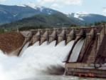
Meets Wash. Renewable Portfolio Standards
Dependable/can be generated on demand to meet peak demand
Wind
Solar
Biomass
Hydropower
Natural Gas
Coal
Nuclear
RENEWABLE
DEPENDABLE
Conservation
Notes:
Renewable Resources:
Wind, Solar
Dependable Resources:
Natural Gas, Coal, Nuclear
Both – Renewable & Dependable:
Biomass
Upgrades to Hydropower Plants
Conservation

Slide 20
Round 2: A few changes
Remove
5 coal
5 conservation
7 solar
8 hydro
8 nuclear
8 biomass
Notes:
For Round 2:
You also have fewer blocks of some resources now,
based on the fact that not all of these resources are available in unlimited amounts
Please Remove:
5 coal (black),
5 conservation (green),
7 solar (yellow), and
8 each of hydro (dark blue), nuclear (orange), and biomass (brown).

Slide 21
Round 2: Choosing your resource mix
Record your ‘resource mix’ on the worksheet.
Report out your resource mix
Notes:
Round 2:
Please record your group’s ‘resource mix’ on the “Round 2” side of the worksheet.
You have 5 minutes (SET TIMER)

Slide 22
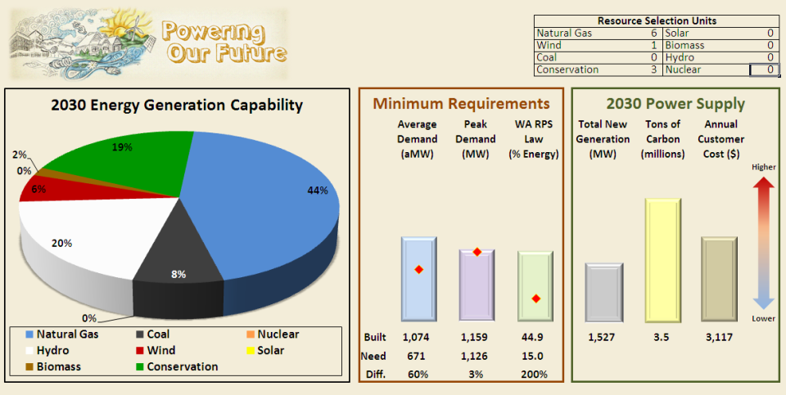
Avista’s Preferred Resource Mix 2011 IRP
Notes:
James
Discuss Exercise
Show Avista’s Preferred Resource Strategy in the model

Slide 23
Avista 2016 Resource Mix
2,381 MW
1,576 aMW
Notes:
James

Slide 24
Conclusion
Were there any surprises?
What did you learn?
What questions do you have?
You can learn more at avistautilities.com/IRP

